Slide 1
Chemistry Paper 1 preparation
Focus will be on……
Key concepts for each chapter
Common questions
Common misconceptions and what to actually say!

Slide 2
Core Practical's for paper 1
Making a pure dry sample of a salt from an insoluble base.
Carrying out an acid/alkali titration to determine concentration.
Electrolysis of an aqueous solution – predict products.
Measurement of energy changes during a reaction.
At least 1 of these, probably more will definitely come up in the paper – be prepared for them!

Slide 3
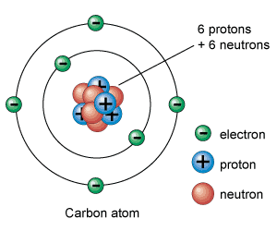
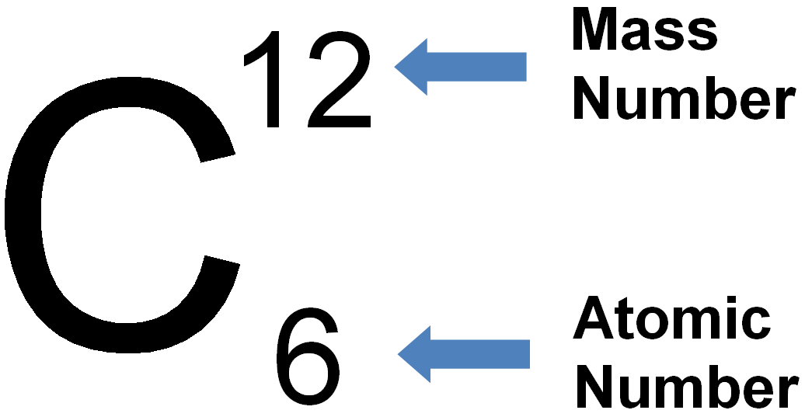
Atomic structure – key concepts
All atoms are neutral
Isotopes are atoms that have the same number of protons but a different number of neutrons.
Ions are atoms that have lost or gained electrons to become charged

Slide 4
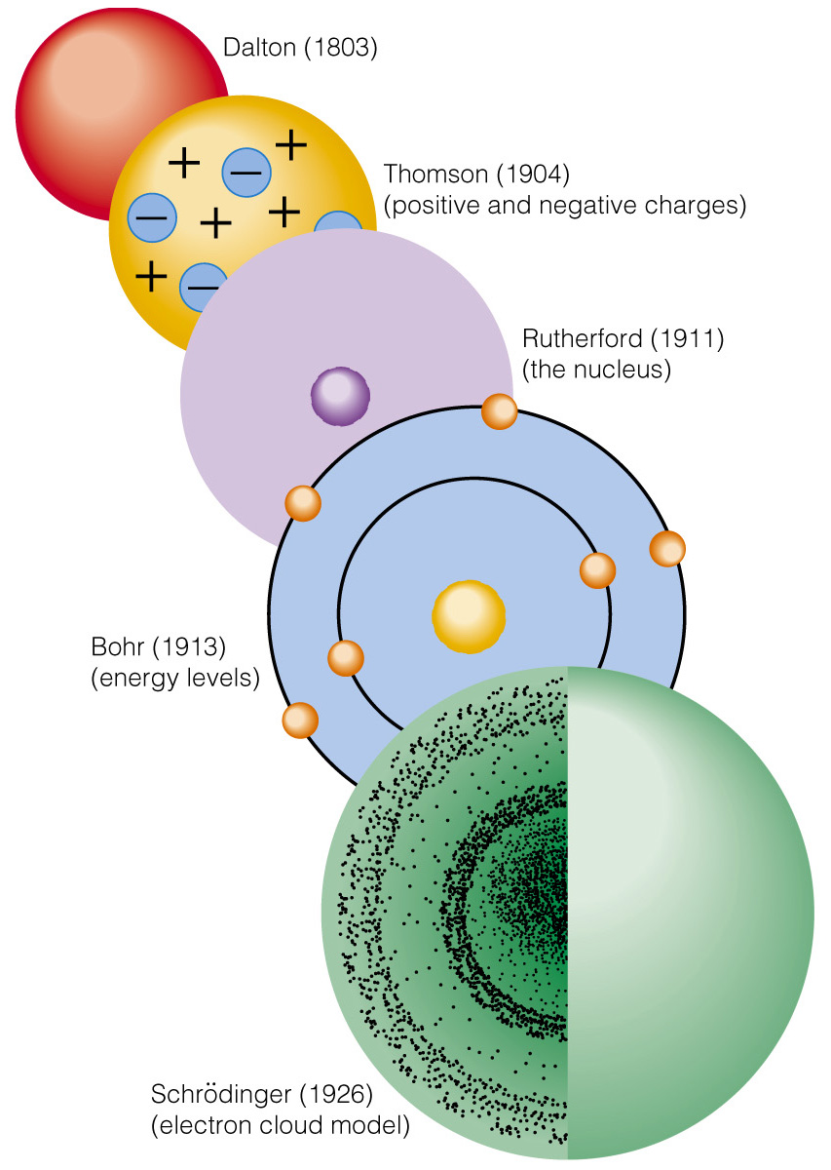
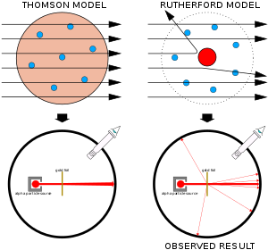
Atomic structure – key concepts
Small dense nucleus
Mostly empty space
Nucleus positively charged

Slide 5
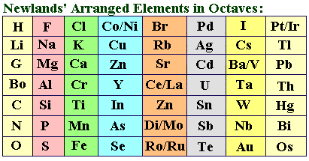
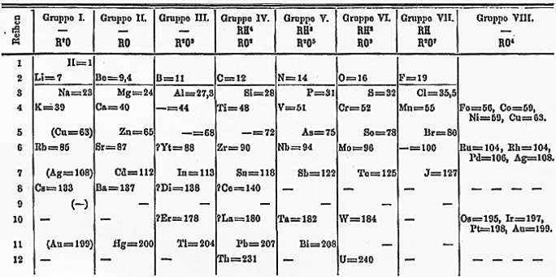
Periodic table – key concepts
Newlands
Arranged in order of atomic mass
Noticed properties seemed to repeat every eight element
Ordered by weight & atomic mass
Mendeleev
Arranged in order of atomic mass
Grouped based on properties too
Left gaps for elements he thought existed but not discovered
Elements discovered fitted his predictions – strong evidence

Slide 6
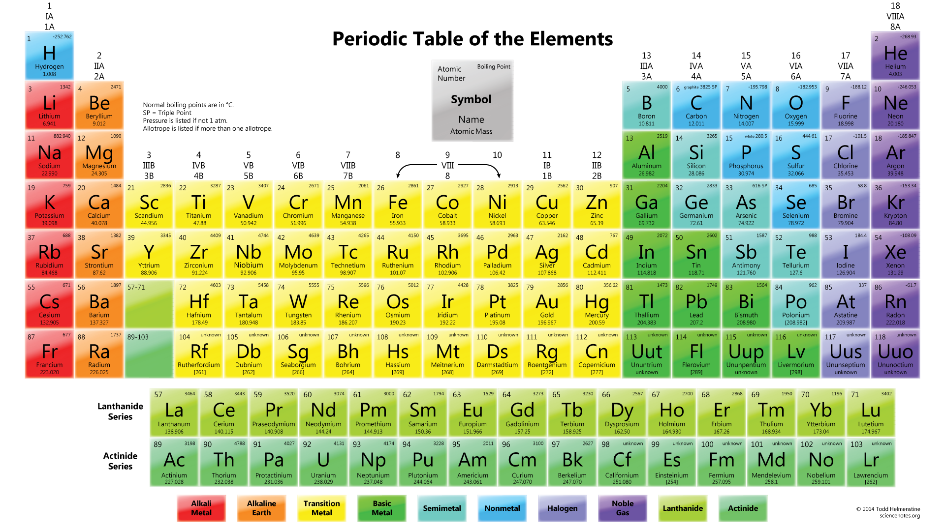
Periodic table – key concepts
Key groups (know and explain reactivity):
Group 1
Group 7
Group 0
Know what a group is and what a period is

Slide 7
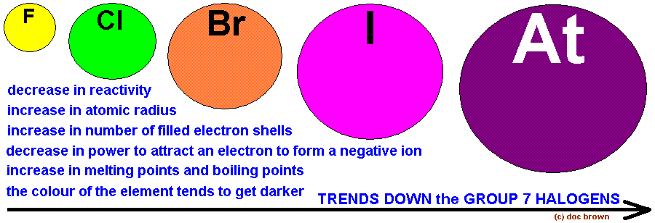
Periodic table – key concepts

Slide 8
Structure & bonding– key concepts
All atoms bond to achieve a full outer shell
Metal & non-metal bond through IONIC bonding
Two non-metals bond through COVALENT bonding
Metals bond through METALLIC bonding

Slide 9
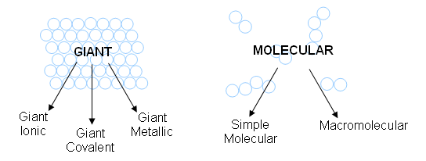
Structure & bonding– misconceptions
Bonding & structure are not the same thing. If a question asks you to describe the structure & bonding you need to say something about each of them

Slide 10
Boiling points – misconceptions
To boil something, particles must be pulled apart
If it is a giant lattice, each particle must be separated
Ionic lattice→ IONS
Metallic lattice → ATOMS
Giant covalent lattice→ ATOMS
If it is a molecule, each molecule must be separated
Simple molecular → MOLECULES

Slide 11
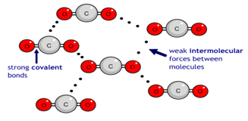
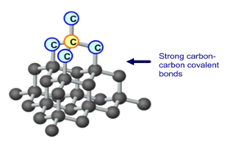
In molecules you break the weak intermolecular forces, little energy needed
In lattice structures you break the strong bonds between ATOMS/IONS, lots of energy needed.

Slide 12
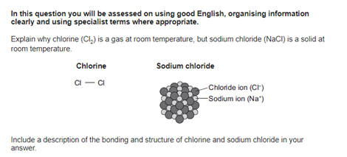
6 Marks

Slide 13
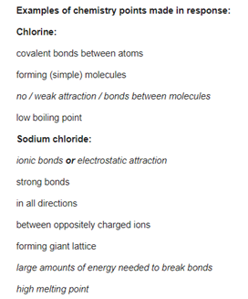

Slide 14
In molecules you break the weak intermolecular forces, little energy needed
In lattice structures you break the strong bonds between ATOMS/IONS, lots of energy needed.

Slide 15
Quantitative chemistry – well understood concepts
These are generally well understood concepts, I have listed them here purely so that you know you need to get to grips with them if they are not well understood by you.
Finding A_{r} (relative atomic mass)
Working out M_{r}
Using the relationship mass = M_{r} x moles

Slide 16
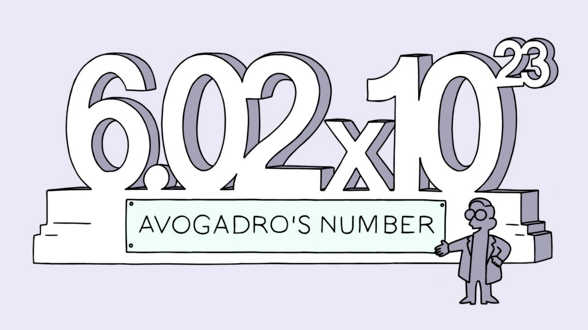
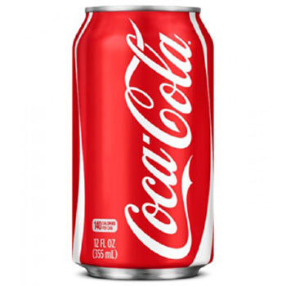
Quantitative chemistry – key concepts
Moles – Remember a mole is just a big number and that we use it in chemistry because when dealing with atoms/molecules etc we are always dealing with huge numbers of them.
1 mole of coke cans would cover the entire Earth’s surface to a depth of 200 miles!

Slide 17
Using moles to work out concentrations/volumes/masses
Mole ratio 1 : 2 : 1 : 2
CH₄ + 2O₂ → CO₂ + 2 H₂O
Mass (g)
M_{r}
Moles
18g
16
1.125
49.5g
44
1.125
40.5g
18
2.25
mass = M_{r} x moles

Slide 18
Using moles to work out concentrations/volumes/masses
Mole ratio 1 : 1 : 1 : 1
HCl + NaOH → NaCl + H₂O
Vol (dm³)
Conc (mol dm⁻³)
Moles
0.025
0.2
0.005
0.01
0.5
0.005
Mole = Concentration x volume

Slide 19
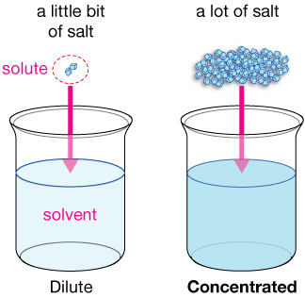
Concentration– key concepts
Concentration is a measure of how much stuff there is in a given volume.
Moles or mass
Cm³ or dm³
Moles link the two equations.
Work out the mass of NaOH in 25cm³ of 0.5 mol dm⁻³ solution.
Mass = M_{r} x moles
Moles = Concentration x volume

Slide 20
Concentration– key concepts
Moles link the two equations.
Work out the mass of NaOH in 25cm³ of 0.5 mol dm⁻³ solution.
Mass = M_{r} x moles
Moles = Concentration x volume
Convert 25cm³ to dm³ – divide by 1000 = 0.025dm³
Work out moles – concentration x volume = 0.0125 mol
Work out the M_{r} of NaOH = 40
Use the M_{r} and moles to work out mass – 40 x 0.0125 = 0.5g

Slide 21
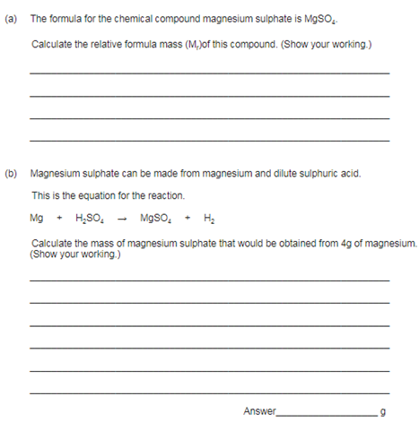

Slide 22
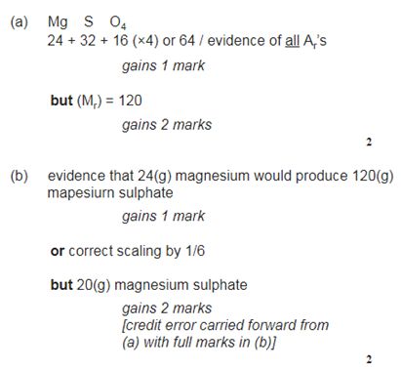

Slide 23
Chemical changes – key concepts
A more reactive element will displace a less reactive one from a compound
We can compare reactivity of elements by comparing their reactions with…
Water
Acid
Oxygen
The more vigorous the reaction the more reactive the element is

Slide 24
Chemical changes – key concepts
Metal + Acid → Salt + Hydrogen
Metal + Oxygen → Metal Oxide
Acid + Alkali → Salt + Water
Acid + Base → Salt + Water
A base is an insoluble compound that neutralises an acid
Acid + Carbonate → Salt + Water + Carbon dioxide

Slide 25
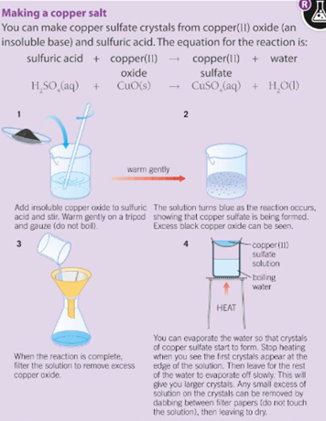
Core practical – Making a salt from a base

Slide 26
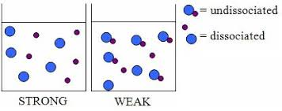
Chemical changes – key concepts
Strong acids fully ionise
Weak acids do not fully ionise (notice the reversible reaction symbol)

Slide 27
Questions
1 a Explain why hydrochloric acid is classed as a strong acid.
b Write an equation to show how hydrochloric acid ionises in water.
2 a Explain why ethanoic acid is classed as a weak acid.
b Write an equation to show how ethanoic acid ionises in water.
3 a Explain why 0.1 mol/dm³ hydrochloric acid has a lower pH than 0.1 mol/dm³ ethanoic acid. b Explain why 0.1 mol/dm³ hydrochloric acid reacts faster with magnesium and sodium carbonate than 0.1 mol/dm³ ethanoic acid does.

Slide 28
Electrolysis – key concepts
Electrolysis – splitting up using electricity
In electrolysis metals GAIN electrons
Non-metals LOSE electrons
This reverses the process of ionic compounds forming
OILRIG – Oxidation is loss, Reduction is gain (of electrons)

Slide 29
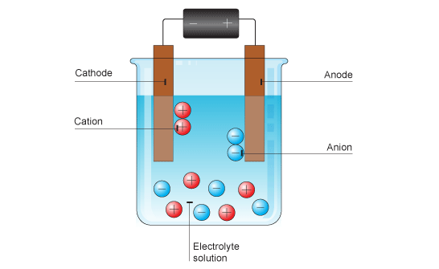
Electrolysis – key concepts
Positive IONS go to the negative (cathode) electrode
Negative IONS go to the positive (anode) electrode
Opposites attract.

Slide 30
Electrolysis – key concepts
Half equations show what happens at each electrode
2Cl⁻ → Cl₂ + 2e⁻
Na⁺ + e⁻ → Na

Slide 31
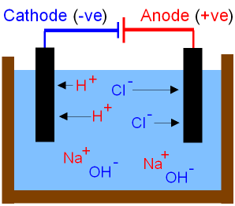
Electrolysis of solutions– key concepts
Only 1 ION can be displaced at each electrode so….
@ the positive:
If a halide ion is present then the halogen is produced. Otherwise O₂ is produced.
@ the negative:
If the metal is less reactive than hydrogen the metal is produced. Otherwise H₂ is produced.

Slide 32
Energy changes – key concepts
All reactions involve bond breaking and bond making
Bond breaking is endothermic (requires energy)
Bond making is exothermic (releases energy)
The balance of how much energy is put in compared to how much is given out determines the overall energy change.

Slide 33
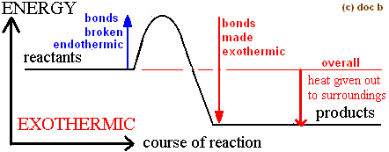
Exothermic – key concepts
Energy put in breaking bonds is less than energy given out making bonds.
Overall, energy is released to surroundings.
MISCONCEPTION – enthalpy change is NOT dependent on the number of bonds made or broken. DO NOT mention number of bonds in your answer.

Slide 34
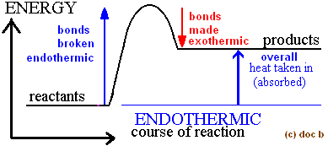
Endothermic – key concepts
Energy put in breaking bonds is greater than energy given out making bonds.
Overall, energy is taken in from the surroundings.
MISCONCEPTION – enthalpy change is NOT dependent on the number of bonds made or broken. DO NOT mention number of bonds in your answer.

Slide 35
Bond enthalpy calculations – key concepts
Work out the number of each type of bond broken
Multiply this number by it’s bond energy
Add them all together = ENERGY IN
Work out the number of each type of bond made
Multiply this number by it’s bond energy
Add them all together = ENERGY OUT
Calculate ENERGY IN – ENERGY OUT
This is your energy change INCLUDE THE SIGN!

Slide 37
