Slide 1
Chemistry Paper 1
Quick revision

Slide 2
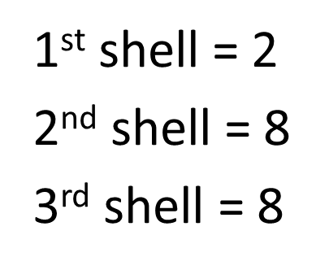
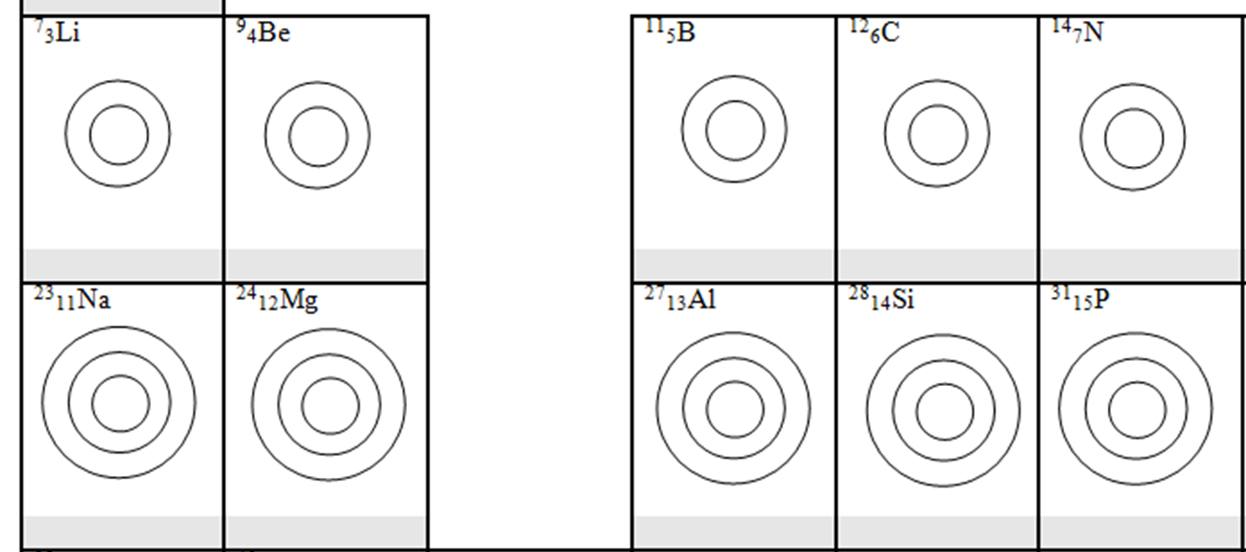
Electronic structure
The maximum number of electrons in each shells are:
How does group number relate to electronic structure?

Slide 3
Atomic model - PART 1
1800s
John Dalton – tiny spheres that could not be divided.
1890s
JJ Thomson – electron discovered. Plum pudding model - spheres of positive charge with negative charges spread evenly though.
1908 -1913
E. Rutherford, Geiger and Marsden - alpha particle scattering experiment. Nuclear model - mass of atom concentrated in a charged nucleus, with orbiting electrons.
1914
Niels Bohr – electrons orbit nucleus at specific distances in fixed energy levels (shells). Energy given out when electrons change level.
Later…
Positive charge of nucleus could be subdivided into particles of positive charge – protons.
1932
James Chadwick – provided evidence for the existence of neutrons within the nucleus.

Slide 5
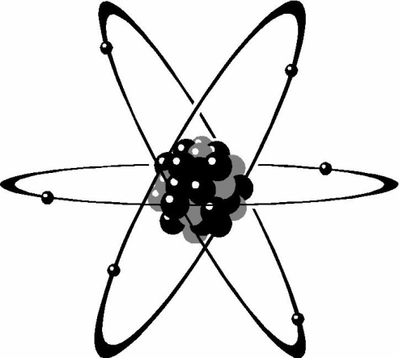
Find the M_{r} of these:
Carbon dioxide
Sulphur dioxide SO₂
Calcium carbonate CaCO₃
Sodium hydroxide NaOH
Sulphuric acid H₂SO₄
Hydrochloric acid HCl
Copper sulphate CuSO₄
Magnesium chloride MgCl₂
Sodium carbonate Na₂CO₃

Slide 6
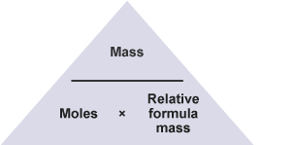
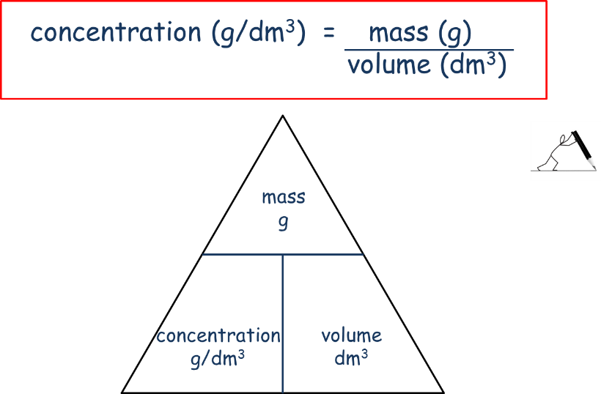
Remember these equations (TRILOGY)
Units
Mass = g
Moles = mol
Relative formula mass = g mol ⁻¹
Moles = Mass ÷ Relative formula mass
Mass = Moles x Relative formula mass
Relative formula mass = Mass ÷ Moles
You will need to calculate number of moles first
Make sure you always convert cm³ into dm³
1dm³ = 1000cm³

Slide 7
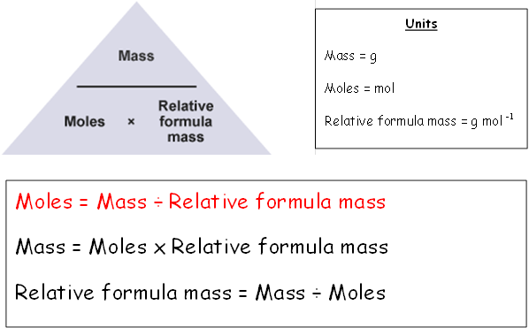
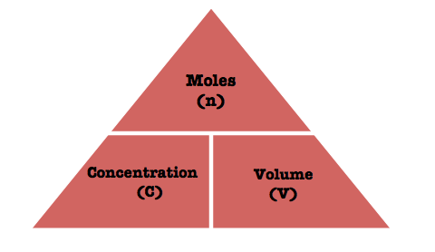
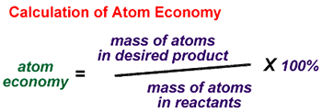
Remember these equations (SEPARATES)
Gas volumes
Concentration
1dm³ = 1000cm³

Slide 8
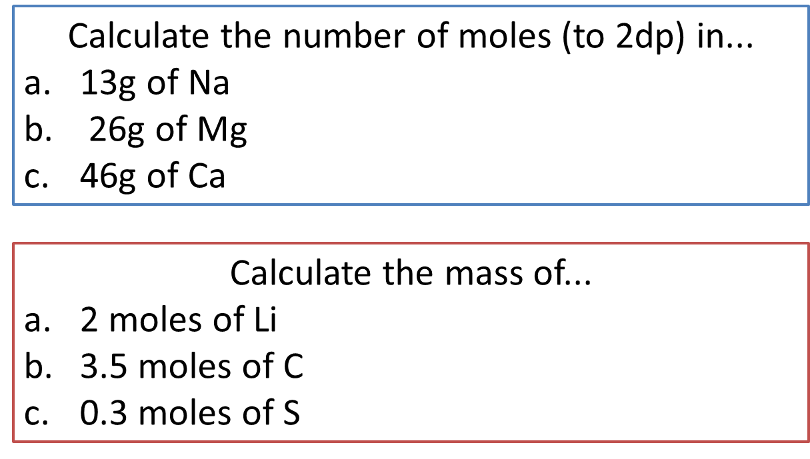
Work out the concentration (in g/dm³) of these solutions:
68g of NaCl dissolved in 4dm³ water
120g of CuSO₄ dissolved in 6dm³ water
4g of KBr dissolved in 0.5dm³ water
18g of LiF dissolved in 250cm³ water

Slide 9
Explain how to make a salt from an insoluble base in these steps

Slide 10
When an ionic compound is melted or dissolved in water, the ions are free to move about the liquid or solution. These liquids and solutions are able to conduct electricity and are called electrolytes. Passing an electric current though electrolytes causes the ions to move to the electrodes.
Direct current (DC) supply
_
+
Positive ions go to negative electrode (cathode) and are reduced (gain of electrons).
Negative ions go to the positive electrode (anode) and are oxidised (loss of electrons).
Ions are discharged at the electrodes producing elements. This is called electrolysis.
Negative electrode (cathode)
Positive electrode (anode)
+
-
-
+
+
-
+
-
+
-

Slide 12
In a ___________ energy is always ____________ (it is never _____ or _____).
Some reactions give out energy making the surroundings _________. These are called ____________.
Some reactions take in energy making the surroundings _________. These are called ____________.
Exothermic, endothermic, warmer, colder,, conserved, lost, gained

Slide 13
Draw reaction profile and define the type of reaction
reactants
Energy
Energy
reactants
Progress of reaction
Progress of reaction

Slide 14
Answers

Slide 15
Electronic structure
The maximum number of electrons in each shells are:
How does group number relate to electronic structure?
Group number is the same as the number of outer shell electron
2,1
2,2
2,3
2,4
2,5
2,8,1
2,8,2
2,8,3
2,8,4
2,8,5

Slide 16
Atomic model - PART 1
1800s
John Dalton – tiny spheres that could not be divided.
1890s
JJ Thomson – electron discovered. Plum pudding model - spheres of positive charge with negative charges spread evenly though.
1908 -1913
E. Rutherford, Geiger and Marsden - alpha particle scattering experiment. Nuclear model - mass of atom concentrated in a charged nucleus, with orbiting electrons.
1914
Niels Bohr – electrons orbit nucleus at specific distances in fixed energy levels (shells). Energy given out when electrons change level.
Later…
Positive charge of nucleus could be subdivided into particles of positive charge – protons.
1932
James Chadwick – provided evidence for the existence of neutrons within the nucleus.

Slide 17
non
Non metal
shared
gas
opposite
liquid
weak
positive
Boiling/melting point
negative
lattices.
Strong covalent bonds.
lose
Melting and boiling points
positive
Free/delocalised electrons.
sea
carbon.
dissolved
Molten/melted
Weak intermolecular forces between layers.
High mp/bp
Malleable
Ductile
Free/delocalised electrons.

Slide 18
Find the M_{r} of these:
Carbon dioxide
Sulphur dioxide SO₂
Calcium carbonate CaCO₃
Sodium hydroxide NaOH
Sulphuric acid H₂SO₄
Hydrochloric acid HCl
Copper sulphate CuSO₄
Magnesium chloride MgCl₂
Sodium carbonate Na₂CO₃
44
64
100
40
98
36.5
160
95
106

Slide 19
0.57 mol
1.08 mol
1.08 mol
14g
42g
9.6g
Work out the concentration (in g/dm³) of these solutions:
68g of NaCl dissolved in 4dm³ water
120g of CuSO₄ dissolved in 6dm³ water
4g of KBr dissolved in 0.5dm³ water
18g of LiF dissolved in 250cm³ water
17 g/dm³
20 g/dm³
8 g/dm³
72 g/dm³

Slide 20
Explain how to make a salt from an insoluble base in these steps
Measure the required volume of acid with a measuring cylinder and add the weighed solid in small portions with stirring.
Required practical
Safety goggles required - the mixture may be heated to speed up the reaction. When no more of the solid dissolves it means ALL the acid is neutralised and there should be a little excess solid.
Filter the solution to remove the excess solid.
On filtration, only a solution of the salt is left.
Then hot concentrated solution is left to cool and crystallise. After crystallisation, you collect and dry the crystals with a filter paper.
If the solution is heated, the solvent will evaporate faster.
Heating a solution until all the solvent has evaporated is known as heating to dryness.

Slide 21
Click to reveal missing words
Required practical
When an ionic compound is melted or dissolved in water, the ions are free to move about the liquid or solution. These liquids and solutions are able to conduct electricity and are called electrolytes. Passing an electric current though electrolytes causes the ions to move to the electrodes.
Direct current (DC) supply
_
+
Positive ions go to negative electrode (cathode) and are reduced (gain of electrons).
Negative ions go to the positive electrode (anode) and are oxidised (loss of electrons).
Ions are discharged at the electrodes producing elements. This is called electrolysis.
Negative electrode (cathode)
Positive electrode (anode)
+
-
-
+
+
-
+
-
+
-

Slide 23
reaction
In a ___________ energy is always ____________ (it is never _____ or _____).
Some reactions give out energy making the surroundings _________. These are called ____________.
Some reactions take in energy making the surroundings _________. These are called ____________.
conserved
lost
gained
warmer
Exothermic
colder
endothermic

Slide 24
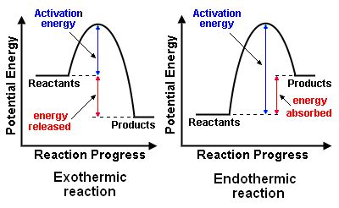
Draw reaction profile and define the type of reaction

