Slide 1

Using GCSEPod to Revise

Slide 2

It’s nearly exam time.
Are you prepared?

Slide 3

Do any of the following sound familiar?

Slide 4
I feel anxious or overwhelmed because I don’t know where to start..

Slide 5
I revise topics I already know rather than tackling harder work.

Slide 6
I use the same revision methods,
often reading notes over and over.

Slide 7
My mind wanders and I sometimes get bored revising.

Slide 8
GCSEPod is here to help you!

Slide 9
A reminder: What is GCSEPod?
GCSEPod provides you with highly concentrated 3-5 minute bursts of audio-visual, expert-written learning which can help to reinforce and consolidate key GCSE topics.

Slide 10





A reminder: What is GCSEPod?
27 GCSE/IGCSE subjects.
Over 6,500 audio-visual Pods.
Covering every exam board.
Correlation between usage and progress.
One website, three apps.
Available online or offline.
Ability to favourite any Pod (topic) you find difficult.
Pre-made exam playlists, helping to organise revision.

Slide 11

When used effectively, GCSEPod can have a BIG impact on final grades
Data from over 2,200 students shows that higher GCSEPod users are more likely to exceed their predicted grades by a larger margin than those who don’t use GCSEPod.
High academic year usage yielded a greater impact than high usage in just the exam period.
On average, highest users received 3 grades higher across their subjects than predicted.
High Users = average 122 Pods watched in academic year
Medium = average 34 Pods watched in academic year
Low = average 6 Pods watched in academic year
Non Users = 0 Pods watched in academic year

Slide 12

GCSEPod can be used on ANY device

Slide 13

I just wanted to say thank you and tell you how much I benefitted from GCSEPod. It was so helpful for getting through GCSEs, an easy, effective way to revise. I worked my way through all the sections making mind maps from the videos. I was really pleased with my results and am sure GCSEPod helped me get there.
GCSE Student

Slide 14

How to find Pods to watch

Slide 15



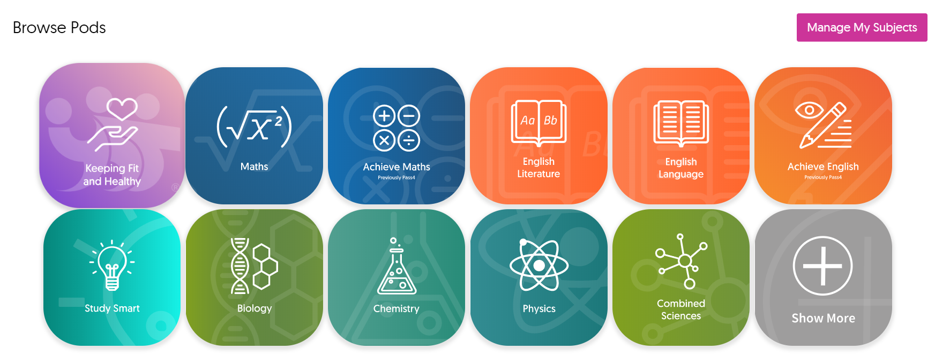
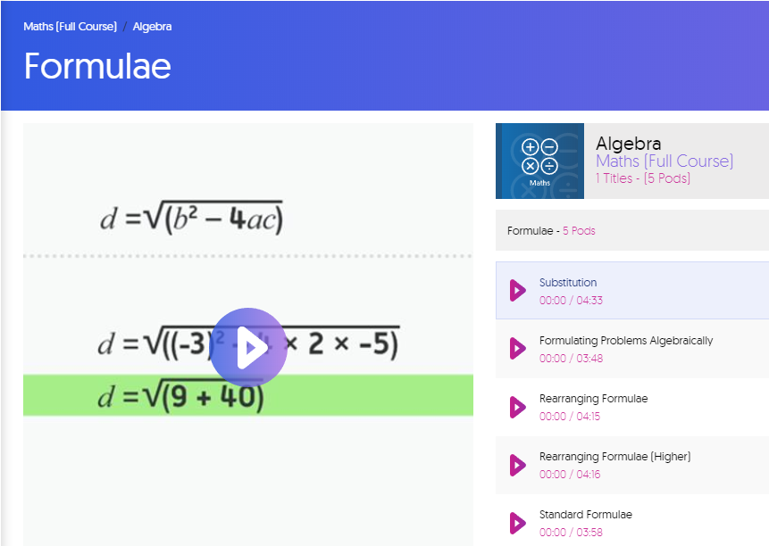
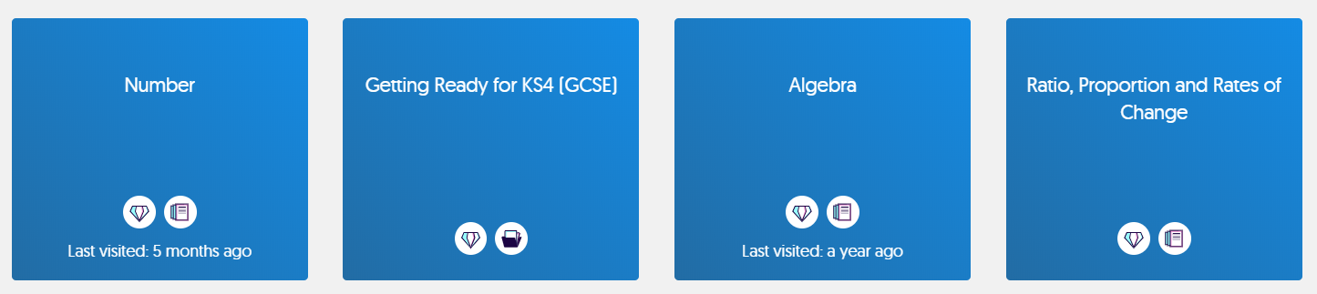
Search for a Topic
1
2
3
Pick your subject
Choose a topic
Start revising

Slide 16
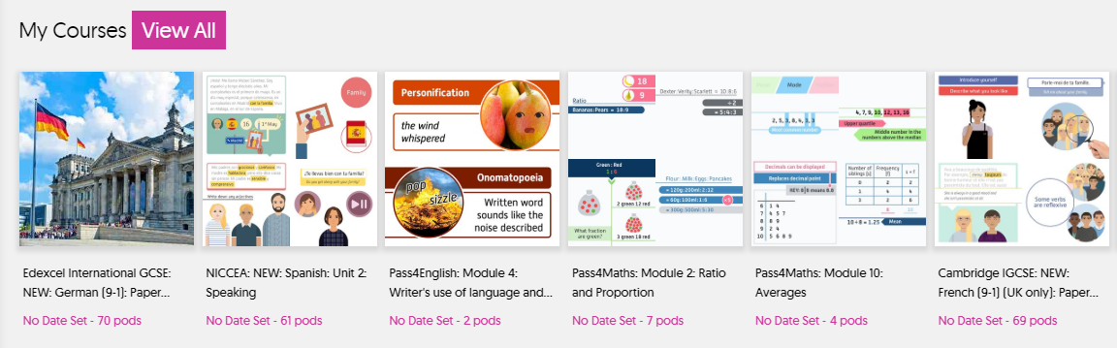
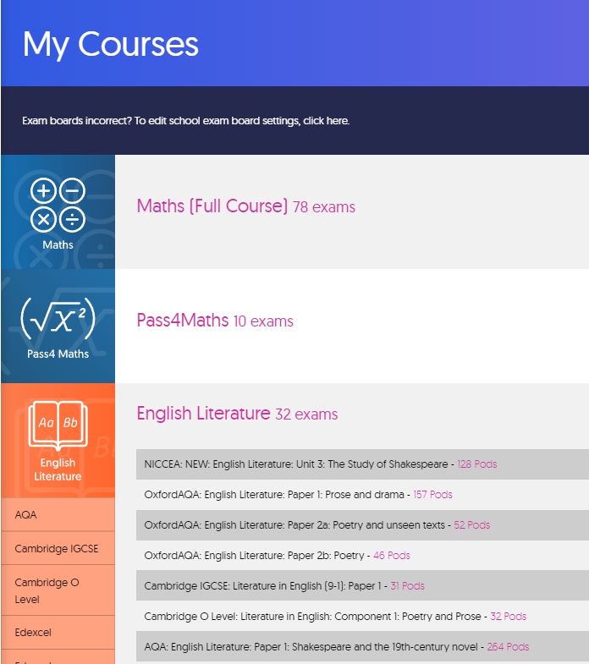
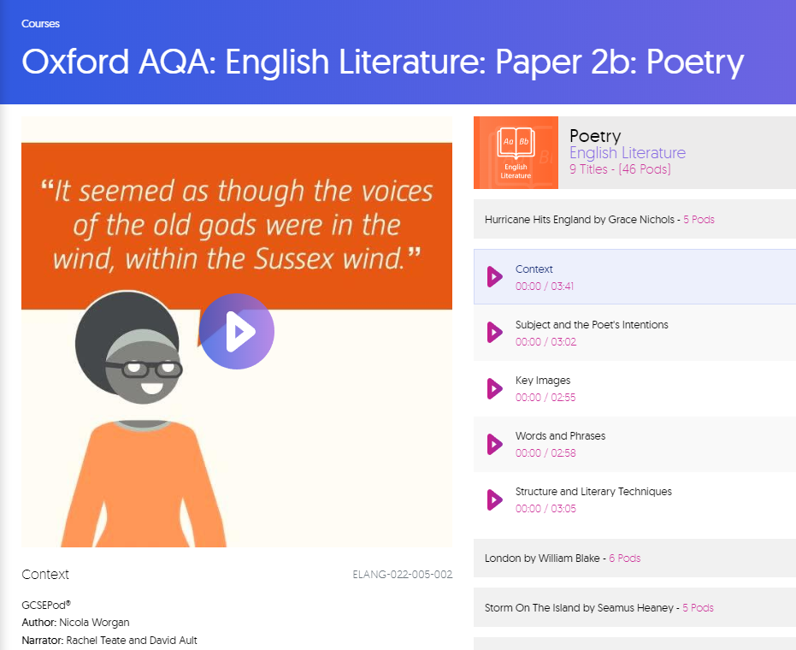
Search for an Exam
1
2
3
Go to My Courses
Choose an exam
Start revising

Slide 17

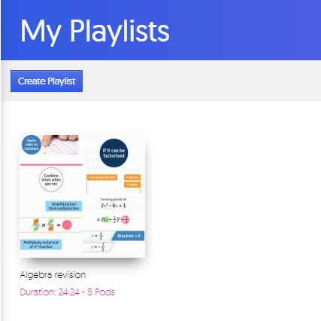
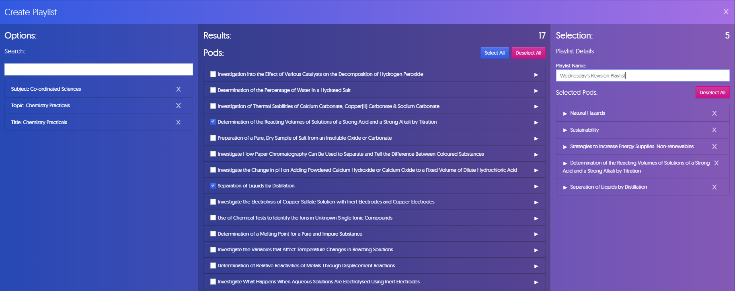
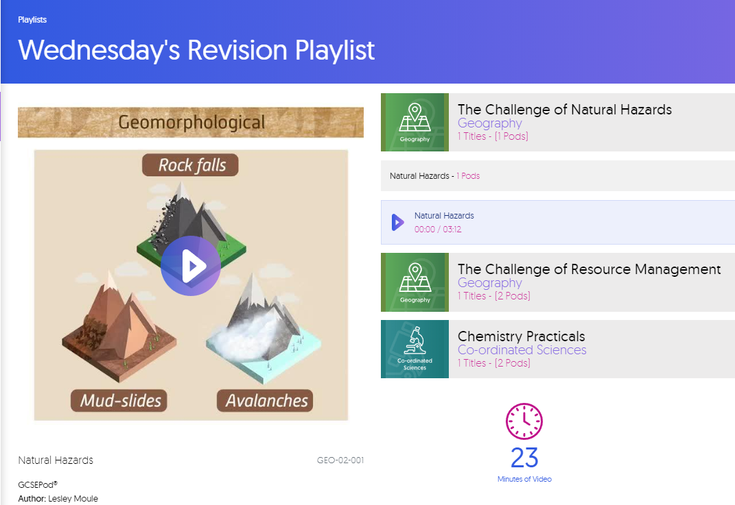
Create a Playlist
1
2
3
Go to My Playlists
Choose Pods
Start revising

Slide 18

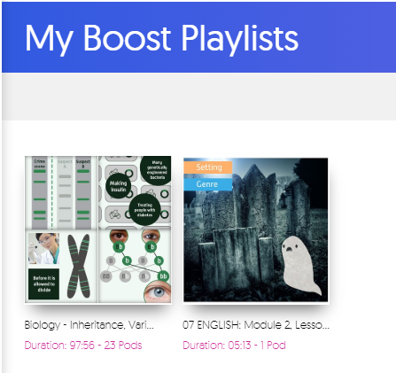
Assignments = Boost Playlists
Ask your teacher to set you an assignment – there are hundreds of questions readily available
You can apply your knowledge to the questions that have been set and get INSTANT results!
Boost Playlists – helps to fill in knowledge gaps
When you complete an assignment, you’ll be given access to a Boost Playlist with recommendations on what you should be watching based on any incorrect answers.

Slide 19

How to use GCSEPod with classic revision techniques

Slide 20

GCSEPod and Note Taking
Notes help to improve your understanding of a topic in your own words. Keep your notes brief and don’t forget to highlight key words, quotes and dates.
Write short and concise notes whilst watching a Pod. Watch a Pod fully first and then replay it whilst pausing it and writing notes.

Slide 21

GCSEPod and Idea Mapping
Summarise what you’ve learnt by creating an idea-map. Start by putting the name of the topic in the centre of a piece of paper. Add branches (like a tree) and add additional key words to each branch which are associated with the main topic. Keep adding more detail as the branches become smaller and use images and colours as well as words to help the information stand out.
Draw an idea-map with all the key words and images that you see and hear in a Pod. Try matching the colours you use on your
idea-map to the colours shown within the Pod. Don’t be afraid to be creative, it’ll help you remember more.

Slide 22

GCSEPod and Flash Cards
Summarise a topic on a flash card or post-it, on one side of the card, write the topic’s name. This will help you when you come to test your knowledge. On the flip side, write down all the key words, symbols, dates, quotes and places that you’ve learnt. When you test yourself, simply look at the topic’s name and see if you can remember everything on the other side of the card without looking.
Create a flash card for each Pod you watch. Write the name of the Pod on one side, and on the other, write all the key information you’ve learnt. Search YouTube for a video on the “Leitner System” to find out more about creating effective flash cards.

Slide 23
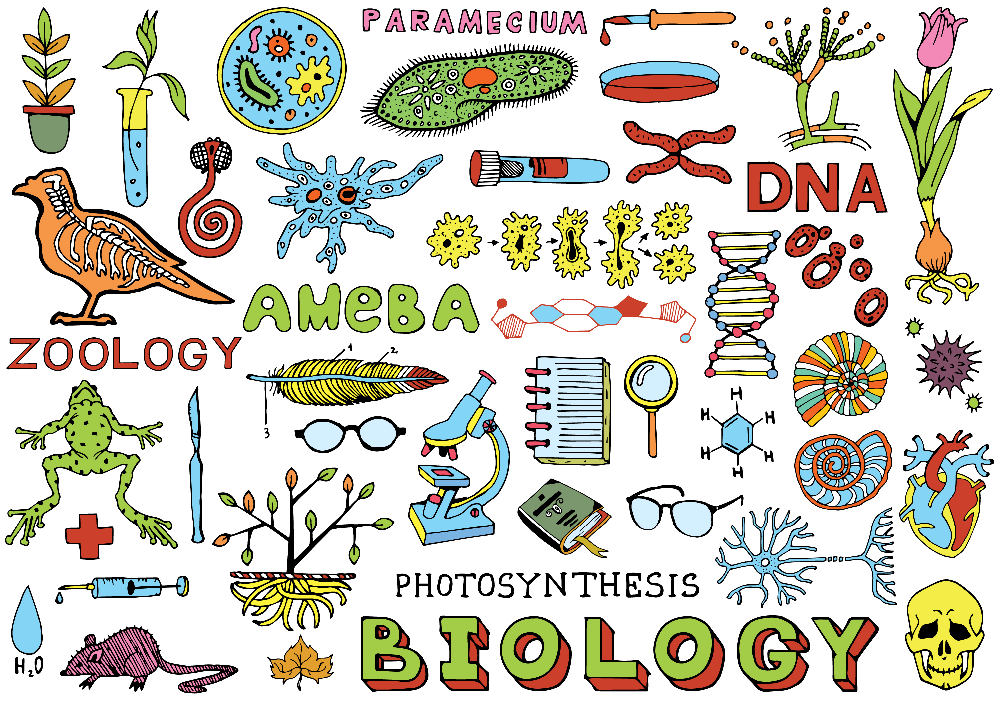
GCSEPod and Summary Posters
Use keys words, pictures and definitions to design a poster on a topic or whole subject. Put the summary poster up in your room and spend regular time looking at it.
Watch a Pod and whilst you can remember, draw a summary poster with all you’ve learnt. Once you’ve finished your poster, re-watch the Pod and see how much you remembered.

Slide 24

GCSEPod and Practice Exam Questions, Past Papers
Practising exam questions and past papers helps to perfect your exam techniques whilst checking your knowledge and highlighting any gaps you may have.
Watch Pods and then answer practice exam questions and past papers. Highlight questions you struggled with and watch the Pods.

Slide 25

GCSEPod and Mnemonics
Create a code using rhymes, phrases or acronyms.
For example, colours of the visible spectrum:
Richard of York Gave Battle in Vain (Red, Orange, Yellow, Green, Blue, Indigo, Violet)
Pick out key words from a Pod and create mnemonics to help you remember.

Slide 26
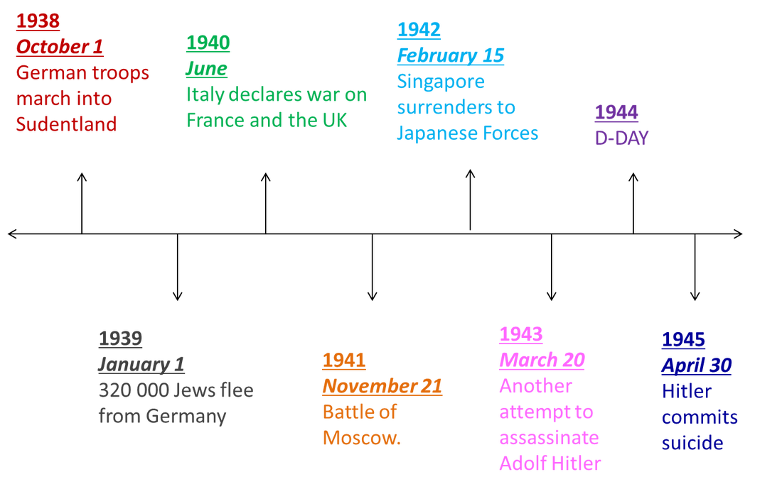
GCSEPod and Timelines
Design a timeline for those subjects where chronology is important like History and English Literature. Timelines are invaluable for making sense of a series of events or stories.
Use key dates within a Pod to create a timeline; it will help you visualise the order of the story.

Slide 27
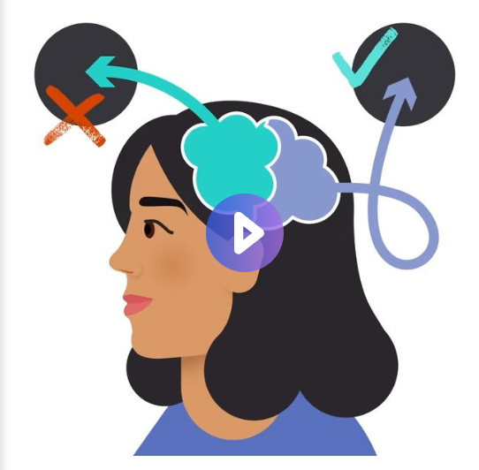
For more revision techniques visit STUDY SMART Pods
https://members.gcsepod.com/shared/studysmart

Slide 28



Slide 29

Coping with Exam Stress

Slide 30

Exercise as often as you can
Believe in yourself
Make sleep a priority
Eat right
Talk about nerves
Keep things in perspective
Get organised

Slide 31
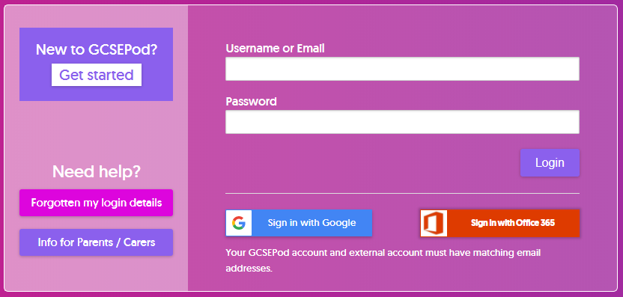
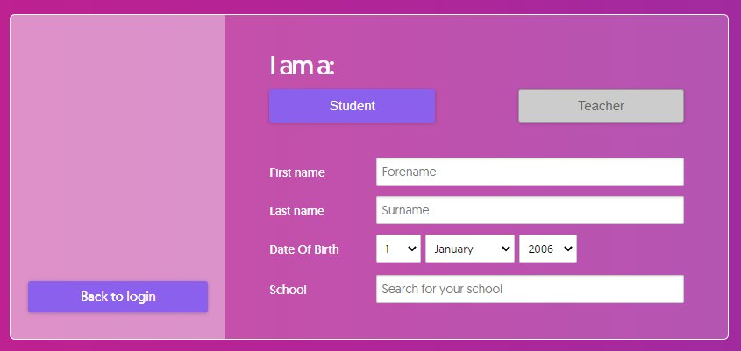
Not Activated Yet?
1
Go to: https://members.gcsepod.com
2
Click “New to GCSEPod?
Get Started!”
3
Enter your name, date of birth and school details
4
Create your own username and password

