Slide 1
What is GCSE POD?
Free, unlimited streaming access to the GCSEPod website.
1000’s of short videos (‘Pods’) covering 27 IGCSE subjects.
Everything filtered for the curriculums you are being taught.
Unlimited downloads to take the videos anywhere.
Notes:
So what’s included in this subscription?
Think of GCSEPod as the Netflix for education. It’s education on demand, wherever you are, whenever you want it.
Or, it’s like a pile of textbooks conveniently in your phone, accessible any time, anywhere.
Because everything is filtered by exam board, it’s like having a teacher with you when you’re doing homework or revising, telling you what it is you need to know.
And because everything can be downloaded, you don’t even need to worry about using up your data allowance on your phone.

Slide 2
YOU ARE
JOINING A STUDENT
COMMUNITY
Over 500,000 students
36+ countries
Accessed 15 million times last year
Notes:
When you start using GCSEPod you are joining a community of students worldwide. Last year GCSEPod was accessed over 15 million times by students just like you…

Slide 3
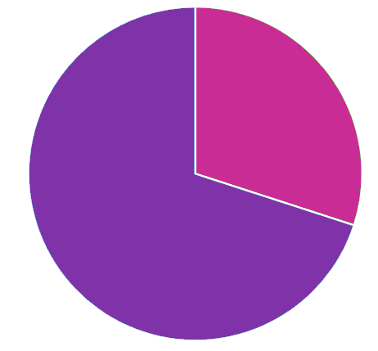
In school
30%
Out of school
70%
Notes:
…and on average, 70% of students were using GCSEPod when they were out of school.
Those that did, saw a BIG impact on their results as shown here.

Slide 4
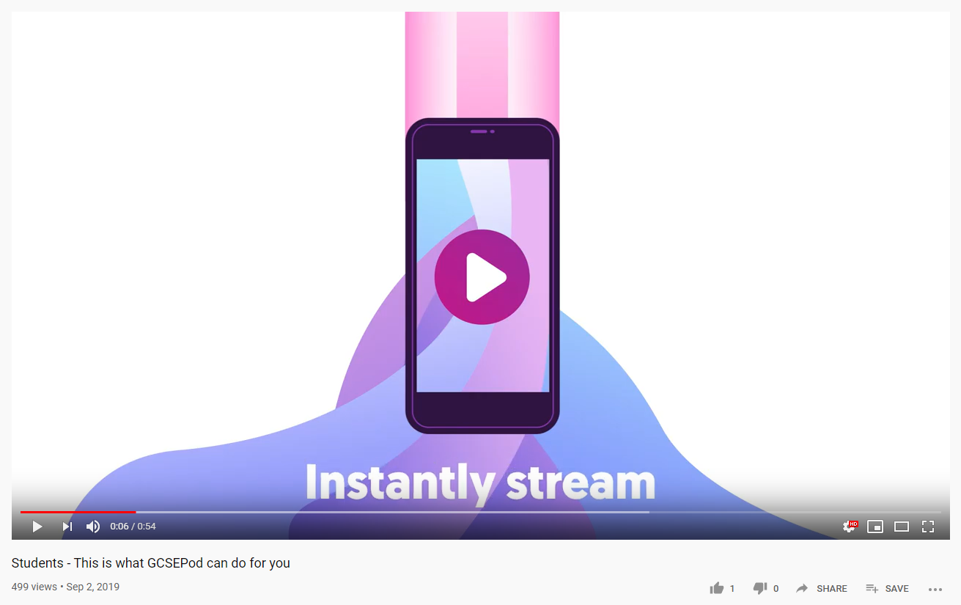
https://www.youtube.com/watch?v=f4TvlMeF2Do
Notes:
So let’s watch a video and find out what GCSEPod is all about.
https://www.youtube.com/watch?v=f4TvlMeF2Do

Slide 5
How you access GCSEPod?
OPTION 1 – Via any browser on your computer, laptop, tablet or phone. Just go to www.gcsepod.com
OPTION 2 – Via the iPhone and Android apps which are free to download from the apple store and play store.

Slide 6
Why is it so effective?

Slide 7
Notes:
By combining audio narration, text and images, GCSEPod helps you to remember the information clearly.

Slide 8
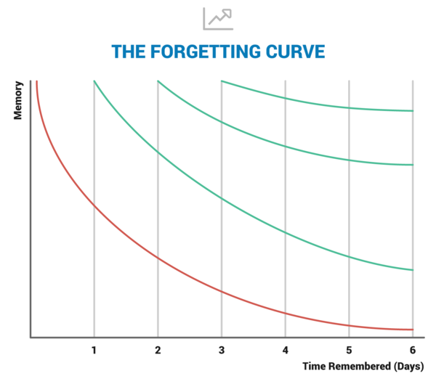
The opposite of cramming.
No spaced practice
10% remembered
Spaced practice
90% remembered
Notes:
When you first learn something the information goes into your short term memory. This is why you will often find that you’ve forgotten most of what you learnt a week later! Spaced practice means revising what you learnt at regular intervals so that the information moves to your long term memory and if easier to access when you need it!

Slide 9
Secrets to success.

Slide 10
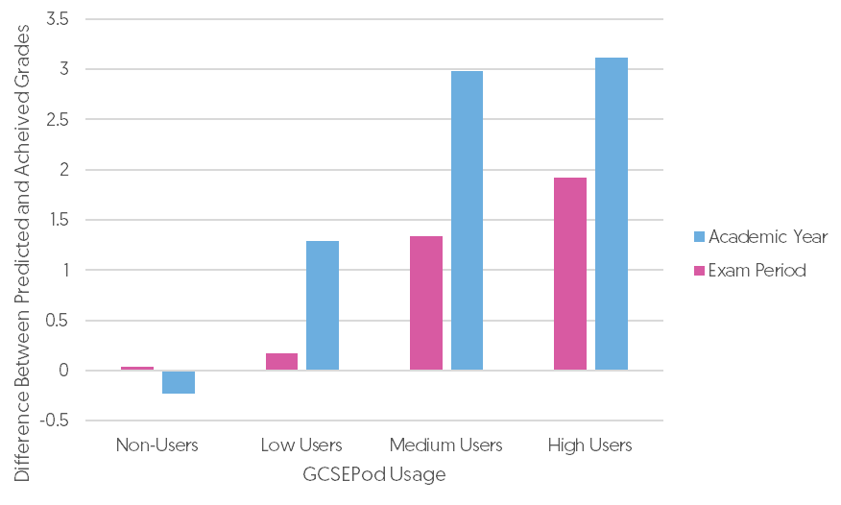
Start now and use often
Just like training for a marathon, you need to start early and train little and often.
Students who used GCSEPod over the WHOLE year, not just during exams, achieved greater results.

Slide 11
Don’t just watch – TRY A BRAIN DUMP
DUMP
Notes:
Write down EVERYTHING you know about a topic. Then watch the relevant Pod and fill in all the bits you missed. Highlight these sections in yellow and review them. A week later, repeat and see how much more you remembered.

Slide 12
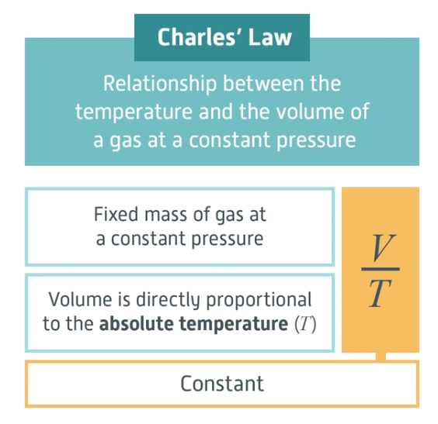
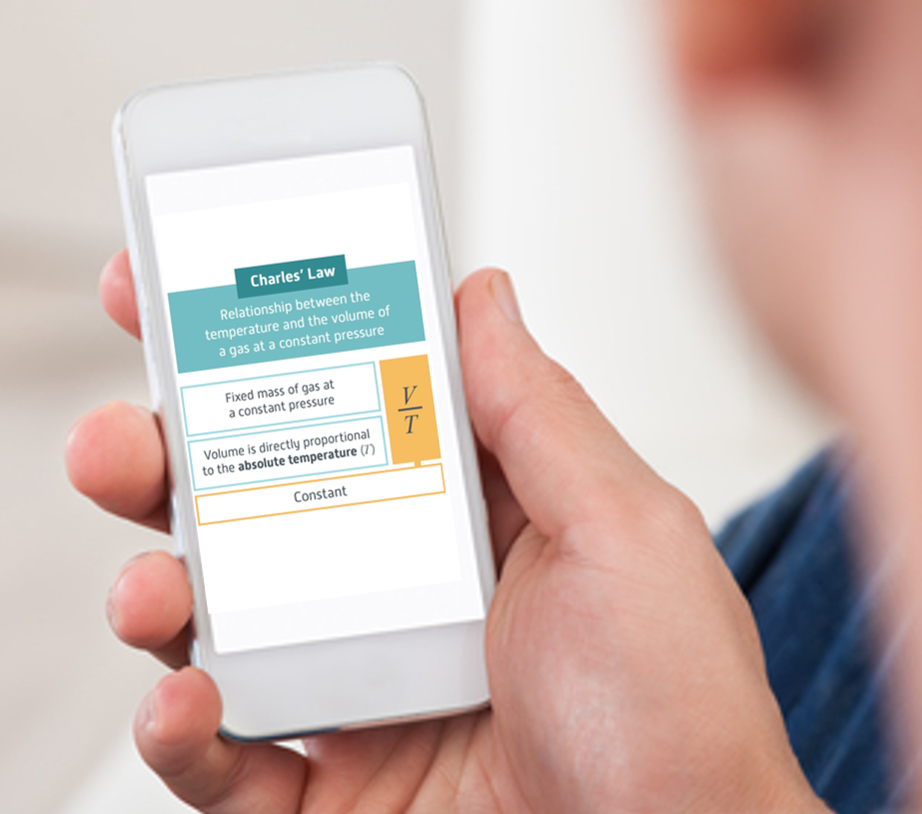
Don’t just watch – CREATE DIGITAL FLASHCARDS
Notes:
When you come across a really useful diagram or explanation, take a screenshot on your phone. Next time you are waiting for the bus, flick through those digital flash cards and try and remember the information on each one.

Slide 13
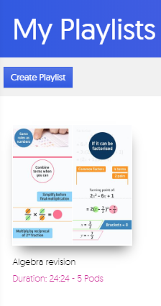
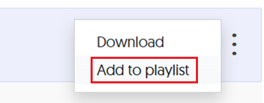
Don’t watch everything! – CREATE PLAYLISTS
Notes:
Make sure you don’t watch videos just on the bits you are interested in! Try and focus on areas you find hard, and put those Pods into a playlist. This will focus your time on the Pods that are most likely to help you succeed.

