Slide 1
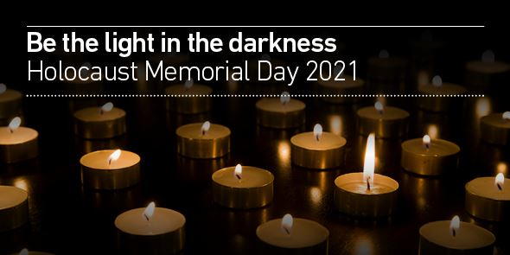

Slide 2
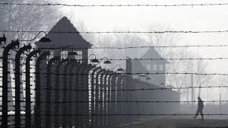
27th January is Holocaust Memorial Day. This date makes the day when the most infamous of the Nazi death camps - Auschwitz was liberated by Russian soldiers. This year is the 76th anniversary.
The Holocaust occurred during World War II and you will be studying more about it in the summer term of Year 8. Hitler and the Nazis murdered six million Jews during the Holocaust, alongside other groups that were persecuted.
Although the Nazi Holocaust was the worst in history there have been other more recent genocides in Cambodia, Rwanda, Bosnia and Darfur. The 27th January is also used to remember them.
The Holocaust Memorial Trust says – “Our world often feels fragile and vulnerable and we cannot be complacent. Even in the UK, prejudice and the language of hatred must be challenged by us all.
HMD is for everyone. Each year across the UK, thousands of people come together to learn more about the past and take action to create a safer future.”

Slide 3
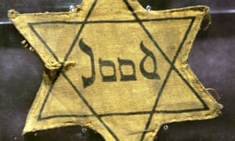
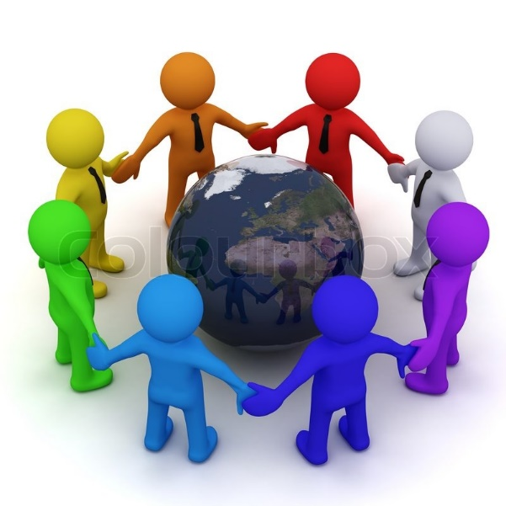
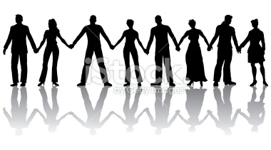
What is the Holocaust Memorial Trust?
Task – Watch this film produced by the Holocaust Memorial Trust, to find our more about this important day.
https://www.hmd.org.uk/resource/what-is-holocaust-memorial-day/

Slide 4
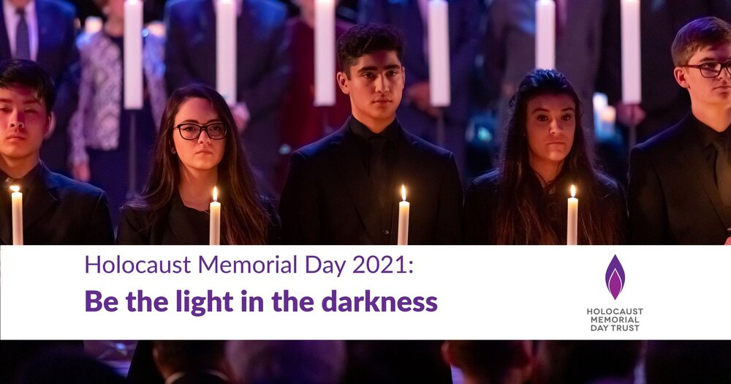
Holocaust Memorial Day 2021
The theme for Holocaust Memorial Day 2021 is – ‘Be the light in the darkness’
This is an opportunity to not just remember the victims but also those people who resisted and stood up to groups like the Nazis in World War II.
This could be:
Resistance – a light in the darkness
Rescuers – extreme bravery in the darkness
Lighting the way with kindness
Shining light into the darkness
‘We will continue to do our bit for as long as we can, secure in the knowledge that others will continue to light a candle long after us.’
Gena Turgel, survivor of the Holocaust (1923-2018)

Slide 5
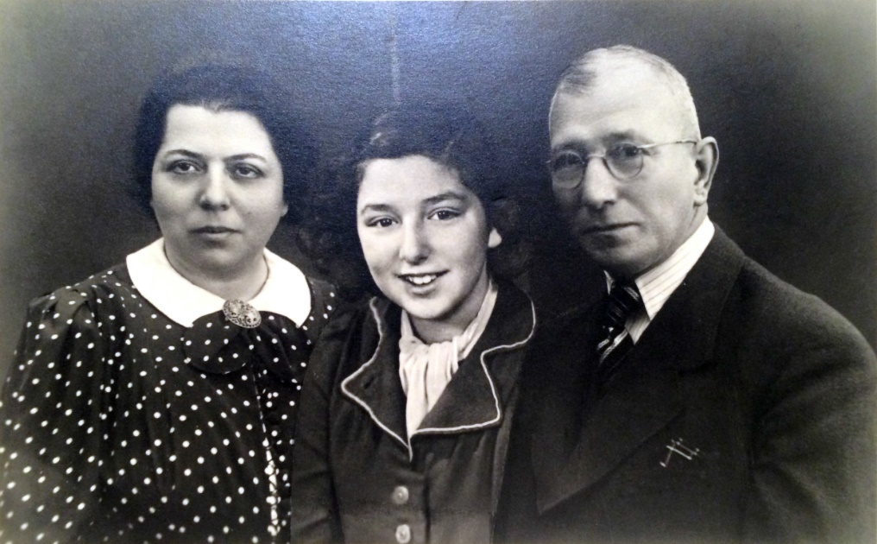
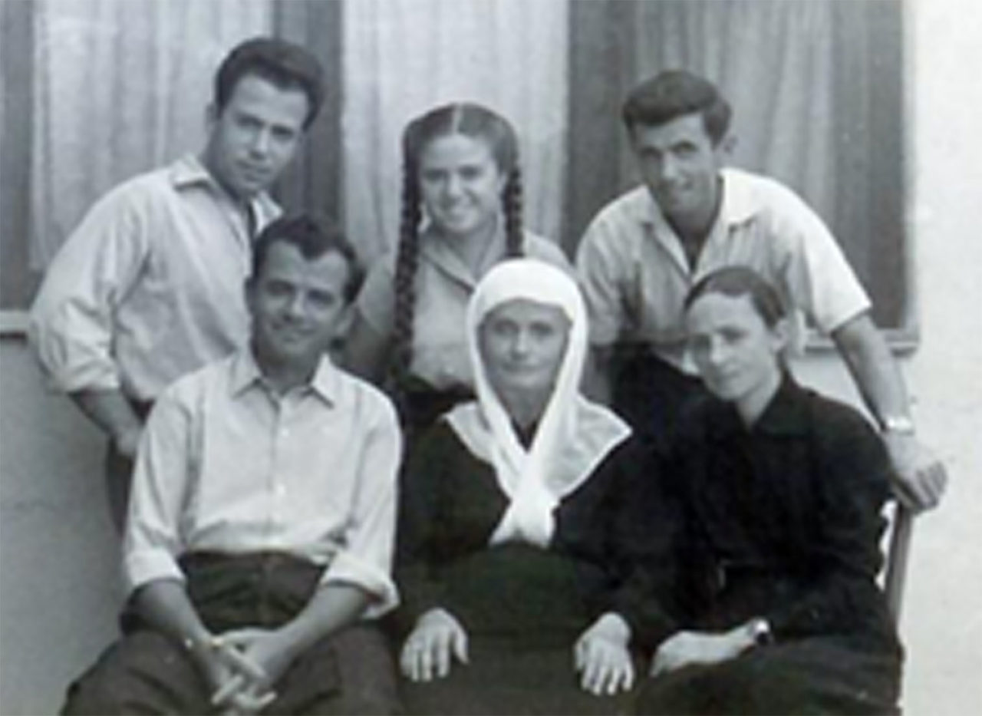

‘Be the light in the darkness’
There are many examples of people who resisted the Nazis. Sometimes just surviving was an act of resistance. Today we are going to find out about three examples:
Susanne Kenton
2) The Veseli Family
3) Gad Beck

Slide 6
Susanne Kenton
Susanne was born in Berlin in 1925. Susanne’s parents ran a bookshop business. Susanne had friends who were Jewish and friends who were not Jewish. When the Nazis came to power in Germany they made it difficult for Jewish people. On Kristallnacht the Nazis smashed Susanne’s family’s bookshop. The Nazis arrested Susanne’s father. He had not done anything wrong. The Nazis arrested him for being Jewish. At school Susanne was asked if she would like to escape from the Nazis on a train. Susanne said yes. Susanne forgot to tell her parents that she had said yes. Susanne’s parents let her go on the train because they wanted her to be safe from the Nazis. Susanne was only 13 years old when she went to London on the train. Her mother and father were not allowed to go with her. In London, Sydney and Golda, a young married Jewish couple, looked after Susanne. The Nazis killed Susanne’s mother and father. Susanne stayed in London and later married and had her own family. On Holocaust Memorial Day Susanne wants us to remember all of the children who were looked after by new families and who saved them from the Nazis.
Glossary:
Jewish – Jews are a group of people who share an ethnicity called Judaism. Judaism is also a religion, which most Jews follow. If you are a Jew people will call you ‘Jewish’.
Kristallnacht – ‘Kristallnacht’ is German for crystal night. We use the word ‘Kristallnacht’ to talk about the night of 9 November 1938 when the Nazis smashed the shops of Jewish people. The Nazis also killed and arrested lots of Jews on this night. The broken glass from the shops looked a bit like crystal.
Nazis – The ‘Nazis’ were a group of people in Germany who believed that they were superior to other people. The ‘Nazis’ were racist, they wanted to kill people who were Jewish for being ‘different’ to them.

Slide 7
2) The Veseli Family
Vesel and Fatima Veseli and their four children were a Muslim family from Albania. They lived in a small village in the mountains. One of the sons was called Refik. When he was 17 his parents sent him to the capital city, Tirana, to learn to be a photographer. At the same time a war was happening across Europe called World War Two. One day a new man came to work in the photography shop with Refik. His name was Moshe Mandil, and he was Jewish. He had come to Tirana with his family from another country in Europe called Yugoslavia. Moshe had to leave his home because his country was attacked by German soldiers. Germany was led by the Nazi Party. They wanted to get rid of all the Jewish people in Europe. One year after Moshe arrived, Germany took control of Albania, and lots of Nazi soldiers came to Tirana looking for Jewish people. The Nazis knew there were only 200 Jewish people living in Albania. However 1,000 more Jewish people, including the Mandil family, had secretly gone there to find safety. Refik realised his new friend was in trouble. He went home and asked his parents if the Mandil family could hide with them in the village. Straight away they said yes. The Mandil family didn’t want to be caught by the soldiers, so they travelled at night, and hid in caves during the day. Finally they arrived at the village. The Veseli family were actually hiding two Jewish families. None of their neighbours knew that the Jewish families were there. In 1944 the Nazi’s attacked the village. Both Jewish families hid in the Veseli’s house, and they all stayed silent in the dark. The Nazis thought the house was empty, and didn’t search it. They were safe. Everyone hiding in the house survived the war, thanks to the Veselis. Many Jews who went to Albania were saved by Albanian people. This is because of their strong Muslim belief that it was the right thing to do.
Glossary:
Muslim: People who follow the religion of Islam.
Albania: A small country north of Greece.
World War Two: A large war fought in Europe from 1939 – 1945. Resistance fighters: People who disagree with what the people in power are doing, and try to stop them.
The Holocaust: The attempt by the Nazis to kill all the Jews in Europe

Slide 8
3) Gad Beck
In 1941 Gad was a 19 Year old young man living in Berlin. He was Jewish and Gay, both things that the Nazis hated. Many of his friends and family were rounded up and sent to concentration camps. Gad had already experienced terrible discrimination like all Jews in Germany. He had been forced to leave his school by the Nazis because he was Jewish. The shop he worked in was attacked during Kristallnacht and he even lost his home. All Jewish people were forced to wear yellow stars to show to the rest of Germany, that they were different but in a bad way. In 1942 Gad’s boyfriend Manfred Lewin and his family were sent to Auschwitz concentration camp and murdered. Gad himself escaped being sent to a concentration camp by a protest of local people. Gad then joined Chug Chaluzi, a Jewish resistance group and he arranged safe houses, delivered money, and helped Jews in attempts to escape Germany. Gad received a lot of support from non-Jewish people he knew, but it had to be kept secret. In March 1945, someone betrayed Gad and he was arrested by the Nazis. However, by this point the war was nearly over and the trains taking Jews to concentrations camps had stopped. Gad was instead thrown into prison, where he feared he might be executed. But that didn’t happen and after the war Gad travelled to Israel to live. He did though return to Germany later in life and became the Director of Berlin’s Jewish Adult Education Centre. Gad felt it was his mission to return, to complete his resistance by rebuilding Jewish life where the Nazis had tried to destroy it.
Glossary:
Safe House – Somewhere Jews or others could be hidden from the Nazis.
‘Kristallnacht – ‘Kristallnacht’ is German for crystal night. We use the word ‘Kristallnacht’ to talk about the night of 9 November 1938 when the Nazis smashed the shops of Jewish people. The Nazis also killed and arrested lots of Jews on this night. The broken glass from the shops looked a bit like crystal.

Slide 9
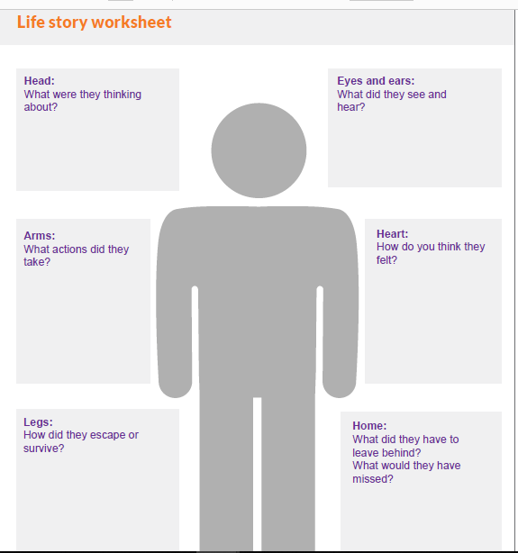
Remembering the Holocaust at OWS………
Task 1 – Choose one of the three individuals you have just read about.
Create your own copy of the diagram on the right. Either put their name, a picture or drawing of them in the centre and colour in.
Then use the story to answer the questions around the individual.
The best work will go in our virtual online memorial for everyone to see, so spend time on colourful, neat presentation and accurate spelling. Check if you are unsure!

Slide 10
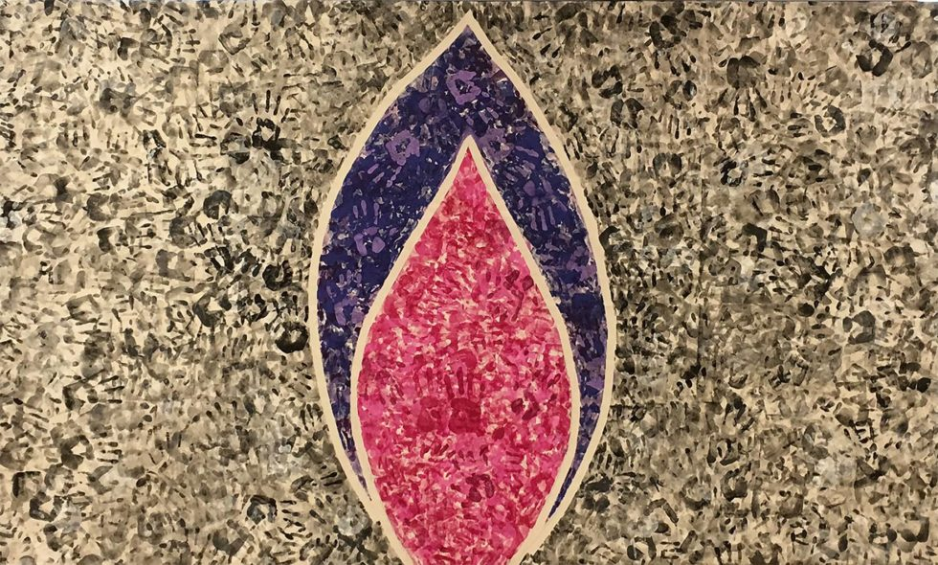
Remembering the Holocaust at OWS………
handprints
Task 2 - The Holocaust Memorial Trust uses a flame as its symbol because to keep a flame burning you must look after it. It is the same with remembrance – we must keep learning, sharing and taking action so the memory of these events is kept alive for years to come.
Task 2 – Create your own remembrance flame. You can be as creative as you like. Draw, paint, a collage, model etc – would all be great. Just make sure it is not a real flame! Look at some of the examples opposite..
Once you have made it. Take a photo (make sure you are not in it) and then send it to sasha.williams@oldburywells.com or ben.grainger@oldburywells.com
We would love as many as possible to go on our online memorial – so please send it in before Thurs 27th Jan
The White Rose Resistance Group
Positive words
Fabric

