Slide 1



GCSE OPTIONS
OCR GCSE Computer Science
Notes:
OCR GCSE Computer Science at Oldbury Wells School.
Computer science is an exciting qualification that could be the first stepping stone you take which provides you with opportunities to work in an ever evolving sector
If you have a passion for computers, a desire to know they work, how they communicate, want to find out about cyber security and love programming in Python, this is the qualification for you.

Slide 2
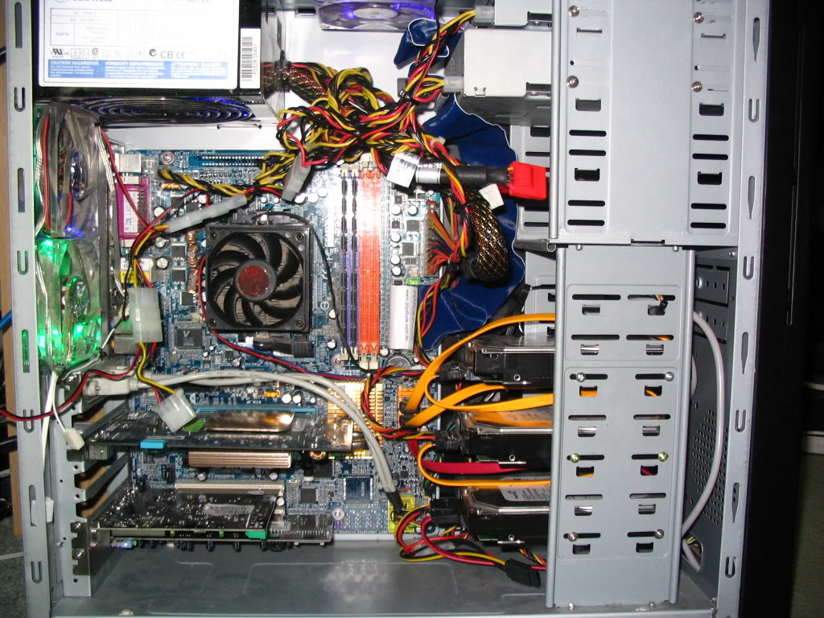

What will I study?
  Unit 1 Computer Systems
  Systems Architecture
  Memory and storage
  Computer networks, connections and protocols
  Network security
  Systems software
  Ethical, legal, cultural and environmental impacts of digital technology
Notes:
The course consists of two units in total.
Unit 1 computer systems and unit 2 computational thinking, algorithms and programming.
First lets take a look at unit 1. Unit 1 is where you will learn about the processor in a computer, its role, why some processors perform better than others and why it really is the brains of any computer. You will also learn about other components in a computer such as RAM and secondary storage such as an SSD.
In this unit you will learn about how computers communicate with one another, network hardware, connectivity and protocols.
Cyber security is a really important part of our every day lives due to the way in which we use computers. You will learn about threats and how to prevent cyber security incidents.

Slide 3

What will I study?
Unit 2: Computational thinking, algorithms and programming
  Algorithms
  Programming fundamentals
  Producing robust programs
  Boolean logic
  Programming languages and Integrated Development Environments
  All students will have the opportunity to complete programming tasks throughout the course.
Notes:
Unit 2 teaches you about computational thinking, algorithms and programming. Over the duration of the course, you will constantly develop your programming skills in Python. You will build upon the knowledge you learnt in key stage three computing and develop it further to solve complex problems.
Whilst studying unit 2 you will also learn how produce robust programs to prevent them security threats and learn how an integrated development environment will support you in your programming.

Slide 4


How will I be assessed?
Paper 1: Computer Systems
1 hour 30 mins paper
50% of your final grade
80 marks in total
You are not able to use a calculator
Paper 2: Computational thinking, algorithms and programming
1 hour 30 mins paper
50% of your final grade
80 marks in total
You are not able to use a calculator
Notes:
You will be assessed by two exams in the summer term of year 11. You will sit an exam for unit 1 computer systems and unit 2 computational thinking, algorithms and programming. Each exam is worth 50 % of your final grade. Maths is included as GCSE computer science requires an ability to perform calculations. It is important to remember that in both of your GCSE computer science exams you are not able to use a calculator.

Slide 5
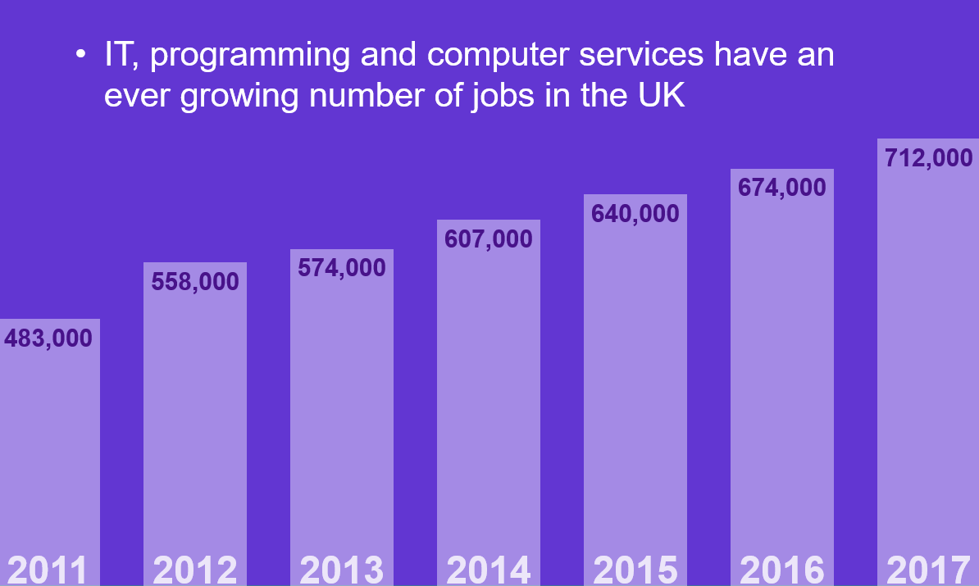
Why should I pick Computer Science?
Jobs available within this sector continue to rise each year
Notes:
IT, Programming and computer services have an ever growing number of jobs in UK. Many companies currently have a huge demand for people with Computer Science skills, especially in programming, cyber-security.

Slide 6


What can Computer Science lead to in the future?
What can Computer Science lead to in the future?
  Programmer
  Computer Hardware Engineer
  Cyber Security Analyst
  Software engineer
  IT technician
  Network engineer
  App developer
  Web developer
  IT Project Manager
  There are many more…..
Notes:
There are many paths you can explore in terms of career options following a computer science qualification. Examples of potential job roles include programmer, cyber security analyst, network engineer, web developer. If you are looking for further inspiration on why you should opt for GCSE computer science take a look at the following slides.

Slide 7

What can Computer Science lead to in the future?
The World Wide Web
Invented by British scientist, Tim Berners-Lee in 1989
  More than four billion people now use it
  Over 45 billion web pages have been written
Every British business needs people with an understanding of how computing can help them.
Notes:
Although the World Wide Web is three decades old, its growth is still expected to be phenomenal in the future. Students are still able to think up innovative ideas and compete with the largest companies in the world.

Slide 8



What can Computer Science lead to in the future?
Game Changing E-Commerce
Shopping has been transformed since
the web was invented
  Online shopping was worth
  £1 trillion in 2014
  It is predicted to be worth
  £3.7 trillion by 2021
Notes:
The world wide web has completely changed the way in which we purchase goods and services. Online shopping has been predicted to be worth nearly 4 trillion pounds.

Slide 9

What can Computer Science lead to in the future?
Games Development
The UK is well known for its games development.
The following were all made in the UK:
  Grand Theft Auto (Edinburgh)
  Elite Dangerous (Cambridge)
  Candy Crush (London)
  Batman: Arkham (London)
  Sonic Forces (Leamington Spa)
  Burnout Paradise (Guildford)
Notes:
The UK has a strong history of computer games that is still thriving to this day. Similar talent is also used in our TV and film industries. Historically, the UK has also been strong in producing computers.

Slide 10

What can Computer Science lead to in the future?
Large Companies in the UK
Major international companies are present in the UK and looking for bright new talent. Examples are:
  Google
  Microsoft
  Apple
  Samsung
  Facebook
Notes:
It is also important to remember that major international companies such as Google and Apple exist in the UK and are always seeking bright new talent.

Slide 11


What can Computer Science lead to in the future?
Entrepreneurs & start-ups
It took just three people to create Snapchat
  Bobby Murphy was the programmer who coded the app
Within four years the software was
sending six billion videos per day
Notes:
CS is one of the best routes into entrepreneurship. It is possible to take a concept and start a business with no investment and just one home computer.

Slide 12



What can Computer Science lead to in the future?
Entrepreneurs
Jeff Bezos (£112 Billion) – Founded Amazon in his garage
Bill Gates ($90 Billion) – Co-founder Microsoft, founded with his friend Paul Allen
Mark Zuckerberg ($71 Billion) – Co-founder Facebook, with his student roommates
Carlos Slim Helú ($67 Billion) – Telecoms investor – found that a background in linear programming gave him the edge in the business world
Larry Ellison ($59 Billion) – Co-founder Oracle, makers of database software
Notes:
Of the top 10 wealthiest people in the world, notice how many started in IT and had a firm grasp of programming. Most entrepreneurs can’t imagine having made it without a knowledge of IT and Computer Science

Slide 13
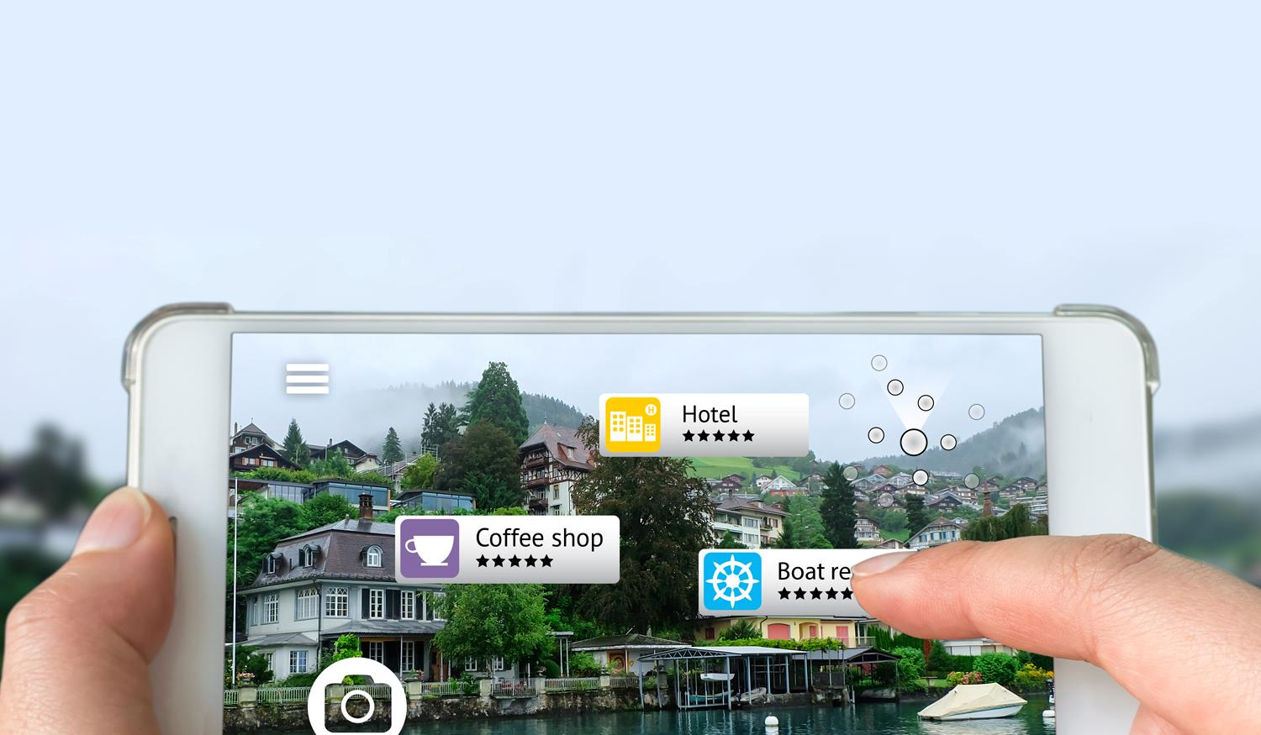
What can Computer Science lead to in the future?
Augmented Reality
By adding information to the world we can:
  add reviews on shops and cafés as we see them
  utilise a heads-up display when driving
  or play Pokémon Go
Notes:
Augmented reality (AR) was shown to full effect with children walking around trying to find Pokémon. However, in the future, it is likely that more functional uses will appear. This has already started to happen in aircraft and cars. In the future, AR is likely to be used in even more innovative ways.

Slide 14
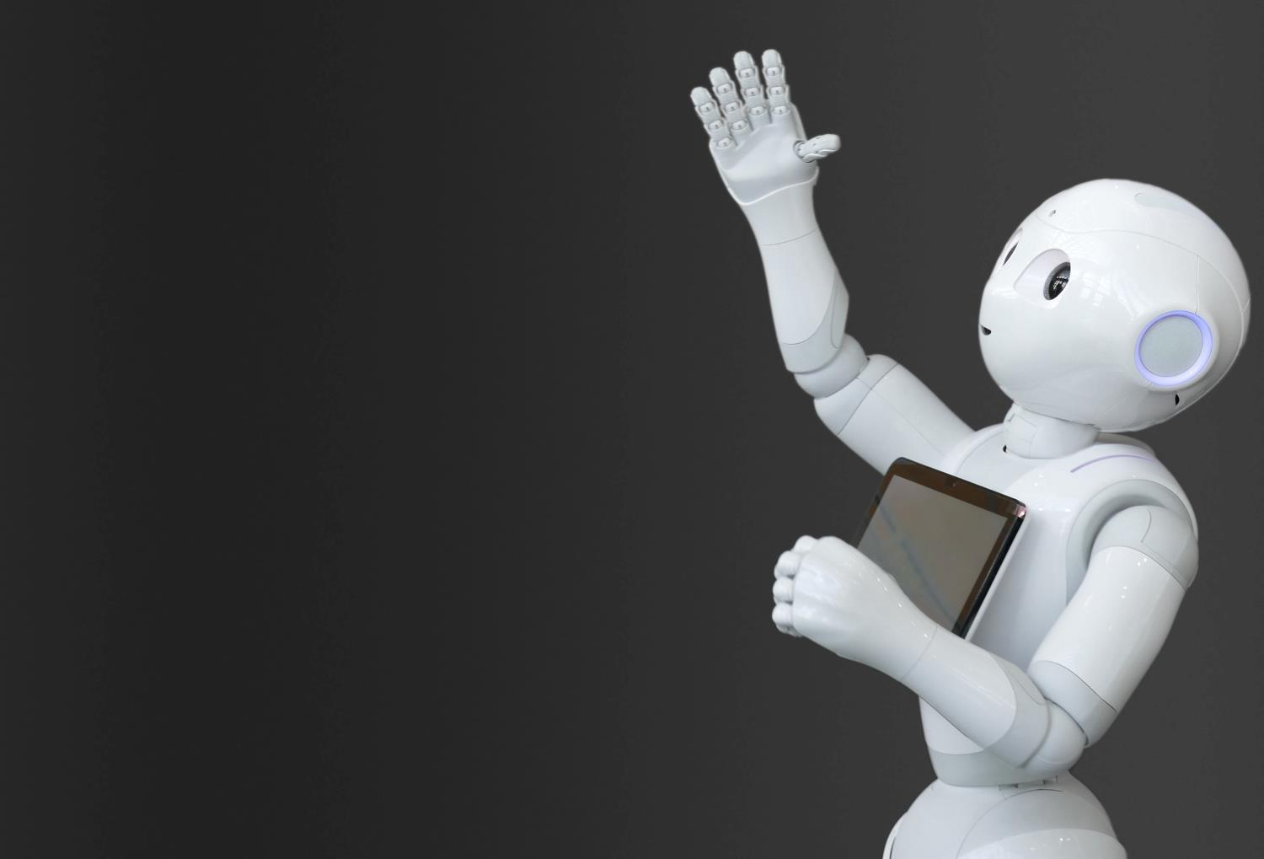
What can Computer Science lead to in the future?
Robotics
We are finding more
and more uses for robots
  Robotic vacuums in the home
  Car assembly
  Clearing mines in a war zone
To make a robot you
need to have a good understanding of how computers work and
how to program them.
Notes:
Robotics is becoming increasingly prevalent in our lives. Today they are cleaning our homes and cutting our lawns, but in the future, they may well be used in nursing homes to assist with care as well as analysing data.

Slide 15
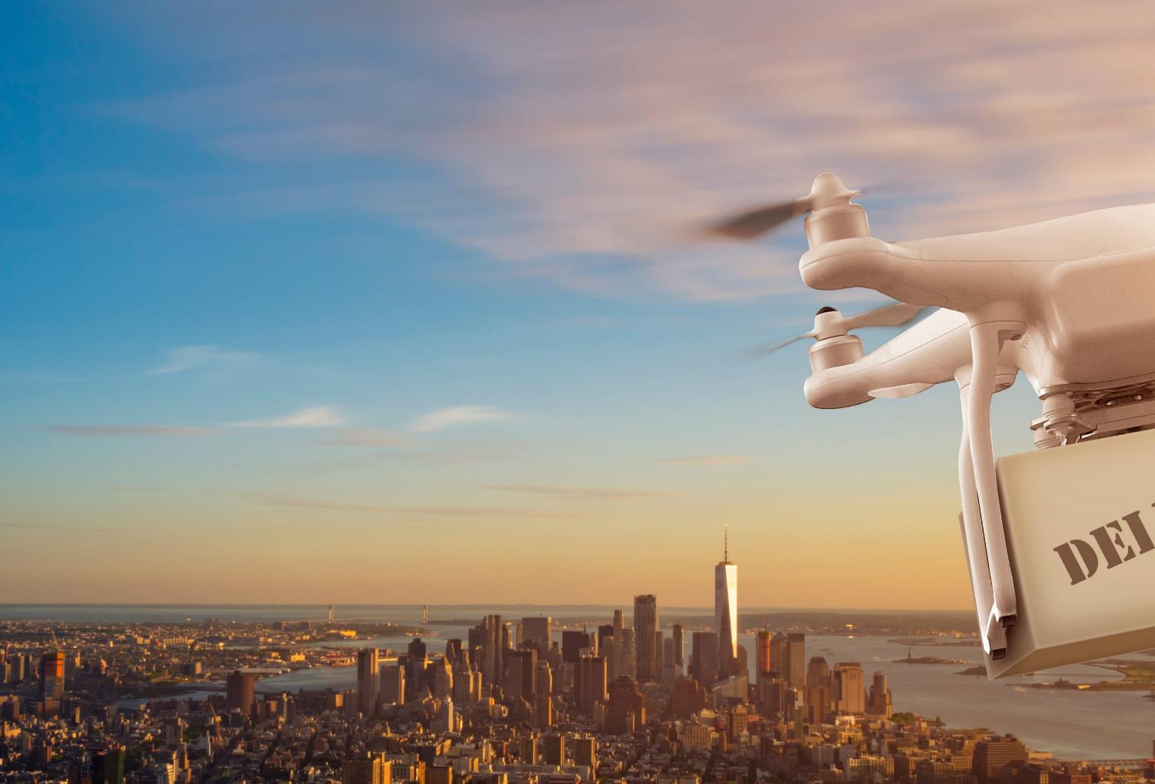
What can Computer Science lead to in the future?
Drones
Drones are already used for film making, search & rescue and surveying
  In the future, deliveries to
  your house could be made
  by drone
  They will need programmers
  to tell them where and when
  to go each day
Would you like to be a part of this future?
Notes:
Drones are currently a popular toy. They have many other uses such as filming landscapes for film and TV, checking damage to verify insurance claims, for farmers to check their fields/crops/livestock and for military purposes.

Slide 16
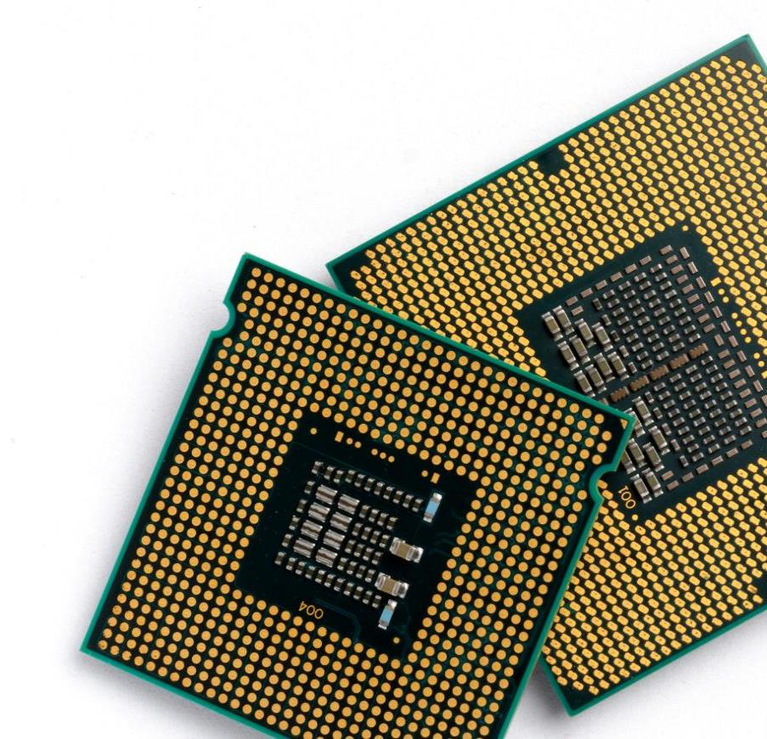
What can Computer Science lead to in the future?
CPU Design
The brain of any computer is the CPU
  The UK is a world leader of CPU design
  Made by ARM, who are based in Cambridge
  ARM chips are used in almost all mobile phones including iPhones
Are you the person who will design the next
generation of devices?
Notes:
CPU/Chip design is a highly specialised area of CS and Electronic Engineering. Although most people have heard of Intel, ARM is one of the major players in chip design and based in the UK. With more and more devices in the Internet of Things (IoT), this demand will only grow.

Slide 17
Where can I find any further information?
Speak to your Computing Teacher during a lesson
Speak to Mrs Dunning or Mrs Fisher during a break or lunch-time
Find out more about the specification at:
https://www.ocr.org.uk/qualifications/gcse/computer-science-j277-from-2020/
Notes:
If you are interested in studying Computer Science and want to find out more ask Mrs Dunning in your computing lesson.
Alternatively You could speak to Mrs Dunning or Mrs Fisher about the course at break or lunchtime.
Another option is to take a look at the exam board website.

