Slide 1


GCSE OPTIONS
“D&T Textiles”
Notes:
Insert Video

Slide 2


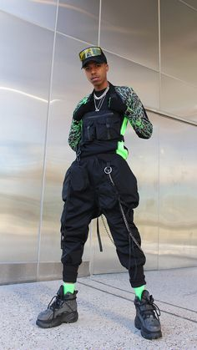
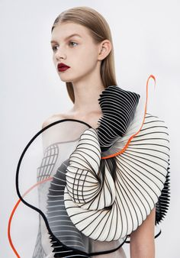
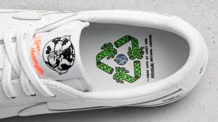
What is
Design Technology:
Textiles?
A qualification that teaches you….
How to design functioning products
How to make functioning prototypes
Why products are important for society and
the environment
Notes:
Insert Video

Slide 3

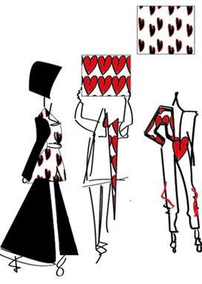
The course is split into:
30% Designing Skills, 30% Making skills, 40% Theory and knowledge
Designing Skills-
How to design to a design brief
How to present ideas using hand drawing and computer aided design (CAD) skills
How to annotate ideas to explain concepts
How to develop ideas into working solutions
Making Skills
How to join and manipulate by hand the
following materials-
Textiles
Plastics
Metals
Papers and cards
How to incorporate mechanisms and electronics into products
How to use Computer Aided Manufacture (CAM)
What will I do
and learn?
Notes:
Insert Video

Slide 4
The course is split into:
30% Designing Skills, 30% Making skills, 40% Theory and knowledge
Theory Skills & Knowledge
Properties and uses of the following materials:
Woods
Metals
Plastics
Textiles
Papers and cards
Manufacturing techniques
Environmental factors
Social and moral factors of design
Sustainability
Work of famous designers
Quality assurance and quality control
Types of power sources
Electronics
Mechanisms and movements
How to research
How to write a design brief and specification
How to analyse and evaluate
What will I do
and learn?
Notes:
Insert Video

Slide 5
Non Examination Assessment (NEA) 50% of the final GCSE Mark
A problem in the form of a project, set by the exam
board. You will have to design and then make a product
to solve the problem set.
This requires an extensive 25 slide A3 size portfolio of
research and design work. Also, a fully functioning
working product.
Formal Exam 50% 0f the final GCSE Mark
A written, 2 hour exam based upon the theory and
skills that you have learnt. Includes:
Section A- General knowledge of all material areas
Section B- Specialist knowledge of materials and components- Textiles/Papers and boards
Section C- Product analysis skills (be able to talk about how a product has been designed and why
How is it assessed?
Notes:
Insert Video

Slide 6

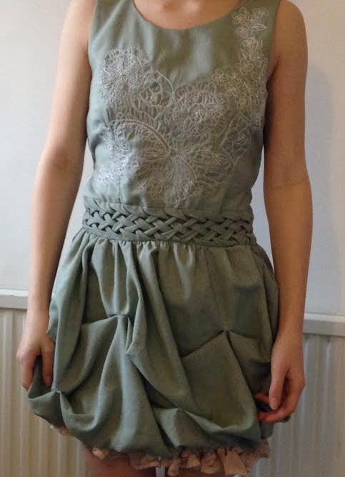
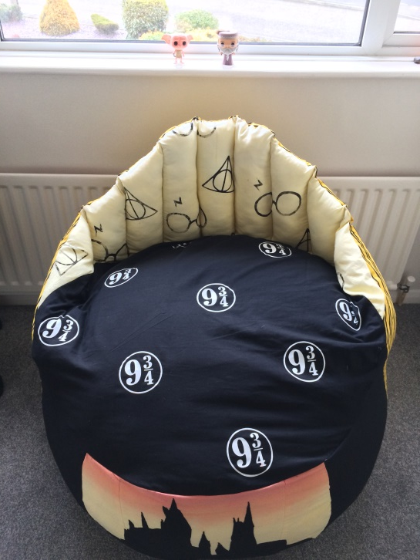
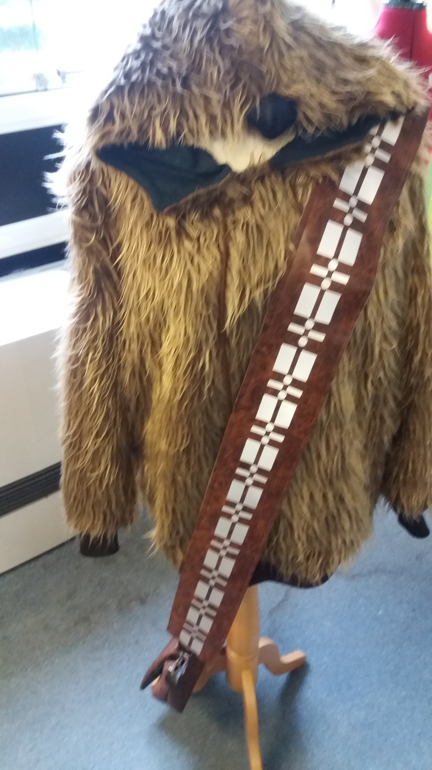
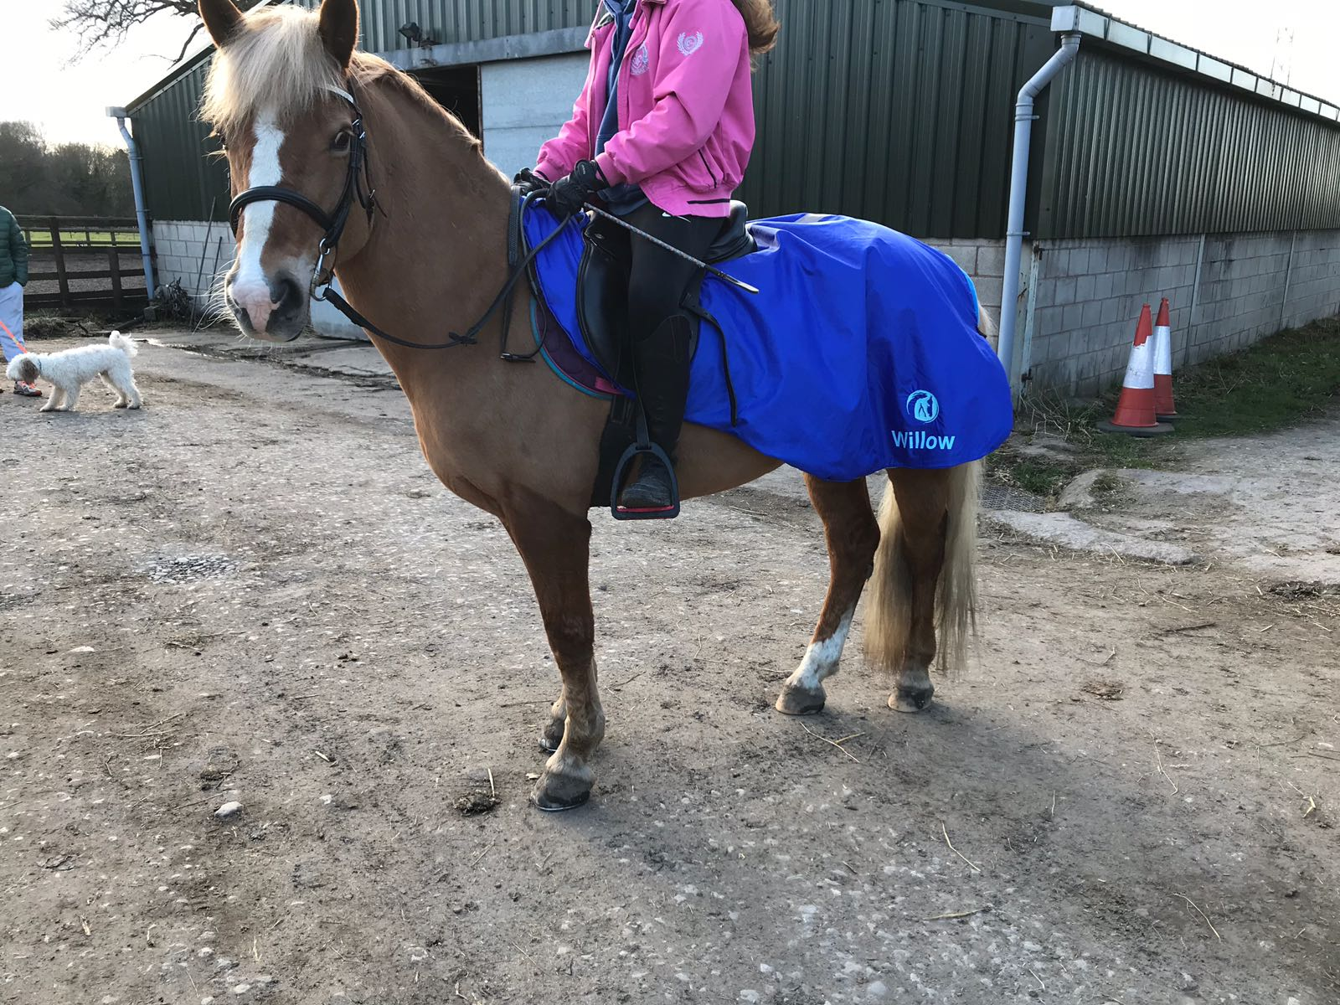
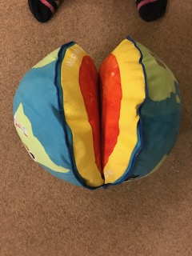
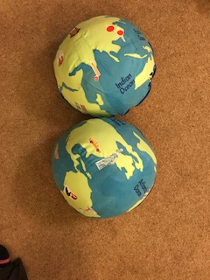
What could I design and make?
In previous years students have made the following products:
Seating
Bags
Interior furnishings
Dresses
Coats
Sportswear
Children's toys
Dog and horse coats
Notes:
Insert Video

Slide 7
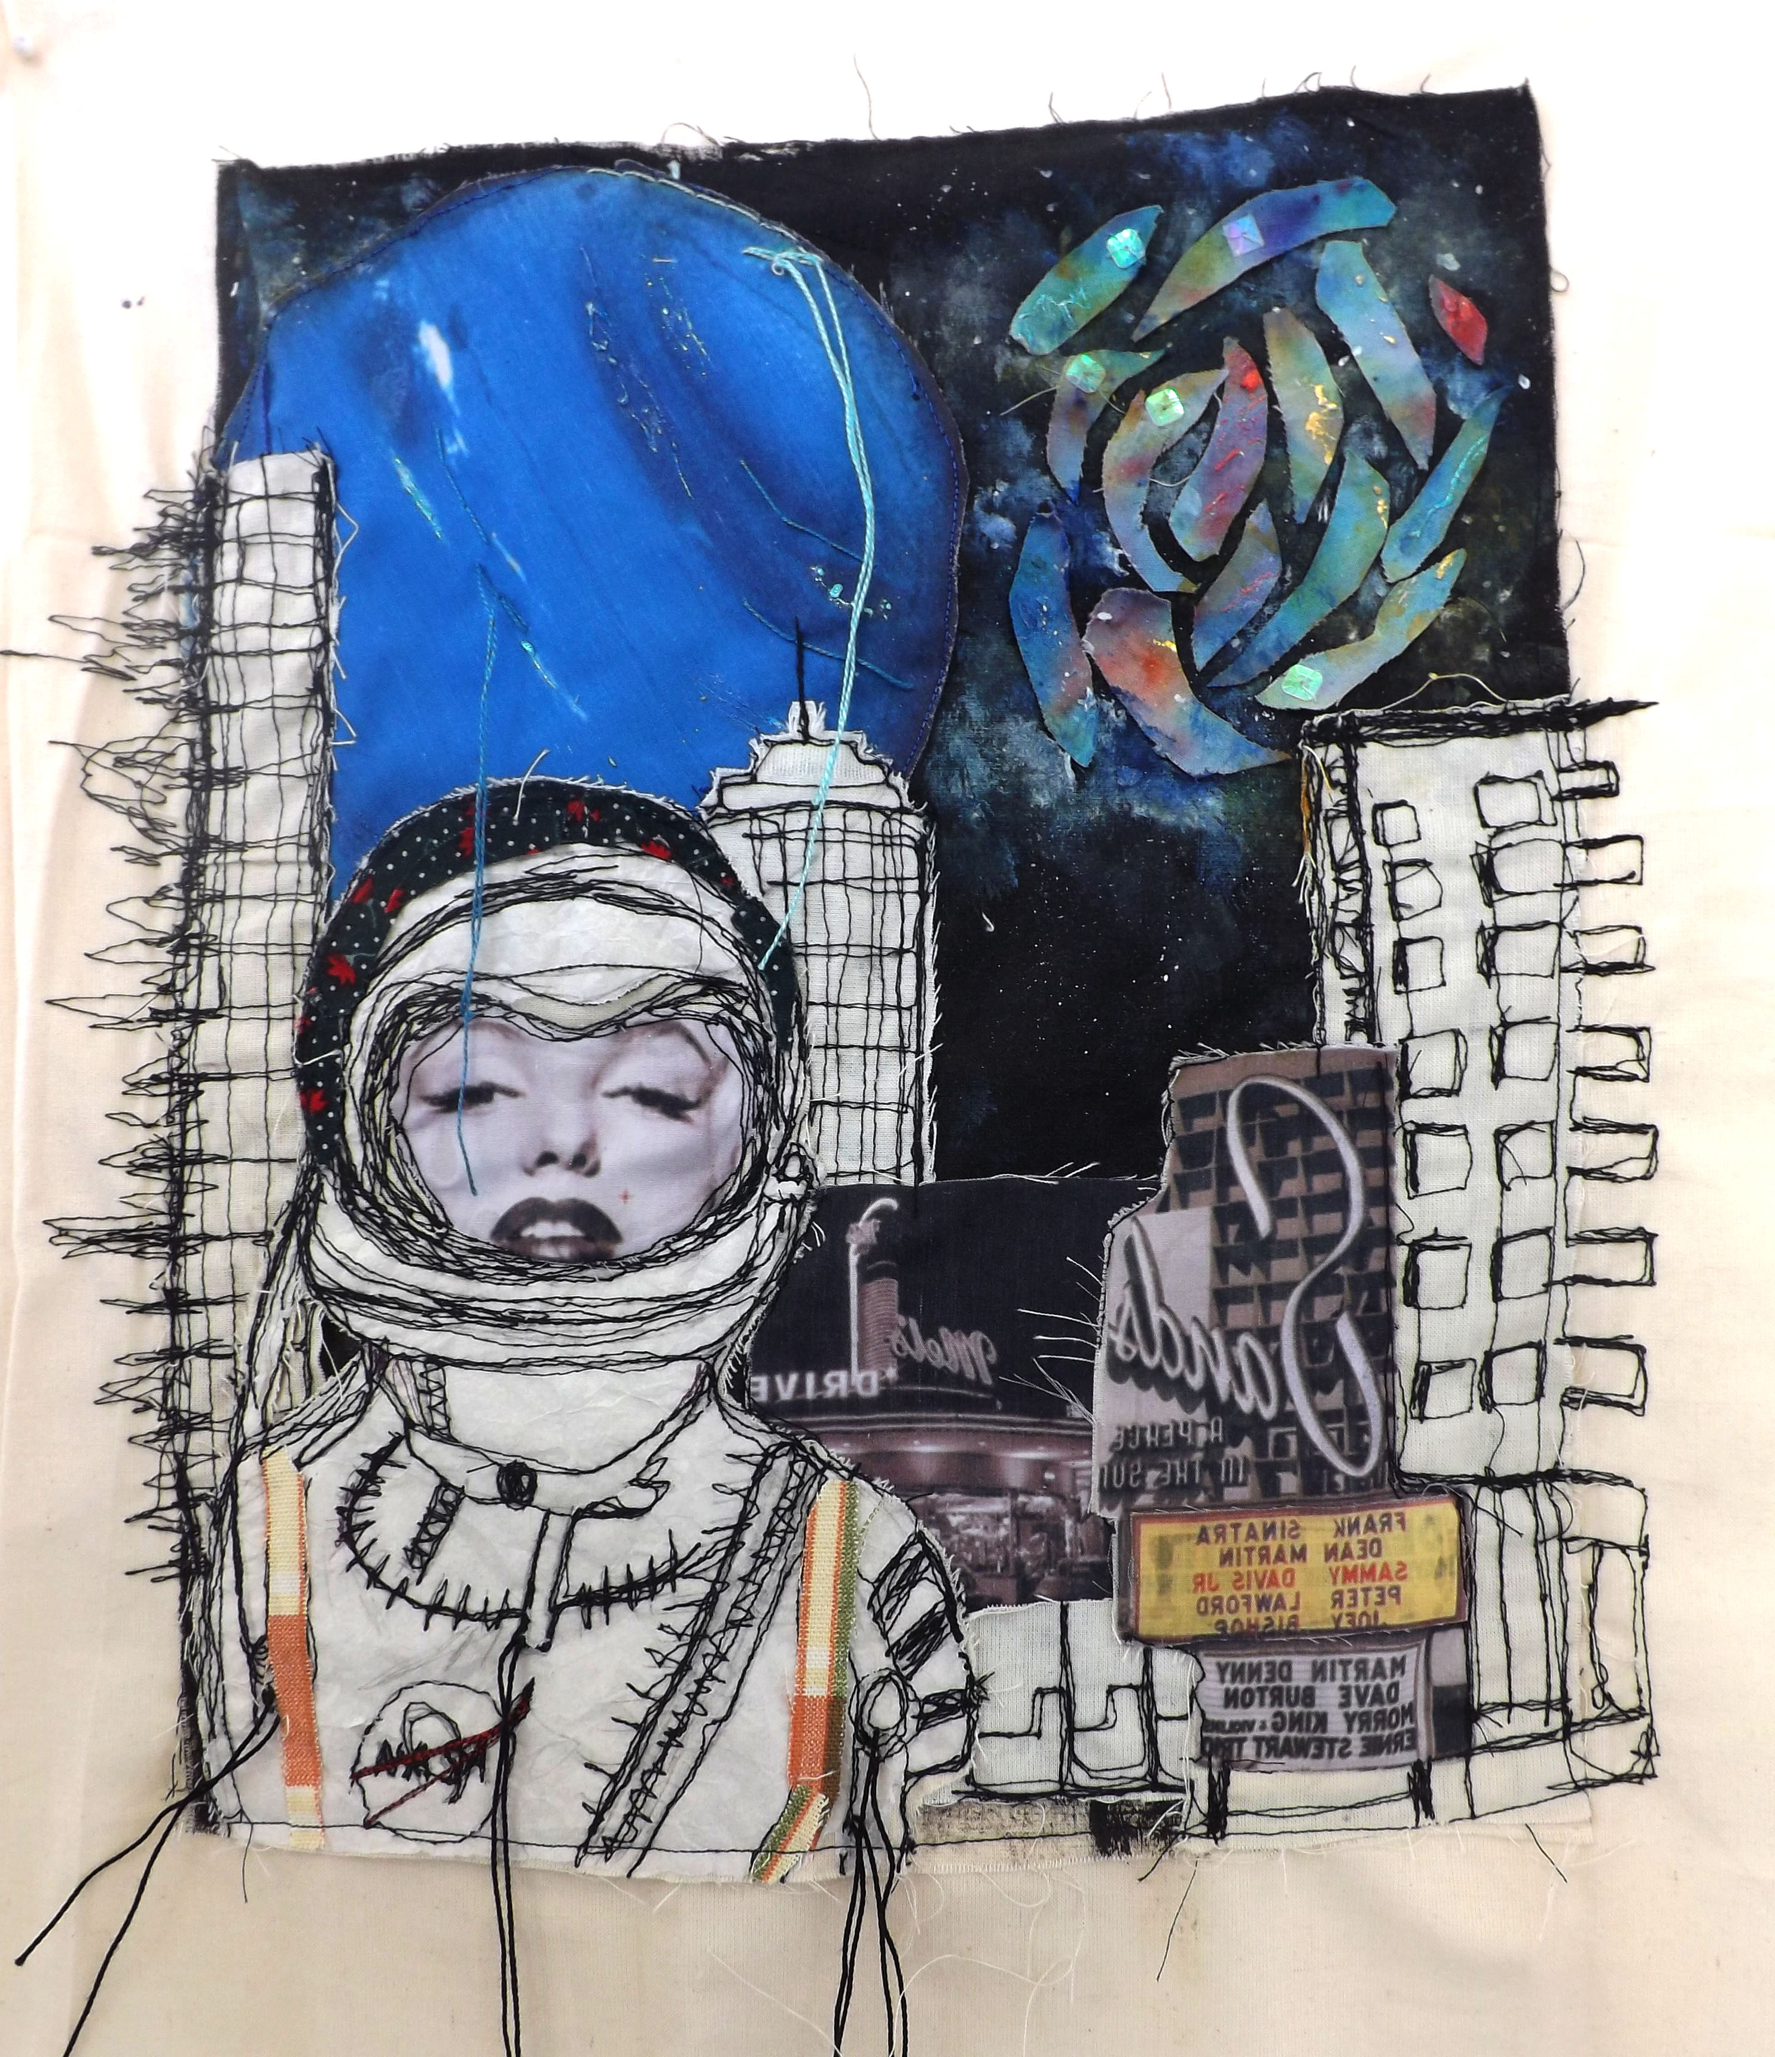
How will I learn the skills and theory?
The course is split into:
30% Designing Skills, 30% Making skills, 40% Theory and knowledge
Designing Skills:
Formal drawing techniques
Professional rendering techniques
Idea generation exercises
Use of Corel and Google sketch-up (CAD)
Theory & Knowledge:
Research projects
Written reports
Formal theory lessons
Focussed practical tasks
Exam questions
Making Skills:
Focussed practical tasks- hand skills
Focussed practical tasks- machinery
Mini projects- Fashion project
Packaging project
Interior project
Print project
Use of laser cutter and 3D printer (CAM)
Textiles techniques Sketch pad
Notes:
Insert Video

Slide 8

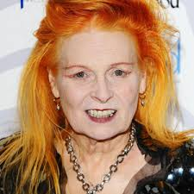
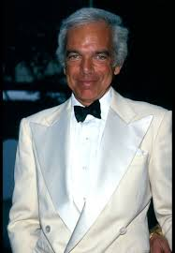

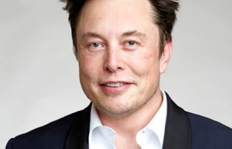
Further avenues of study can be pursued at degree level and beyond. Below is a list of just a few of the types of careers and degree subjects that can be supported by a GCSE Design Technology qualification followed by an A level Product OR Fashion and Textiles Design qualification.
Careers and further avenues of study…
Fashion designer
Independent designer-maker
Surface pattern designer
Graphic designer
Multi-media designer
Design marketing and business industry
Costume designer
Interior designer
Photographer
Product designer
Set designer
Design careers can be very lucrative, for example:
Vivienne Westwood Net Worth: $50 million
Ralph Lauren Net Worth: $6.8 billion
Jean-Paul Net worth : $300 million
Elon Musk Net Worth: $105 billion
Notes:
Insert Video

Slide 9
For further information
you can talk to:
Mrs Bell or Mrs Laurie at school
Please also visit dtteacher.org
to see what completing an
NEA project involves!
Further
information
Notes:
Insert Video

