Slide 1
GCSE OPTIONS
History
Notes:
Insert Video

Slide 2
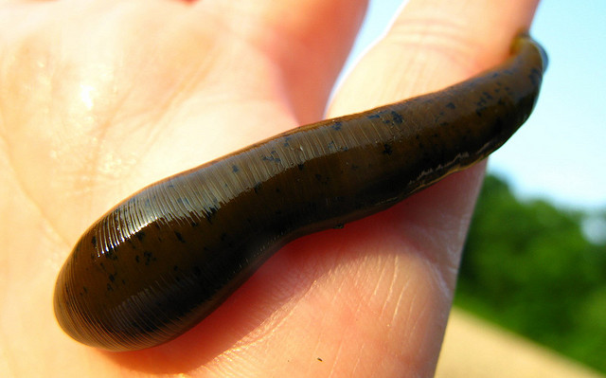
A Study in Development ‘Medicine Through Time’ (c1250 – present)
What will I study?
Notes:
Insert Video

Slide 3
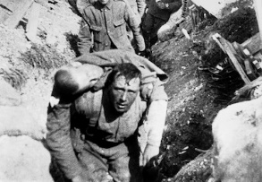
What will I study?
A study of a historical environment – ‘Medicine in the trenches of the First World War, 1914–18: surgery and treatment’
Notes:
Insert Video

Slide 4
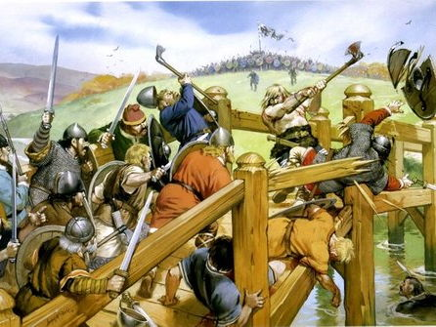
What will I study?
A British depth study –
‘Saxon and Norman England’
Notes:
Insert Video

Slide 5
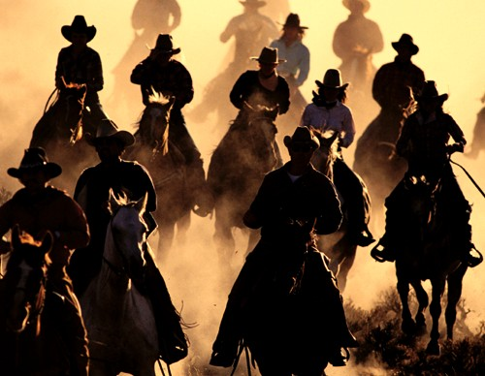
What will I study?
A period study –
‘The American West’
Notes:
Insert Video

Slide 6
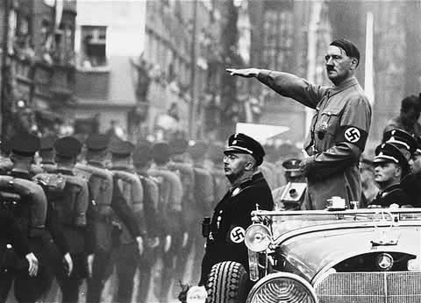
What will I study?
A modern depth study –
‘Weimar and Nazi Germany, 1918–39’
Notes:
Insert Video

Slide 7
How will I be assessed?
Three exams in the summer of Year 11:
Paper 1 – Medicine 1 hr 15 min 30%
Paper 2 – Saxon and Norman England and The American West 1 hr 45 mins 40%
Paper 3 – Weimar and Nazi Germany 1 hr 15 min 30%
Notes:
Insert Video

Slide 8
Why should I pick History?
You enjoy it! OWS Historians enjoy investigating the past and learning about different cultures and periods in History.
To develop your historical detective skills through the analysis of evidence and sources.
To build on your understanding of how events can be interpreted in different ways and be a critical higher level thinker.
To develop your communication skills through discussion and essay style assessments.
Notes:
Insert Video

Slide 9
What can History lead to in the future?
Notes:
Insert Video

Slide 10
Where can I find any further information?
Speak to your History Teacher during a lesson
Speak to Mr Grainger, Mrs Warner, Mr Smith or Mrs Lawson during a break or lunch-time
Find out more about the specification at: https://qualifications.pearson.com/en/qualifications/edexcel-gcses/history-2016.html
Notes:
Insert Video

