Slide 1
Throughout Key Stage 3 you have the opportunity to study some of the most famous events and people from our nation’s history. 1066 and the Battle of Hastings, The Black Death, the reigns of Henry VIII and Elizabeth I, World War I and II as well as so much more!
We have also provided you with opportunities to study the History of people who often appear lost in traditional history books, including both the History months for Black people, women and the victims of the Holocaust.
June is Pride month, where LGBTQ+ people celebrate their identities. The history of LGBTQ+ people is often the most hidden of all.

Slide 2
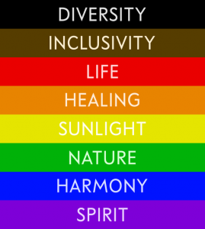
Why is studying LGBTQ+ History so difficult?
LGBTQ+ stands for Lesbian, Gay, Bisexual, Transexual, Questioning and a range of people who would identify as having a non-conforming identity.
This a modern term that people in the past would not understand, however this doesn’t mean that they didn’t exist. Throughout history there has been people who would fit into this group but they had to live their lives in secret.
This was because homosexuality was illegal in Britain until 1968. The playwright Oscar Wilde was imprisoned with hard labour in the 19th Century and mathematician Alan Turing experienced chemical ‘treatments’ because both were found guilty in British courts.
In Nazi Germany 15,000 gay men were sent to concentration camps where many died. Those who didn’t were sent to prison after the war even though the Nazis had been defeated!
As with all studies of the past, we as Historians will have to piece together the lives of the famous and the not so famous from the sources we have available.

Slide 3
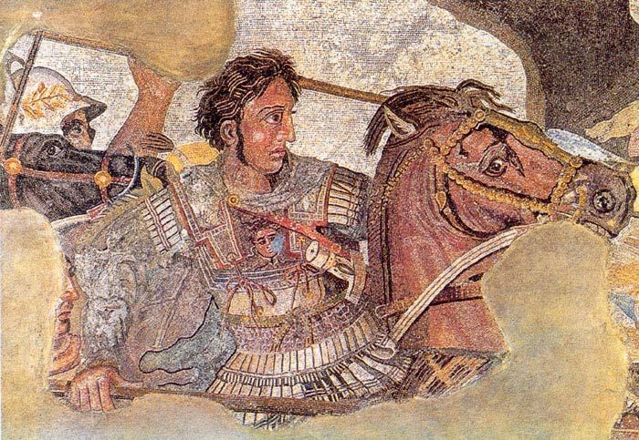
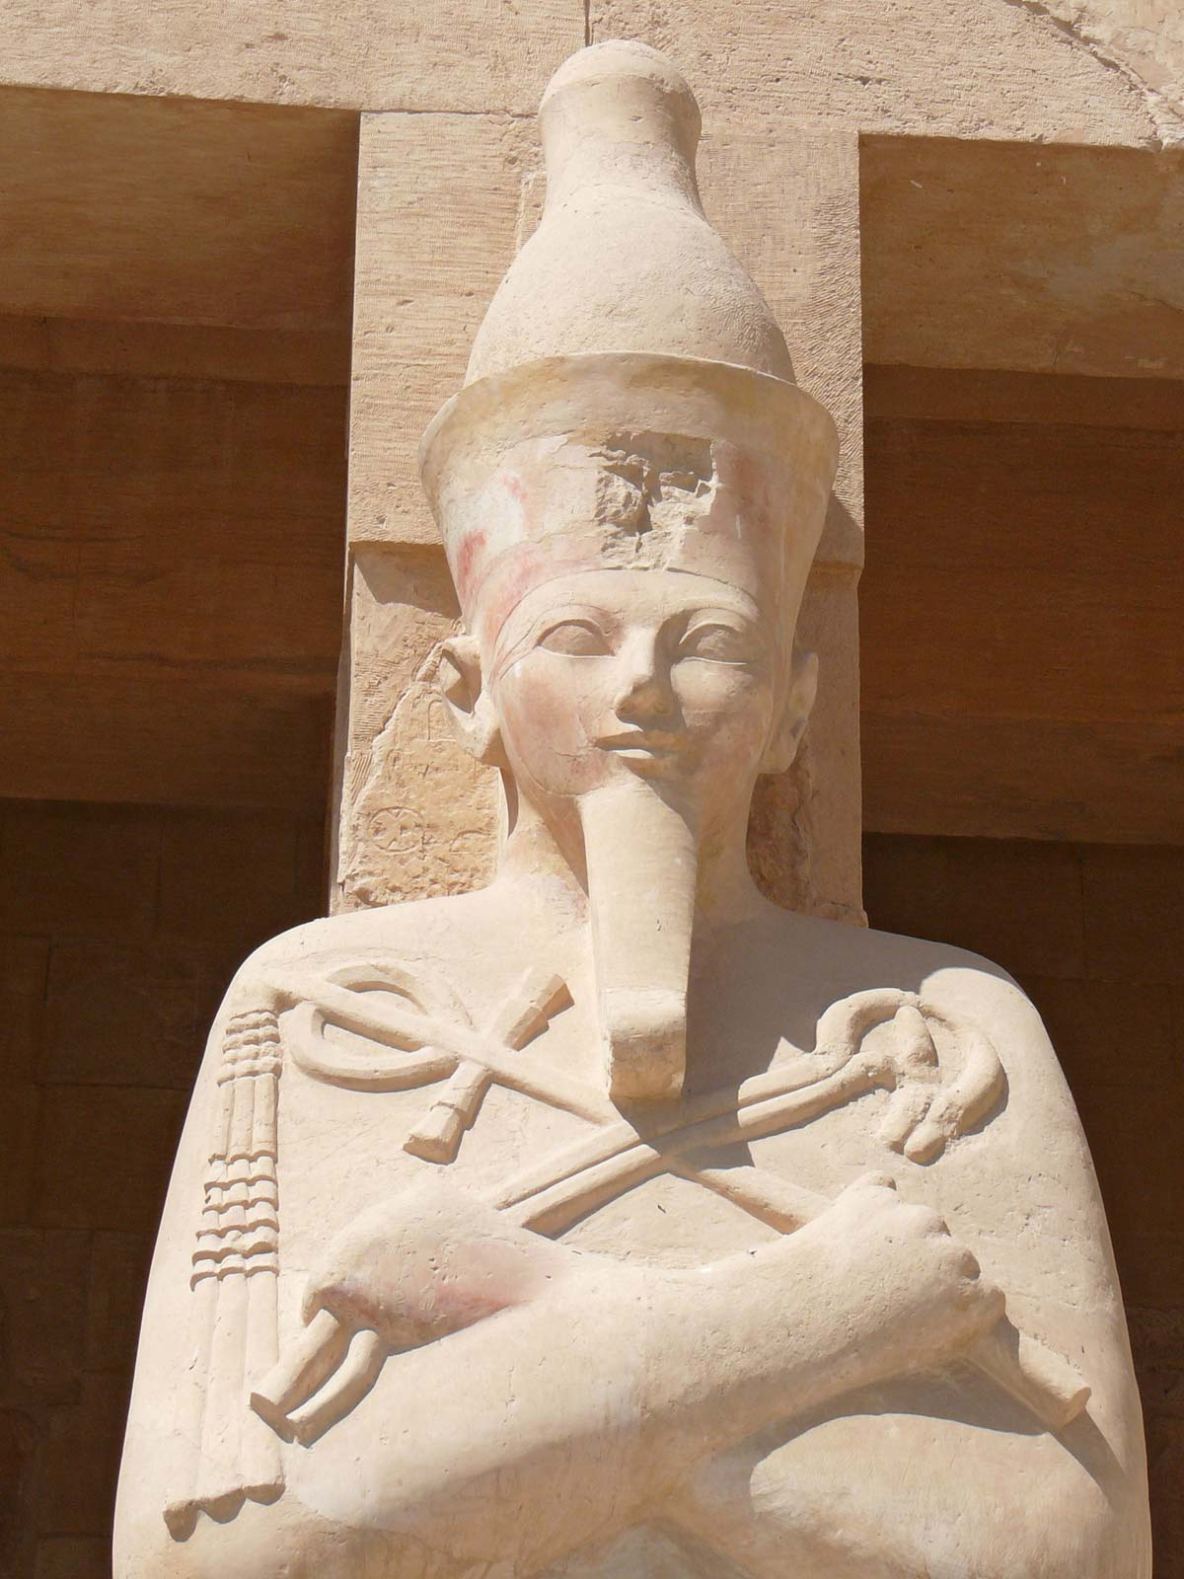
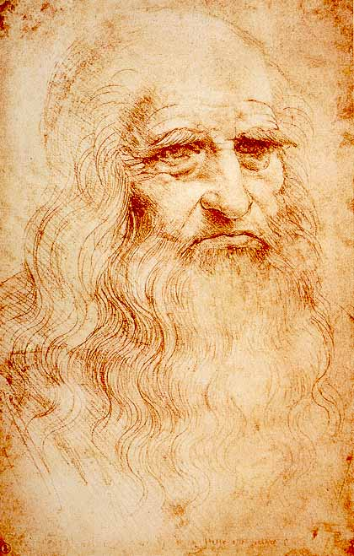
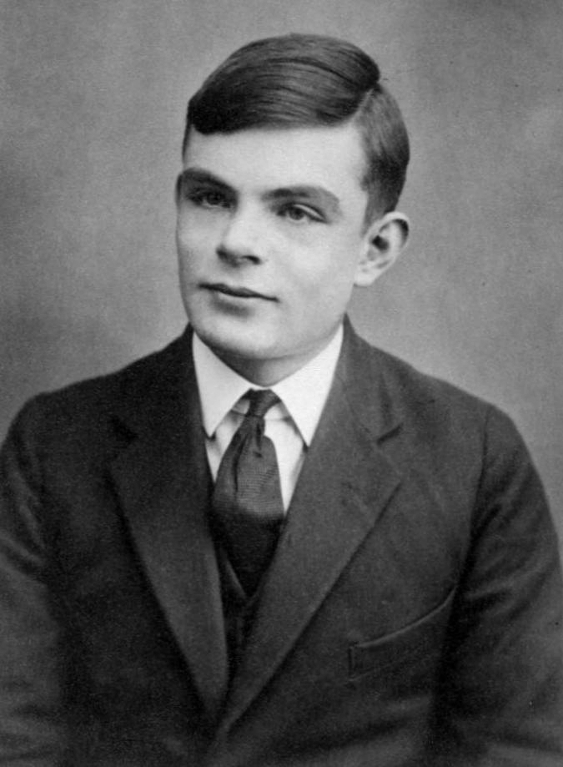
Examples of LGBTQ+ Lives from History
How many of these have you heard of?
Alexander the Great
Alexander the Great was an ancient Macedonian ruler and one of history’s greatest military minds who, as King of Macedonia and Persia, established the largest empire the ancient world had ever seen.
Queen Hatshepsut
She was an Egyptian pharaoh but unlike other female rulers Hatshepsut was always depicted wearing men’s clothing, and she frequently was drawn with a male body. Her descendants Thutmose III later tried to remove all historical reference to her.
Leonardo Da Vinci
One of the most famous artists of all time having painted both the Mona Lisa and the Last Supper.
Alan Turing
Brilliant mathematician who helped to crack the Nazi Enigma code during World War II and whose work led to the first computer.

Slide 4
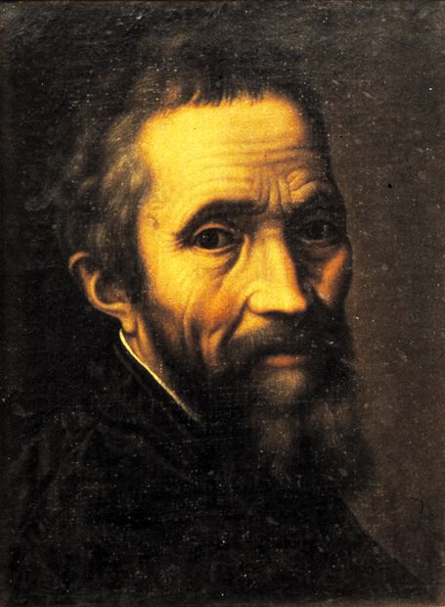
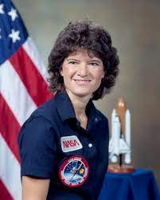
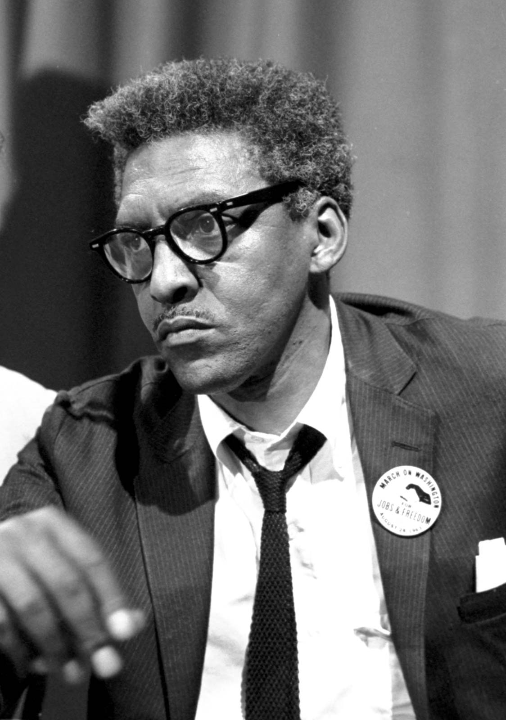
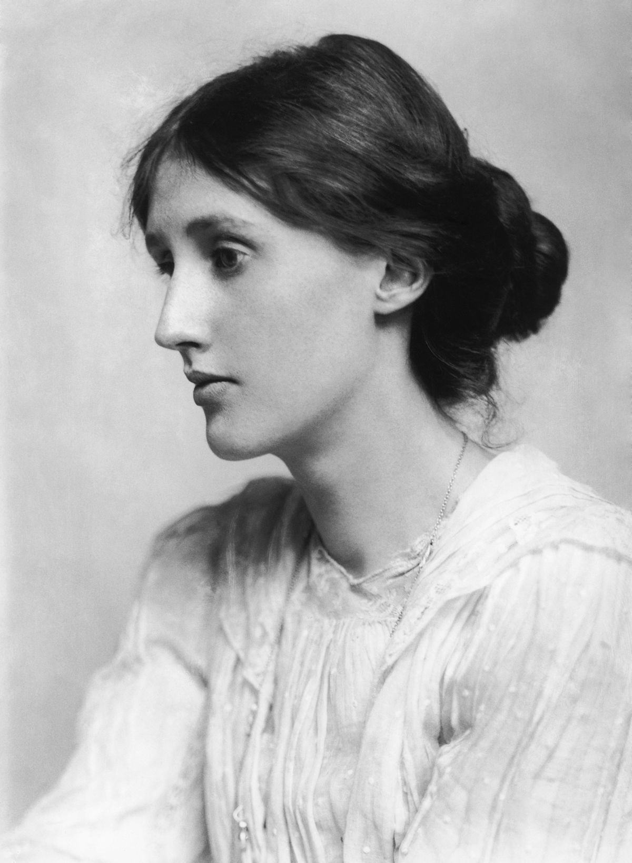
Examples of LGBTQ+ Lives from History
How many of these have you heard of?
Bayard Rustin
An American activist who campaigned for equal rights. He was the chief organiser of the 1963 March on Washington where Martin Luther King Jr delivered his "I Have a Dream" speech.
Virginia Woolf
A famous 19th Century novelist. Woolf openly
discussed the rights of women,
also known for her contribution to mental health
visibility.
Michelangelo
Another hugely talented Renaissance artist that painted the Sistine Chapel and sculpted the David.
Sally Ride
Astronaut and engineer, who
became the first American woman and the youngest American astronaut to travel to space by 1983.

Slide 5
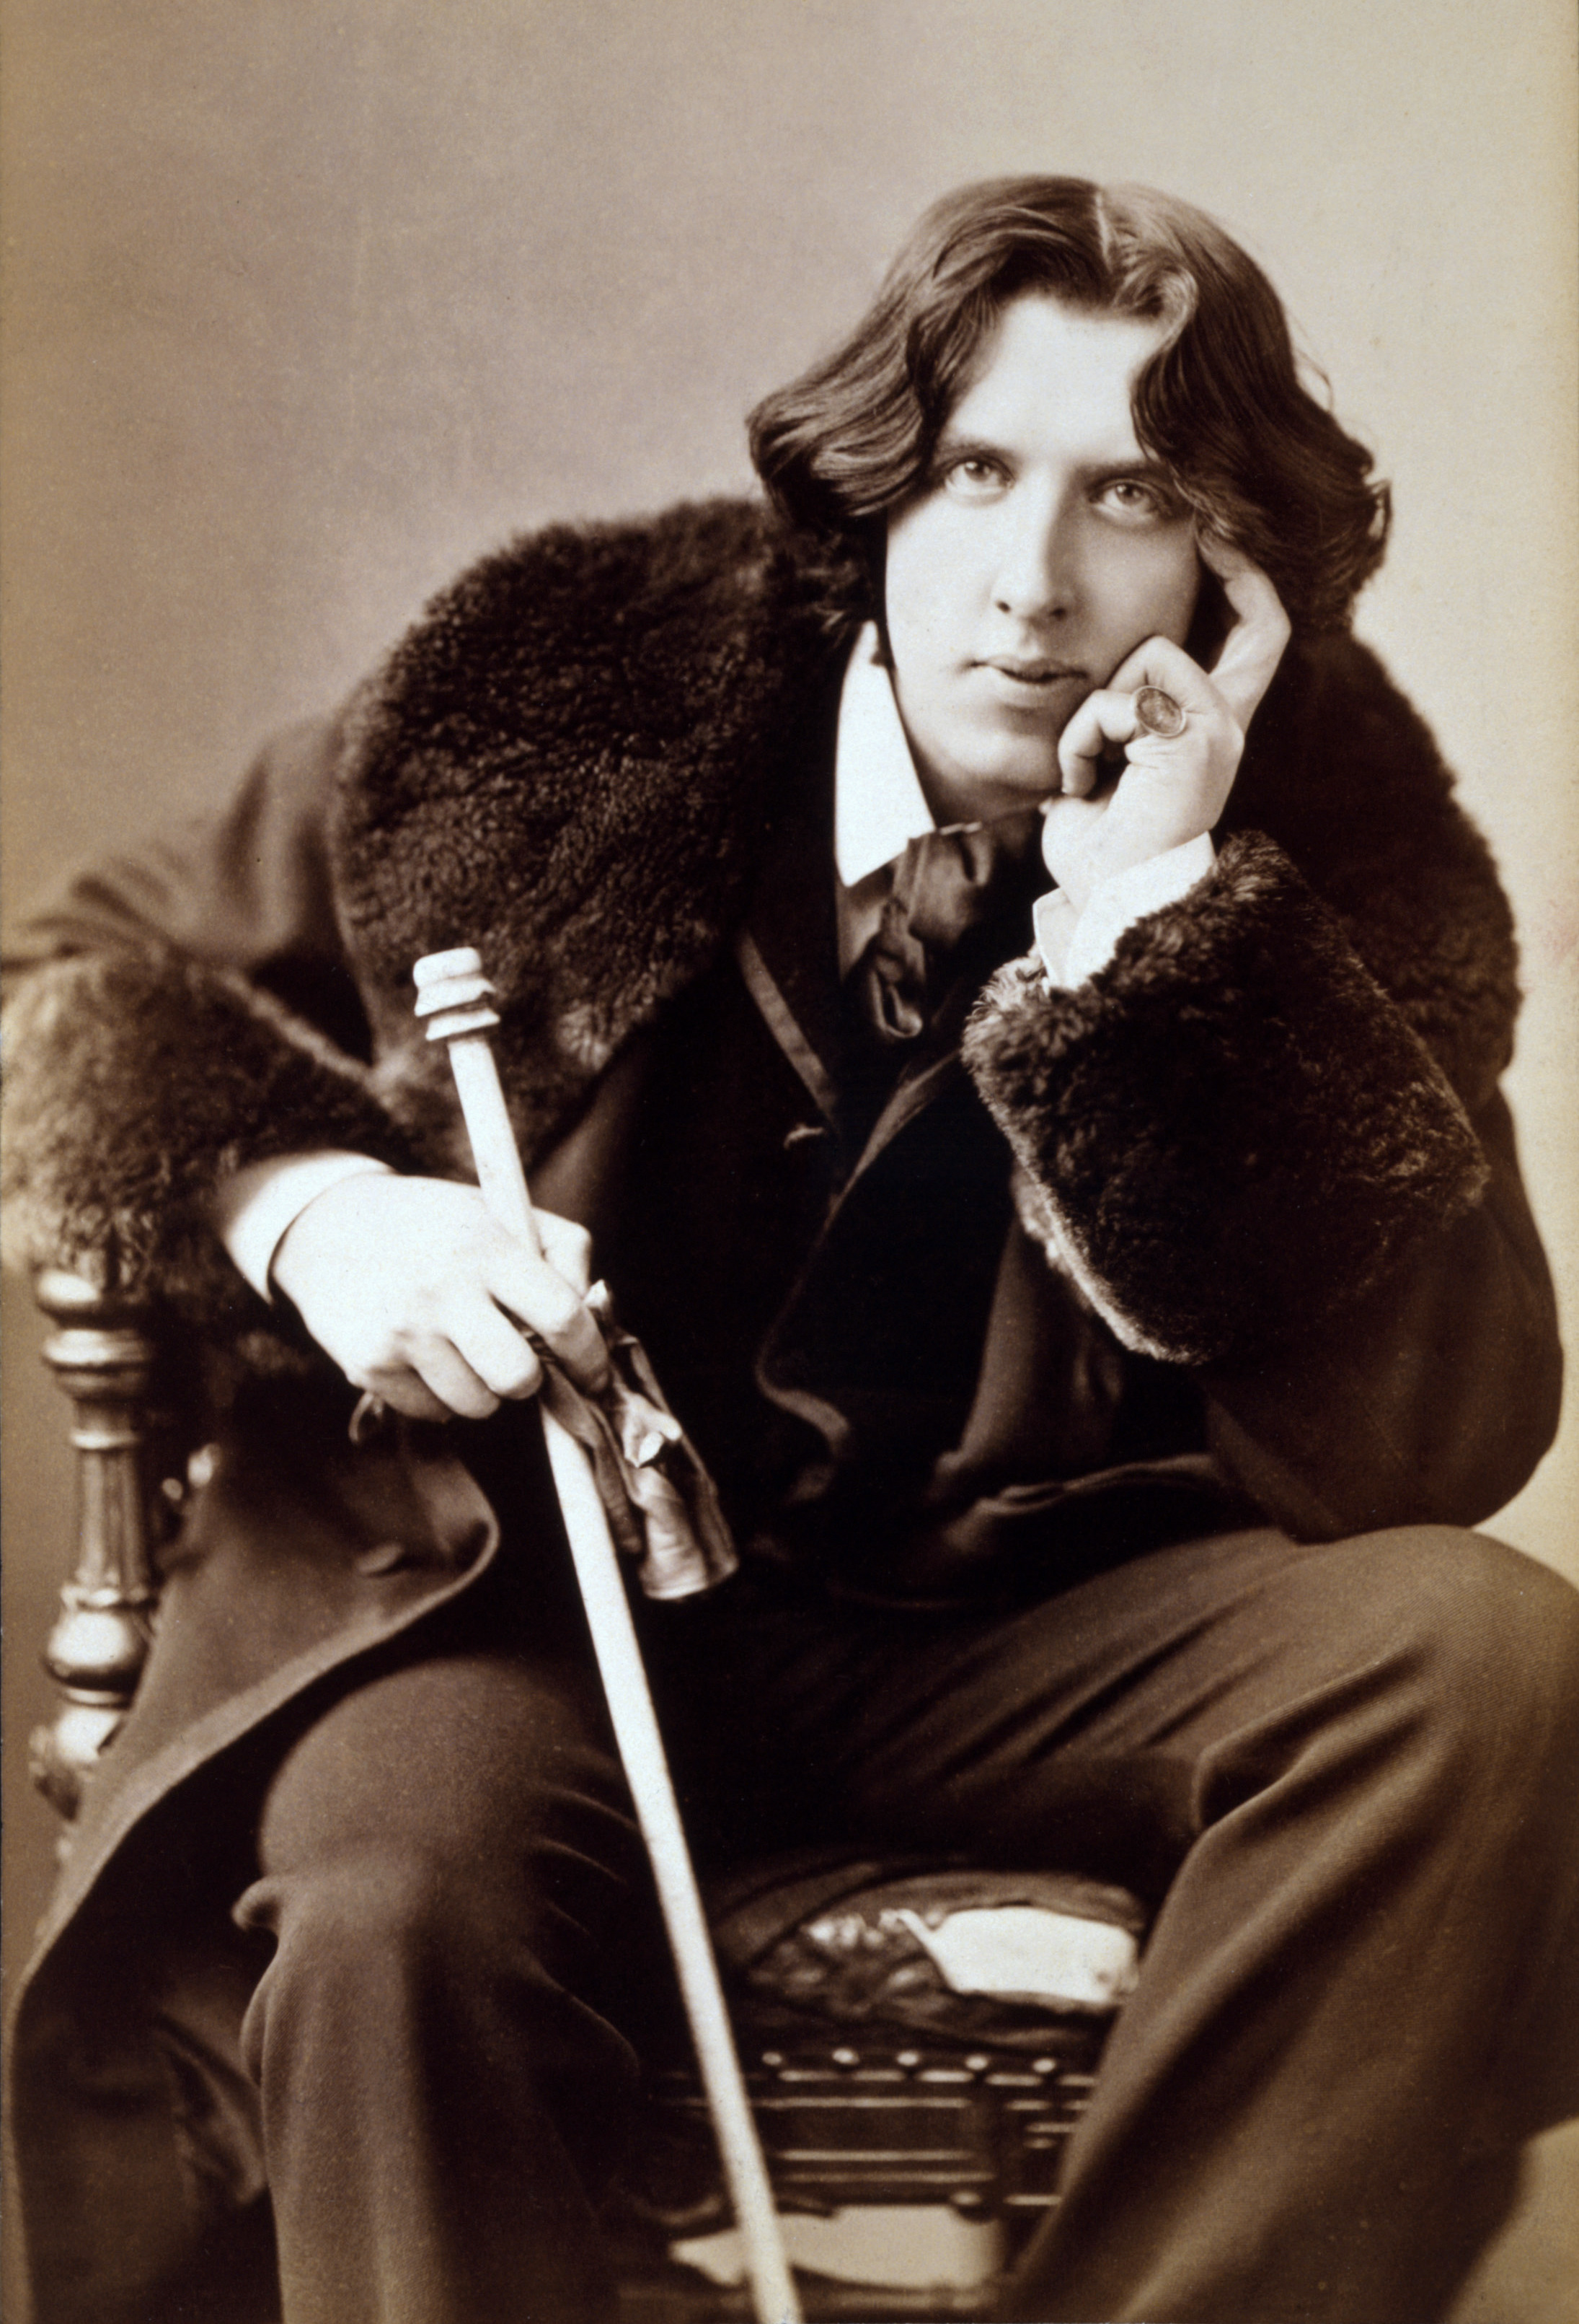
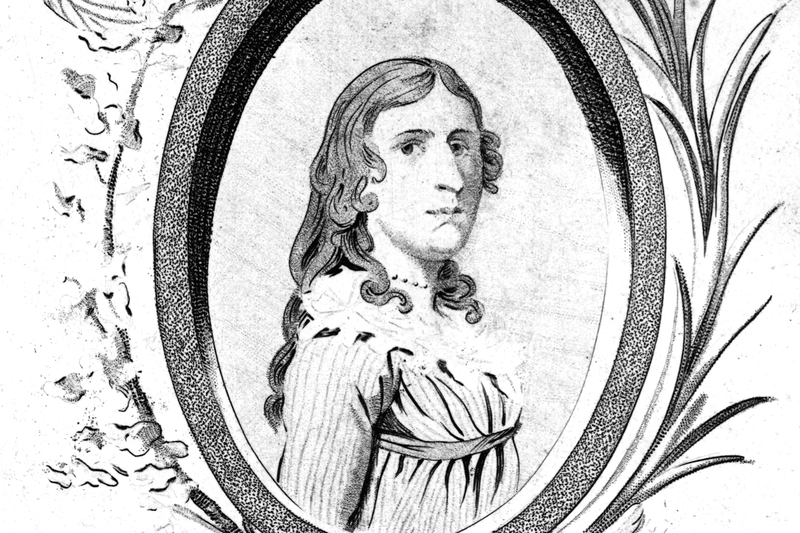
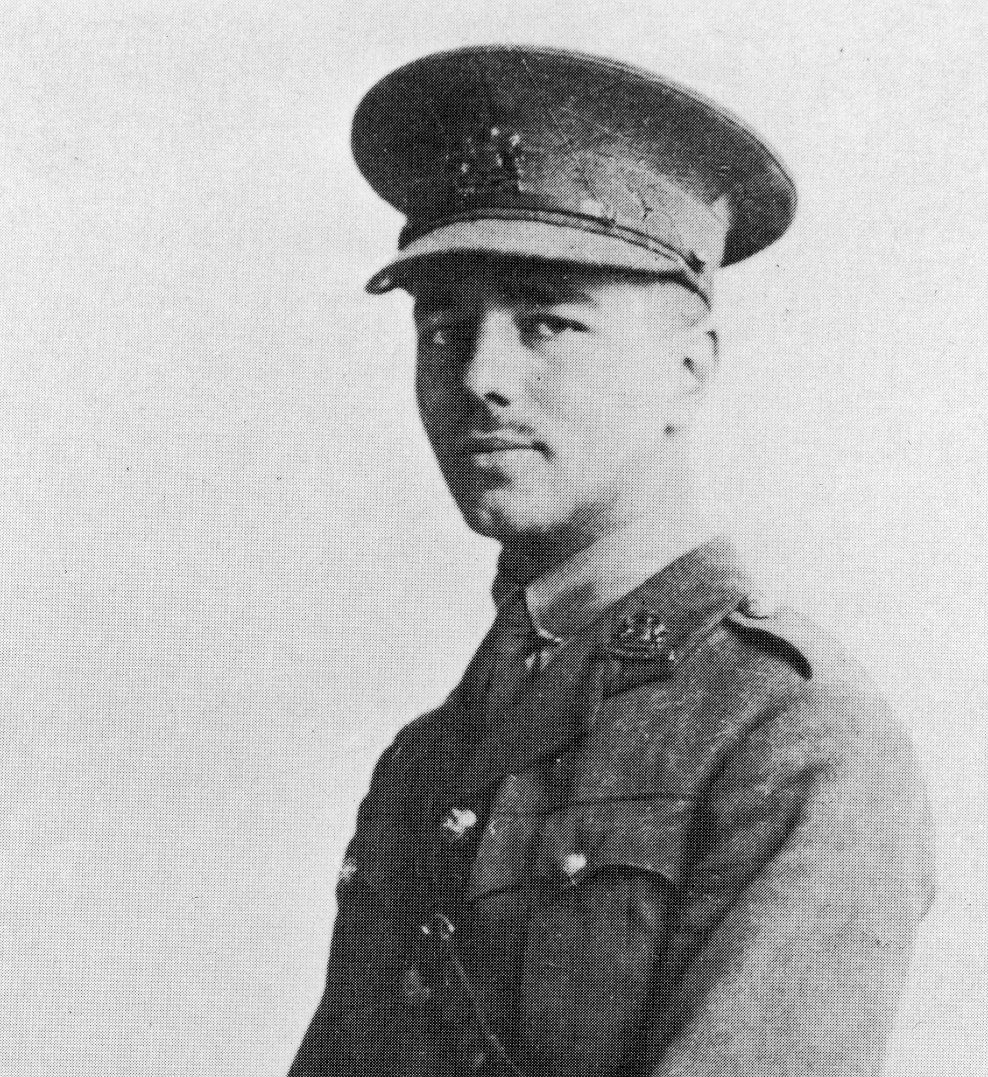
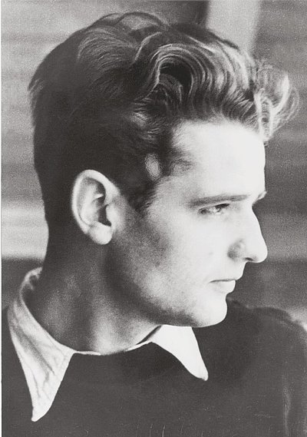
Examples of LGBTQ+ Lives from History
How many of these have you heard of?
Oscar Wilde
was a 19th Century Irish poet and playwright, known for
his novel "The Picture of Dorian Gray" and play "The Importance of Being Earnest".
Deborah Sampson
An American woman who dressed and lived as a man to be able to fight for the USA in the War of independence against Britain.
Wilfred Owen
Shropshire born war poet who served in World War I. His poetry brought to life the battlefields of World War I. He died on the 4th November 1918 7 days before the war ended.
Hans Scholl
Along with his sister Sophie, Hans was a founding member of the White Rose resistance group against Hitler. Executed in 1943.

Slide 6
Commemorating a great life
Task –
In 1978 the rainbow flag was first used by the LGBTQ+ community.
Choose one of the individuals from the previous slides and research their achievements (remember their sexuality was only one aspect of their lives, so focus mainly on what they achieved or what was special/interesting about them).
Then on your rainbow sheet – fill in one thing you have found out in each of the sections on the rainbow before colouring it.
In the clouds write down any challenges, problems or difficulties they faced. (If the evidence isn’t clear on this, suggest possible challenges yourself. Just make it clear these are your ideas rather than facts!)
Finally include a picture or their name in the central arch of the rainbow.
Challenges/problems
Achievements/facts
Name/Picture
Remember – When researching the evidence might be unclear, contradictory or incomplete. Always try to use more than once source of information, so that you can test how accurate it is!

