Slide 2
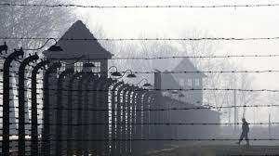
27th January is Holocaust Memorial Day. This date marks the day when the most infamous of the Nazi death camps - Auschwitz was liberated by Russian soldiers. This year is the 77th anniversary.
The Holocaust occurred during World War II. Hitler and the Nazis murdered six million Jews during the Holocaust, alongside other groups that were persecuted.
Although the Nazi Holocaust was the worst in history there have been other more recent genocides in Cambodia, Rwanda, Bosnia and Darfur. The 27th January is also used to remember them.
The Holocaust Memorial Trust says – “Our world often feels fragile and vulnerable and we cannot be complacent. Even in the UK, prejudice and the language of hatred must be challenged by us all.
HMD is for everyone. Each year across the UK, thousands of people come together to learn more about the past and take action to create a safer future.”

Slide 3
Key Questions about the Holocaust
Why did the Holocaust happen?
In 1933 Hitler and the Nazis came to power in Germany.
They had the racist belief that some races were superior to others.
Hitler blamed the Jews for all the problems that Germany was experiencing at the time, even though it wasn’t true.
It was easy for Hitler to pick on groups of people who were seen to be different.
What happened?
Laws began to be passed that removed rights from Jewish people. These included being banned from a range of jobs and not being allowed to use the same facilities as other people. Jewish books were also burnt.
Jewish people were made to wear the yellow star, so they could be easily identified.
The Nazis acted violently towards Jews and their property. On the 9th November 1938 7,500 Jewish business were destroyed and 100 people killed in ‘The Night of Broken Glass’.
Shortly after this, Jewish men, women and children were sent to concentration camps in Eastern Europe. 6 Million people were either murdered, died through disease, or were starved and worked to death.
How did it end?
When the Nazis were defeated in 1945 - Russian, British and American soldiers freed the remaining Jews. Some Jews had also already freed themselves.
What is the message for today?
The Holocaust is a reminder of what happens when people hate others because they are different. It also reminds us all to stand up and challenge racism and hate in our society.

Slide 4
Holocaust Memorial Day 2022 is – ‘Light the darkness’
What can we do?
The Holocaust Memorial Trust says:
At 8pm, get ready to Light the Darkness with us. Households across the UK will be lighting candles and safely putting them in their windows to:
Remember those who were murdered for who they were
Stand against prejudice and hatred today
Light a candle and put it in your window at 8pm on 27th January 2022 (if you are able to do so safely. Remember to check with your parents and don’t leave lit candles unattended.)
#HolocaustMemorialDay #LightTheDarkness
Please take a photo of your candle and we will create an OWS collection of pictures that ‘Light the darkness’.
Please send them to:
Ben.Grainger@oldburywells.com
‘We will continue to do our bit for as long as we can, secure in the knowledge that others will continue to light a candle long after us.’
Gena Turgel, survivor of the Holocaust (1923-2018)

Slide 6
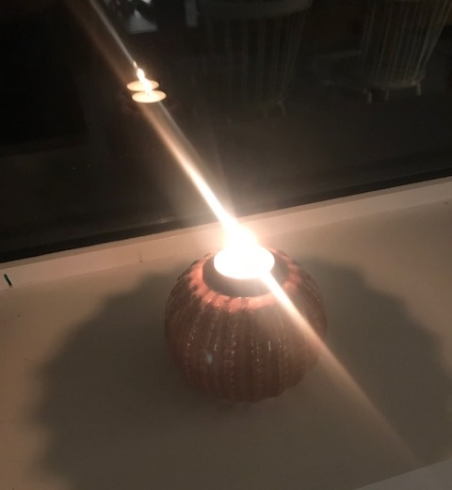
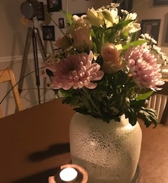

Slide 7
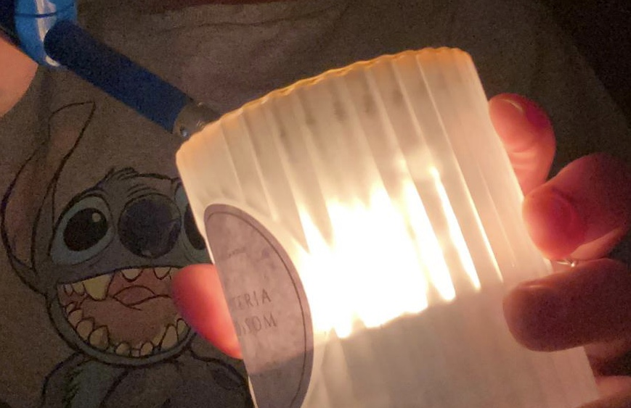

Slide 8
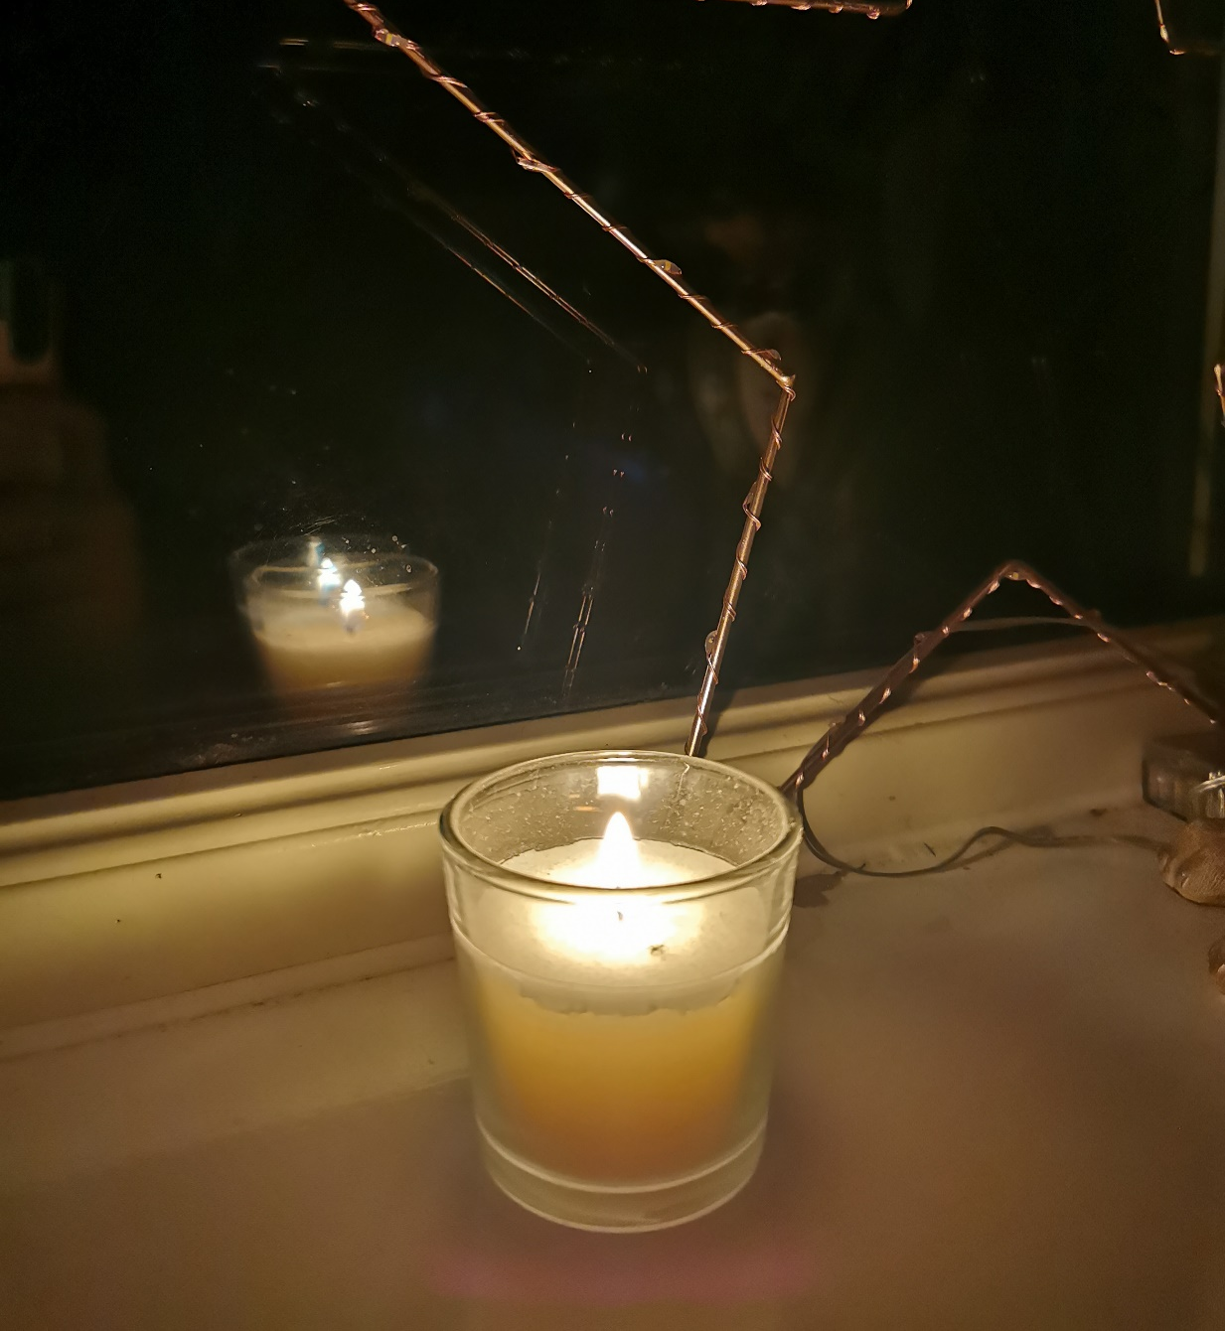
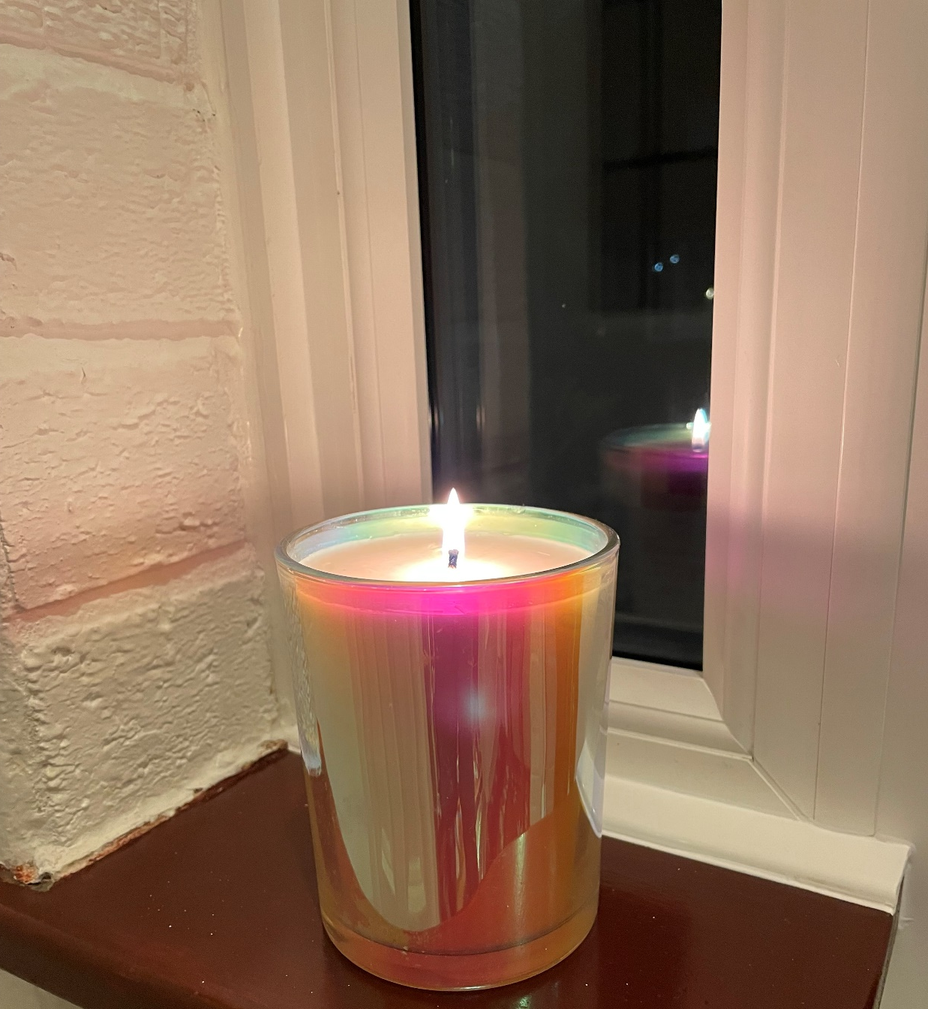

Slide 10
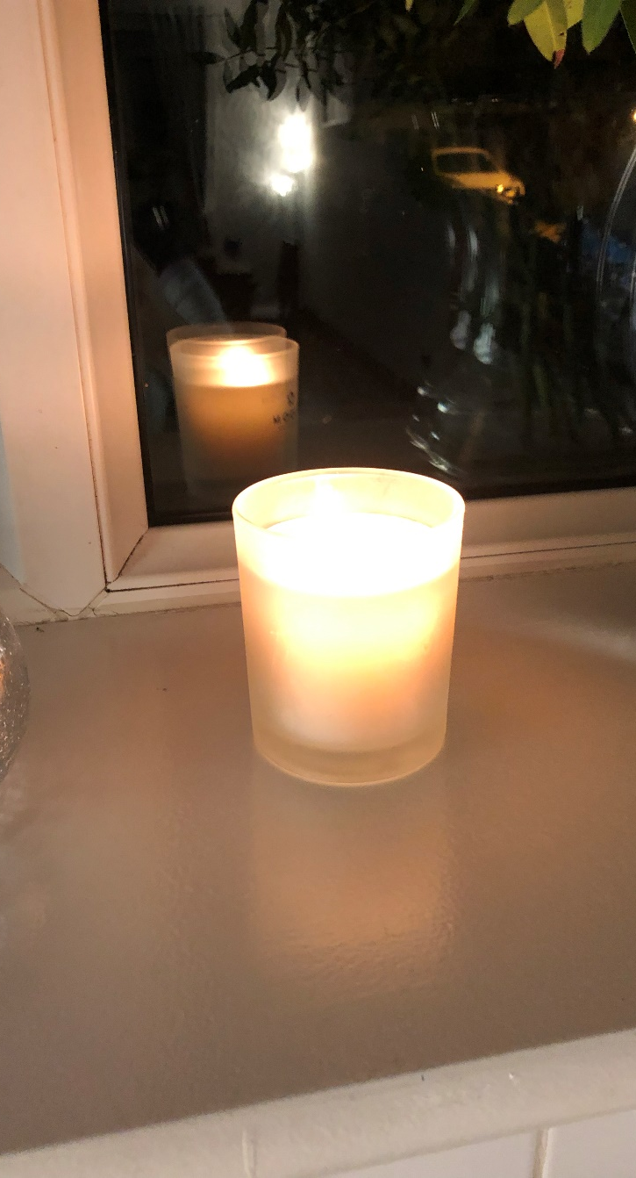
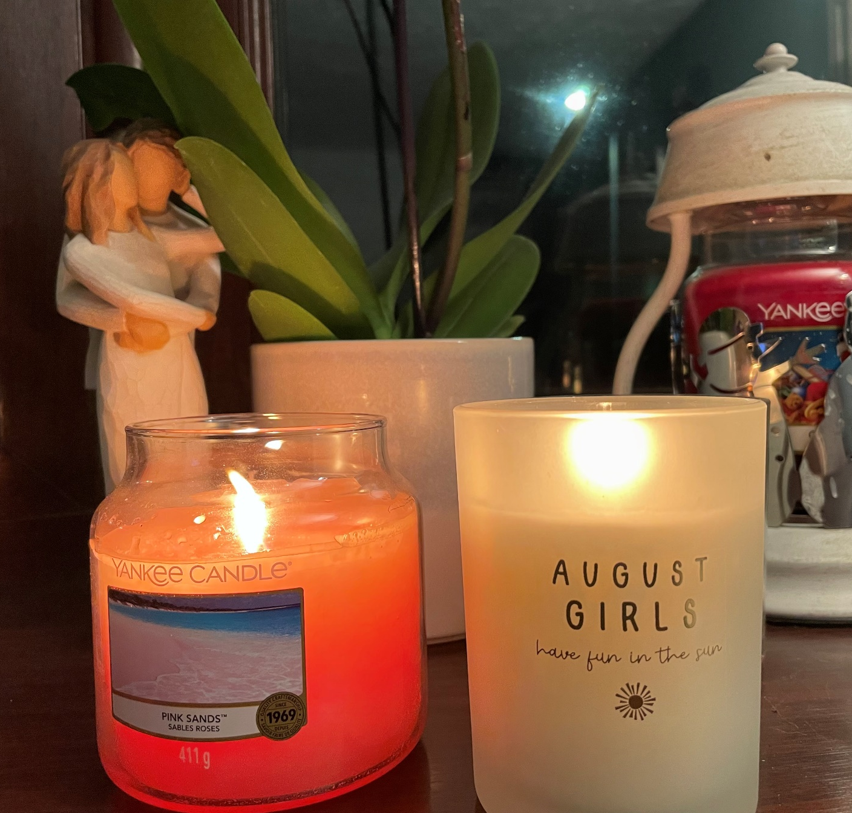
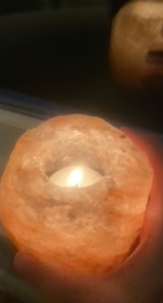

Slide 11
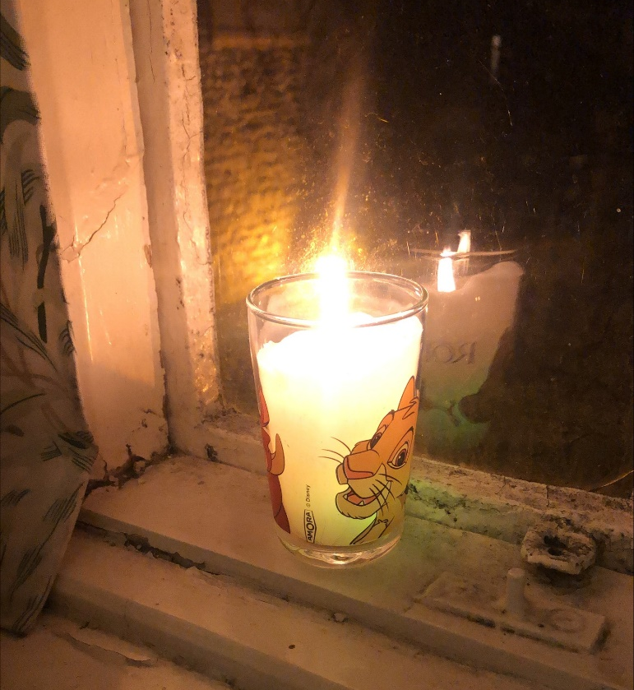
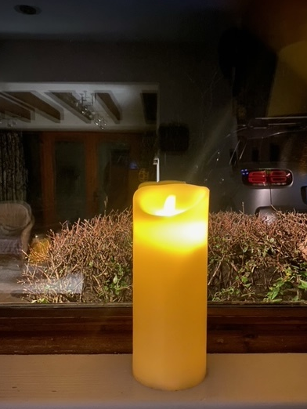
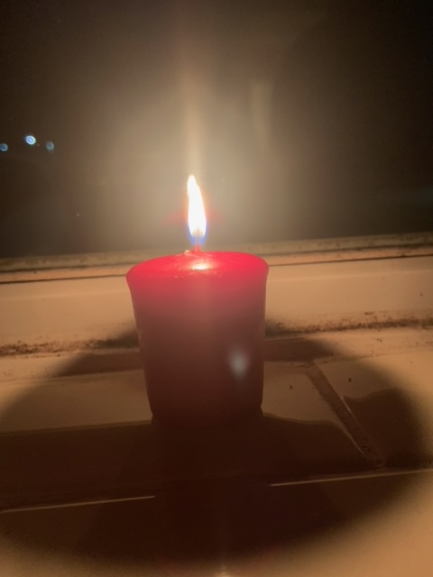

Slide 12
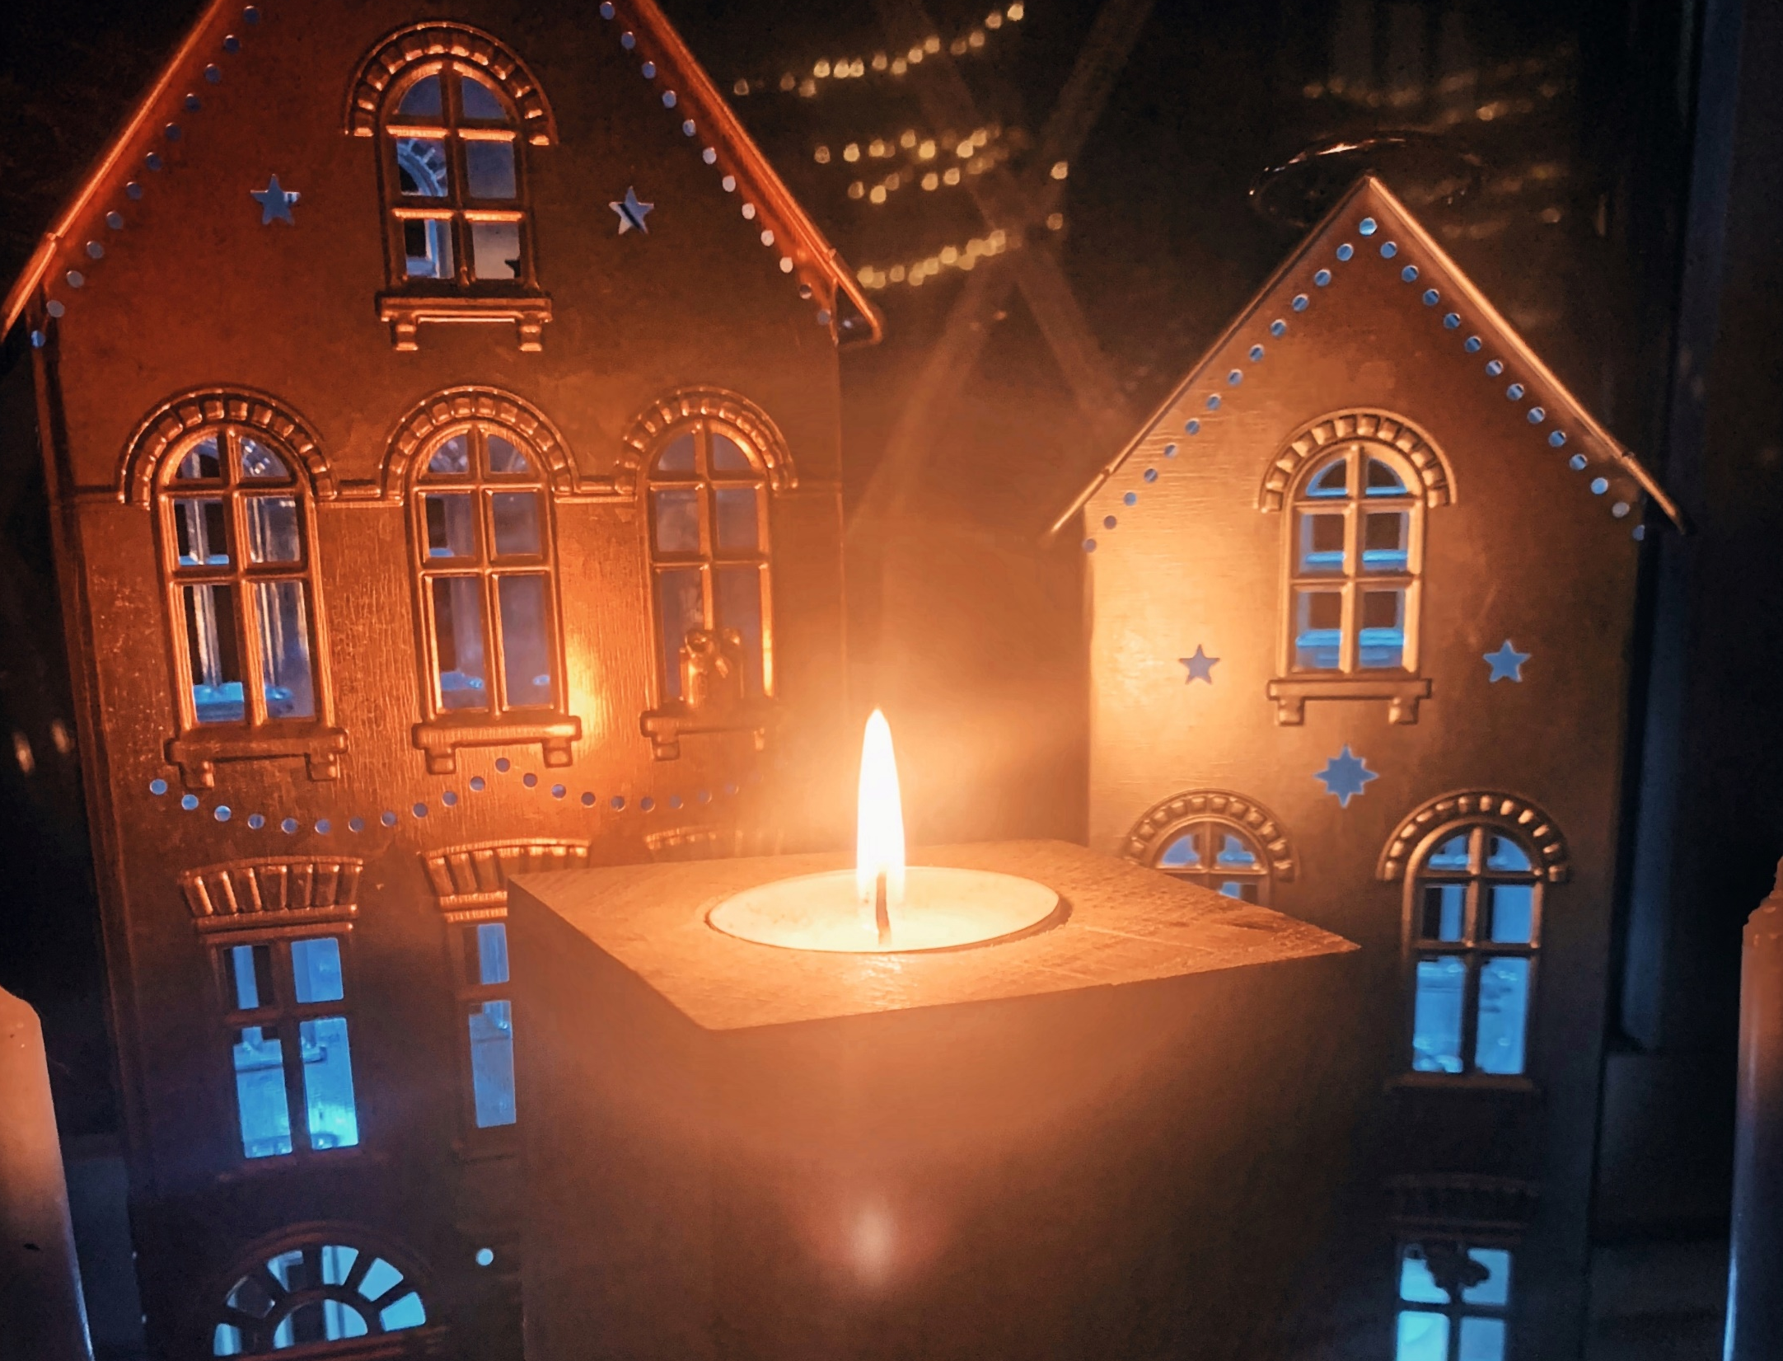

Slide 13
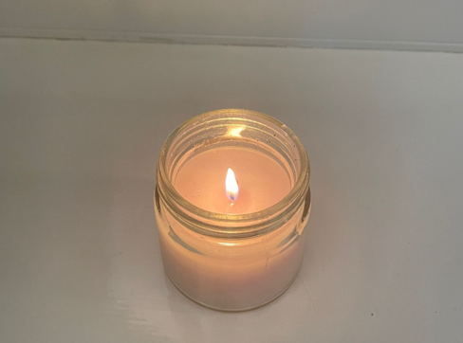

Slide 14
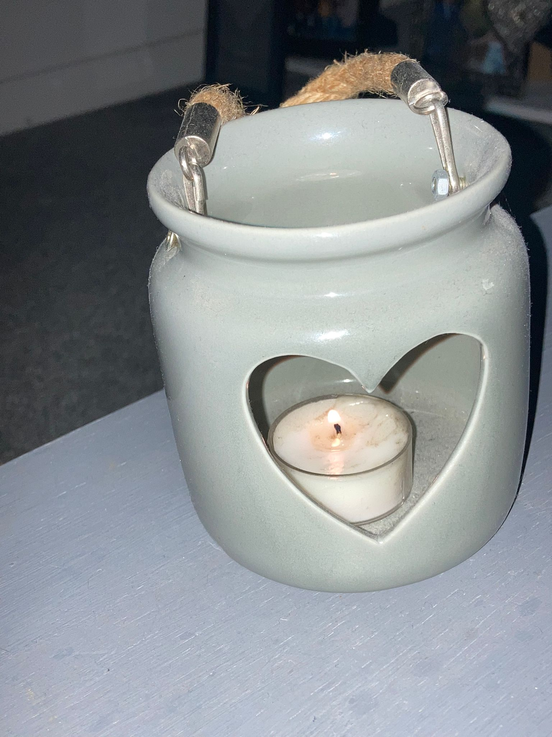
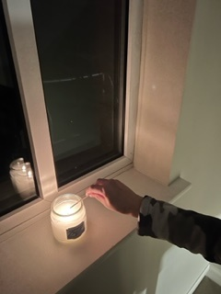

Slide 15
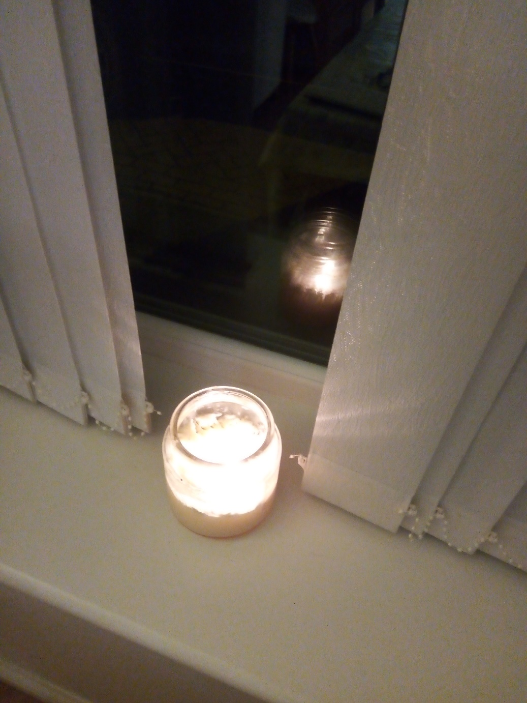
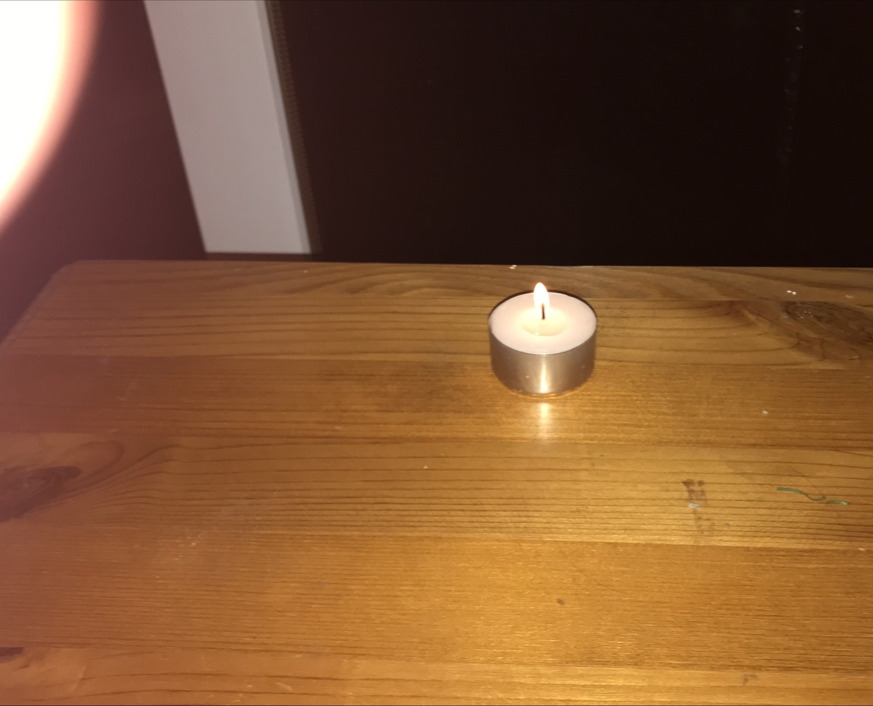

Slide 16
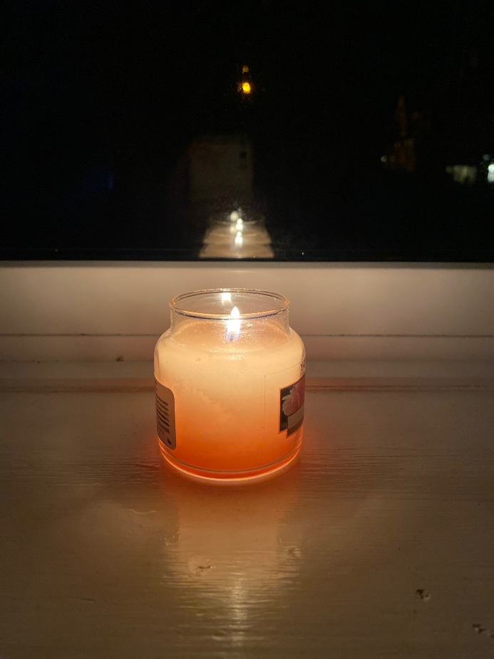
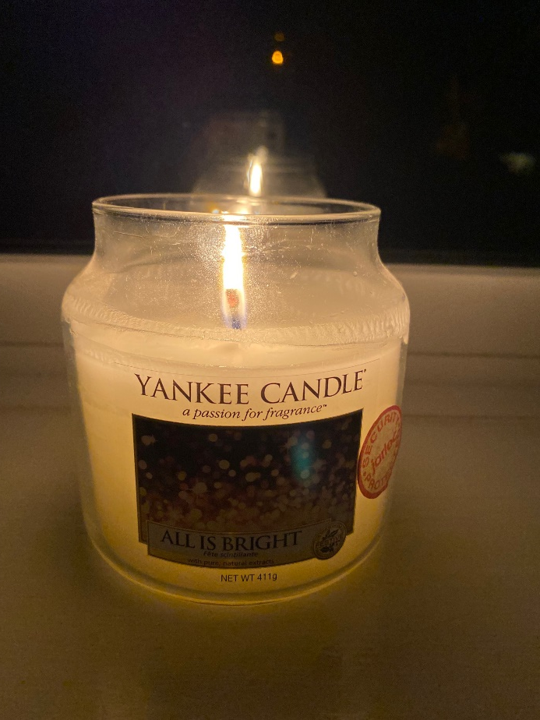
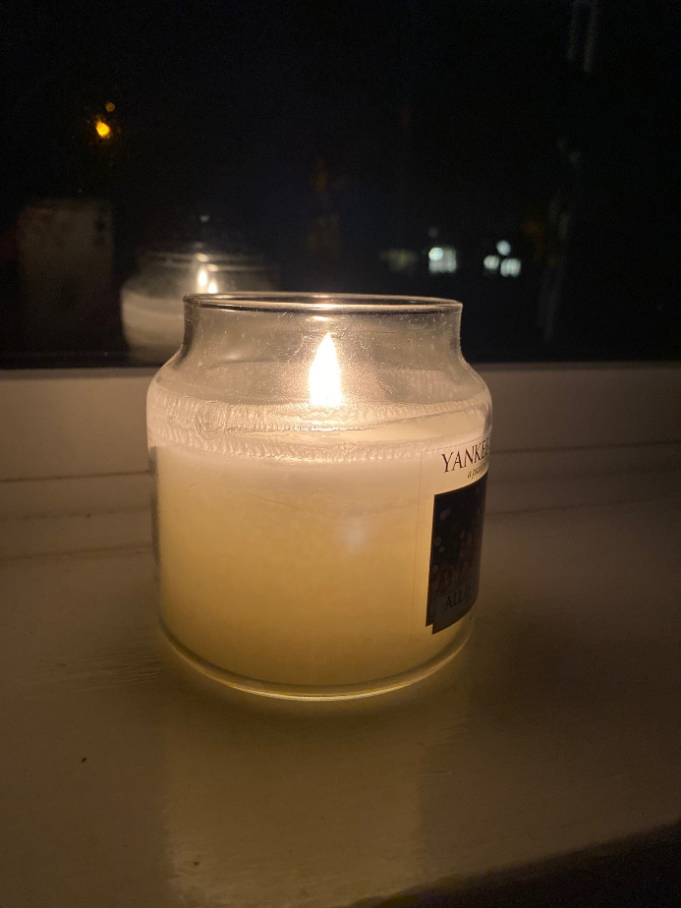

Slide 18
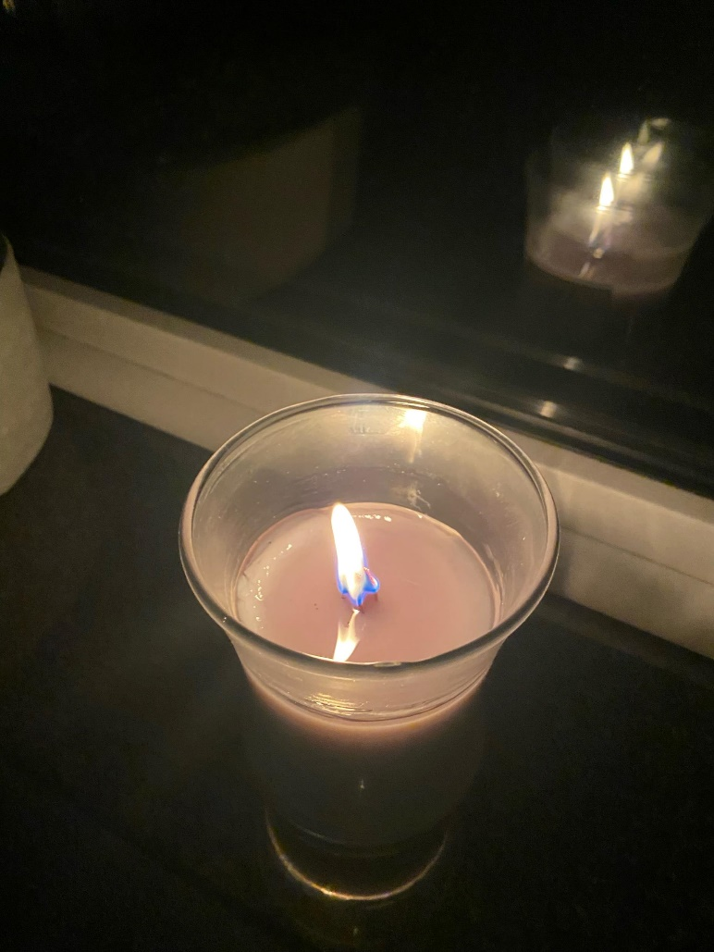

Slide 19
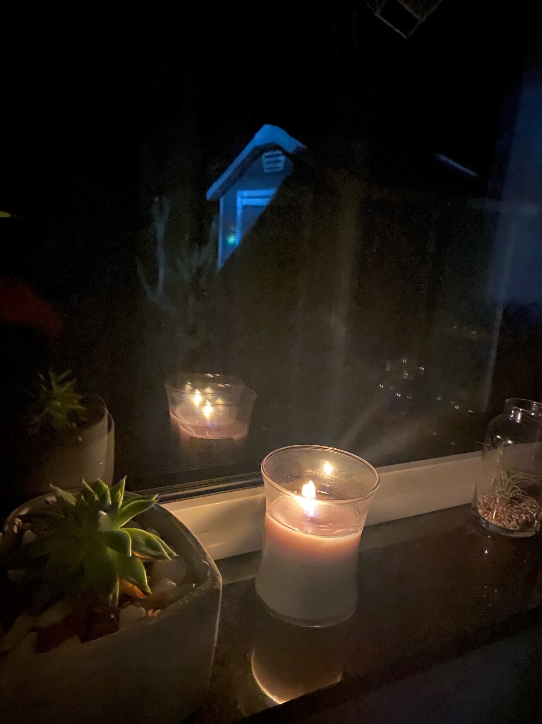
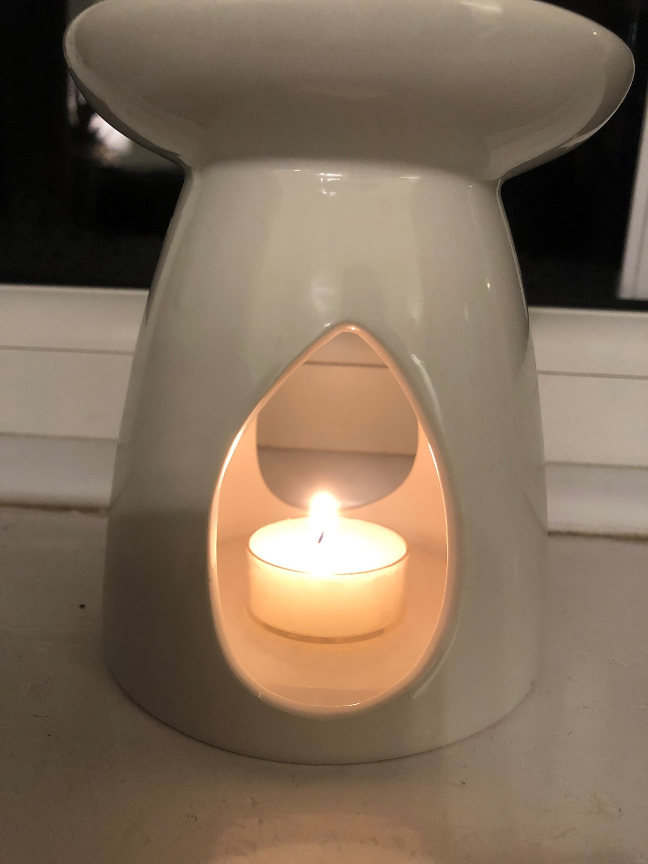

Slide 20
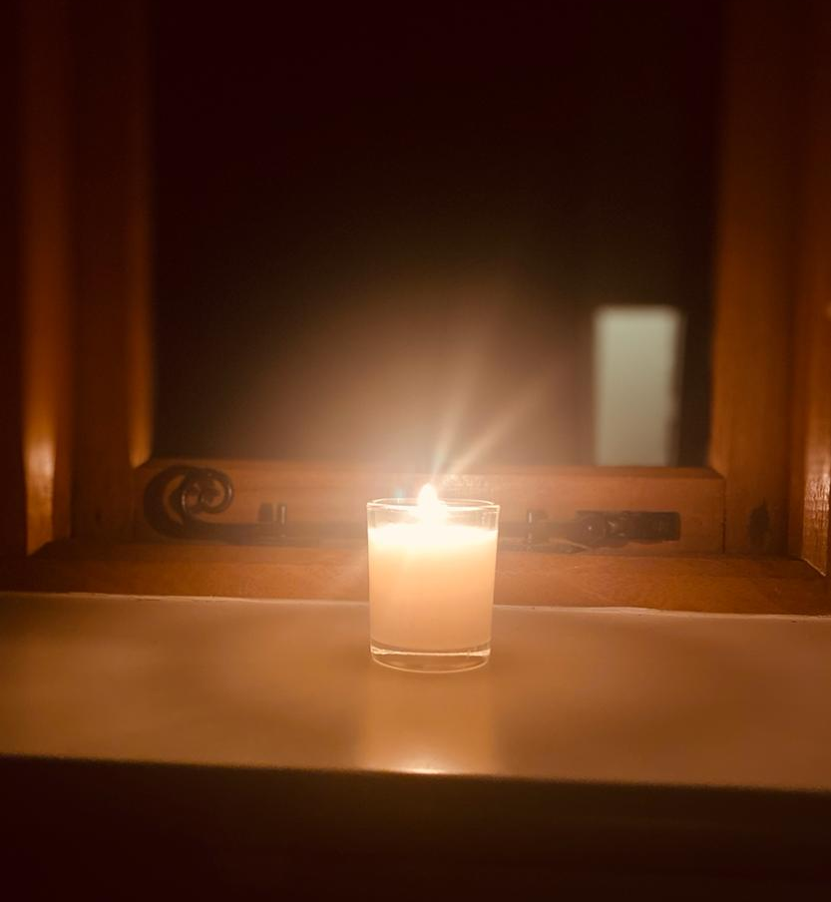
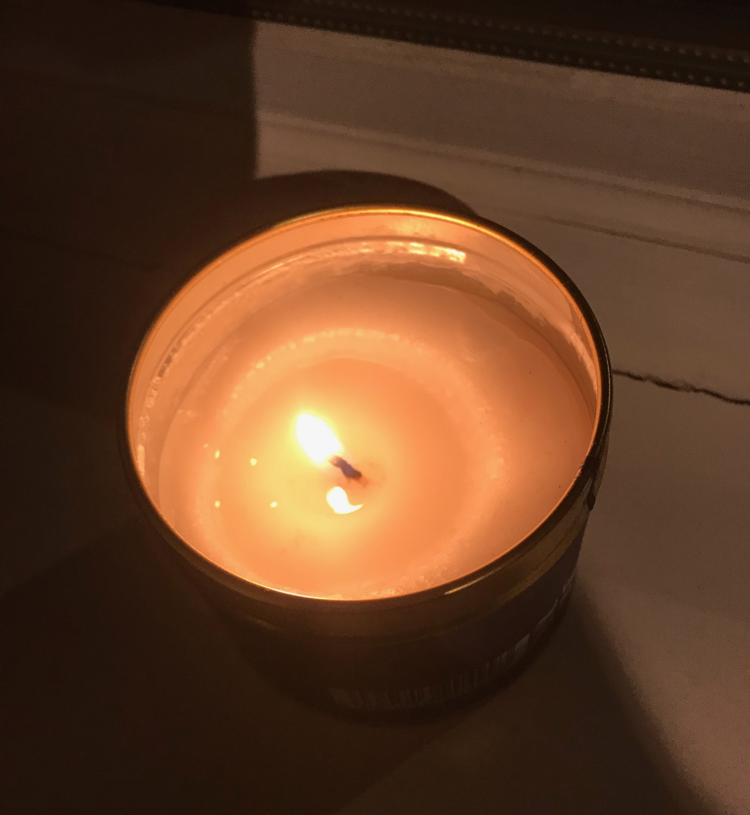

Slide 21
