Slide 1


Welcome
PSHE Parent Consultation

Slide 2
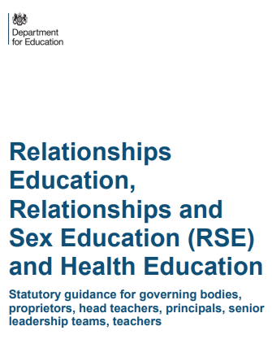


Slide 3
http://www.oldburywells.com/media/42772/overview-of-lessons.pdf

Slide 4

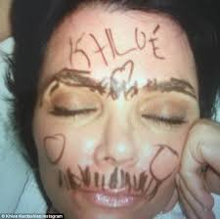


What is consent and why is it so important we learn about it?
Hannah went to a friend’s sleep-over. After staying up late and having fun, she fell asleep first. As Hannah slept, her friends decided to draw on her face with marker pens.
The next day Hannah was furious. Not only could she not get the pen off but she felt horrible and weird about her friends doing things to her while she was asleep.
Why did this make Hannah feel so horrible?
Would she have felt different if she couldn’t get the pen off but had allowed them to draw on her?
Explain the meaning of the word ‘consent’.

Slide 5
What is consent and why is it so important we learn about it?
Key Terms
Consent – to give permission for something to happen.
Non-consensual – doing something without someone’s permission.
Non-consensual sex – this means rape.
Key Words
Learning Outcomes:
Correctly identify cases where consent has or has not been given.
Describe the ‘cup of tea’ analogy and how it can be used to explain consent accurately.
Explain whether consent has been given in particular situations and how you know this.

Slide 6

Task One:
https://www.youtube.com/watch?v=u7Nii5w2FaI
Watch the clip carefully and then complete the table:
What is the clip trying to say?
Is this point easy to understand?
Are there ever any cases where you should make an unconscious person drink tea, or a conscious person drink it against their will? What could potentially happen if you did?
We’re now going to look at some serious real life instances where people need to be very aware of the concept of consent.
Times people will drink tea. | Times people won’t drink tea.

Slide 7
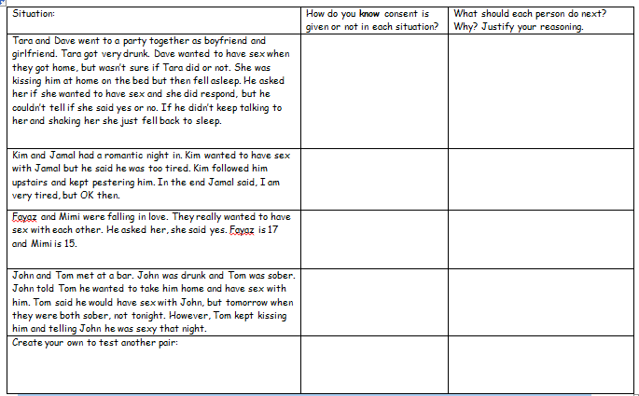
Task Two:
Your teacher will now give you a real life
situations sheet according to your challenge level.
Discuss the situations carefully with your partner and be prepared to feedback to the class with your ideas.

Slide 8




Plenary – Exactly Ten
Summarise in EXACTLY 10 words what the most important thing is about consent that everyone should know……
Learning Outcomes:
Correctly identify cases where consent has or has not been given.
Describe the ‘cup of tea’ analogy and how it can be used to explain consent accurately.
Explain whether consent has been given in particular situations and how you know this.

Slide 9


