Slide 1
AQA
    GCSE
      Design and Technology 8552
Energy generation
Unit 2
  Energy, materials, systems and devices
1

Slide 2
Objectives
Understand how power is generated from fossil and nuclear fuels
Understand how power is generated from renewable energy sources such as: wind, solar, tidal, hydroelectric and biomass
Be aware of the arguments for and against the selection of fossil fuels, renewable energy and nuclear power

Slide 3
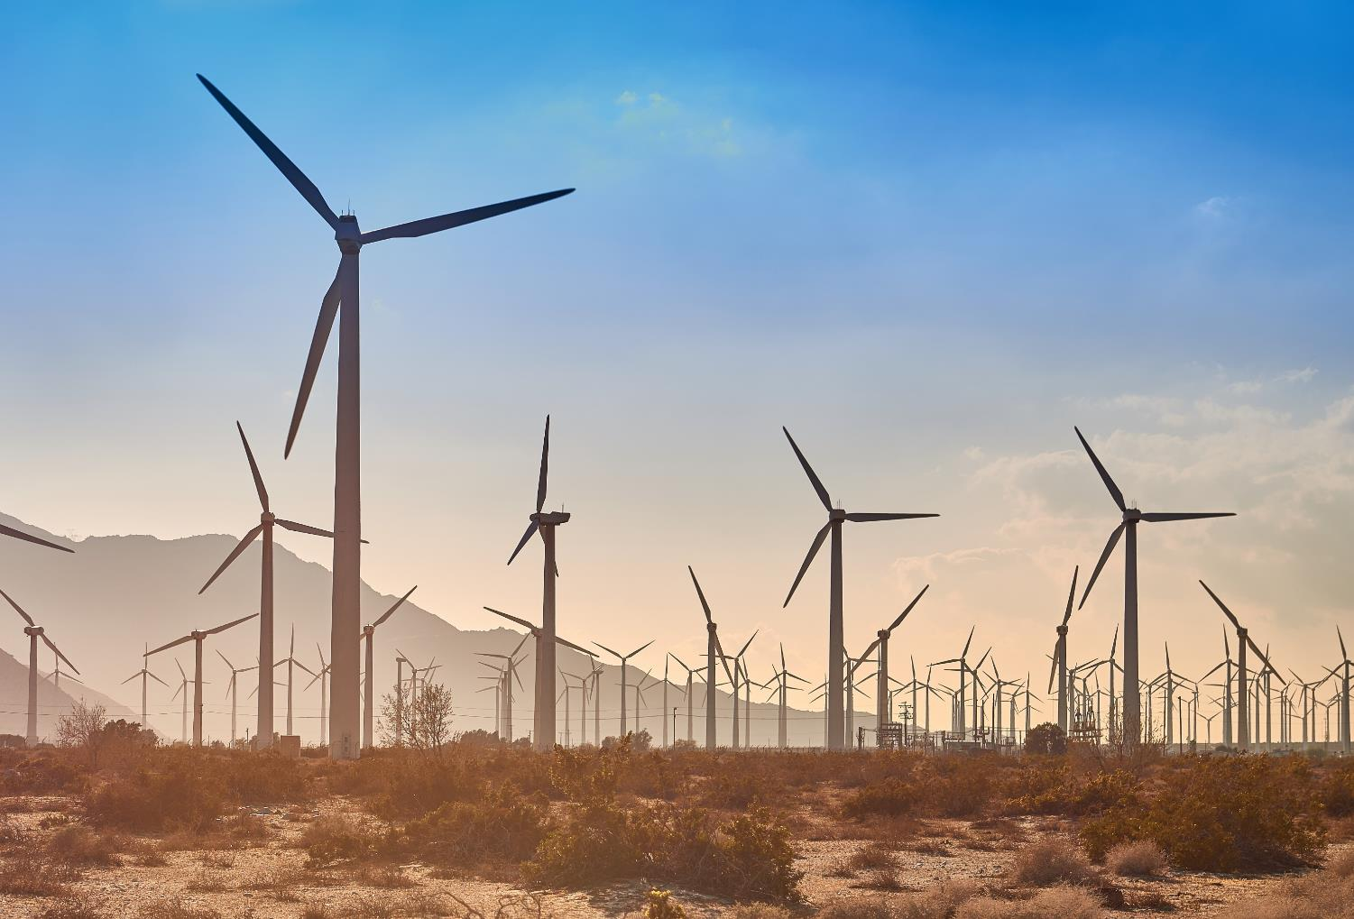

Where does our energy
come from?
Name as many energy
sources as you can think of
  How is power generated from these sources?

Slide 4
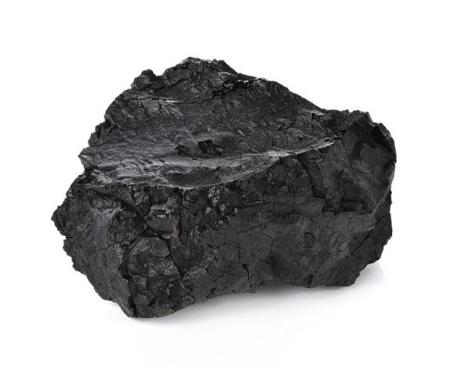
Fossil fuels
Fossil fuels are formed from the fossilised remains of plants and animals over millions of years
  Coal, oil and gas are extracted through mining and drilling
  Why are fossil fuels considered a finite resource?
  Why are they so relied upon for power generation?

Slide 5
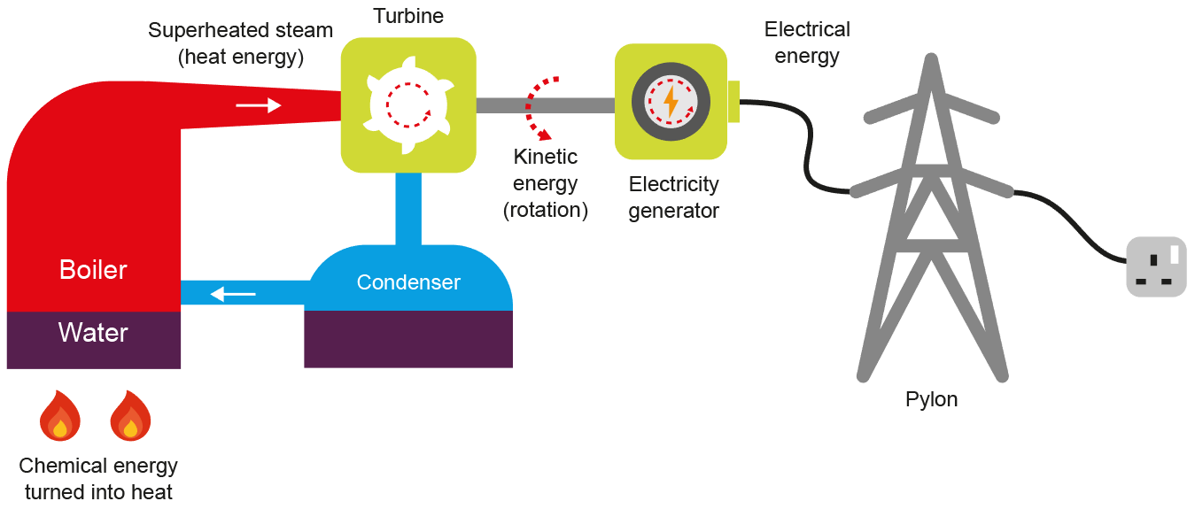
Energy generation
Fossil fuels can be burned to superheat water under pressure, which in turn, drives turbines
  How is energy from fuel converted to electricity at this point?

Slide 6
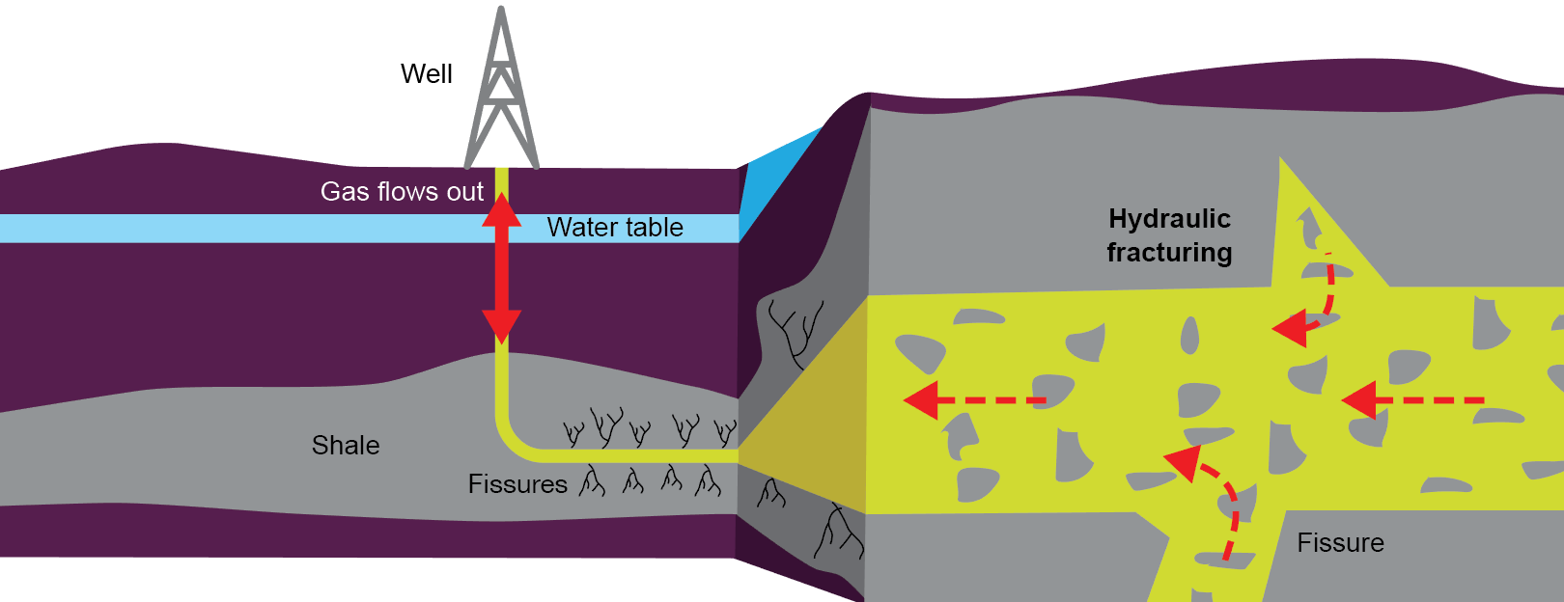
What is fracking?
Fracking involves drilling into layers of shale rock deep in the earth to release pockets of gas
  Water, sand and chemicals are injected into a well in order to force gas back up – what could go wrong?

Slide 7
Renewable energy sources
Renewable alternatives to fossil fuels include:
  Wind
  Solar
  Tidal
  Biomass
  Hydroelectric
Why are these classified as ‘renewable’?

Slide 8
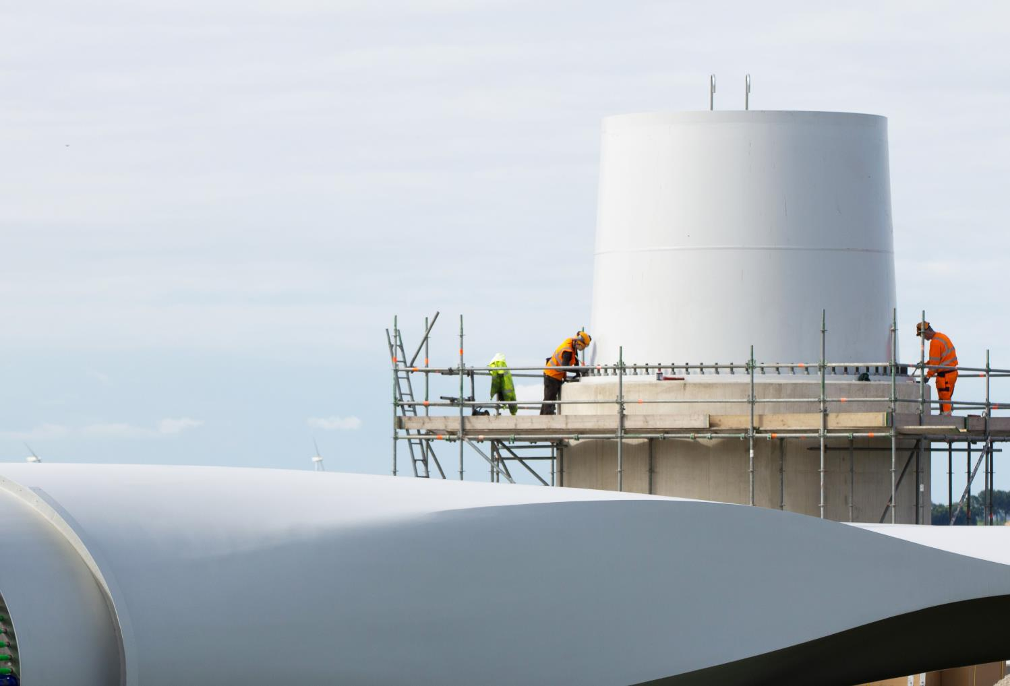
Wind turbines
What are the arguments for and against wind power?
  Would you want a turbine constructed beside
  your house?

Slide 9
Wind turbines
What are the arguments for and against wind power?
For | Against

Slide 10
Wind turbines Answers
What are the arguments for and against wind power?
For | Against
Low maintenance | Only work when windy
Clean energy | Eyesore to some
Higher winter output | Hazard to birds
Low cost energy | Noise

Slide 11
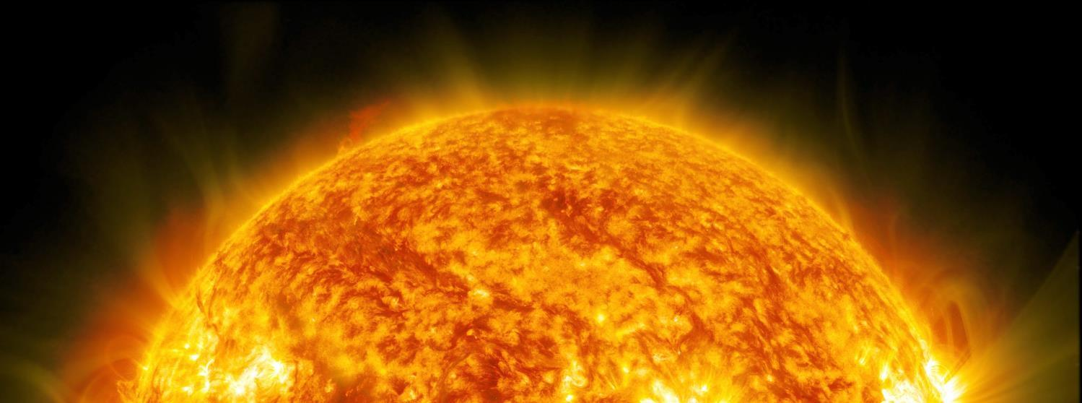
Solar energy
The Sun produces a constant stream of solar energy that reaches Earth
  In just one hour it provides enough energy to power the world for one year
  In 2015, solar energy generation passed the 1% mark of the world’s energy requirement

Slide 12
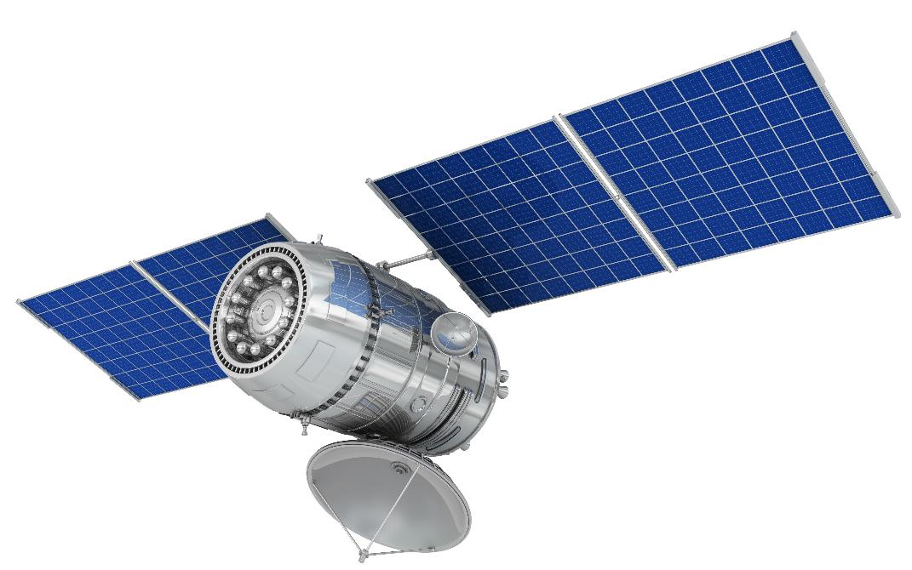
Photovoltaic cells
Light photons hit the PV cell which allows electrons to flow, creating an electric current
  Where are PV cells used?
  What are the advantages and
  disadvantages of
  PV cells?

Slide 13
Solar energy
The advantages and disadvantages of using PV cells to harness solar power include:
Advantages | Disadvantages
Low maintenance | Seasonal fluctuations
Clean energy | No power generated at night
Relatively low-cost | Complex positioning issues

Slide 14
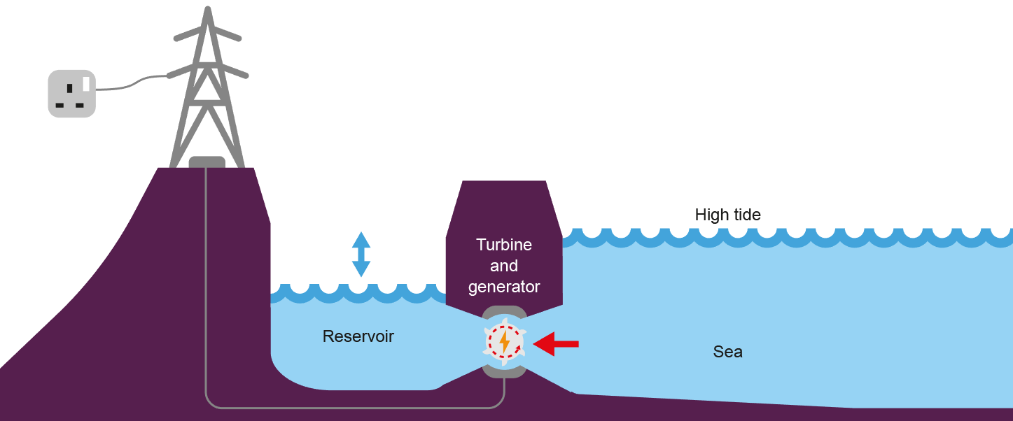
Tidal energy
The rise and fall of the tide forces water through turbines which drive generators to produce electricity
  What are the advantages and disadvantages of this system?

Slide 15
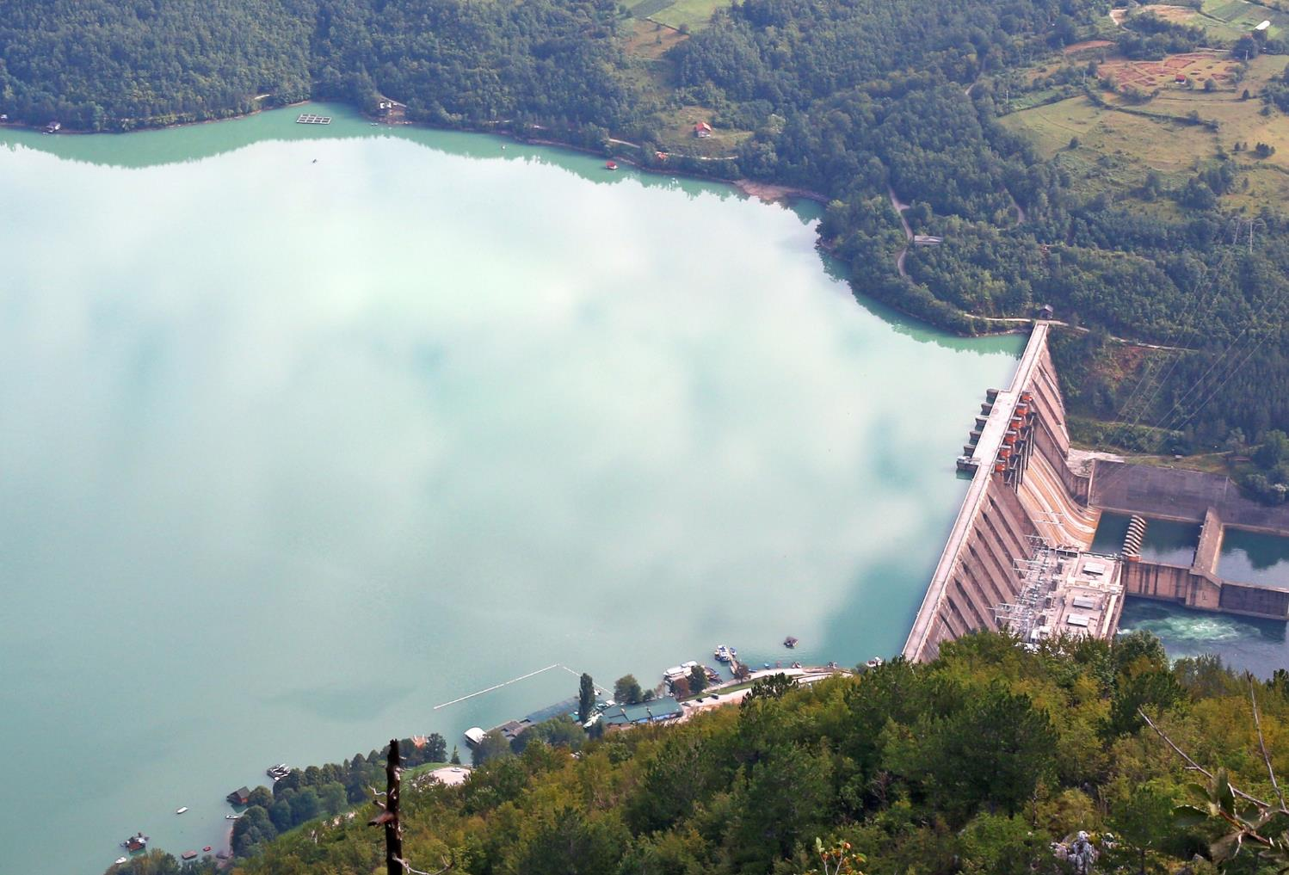
Hydroelectric power (HEP)
Hydroelectric power is
a very reliable and controllable energy source
The set-up costs are financially and environmentally expensive
  Vast areas need to be flooded to
  create reservoirs
  How would this affect those
  living locally?

Slide 16
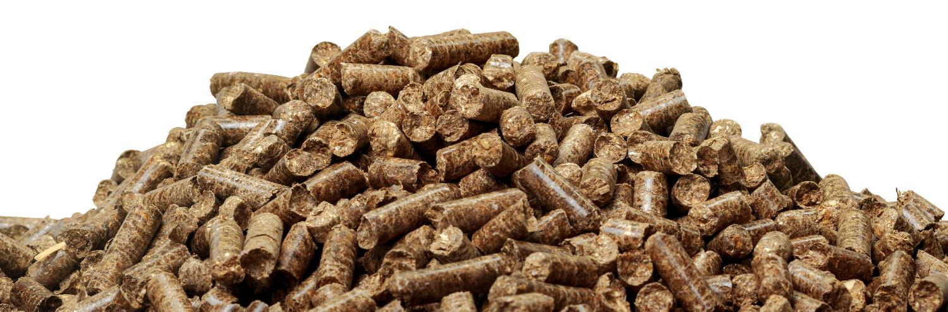
Biofuel and biomass
Biofuel and biomass are created from organic matter which is burned to generate power
  Biomass fuels include food and farm waste, compost and wood chips or compressed pellets
  Why is biomass considered to be carbon neutral?

Slide 17
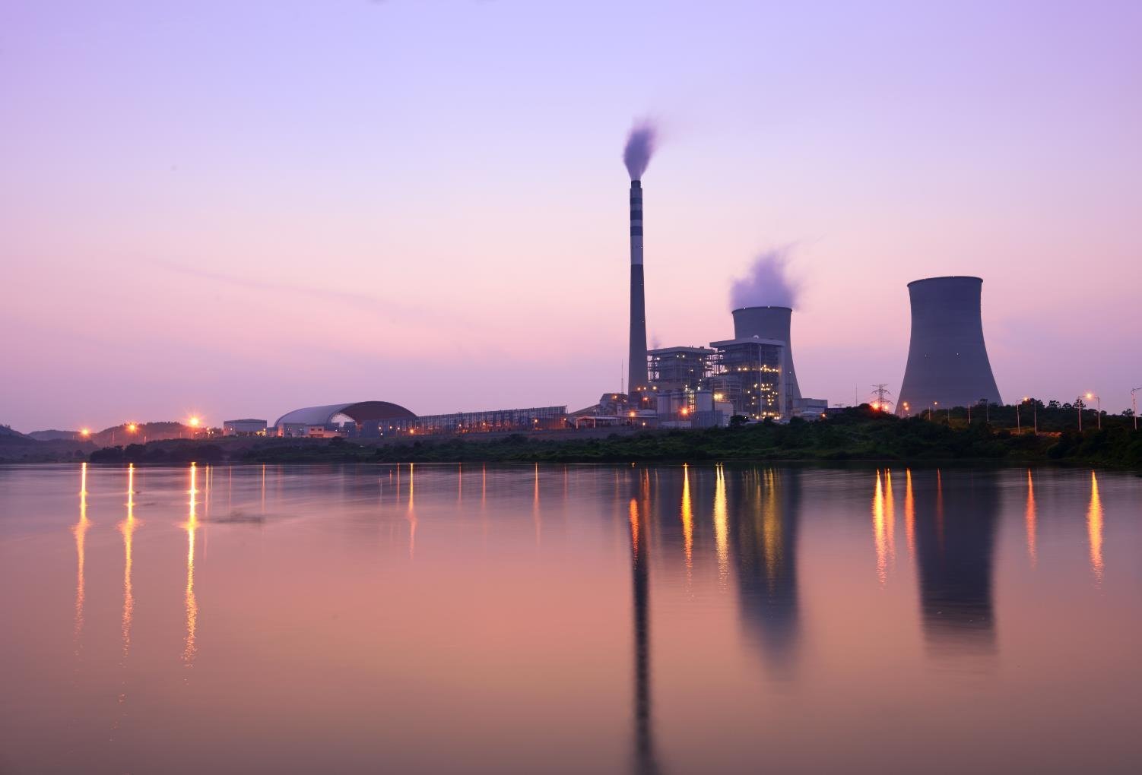
Nuclear power
Nuclear power accounts for over 11% of the
world’s electricity
  Is nuclear power a renewable
  energy source?

Slide 18
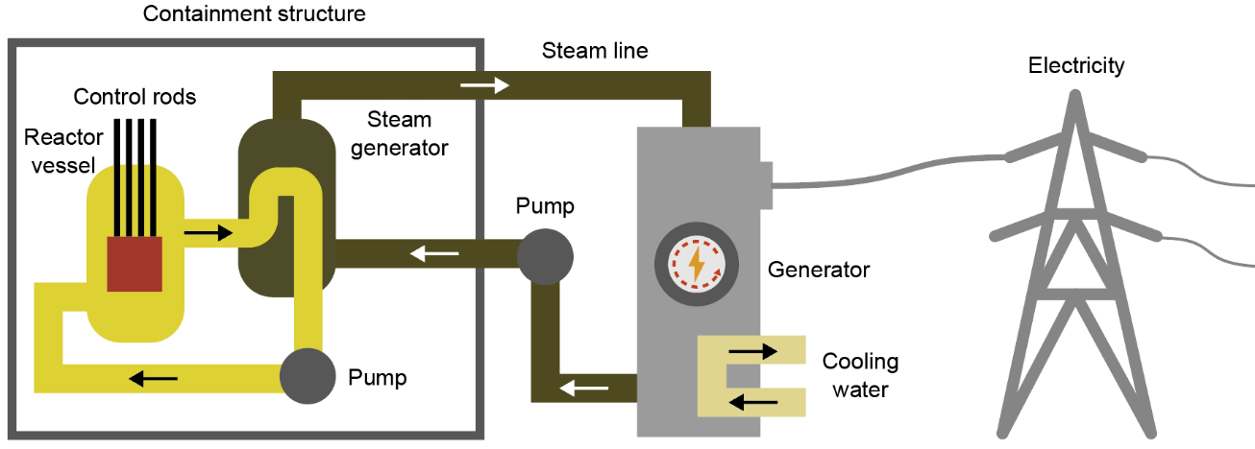
What about nuclear power?
Nuclear power provides an abundant, reliable supply of clean energy
  Why, therefore, is it so unpopular with some campaigners?

Slide 19
Worksheet 1
Complete Tasks 1 and 2 of the worksheet
  Look at the mix of the UK’s electricity supply
  Examine the arguments for and against nuclear energy

Slide 20
Plenary
Explain the role heated water plays in producing electricity along with turbines
Explain how a mixture of energy sources can provide a reliable supply of electricity
Explain why fossil fuels are a finite resource
  What is their connection with greenhouse gases?

