Slide 1
AQA
    GCSE
      Design and Technology 8552
Smart materials
Unit 2
  Energy, materials, systems and devices
4

Slide 2
Objectives
• Be able to recognise a range of smart materials
• Understand how the functional properties of a range of smart materials can be changed by external stimuli

Slide 3


Starter
Smart materials react to an external stimulus by changing their characteristics and/or properties
  What stimulus is changing
  the colour of the mug?
  Why does the handle
  stay black?

Slide 4
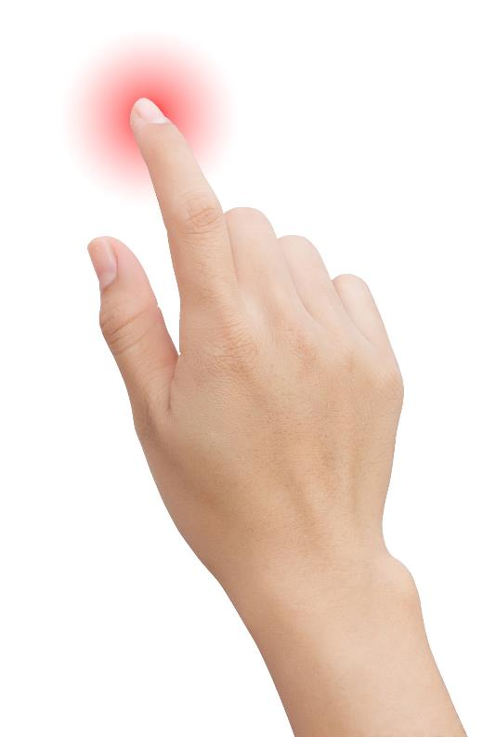
Smart materials
What different stimuli can make changes occur in smart materials?

Slide 5
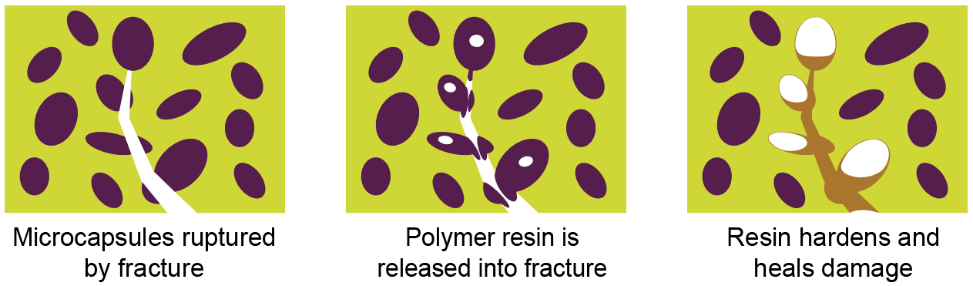
Self-healing polymer
Self-healing polymers react to stress fractures by releasing a resin into the new crack
  Microcapsules of liquid resin are ruptured to bond the polymer back together again
  What triggers the resin to cure?

Slide 6
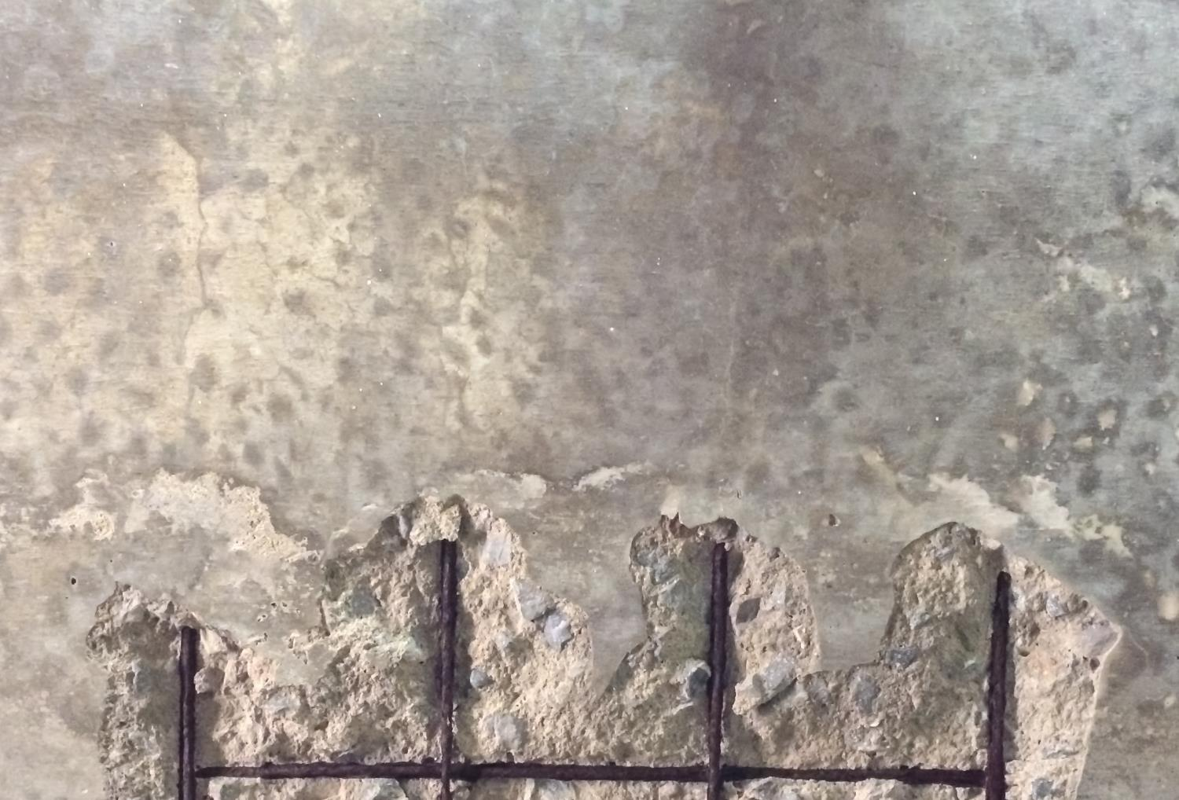
Self-healing concrete
Designed to avoid stress cracks filling with water
  Cracks enlarge over time and water can cause the steel reinforcements to rust and weaken the structure
  Self-healing concrete has spheres of bacteria added to the mixture which contain their own food
  When a crack forms and water seeps in, the bacteria start to feed, producing calcium carbonate which fills the crack

Slide 7
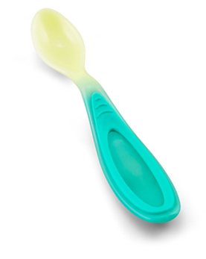
Thermochromic pigments
Hot and cold temperatures trigger a change of colour in special thermochromic dyes
Applications include:
  Fever scan strips used on infants
  Room thermometers
  Children's cutlery and crockery
  Novelty goods and colour changing clothing
Some pigments have a permanent change
  How might these be useful in the medical
  or food industry?

Slide 8
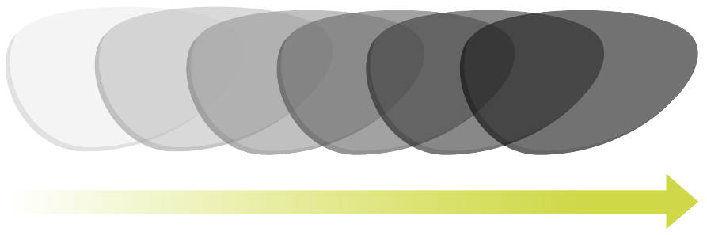
Photochromic particles
Ultraviolet light reacts with photosensitive silver halide particles within the lenses
  This reaction is commonly seen in prescription sunglass lenses that darken in bright sunlight and return to clear indoors
  The reaction can take up to two minutes to complete
  Over time the particles can lose their ability to revert to clear
UV Light levels

Slide 9

Photochromic pigments
UV light stimulates particles in a
special pigment
The effect only lasts as long as
strong UV light is present
These pigments are mainly used
for novelty goods and colour
changing paints
  How might these pigments be
  used in improving security?

Slide 10
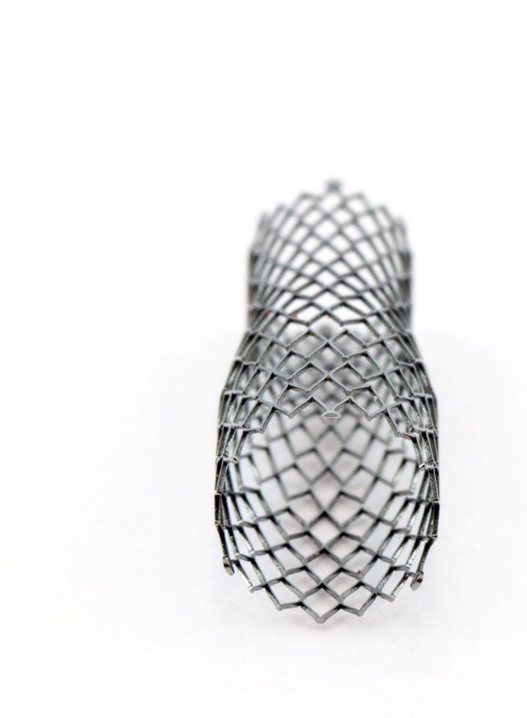
Shape memory alloy (SMA)
Nitinol is an SMA of nickel and titanium
  Nitinol needs to be ‘set’ into a shape which
  requires a high temperature of around 540°C
  Once set, the alloy can be
  deformed into a different shape
  Heat or electricity is used to
  trigger a response in its shape
  When reheated to around 70°C it
  will go back to its pre-set shape
How might nitinol be used in
dentistry, eyewear or heart surgery?

Slide 11
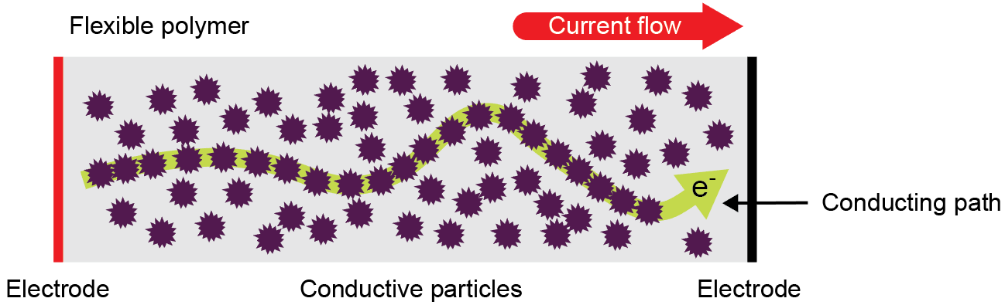
Quantum Tunnelling Composite
QTC is a polymer that contains billions of metal particles that don’t actually touch each other
  It is an unusual material being both an insulator and
  a semi-conductor
  When pressure is applied the polymer becomes a conductor allowing an electrical signal to flow
  Where might this material be useful?

Slide 12
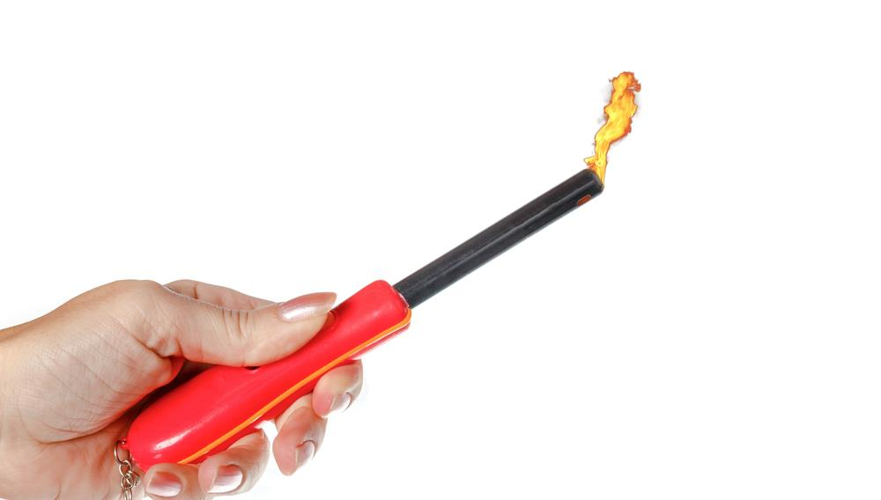
Piezoelectric material
Piezoelectric material works in two ways:
  Subject it to movement or stress and it produces electricity
  Attach an electrical signal to it and it moves
How might it be used to detect vibrations?

Slide 13
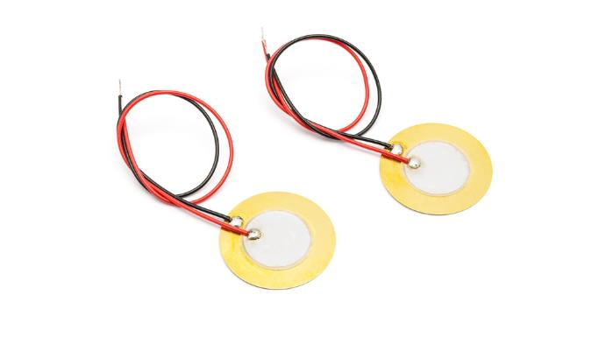
Piezo transducer
Using a thin layer of piezoelectric material, small transducers vibrate when an electrical signal is sent through the contacts
  These are used in mobile phones and other small electronic devices and toys
  When tapped or spoken into they produce a small electrical charge that can be amplified to create sound or trigger a response in a circuit

Slide 14
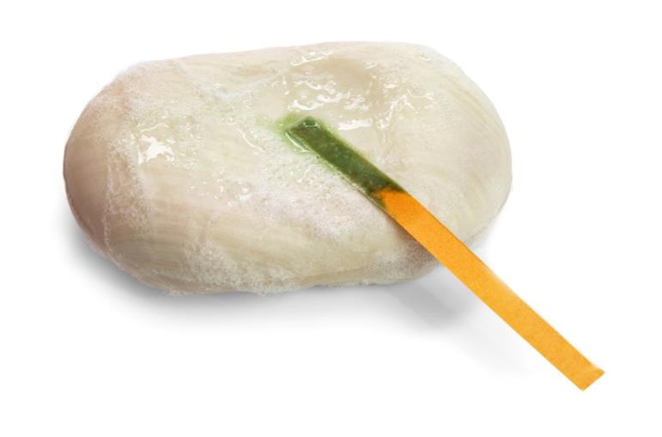
Acid or alkali?
PH levels can be detected using litmus paper
  It uses compounds found in different varieties of lichen
  Different colours and shades appear depending on the PH
  Common uses include: Garden soil testing / pool water testing / skincare products – (dermatological testing)

Slide 15
Worksheet 4
Complete Tasks 1 and 2 of the worksheet

Slide 16
Plenary
Imagine you are a designer for a car manufacturer
  You have been asked to create the best driving experience for their customers
How could smart materials be used to help you design the ultimate car?
  Consider all aspects of the passenger experience including safety, entertainment, comfort, easy of use of controls, reduced maintenance etc.

