Slide 1
AQA
    GCSE
      Design and Technology 8552
Forces and stresses on materials
Unit 4
  Common specialist technical principles
1

Slide 2
Objectives
Be able to recognise and characterise tension, compression, bending, torsion and shear forces and stresses
Understand the impact of different forces and stresses on materials

Slide 3


Starter
Designers need to consider
the forces and stresses that every
product will need to withstand
This enables products to
function correctly
  What forces are acting on this balloon
  and the air inside it?
  What forces are acting on the ribbon?
Are there more formal definitions
for these forces?

Slide 4

Forces and stresses
All materials, structures and products have to withstand various stresses as forces are applied
These forces include:
  Tension
  Compression
  Torsion
  Bending
  Shear

Slide 5
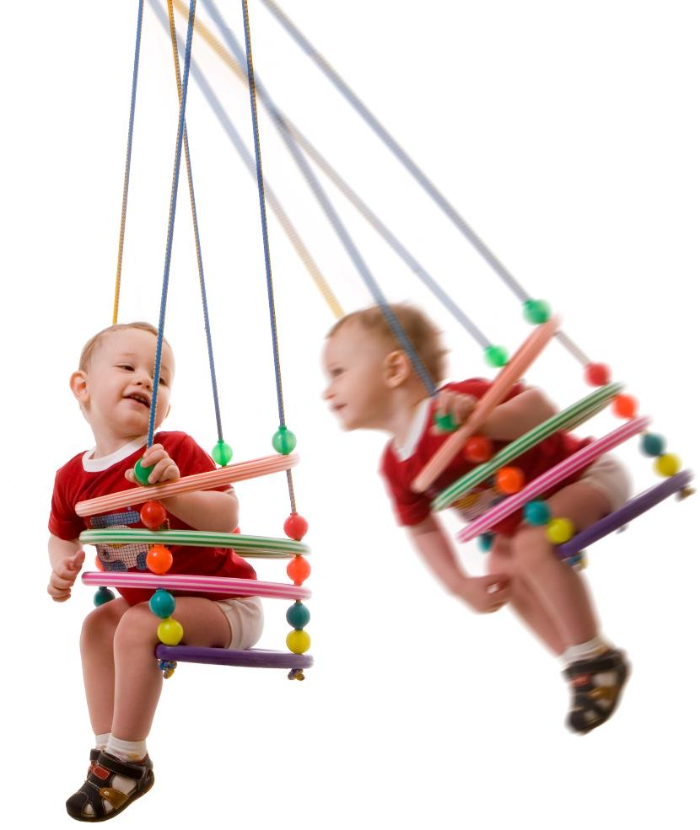
Static and dynamic loads
A static load does
not move and will exert far less stress than a dynamic load
  What force(s) are
  swing ropes subject to?
  When are the ropes under the greatest
  stress given an
  identical load?

Slide 6

Force = Mass x Acceleration
Designers have to consider the speed behind the force as well as the type of force
  If you jumped on an icy pond, would it be more or less likely to crack than if you stood on it?

Slide 7

Tension
Helicopter blades are under tension when
the rotor spins
They need to have high tensile strength
to withstand these forces
  How would you define
  tensile strength?
  Suggest three other
  examples of components
  experiencing tension?

Slide 8
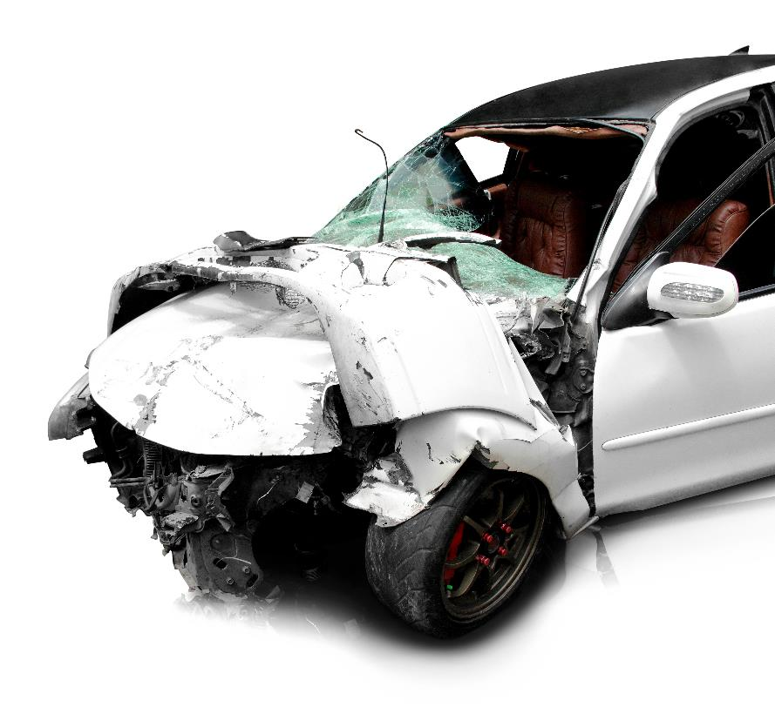
Compression
The impact of a car crash exerts
compressive force on the vehicle
  How would you define
  compressive strength?
  How is a car designed to
  handle compression?
  How is compression
  used with gases?

Slide 9
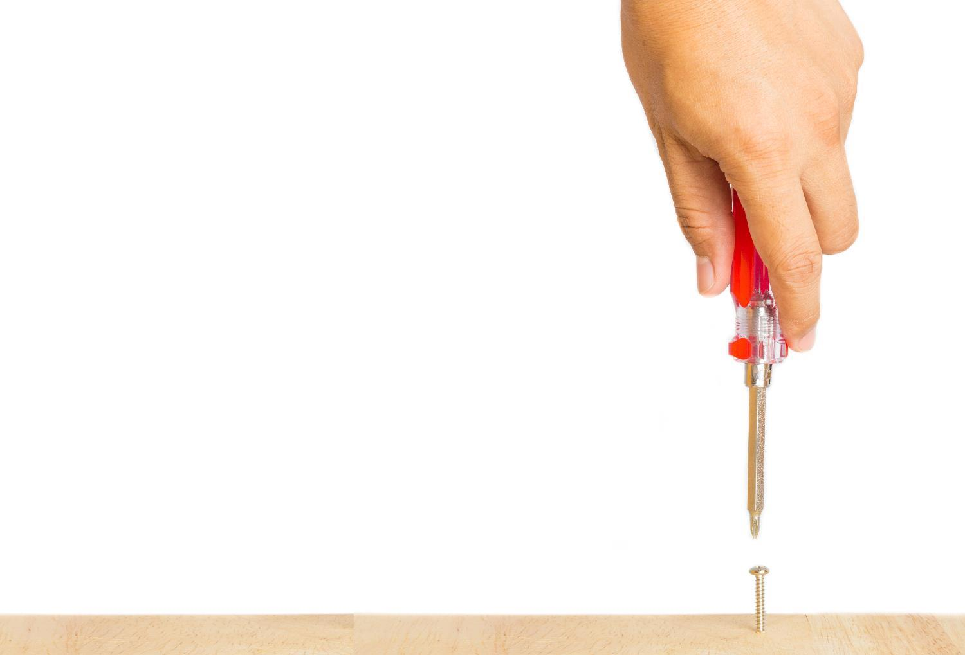
Torsion
Twisting a material puts it
under torsion
  What are the similarities and differences between tension and torsion?
  How is a screwdriver blade
  subject to torsion?
  What is a functionally acceptable level of torsional strength for a screwdriver?
  How might a vehicle chassis
  experience torsion?

Slide 10
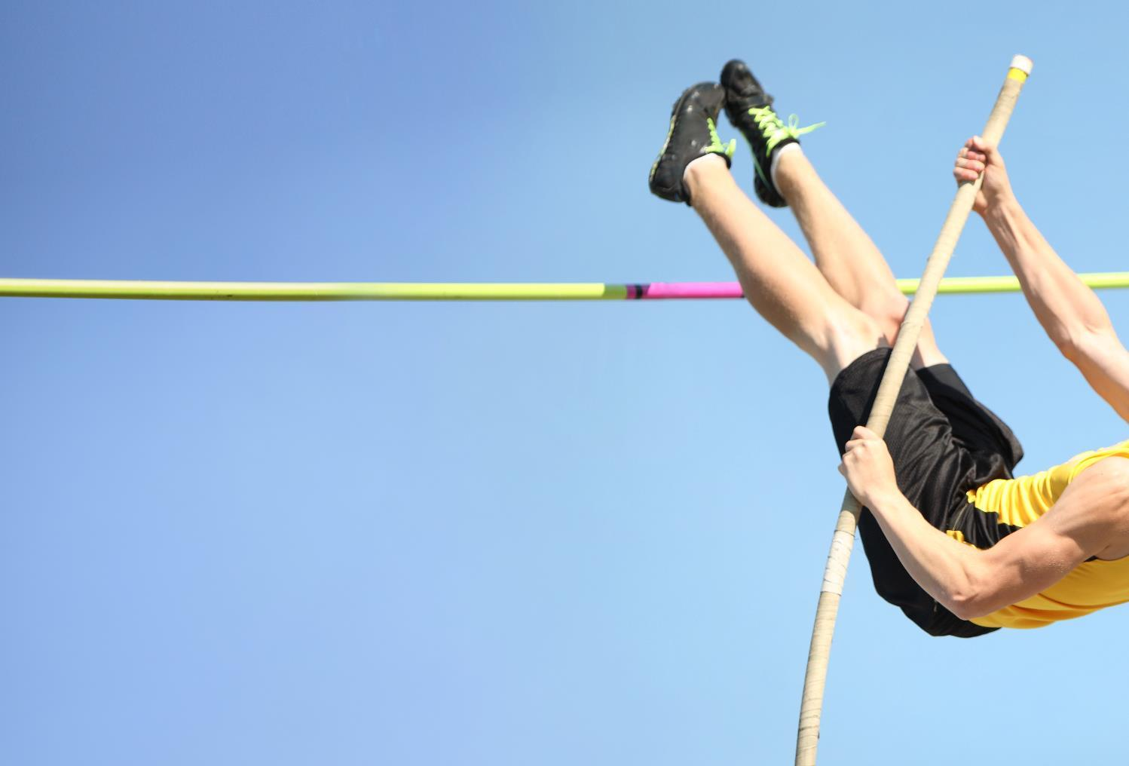
Bending
Stiffness is the ability of a material to resist being bent out of shape
Some products and materials are designed to have a certain degree of stiffness to perform their function
  How do tension and compression exert themselves on either side of a bending pole?

Slide 11

Shear
A shear force occurs when opposite forces act on an object in a direction perpendicular to its length
  Which part of these garden
  shears is perpendicular to
  the force of the handles?
  Which part has to withstand
  the most shear force?
  How is the nail in a picture
  hook under shear force?
  Give two other examples of
  shear forces in action?

Slide 12
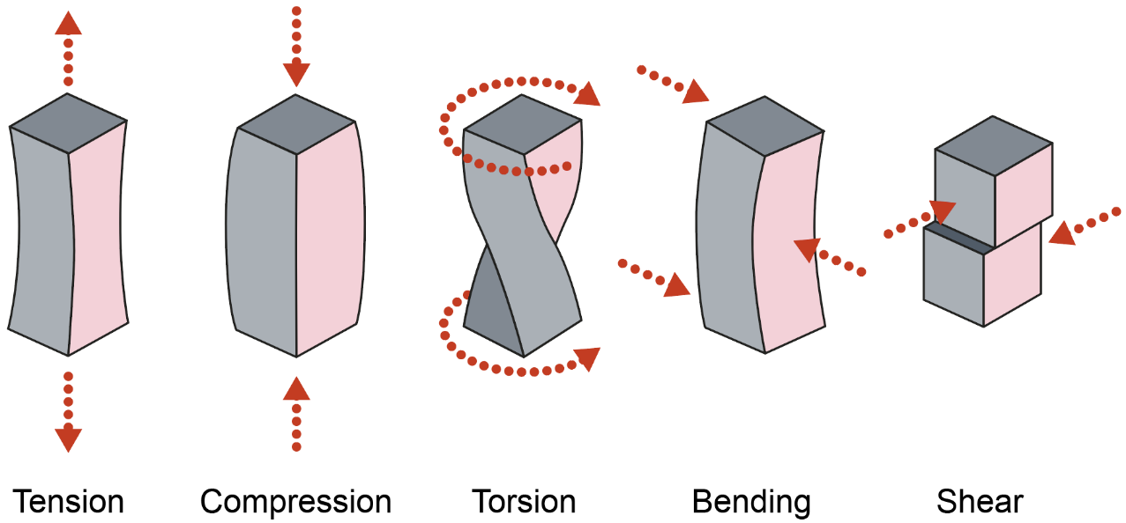
Defining forces
Work in pairs to define these five key forces:

Slide 13
Worksheet 1
Complete Task 1 of the worksheet

Slide 14
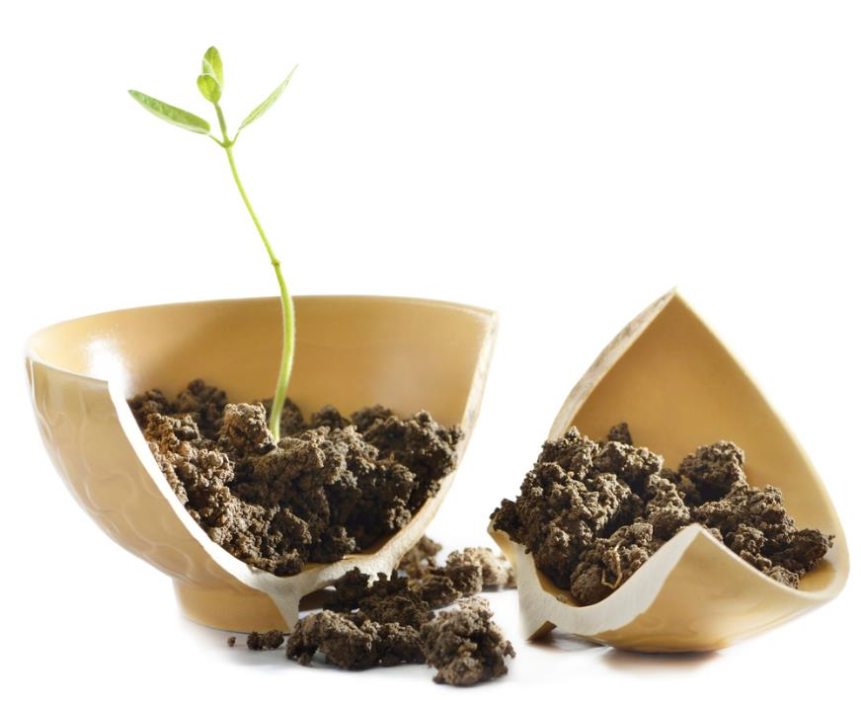
Forces and materials
Different materials and components are chosen for their ability to withstand certain forces
  Why is a plastic pot more resistant to
  compressive or shear forces than a ceramic pot?

Slide 15
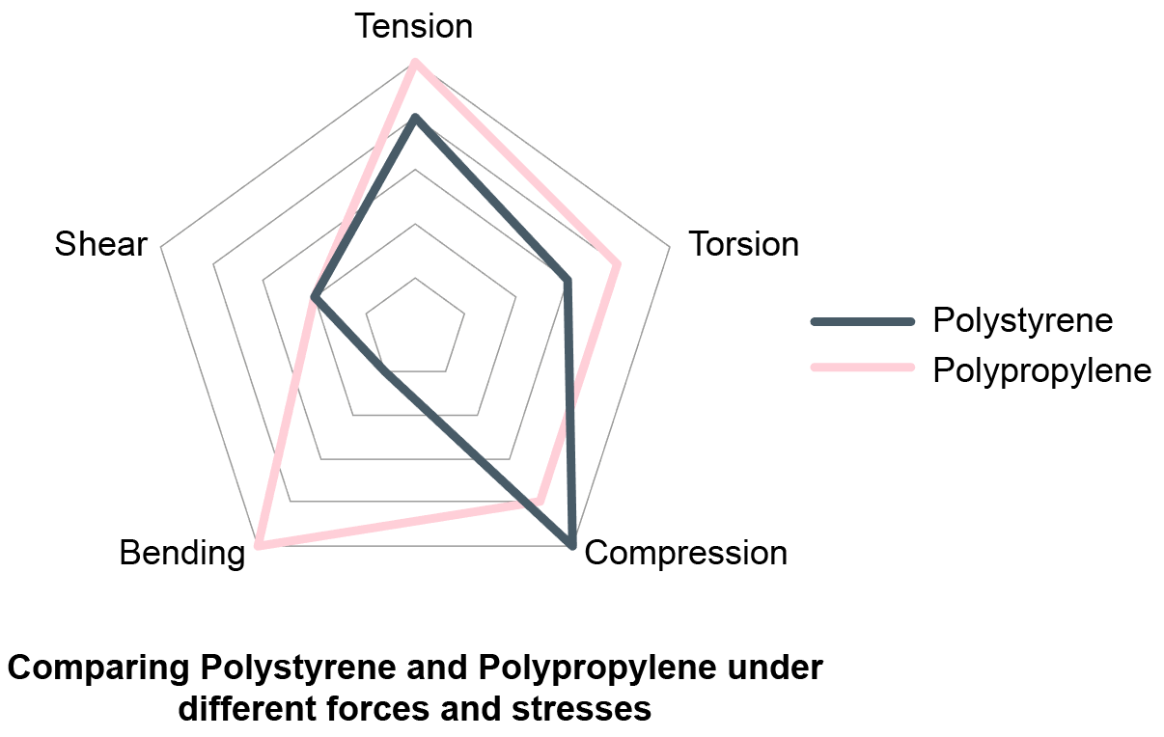
Worksheet Task 2
Exert different forces on two different materials and record your findings on a radar chart

Slide 16
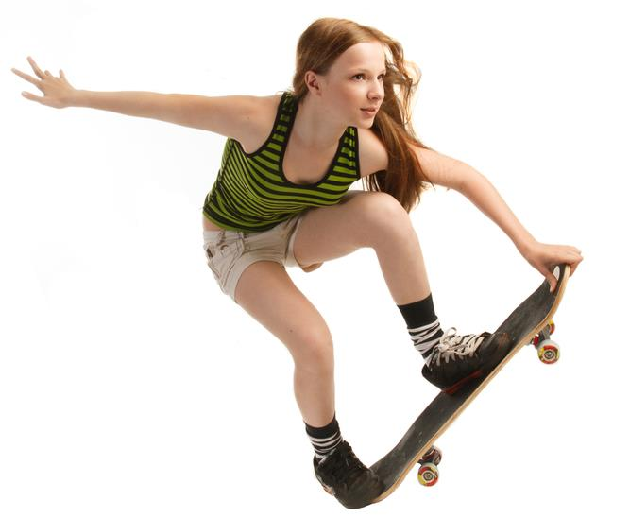
Plenary
Complete Task 3 of the worksheet
Explain how a skateboard is designed to withstand each of the following forces?
  Tension
  Compression
  Torsion
  Bending
  Shear

