Slide 1
AQA
    GCSE
      Design and Technology 8552
Scales of production
Unit 4
  Common specialist technical principles
5

Slide 2
Objectives
Understand how products are produced in
different volumes
Explain when and why different manufacturing methods are used for different production volumes
Be able to link the use of relevant specialist processes to the appropriate level of production

Slide 3
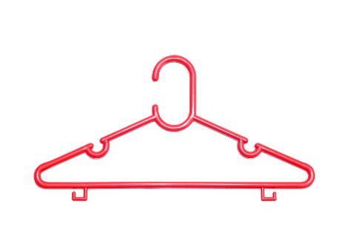
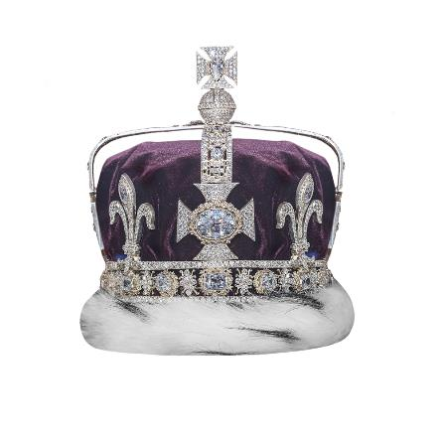
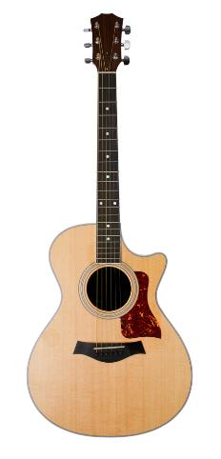
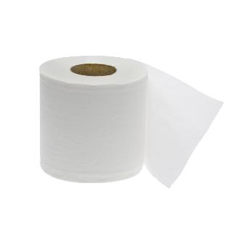

Starter
Put the following items in order by the volume manufactured:
Many
One

Slide 4
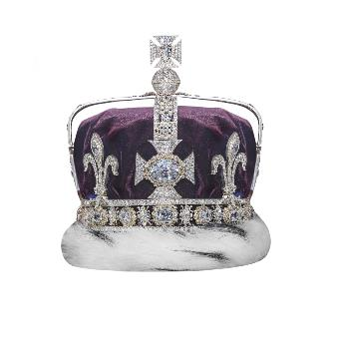

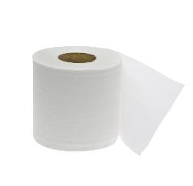
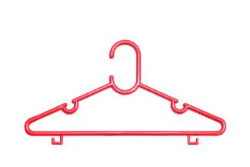

Production volumes
How did you decide where to place the objects?
  Why do we produce products in different volumes?
  How were these products made?
  How do production volumes affect
  production techniques?
Many
One

Slide 5
Scales of production
Some products are manufactured in huge volumes, whereas for other products, only one unit is made
There are four different scales of production:
  One-off production
  Batch production
  Mass production
  Continuous production

Slide 6

One-off production
A single product or unit is made
One-off production is suitable for prototypes and when a product
is designed for a client with
specific needs
  Why might one-off production be
  linked with design for disability?
  Suggest two other examples of
  one-off products?
  Why do one-off products have a
  high unit cost?

Slide 7
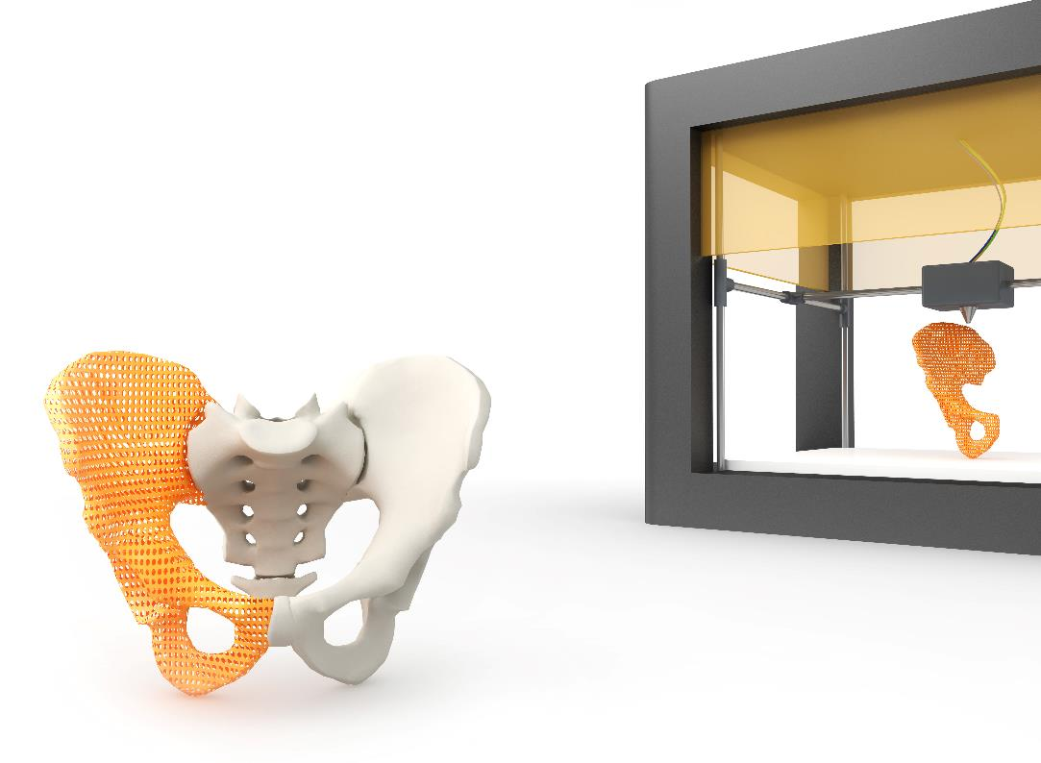

Prototypes and 3D printing
Prototypes are classified as one-off
products and 3D printing is often used
to manufacture prototypes
  What makes 3D printing a suitable
  process for one-off production?

Slide 8

Personalisation and
one-off products
What is the difference between one-off and personalisation?
  Complete Worksheet Task 1

Slide 9

Batch production
More than one unit is produced at a time in a set or batch e.g. confectionary, newspapers
or furniture items
Patterns, templates or jigs are
used to increase efficiency
Production lines are flexible
and generally have shorter
lead times
  Why are seasonal products suitable
  for batch production?

Slide 10
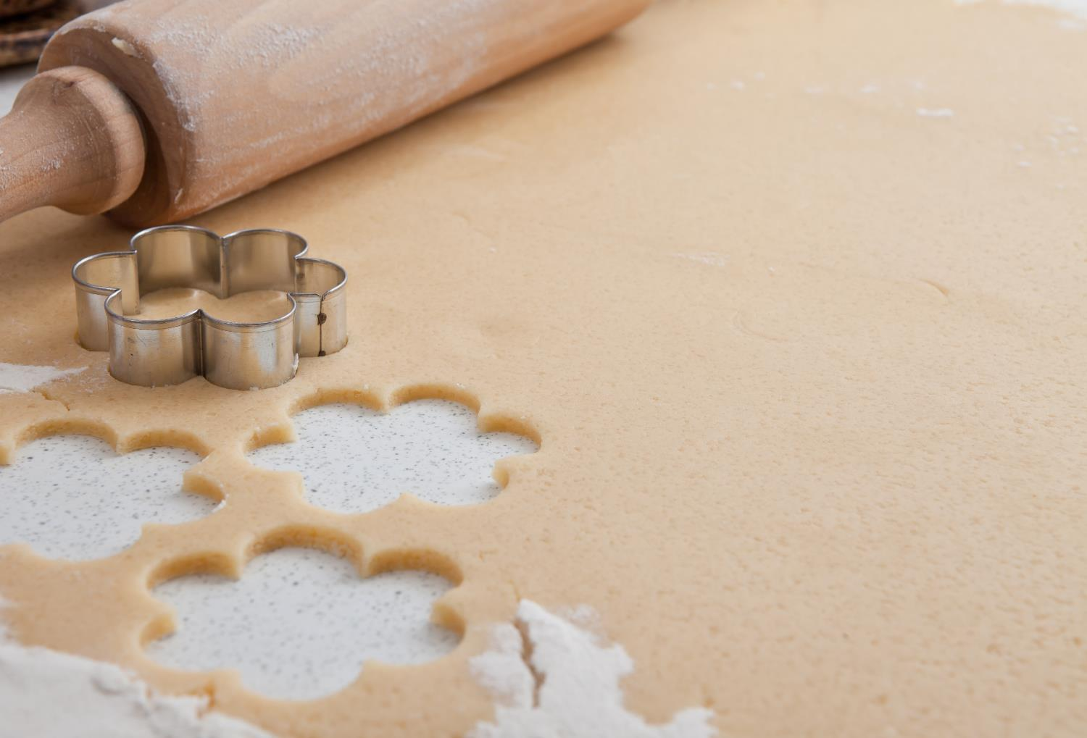
Jigs, patterns
and templates
Jigs and patterns can be made or
bought in to expedite a certain process
  They can help to perform repetitive
  or awkward tasks accurately
Jigs can be used in one-off,
and batch production
  How do jigs make production
  faster and more accurate?
  How could jigs help
  reduce waste?

Slide 11
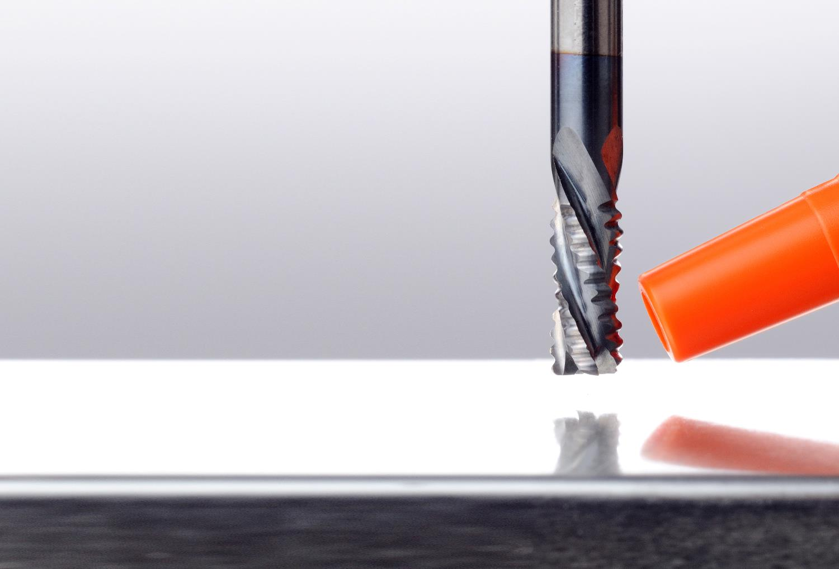
CNC machines
CNC stands for Computer Numerical Control
These are CAD/CAM machines like laser cutters and CNC routers
  These machines are often used in batch production because they are accurate and efficient but also flexible
  What makes them so versatile?

Slide 12
Worksheet 5
Study the jigs, patterns, templates and stencils in Task 2 and explain what each one is designed to do
  Design a jig of your own

Slide 13

Mass production
Mass produced products are made in large volumes, in factories with a high level of automation and very few, if any, processes completed by hand
High set-up costs and low unit costs
characterise mass production
  Give three examples of mass
  produced products?
  Why are mass production lines
  less flexible than those for
  one-off or batch production?

Slide 14

Set-up costs
The more automation in a
production line, the higher
the set-up costs will be
Products made using complex
industrial machinery will be
mass produced
  Which industrial processes have high set-up costs?
  How can a manufacturer justify the high set-up costs of mass produced products?

Slide 15

Continuous production
A continuous production line is run non-stop,
24 hours a day, 7 days a week, manufacturing products to meet a constant demand
  What types of products would be suitable for
  continuous production?
  How labour intensive
  are continuous production lines?
  How does this affect
  unit and set-up costs?

Slide 16
Worksheet Task 3
High unit cost
Low unit cost
High set up cost
Low set up cost
Maximum flexibility
Minimum flexibility
Handmade
Automation
Skilled workers / operators
Unskilled workers / operators
One-off
Batch
Mass
Continuous

Slide 17
Worksheet Task 3
High unit cost
Low unit cost
High set up cost
Low set up cost
Maximum flexibility
Minimum flexibility
Handmade
Automation
Skilled workers / operators
Unskilled workers / operators
One-off
Batch
Mass
Continuous

Slide 18
Plenary
A variety of different manufacturing techniques have been covered:
  Manufacturing by hand
  3D printing
  Laser cutting
  Use of jigs and patterns
  CNC routers
  Injection moulding
  Robotics
Complete Worksheet Tasks 4 and 5

