Slide 1


Paper 2 Question 5 Exam Preparation
You are in the exam hall, you have all your stationery, your water, your brain, everything you need. You turn to Question 5 on Paper 2 and see this:
"Students have too many distractions in daily life. Mobile phones and music players should be banned."
Write a broadsheet newspaper article in which you explain your point of view on this statement
(24 marks for content and organisation
16 marks for technical accuracy)
[40 marks]
What’s the purpose of the piece you will create?
How will this affect your tone and style of writing?
Which audience are you being asked to write to?
How will this affect your tone and style of writing?

Slide 2

Learning objectives
To apply our understanding of Question 5 to our own answers in exam conditions
To manage our time effectively to produce quality exam answers
To evaluate the effectiveness of our answers based on the mark scheme

Slide 3

Purpose: Writing to Explain
Purpose: | WRITING TO EXPLAIN
What is it? | Explaining your opinion on a topic to your reader.
What does it involve? | You are not convincing people or advising, you are explaining.
What key features do you often find in this type of writing? | Facts Opinions A neutral and unbiased tone that gets across your opinions on a topic
When you are writing to explain, you are showing you understand what this purpose of writing involves.
It means you are presenting your opinions around a topic, but you do so in a neutral and factual way, rather than trying to show bias and persuade or argue a point.

Slide 4

Audience: The readers of a weekend magazine
In this exam question you are writing to the readers of a broadsheet newspaper.
They are looking to be informed, interested and engaged, which means your article needs to explain your ideas clearly and carefully, but also be interesting to anyone reading it! You can expect your readers to have a good knowledge of the subject area you are writing about.
That means:
Extensive vocabulary
A carefully planned out structure that supports your ideas and how you get them across to your readers
Appealing to the readers of the broadsheet newspaper through your choice of writing to explain and article language techniques

Slide 5
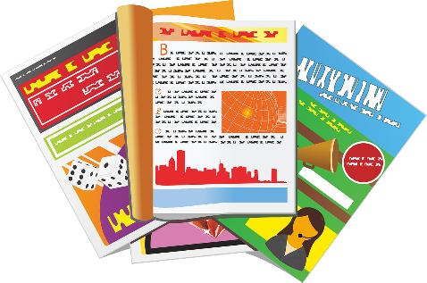

Form: Article
Here are the basic features the exam board are looking for:
a clear/apt/original title
a strapline (heading beneath the main headline)
subheadings
an introductory (overview) paragraph
effectively/fluently sequenced paragraphs.
Putting these elements into your article means you are showing the examiner you can write a specific form of writing and also that you think about the register, style and tone of your writing carefully, too!
Tone, style, register
The tone (sound of writing) is confident and changes dependent on the point being made.
The writing is appropriately formal or informal (register).
The pace (speed) of the writing changes depending on the point being made.

Slide 6
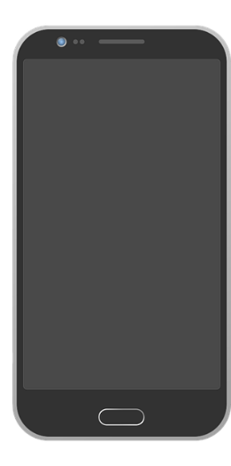
Paper 2 Question 5 Exam Practice
You have 45 minutes to plan and write your answer to this task:
"Students have too many distractions in daily life. Mobile phones and music players should be banned."
Write a broadsheet newspaper article in which you explain your point of view on this statement
(24 marks for content and organisation
16 marks for technical accuracy)
[40 marks]
Remember you are being marked on:
Your register/tone/style
How well your writing matches the purpose and audience.
Your paragraphing
Your use of connectives/discourse markers
Your sentence structures
Your vocabulary
Your use of punctuation

Slide 7

Congratulations on creating and completing your writing piece!
Now you have been given an example of a really effective piece of writing that responds to the same task as you did.
Read through it carefully and make notes on what you think works well in the article.
Remember you are being marked on:
Your register/tone/style
How well your writing matches the purpose and audience.
Your paragraphing
Your use of connectives/discourse markers
Your sentence structures
Your vocabulary
Your use of punctuation

Slide 8
"Students have too many distractions in their daily lives. Mobile phones and music players should be banned."
Write a broadsheet newspaper article in which you explain your point of view on this statement
(24 marks for content and organisation
16 marks for technical accuracy)
[40 marks]
Smart phones have become an everyday essential for students across the country and it is easy to see why. They are a gateway into the world wide web; they are powerful and effective communication devices that have become integral to all social aspects of young people’s lives and they allow us to share and explore all kinds of information. So much of youngsters’ lives are now dominated and controlled by these magical devices, but they do cause problems.
To begin with, sitting down in a classroom and listening to someone else for an hour or writing down great chunks of text onto paper have become almost alien to youths. Outside of the school walls students tap away on their tablets or computers, speaking to others via the myriad of social media apps that now exist. To go into a space where children sit in rows or around tables and actually speak to each other is becoming stranger and stranger to them.
However, responsibility for this issue should not come down to just students. Adults themselves see their own lives increasingly through the glow of a screen rather than in actual social interaction with each other and their own children. When a student goes home, are they greeted with smiles and prolonged discussion or are they confronted with brothers and sisters and assorted family members eerily focussed on small black boxes?
Music players are now no longer such a problem for young people as they have become totally integrated into smartphones. Music is shared between devices and with students sharing earphones plugged into their tech so they can immerse themselves in audio euphoria as well.
Yet to suggest phones should be banned is a concept that evokes tremendous controversy and frustration from many sections of society. Smartphones do cause issues in the school environment, but at the same time it is possible to further integrate technology into education rather than banning their use completely. In the fast-paced modern world students have to know the ins-and-outs of the latest technology in order to be able to compete with others in the jobs market. Schools have a responsibility to get young people ready for the world of work and beyond, yet by seeing smartphones as evil they are failing to provide this support.
Overall then phones do cause issues in certain environments, and students have a responsibility to use their devices in the right way at the right time, but at the same time parents and guardians and teachers all have their own roles in making sure they embrace this technology rather than simply shunning it.

Slide 9

Using the following scales, peer assess your partner’s writing piece
AO5
Give the student a mark out of 4 for matching the purpose.
Give the student a mark out of 4 for matching the audience.
Give the student a mark out of 4 for paragraphing.
Give them a mark out of 4 for using connectives/discourse markers.
Give them a mark out of 4 for vocabulary.
Give them a mark out of 4 for ideas.
Total = /24
AO6
Give them a mark out of 4 for punctuation
Give them a mark out of 4 for vocabulary
Give them a mark out of 4 for sentences
Give them a mark out of 4 for spelling
Total = /16
1 = Occasional
2 = Some
3 = Mostly
4 = Effective
When you’ve given them marks, provide them with PIN feedback:
P = Praise (What is good about the work)
I = Improvement (What could get better)
N = Now (What they should do now to show improvement)

Slide 10
Student by marked: _____________________
Student examiner:_______________________
AO5
Matching the purpose | __/4
Matching the audience | __/4
Paragraphing | __/4
Using connectives/discourse markers | __/4
Matching vocabulary to purpose and audience | __/4
Strength of ideas | __/4
Total: | __/24
1 = Occasional
2 = Some
3 = Mostly
4 = Effective
When you’ve given them marks, provide them with PIN feedback:
P = Praise (What is good about the work)
________________________________________________
________________________________________________
I = Improvement (What could get better)
________________________________________________
________________________________________________
N = Now (What they should do now to show improvement)
________________________________________________________________________________________________________________
AO6
Use of punctuation | __/4
Using vocabulary accurately | __/4
Using sentences | __/4
Accurate spelling | __/4
Total: | __/16
Notes:
To print out for students to use

Slide 11

Plenary: Roadmap to Success
On your roadmap, write down all the steps you will need to take in order to be successful from the start to the end of the exam.
Finish
To apply our understanding of Question 5 to our own answers in exam conditions
To manage our time effectively to produce quality exam answers
To evaluate the effectiveness of our answers based on the mark scheme
Start

Slide 12
Finish
Finish
Start
Start
Finish
Finish
Start
Start
Notes:
To print out for students

