Slide 1
Year 11
REVISION GUIDE
Unseen
poetry
English Literature
Paper 2
Section B

Slide 2
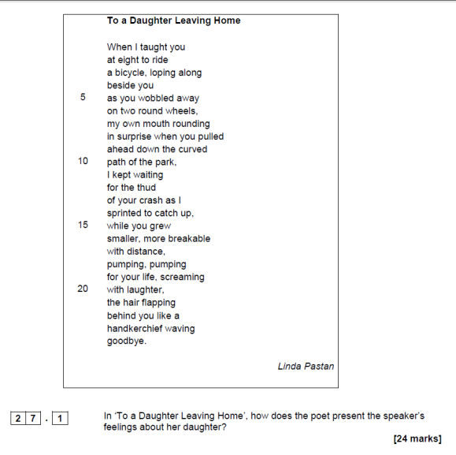
Funeral Blues
Stop all the clocks, cut off the telephone, Prevent the dog from barking with a juicy bone, Silence the pianos and with muffled drum Bring out the coffin, let the mourners come. Let aeroplanes circle moaning overhead Scribbling on the sky the message ‘He Is Dead’, Put crepe bows round the white necks of the public doves, Let the traffic policemen wear black cotton gloves. He was my North, my South, my East and West, My working week and my Sunday rest, My noon, my midnight, my talk, my song; I thought that love would last for ever: I was wrong. The stars are not wanted now: put out every one; Pack up the moon and dismantle the sun; Pour away the ocean and sweep up the wood. For nothing now can ever come to any good.
W. H. Auden
You will be given one poem initially and there is a 24-mark question to complete.
So let’s practise with this poem here…
Choose 3 quotations you know you could analyse well.
What makes a good choice?
If your quotation is packed with ‘power words’ you know that your analysis will be strong. Even better if there is a device being used. If there is, make sure you state that device and analyse it/ explore its effects.
This poem was originally written to mock somebody but Auden made changes to it and the poem is now considered to be moving and emotive.
Quotation | Power words worth pulling out | Subject terminology | Deeper meanings/ effects of line/ quotation

Slide 3
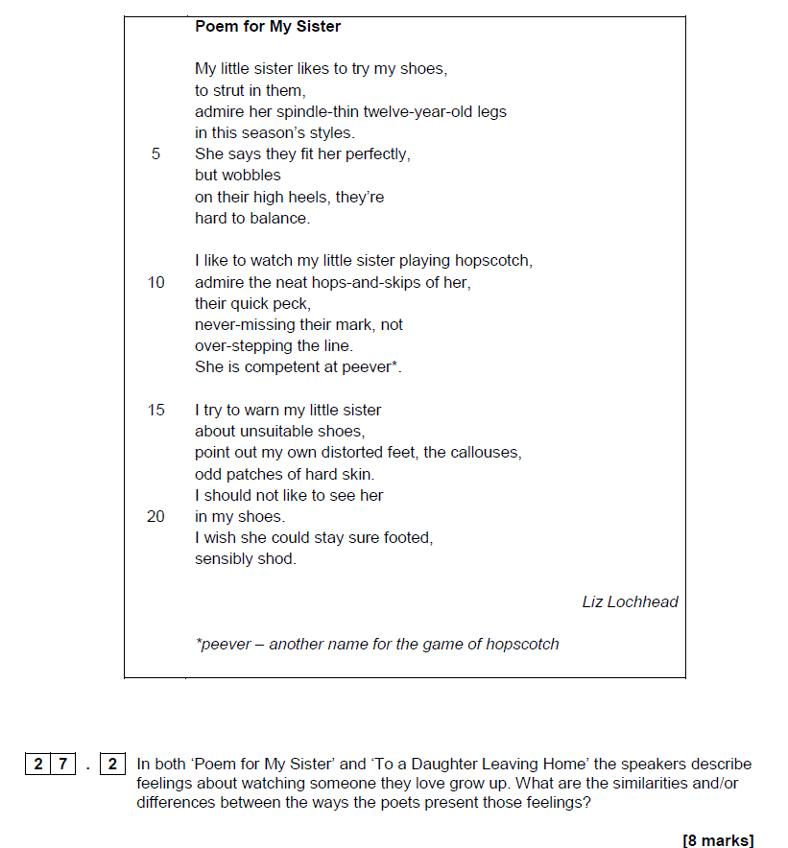
About His Person
Five pounds fifty in change, exactly, a library card on its date of expiry. A postcard stamped, unwritten, but franked, a pocket size diary slashed with a pencil from March twenty-fourth to the first of April. A brace of keys for a mortise lock, an analogue watch, self-winding, stopped. A final demand in his own hand, a rolled up note of explanation planted there like a spray carnation but beheaded, in his fist. A shopping list. A giveaway photograph stashed in his wallet, a keepsake banked in the heart of a locket. no gold or silver, but crowning one finger a ring of white unweathered skin. That was everything.
Simon Armitage
After you have completed this essay, you will see another poem and question to accompany it.
You are required to THEN COMPARE THE 2 POEMS in a mini essay (this section is only worth 8 marks).
FIND 2 LINKS – FOCUS ON METHODS AND THEIR EFFECTS
Question 27.2
In both poems ‘About his Person’ and ‘Funeral Blues’ the poets explore the theme of death. What are the similarities and differences in how they explore death?
Both poets use figurative language to express elements of the situation. In Funeral Blues he states ‘He was my North, my South, my East and West’ which shows his regret at losing his loved one and how much his loved one meant to him. The metaphor implies the man was so important to him that he gave him direction and Auden followed him or was lead by him; he must have thought highly of him.
In a similar way, in About his Person, Armitage states ‘but beheaded in his fist/ a shopping list’. This implies a task cut short and that he gave up on trivial things, suggesting, like most of the poem does, that he took his own life. ‘Beheaded’ is a sharp and violent word suggesting a sudden and brutal end which is reflective of how he decided to die.
Now complete your own second linked paragraph…
This pupil is heading for 6-

Slide 4
Make links…
For Heidi with Blue Hair
When you dyed your hair blue (or, at least ultramarine for the clipped sides, with a crest of jet-black spikes on top) you were sent home from school
because, as the headmistress put it, although dyed hair was not specifically forbidden, yours was, apart from anything else, not done in the school colours.
Tears in the kitchen, telephone-calls to school from your freedom-loving father: ‘She’s not a punk in her behaviour; it’s just a style.’ (You wiped your eyes, also not in a school colour.)
‘She discussed it with me first - we checked the rules.’ ‘And anyway, Dad, it cost twenty-five dollars. Tel them it won’t wash out - not even if I wanted to try.
It would have been unfair to mention your mother’s death, but that shimmered behind the arguments. The school had nothing else against you; the teachers twittered and gave in.
Next day your black friend had hers done in grey, white and flaxen yellow - the school colours precisely: an act of solidarity, a witty tease. The battle was already won.
F. Adcock
My father thought it bloody queer, the day I rolled home with a ring of silver in my ear half hidden by a mop of hair. "You’ve lost your head. If that’s how easily you’re led you should’ve had it through your nose instead." And even then I hadn’t had the nerve to numb the lobe with ice, then drive a needle through the skin, then wear a safety-pin. It took a jeweller’s gun to pierce the flesh, and then a friend to thread the sleeper in, and where it slept the hole became a sore, became a wound, and wept. At twenty-nine, it comes as no surprise to hear my own voice breaking like a tear, released like water, cried from way back in the spiral of the ear. If I were you, I’d take it out and leave it out next year.
S.Armitage
Both poets show the after effects
of their rebellion/ the consequences
Question 27.2: Compare how both poets explore the idea of rebellion

Slide 5
Now try to create a linked paragraph
or two for yourself, answering this question…
Question 27.2: Compare THE METHODS used by both poets to
explore the idea of rebellion

Slide 6
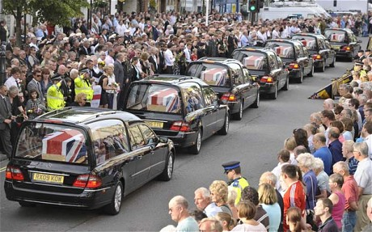
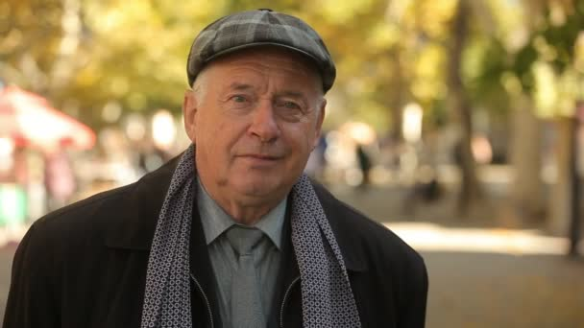
27.2 Both of these poems explore death.
Compare how they do this.
Use arrows to connect useful quotations again…
Roadside
I curl into someone's arms on this rainy day,
Cry for a man I never knew and never loved.
A life immortalised in a tabloid passes by me
And I recognise the photo of him,
Next to the hearse,
As if he were a distant relative, an old friend,
Passing through or passing out.
In the shots taken before the months of
Dry, gagging heat,
He stands in a proud, stiff uniform.
The months before the eyes became wary, weary,
Watchful, dead.
Our kerb-side acknowledgement means little but we offer it anyway.
The raindrops on the car windows obscure the coffin and I am glad.
The outline is softer, photogenic.
Behind me a shopkeeper stands in her doorway,
knowing the drill.
Some of this road is lined with grey, metal barricades,
As if, not contained, we might rush forward to
Wake him, hold him, thank him, interview him.
And he is only here because as he wandered
Down a road, quite dissimilar to this one, he
Failed to sense the bomb.
The cameras wait until he passes before
Gobbling the back of the hearse.
The silence aches, keeps pace with the cars.
M.Dina
Fallen Hero
How his youngest son’s heart must have
Dive bombed,
Then clotted in the depths of haunting fancies
To see his father, a grandfather
Fallen on the stairs. Waiting
To be taken away, patiently,
Peacefully, after the panic.
Bulbous nose and pink veined cheeks,
Whisper of a golden trombone voice and
Grey flat cap.
Heading out.
A caricature of an old man
At a grotesque angle.
Swept back, deep black
Clark Gable hair.
His youngest son drifts in an eerie expanse of disbelief
And futile urgency.
Sees his father
Through the malevolent letter box
Meant only for mail, not for a glimpse
Of tomorrow.
Not to inspire wonder about, if I am alone,
Is this how I will die?
G. Juuso

Slide 7
Whisper of a golden trombone voice and Grey flat cap. Heading out.
The months before the eyes became wary, weary, Watchful, dead.
Close analysis - Make rough notes of analysis for these 2 quotations.

Slide 8
Now complete the full essay –
Question 27.1: Explore how shock and sadness are portrayed in Fallen Hero

Slide 9
Now complete the full essay –
Question 27.2.
Explore the similarities and differences in how both poems explore the theme of death.

Slide 10
Invasion
Soon they will come. First we will hear
the sound of their boots approaching at dawn
then they’ll appear through the mist.
In their death-bringing uniforms
5 they will march towards our homes
their guns and tanks pointing forward.
They will be confronted by young men
with rusty guns and boiling blood.
These are our young men
10 who took their short-lived freedom for granted.
We will lose this war, and blood
will cover our roads, mix with our
drinking water, it will creep into our dreams.
Keep your head down and stay in doors –
15 we’ve lost this war before it has begun.
Choman Hardi
Annotate the poem first.
What is worth analysing?
Which 3 or 4 quotations would you explore and why?
Example:
Deadly/ powerful/ they carry death
with them/ dominant
A force/ lacking identity/
work as a unit/ power
in numbers
In their death-bringing uniforms
QUESTION:
How does Hardi feel about the coming war and how are these feelings portrayed?
Iraq attacked Iran – Hardi’s family fled there

Slide 11
Model essay – question 27.1
How does Hardi feel about the coming war and how are these feelings portrayed?
Hardi begins her poem with ‘soon’. This suggests they haven't got long and their peace is about to be shattered. The fact that she knows this to be certain also disturbs the reader.
She continues by exploring sound first of all – that she will hear the soldiers before she sees them. This is even more terrifying for the reader as we fear what we cannot see and make sense of. ‘The sound of their boots approaching at dawn’ implies there are many men and the small village doesn’t stand much of a chance. ‘Dawn’ suggests early morning which makes the reader understand that the attack will be sudden and early, too early for them to prepare; this puts them at a disadvantage: an early morning surprise attack makes them vulnerable.
The metaphor ‘death-bringing uniforms’ is also unsettling. It implies the soldiers will kill on sight and the word ‘uniform’ makes them seem unified and together in their cause – it makes them seem prepared and professional.
Lastly, the command of the last stanza, divided from the rest of the poem to show its importance, reveals Hardi’s true feelings: that they haven’t got a chance. ‘Keep your head down’ is an instruction not to attract attention to oneself. Evidently, she would rather they didn’t stir up trouble and didn’t resist. She maybe hopes that the soldiers will leave them be if they don’t attempt to rebel. This raises difficult questions in the readers mind about whether one should stand up and fight to protect each other or let the larger army win and take over if it means keeping people safe.
GRADE 6
LABEL WHAT THE PUPIL IS DOING WELL…
6+ (B+) 6= (B=) 6- (B-) | I can… Develop Analyse Consider Explore | When analysing a text I can create a thoughtful and well developed response . I can show use of considered reference to support my well structured interpretations of the text we are studying. I can show a developed and detailed analysis of the writer’s methods and effects of those methods. I can use subject terminology well throughout my response.
Add your own additional paragraph to this essay…

Slide 12
You need to tackle as many different poems as you can between now and the exam so that you can handle any poem AQA give you…
What impression do you get of this man in the first 2 lines?
When does the tone change and what more do we learn about him?
What overall impression do you get of the man after finishing the poem?
Armitage
Poem
And if it snowed and snow covered the drive
he took a spade and tossed it to one side.
And always tucked his daughter up at night.
And slippered her the one time that she lied.
And every week he tipped up half his wage.
And what he didn’t spend each week he saved.
And praised his wife for every meal she made.
And once, for laughing, punched her in the face.
And for his mum he hired a private nurse.
And every Sunday taxied her to church.
And he blubbed when she went from bad to worse.
And twice he lifted ten quid from her purse.
Here’s how they rated him when they looked back:
sometimes he did this, sometimes he did that.
There are many negative power words in this poem that are worth exploring. What are they?
What is Armitage saying about the way we remember people and look at their actions?

Slide 13
…and again…
Salma
One winter we played between your house and mine.
Daring bursts across the wide road which connected and divided us.
An alliance of girlish comradery –
In your house we ate squares of cloying, home-made halwa
Which made my jaw clench as we ate ourselves into plumpness.
Your mother in her hot, yellow kitchen, whispered admonishments
As we pounced shoeless, swooping ballerinas, on your scarlet settee
Which ran the length of your living room
And held your salwar-swathed grandmother –
Sewing, always sewing.
In my house we crouched in the box-larder that smelled of the chip pan.
My mother howled loudly as we darted across the beige three-piece,
Ignoring the tea stains and the ash tray.
Ignoring my paint-speckled father –
Smoking, always smoking.
We sat next to each other at your sister’s dresser and compared my blue eyes to your brown,
Delighted to discover matching flecks of yellow-gold.
We mimed women wearing your mother’s drop earrings and layered amber chains.
Years passed before I saw you again, from my front garden.
Your sister gazed lovingly at you as I tried to recall her name.
The cars in front of you draped in gold netting and flowers,
Ready to take you away.
Emerging from your front door, you were wrapped in vermillion red
And surrounded by hushed and delicate compliments.
And music, such happy music.
P. Sharney
How is the theme of childhood explored in the first stanza?
Where is repetition used in the poem and why?
How does it create meaning?
Where can you see symbolism within this poem? How is it used to reveal important ideas?
How do the 2 girls’ childhoods differ?

Slide 14
Question 27.1: Explore how childhood
and change are explored in the poem ‘Salma’.

Slide 15
On Witnessing a Full Immersion Baptism
Pastor Albert was huge when I was small.
I used to think he was God.
He held curled hands out to the side as he spoke,
As if he missed a lectern
In our guileless, free church of no lecterns and no statues,
As if he needed something solid to grip, and bear his weight.
He spoke to our Friends and to my mother,
Her upturned olive face of serenity and fearless faith
Which made her eyelids flutter and her lips tremble; her face garnished with a glow like a hug.
When Albert spoke, the rows of people behind us listened;
Some mumbled and murmured in a tongue I wouldn’t understand.
The Fellowship barricaded our souls inside for our own good
As he showed us what to do right
And I counted the cheap candles on the window ledge again and again.
And then one evening he stood in front of us
As the water of the pool wrapped around a shaking woman’s heels,
A smothering, gentle clasp,
A caress to fix her.
Her joy found me.
It made me try to thank the God
we had ignored for so many years
That such waters exist.
That there are those who are placed
By strong and forgiving hands,
Under the water,
For the time it takes to pass a few
Divine and promising words:
Promises of faith
That they will surface again,
Cleansed and calm,
And with Albert holding their arm.
I. Katherine
Choose a question:
27.1 How is religion explored in this poem?
27.1 How are ideas about childhood and growing up explored in this poem?
27.1 How are ideas about peace and serenity presented in this poem?
Complete one example paragraph.

Slide 16
Who do you think he means when he says ‘them’?
What’s the poem about?
Polanco doesn’t want to be restrained; he wants to be free and
not tied to anything or anyone.
Identity by J. Polanco Let them be as flowers, always watered, fed, guarded, admired, but harnessed to a pot of dirt. I'd rather be a tall, ugly weed, clinging on cliffs, like an eagle wind-wavering above high, jagged rocks. I'd rather be unseen, and if then shunned by everyone, than to be a pleasant-smelling flower, growing in clusters in the fertile valley, where they're praised, handled, and plucked by greedy, human hands. I'd rather smell of musty, green stench than of sweet, fragrant lilac. If I could stand alone, strong and free, I'd rather be a tall, ugly weed.
What does ‘harnessed’ mean and why has he chosen this word?
Where is there repetition in the poem and what is its effect?
In stanza 2, which words are connected to danger?
How can you tell he is not scared by these dangers though?
What is the purpose of this triple? What is the poet trying to say?
Colour is used a little in this poem. Where and why?

Slide 17
Complete this partial essay.
27.1 How does Polanco explore identity, freedom and how he feels about being true to himself?
Firstly, Polanco clearly feels that he would rather be true to himself (and his roots) than pretend to be something else. This can be seen by ‘watered, fed, guarded, admired, but harnessed to a pot of dirt.’. This quotation implies…
The word ‘harnessed’ is a negative one as it suggests…
Next, the poet states ‘clinging on cliffs, like an eagle wind-wavering above high, jagged rocks.’ appeals to him much more than putting on a showy appearance. The quotation reveals…
‘Clinging’, ‘wavering’ and ‘jagged’ create a semantic field of thrill and danger. These words imply…
Lastly, the poet states ___________________________________________________________________________________. This quotation implies…
Choose your own quotation this time.

Slide 18
Question 27.1
GRADE
7-9 APPROX
GRADE 5/6 APPROX
GRADE
4/5
APPROX
GRADE
2/3
APPROX
This is the mark scheme.
Use it to grade your question 27.1 – even approximate gradings will be useful. You will be used to doing this in class as we have peer-assessed and self-assessed all year!
There are a couple of graded pieces in the revision guide as well; this will help you with your own grading.

Slide 19
For the smaller question you only need to create 2 (possibly 3 if you have time) clearly linked paragraphs of analysis.
Use this mark scheme to assess a comparison piece that you have done.
Question 27.2
How can you improve and move up the mark scheme?
GRADE
7-9 APPROX
GRADE
2-1
APPROX

