Slide 1
Paper 2: Anglo-Saxon and Norman England, c1060-88 (British Depth Study)
Exam Paper is made up of:
Anglo-Saxon and Norman England (Q4A-4C) 55 mins
Question 4 (a) – 4 marks – 5 minutes. Describe two features of….
Question 4 (b) – 12 marks- 20 minutes. Explain why ….
Question 4 (c) – 16 marks – 30 minutes. How far do you agree? (choose (i) or (ii). You will have a choice of two questions. You must consider both sides of the argument. You must reach a judgement on how far you agree

Slide 2
Anglo-Saxon/Norman England
1050 – Earl Godwin exiled for refusing to obey William.
1053 – Harold Godwinson becomes Earl of Wessex.
1064 – Harold’s Embassy to Normandy
1065 – Uprising against Earl Tostig. Tostig Exiled.
1066 – Battles of Gate Fulford, Stamford Bridge and Hastings
1068 – Revolt of Earls Edwin and Morcar
1069-70 – Harrying of The North
1075 – Revolt of The Earls
1070 – Stigand replaced by Lanfranc as Archbishop of Canterbury.
1084 – Heavy Geld Tax Levied
1085 - William starts Domesday book to defend from Vikings
1086 – First drafts of Domesday book shown to William.
1087 – Death of King William I. William II (Rufus) now king.
1088 – Odo leads a rebellion against William Rufus

Slide 3
Topic 1: Anglo-Saxons 1050-1066
Anglo-Saxon Society
Local government was split into:
shires -an earldom was divided into shires
Hundreds – 100 hides of land and were divided into tithings
tithings -10 households (10th of a hundred)
and hides – an area of land covering 120 acres
Each shire had a court, a shire reeve, a burh and had to provide troops for the fyrd.
The King, Earls and Government.
The King - was at the top - Anglo-Saxon kings were expected to lead armies, makes laws and be religious. Edward had to contend with Danelaw and work with The Witan.
Earls - Earls ruled Kent, Wessex, East Anglia, Mercia and Northumbria.
They had to collect taxes, defend their earldoms, oversee justice and had military power over thegns and their elite body of professional bodyguards: Their Housecarls. The Earls had less power when there was a strong king but Edward the Confessor had to rely on Earl Godwin. They also relied on thegns.
Thegns -were nobles, but less powerful than earls. They were primarily warriors and did duties e.g. build roads. in return, for land.
Ceorls -sometimes called freemen, owned their own small area of farmland. All male ceorls had to serve in an army if needed.
Peasants had to work on the lands of their lords for up to 3 days a week and do any jobs he requested. On other days they farmed their own rented land. Every male peasant could be asked by their lord to fight in wartime.
Slaves (around 10% of the population) were not free and had no land.

Slide 4
Anglo-Saxon Society Anglo-Saxon Economy and legal system
Shire Reeves and The Fyrd
Shire Reeves had to collect geld taxes and enforce the law (Shire courts).
They also had to provide men for the Fyrd and had to maintain roads and fortifications.
Each group of five hides of land was obliged to provide one man for the Fyrd.
Thegns would probably train more for the Fyrd but could only be kept from their lands for 40 days before being disbanded (especially during harvest)
Legal system The king was issued laws however collective responsibility was important e.g hue and cry’ and tithings (groups od 10 men). Blood feuds could be settled using Wergild. Use of physical and capital punishment
Economy:
‘Anglo-Saxon England was a rich country. It was suited to farming and traded wool with Germany for silver coins. It also traded with Denmark and Normandy.
About 10% of the population lived in Burhs:
They were situated every 15-20 miles to protect from Viking raids and linked by roads so troops could move quickly.
Towns were important for trade (often had own mint) and some grew due to trade e.g. York with Denmark
Villages – agricultural –peasants and ceorls generally subsistence farmers but may grow extra to trade at marked
The church
The Anglo-Saxon church was independently minded from Roma and focussed on Celtic Saints. These were often linked to the local area and felt familiar and part of people’s lives. Bishops were rich and powerful. Priests were local members of a community.

Slide 5
The last years of Edward the Confessor and the succession crisis
House of Godwin
Money – Wessex was the richest earldom
Military– The Godwins were lords to many hundreds of thegns = more powerful than the king.
Church – The Godwins had convinced Edward to appoint many bishops who favoured them.
Lands – the lands they held were very important e.g. Wessex was key to defending England from attacks from the sea
Alliances – The Godwins had made political marriages
There is some suggestion Edward tried to deal with the Godwins e.g. over the Dover Fracas – where a Norman aristocrat was killed. But he let them back from exile to avoid a war
Harold Godwin succeeded Earl Godwin in 1053. His families power was initially reduced but by the mid 1060s they had built up their power again:
-Harold was a rich adviser to the king.
-1055 Tostig was Earl of Northumbria.
-1057 Gyrth and Leofwine were made earls of East Anglia and The South West midlands
The Godwins were militarily and financially successful. The Godwins defeated Llewellyn (Wales) and earned £8000 compared to the kings £6000.
Harold’s embassy to Normandy 1064 - Harold was taken prisoner by Count Guy of Ponthieu but William rescued him. Harold fought for William and William rewarded him with gifts of weapons. It allowed William to gain the support of the Pope later on as Harold allegedly swore on holy relics to help William become king.

Slide 6
(4a) Describe two features of the power of Saxon government (4)
Feature 1:
Feature 2:
Advice:
2 x PE
5 minutes

Slide 7
The rising against Earl Tostig and The Rival Claimants
The rising against Tostig in Northumbria Why? Tostig raised taxes (Danelaw area), abused power, assassinated rivals, was a southerner (upset people/got things wrong) and was too friendly with Malcom III. Events: 1065 the rebels marched on York. They killed Tostig’s housecarls and invited Morcar to be their Earl. Outcome: Harold did not defeat the rebels. He met the rebels, agreed to their terms and married Morcar’s sister. He agreed Tostig had pushed Northumbria too far and liked that the rebels had chosen Morcar (A Southerner) to be their earl. Harold was more worried about keeping the country together to face future invasions. Harold went against Edward in this Was he already plotting for the succession? | Death of Edward and rivals – the succession crisis Why? Edward died on 5th January 1066 and named Harold Godwinson as his successor. Claimants: Edgar The Aethling – Edward’s nephew, direct blood relative. Too young to lead armies. Harold Godwinson – Good military leader, support of Witan. There when Edward died. Related by marriage. Harald Hardrada – King of Norway. Good military leader. Claim to throne through Magnus. Supported by Tostig (exiled after the rising). William Duke of Normandy – Good military leader. Claim based on Edward’s promise/Harold’s Embassy.

Slide 8
Harold’s coronation and The Battle of Gate Fulford
Harold’s Coronation
Causes:
Harold was in the right place at the right time.
Harold had the support of The Witan who were already gathered.
The Witan knew they needed to act quickly to choose a successful warrior king as successor to counter the threats from William.
Challenges
Tostig and William looking to invade.
The North and Mercia.
Responses
Harold visited York to ensure they would fight for him in the event of an invasion.
Harold gathers the largest army England had ever seen and stationed them on The South Coast to wait for William. He takes his fleet to The Isle of Wight
The Battle of Gate Fulford
Hardraada landed in the North with 200-300 long ships carrying around 10,000 soldiers. He sailed up the Humber and marched towards York.
Edwin and Morcar opted to fight outside the walls of York. They had approximately 6000 soldiers.
Edwin and Morcar met him near the River Ouse. They pushed Tostig back but Hardrada attacks them from behind and wipes out their army.
The English got stuck retreating.
Outcome:
Harold Godwinson had to march 185 miles North to deal with Hardrada.
Thousands of English troops were killed or wounded, making them unable to fight against the Norman invasion.
York surrendered and agreed to send hostages
Fyrd Disbanded: Harold had disbanded The Fyrd only three days before Harada landed as they needed to tend their crops.
Edwin and Morcar both survived the battle but were did not fight at Hastings

Slide 9
(4b) Explain why Earl Harold of Wessex became king of England in 1066.
You may use the following in your answer:
-The Witan
-The power of the Godwin family
You must also include information of your own. (12)
3XPEE and J
20 mins
You need to explain – at least 3 reasons. You are given two reasons. You need to add an extra point of your own.
Focus – explain why
You will be given two stimulus points but will also need to come up with at least one of your own
Aim to give at least three explained reasons

Slide 10
The Battles of Stamford Bridge and Hastings- the Norman invasion
Stamford Bridge – Harold marched 180-210 miles in five days. They surprised Hardrada who was waiting at Stamford Bridge for hostages. A Viking Champion held the bridge killing 40 English soldiers before he was killed by a Saxon who stabbed him from below. The Saxons attacked the outnumbered and unprepared Vikings and killed most of them along with Hardrada and Tostig before the reinforcements turned up. Only 24 ships returned to Norway. Outcome: Hardrada and Tostig were killed. Harold achieved a great victory William invaded in the south – so Harold had to move rapidly south, tiring his housecarls – had to try and get the fyrd together | Hastings: William landed at Pevensey Bay whilst Harold was still in The North. The Battle lasted eight hours. William’s foot soldiers and archers were unsuccessful in breaking the shield wall. Some of Harold’s forces on top of Senlac Hill followed William’s cavalry down the hill, believing the duke was dead – used the ‘feigned retreat’ to get English soldiers to leave the shield wall Once they were killed, William combined his archers and cavalry to break The Saxon Shield Wall. Harold and his brothers were killed, some of The Fyrd ran away. https://www.youtube.com/watch?v=zigjVCFzZ38 (6 mins)
Reasons for victory at Hastings – Williams knights and archers were all professionally trained whereas Harold’s were a mix of Housecarls and Fyrd. -William’s troops were well disciplined and responded well to William’s leadership. -Harold’s soldiers were tired after marching over 400 miles and many of them had been killed at Stamford Bridge.

Slide 11
Topic 2: William securing the kingdom
Establishing control - The Submission of The Earls 1066
The March to London and Berkhamstead William waited in Hastings for The Anglo-Saxon Earls to come and swear loyalty to him. He then went to Dover to secure the port so he could get reinforcements from Normandy. Saxons survivors fled to London where Edwin and Morcar declared Edgar king. William marched to London but it was well defended. He marched to Winchester, Wallingford and then Berkhamstead. Edgar, Edwin and Morcar submitted to William at Berkhamstead. William promised to be a gracious Lord. | Why submit? Earls strong London was fortified. Edgar had a good claim to the throne. Williams troops were tiny (5000) compared to The Fyrd that could be raised by The Earls. Mercia and Northumbria represented half the country and were undefeated. William Strong William had control of the royal treasury in Winchester. The Battle of Hastings had been a crushing defeat. Many thought that God was on his side. London was strong but William was threatening to cut it off from reinforcements from The North.
https://www.youtube.com/watch?v=KGDu-_vi8sg&list=PLcvEcrsF_9zK2bOCseaghBIucwf9pcsFX&index=5 4 mins 57 secs

Slide 12
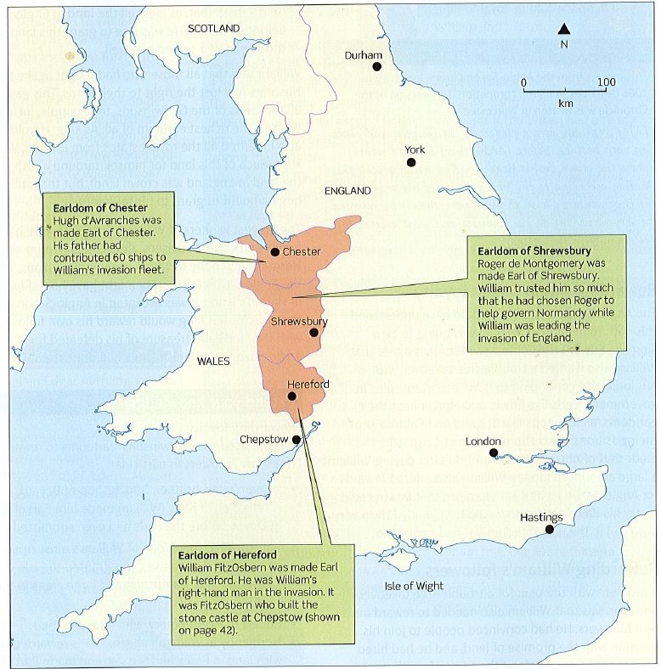
Establishing control
Marcher Earldoms:
Causes: William didn’t want Wales to be a threat.
Events: William set up 3 new earldoms centred on Chester (Hugh d’Avranches), Shrewsbury (Roger de Montgomery) and Hereford (William FitzOsbern) – these were called the Marcher earldoms
Key features:
Shire-sized, centred on shire town
Special privileges to create settlements
Granted the full power of the law = can respond quickly to disobedience and unrest.
Exempted from tax - unlike other earls
The right to build castles - anyone else had to apply to the king
Rewarding Anglo-Saxons and Normans
Anglo-Saxons: Earls like Edwin and Morcar kept their earldoms. Archbishops Stigand and Ealdred kept their positions as they swore loyalty to William.
Normans: William granted lands to those who had supported him. He declared all land in England belonged to him and introduced a heavy geld tax

Slide 13
Establishing control - Castles
William built approximately 500 castles throughout his reign starting at Pevensey Bay where he landed.
They were different to fortified Burhs. They were private not public. Motte and Bailey Castles were also harder to attack and set fire to.
Burhs were designed to protect Anglo-Saxons but castles were used to control them. In rebellious areas, these castles could be built at 32km intervals.
Key features of Motte and Bailey Castles
Palisade fence made from solid timbers driven deep into the ground.
Access to the keep was protected by steep steps.
A strong wooden tower called the keep provided a look-out point
A gatehouse or drawbridge protected the entrance to the bailey.
The bailey is where stables and soldiers’ houses were to launch attacks
A water-filled ditch surrounded both as a line of defence.

Slide 14
The causes and outcomes of Anglo-Saxon resistance, 1068-71
Hereward the Wake – rebellion at Ely
Causes:
Another Danish fleet under King Sweyn arrived at The Isle of Ely in East Anglia.
Sweyn made alliances with local people who used to be part of Danelaw e.g. Hereward the Wake.
Hereward had been a thegn under Edward whose lands had been stolen by Normans.
The local lord had been replaced by a Norman lord.
The Rebellion:
Hereward the Wake and the Rebels were confident. Ely Cathedral was surrounded by marshland and only the rebels knew the way through.
William tried to cross the marsh with a wooden causeway but it collapsed and his soldiers drowned. He also paid a witch to curse the rebels
Result: Some monks betrayed Hereward and Ely Cathedral fell. Hereward disappeared. Morcar captured.
Revolt of Edwin and Morcar in 1068
Causes: In 1067, William returned to Normandy believing England was secure. Edwin and Morcar were William’s prisoners - they were annoyed by William’s tyranny.
Events: Edwin and Morcar escaped and were joined in rebellion with others e.g. Waltheof and Edgar the Aethling. William went North building castles and Edwin and Morcar surrendered.
Consequences: Edwin and Morcar surrendered. Edgar the Aethling fled to Scotland and the rebels were not united.
Edgar The Aethling and the rebellions in The North in 1069
Causes: continued resentment. Rebels from Northumbria joined Edgar (Backed by Malcolm III of Scotland)and King Sweyn of Denmark (sent a ships led by his Asbjorn)
Robert Cumin -new Earl of Northumbria but in January 1069 his soldiers were looting and burning their war North and burned Durham.
Events:
A group of Northumbrians surprised and massacred Cumin and his troops. There was an uprising in York but the survivors held out until William arrived and routed the rebels – laying waste to York. Fitzosbern was established in a new castle.
In 1069 King Sweyn of Denmark sent a fleet to fight with Edgar and Northern Rebels and took over York after The Normans set fire to it.
Consequences: William managed to buy off the Danes who returned to Denmark. As soon as William put down one rebellion another started - he then embarked on a campaign to ‘Harry the North’ in destruction.

Slide 15
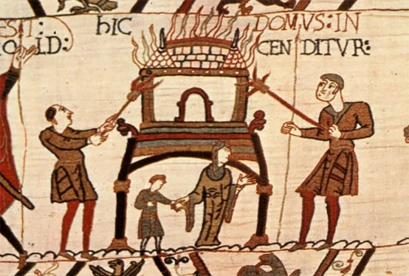
The legacy of resistance to 1087 - The Harrying of The North
 | What happened | Reasons
The Harrying of The North 1069-1070 | William killed everyone in rebelling areas. He burned houses, grain stores, crops and killed livestock. He destroyed farm equipment and sowed salt into the fields to prevent future crops growing. | Death of Robert Cumin -The rebels kept refusing to meet him in open battle. The Harrying of The North made it impossible for people to live there. -as soon as one rebellion put down another started – multiple rebellions at a time -The North clearly required different tactics to the South as the Danelaw resented Southern rule. -He had to get rid of the threat of a Danish invasion and stop moving troops from one area to another.
 | Short Term impact | Long Term impact
The Harrying of The North 1069-1070 | -100,000 dead. -People resorted to cannibalism. -This massively reduced the chance of a future Danish invasion. Sweyn maybe chose Ely because Northumbria was no longer suitable. | --There were no further uprisings in Northumbria. -60% of Yorkshire as listed as ‘vasta’ or wasteland and William couldn’t tax it. -There were somewhere between 80,000 and 150,000 less people than in January 1066.
https://www.youtube.com/watch?v=kNWoXlAZdkM&index=6&list=PLcvEcrsF_9zK2bOCseaghBIucwf9pcsFX 5 mins.59 secs

Slide 16
The legacy of resistance to 1087 -
 | What William did |  | How was land lost?
Changes in Land Ownership 1066-1087 | Of 190 tenants-in-chief, only two were Anglo-Saxon. A quarter of the land was held by The Church but The Normans held the most senior positions. The king’s royal estates made up 1/5 of the land. Only 5% of the land was still in Anglo-Saxon hands, typically in small estates. Half the land of the 190 tenants-in chief was held by just 11 men including William FitzOsbern, Odo of Bayeux and Robert of Mortain. They were all Norman nobles and William’s relatives. |  | Forfeit – William owned all the land, anyone who fought against him lost their land. New Earldoms – William created new blocks of land like The Marcher Earldoms from several old blocks. Land Grabs – Straightforward theft of land by Normans from Anglo-Saxons. Norman sheriffs were notorious for this sort of thing. Heirs – William made Normans ‘heirs’ to Anglo-Saxon lands.
How land was owned under Edward Bookland – lords were given a charter to show they owned the land. Leases – Land was loaned to someone for money. This could for a long time e.g. three generations. |  | How land was owned under William There was only one landowner: The King. William owned all land. William made Saxons pay for their own land or granted it to his followers for free. Anyone who disobeyed him lost land.

Slide 17
The legacy of resistance to 1087 - Changes for the peasants and changes to government
Peasants - Peasants were still not free and were taxed more, there were fewer and fewer examples of ‘free’ peasants’- called Ceorls – less independent and couldn’t move ‘Lords’ as much.
Thegns – Normans inherited their lands when they died – not their children. If did not obey the lords = land forfeited.
Maintaining Royal Power – Military Strength William mainly maintained power through his military strength. Anglo-Saxons would have respected great warriors and shown to many that he was favoured by God. Some Anglo-Saxon armies joined his armies against rebels.
Royal Ceremonies – William made a point of being seen wearing his crown three times per year and swore to preserve Edward’s laws.
- Coinage and writs – William took control of minting coins with his Royal Seal on and used writs to control royal power.
Journeys around England – William travelled around and met people to show his power was never far away.
Owning the land – William was a much stronger king than Edward as he technically owned all land.
Remember that William still relied on oath-taking. He made every landholder in Britain swear an oath of allegiance to him in 1086 when he thought Vikings would invade again.

Slide 18
Revolt of The Earls 1075
The rebels: Ralph de Gael (Earl of East Anglia), Roger De Breteuil (Earl of Hereford) and Waltheof (Earl of Northumbria)
Causes:
Roger – Objected to the fact that he was granted less land than his father and the fact that William had introduced his own sheriffs to The Marcher Earldoms
Ralph – Unknown but probably resented loss of power and wealth compared to his father.
Waltheof – Was the one who informed Lanfranc of the revolt which led to it failing. Maybe he was playing both sides but wanted to be on the winning side.
Events – Anglo-Saxons and Normans joined together to pin Ralph and Roger into their earldoms. The Danish Fleet arrived too late. Ralph escaped to Normandy and Waltheof was executed. William failed to take Ralph’s castle in Normandy.
Effects
Normans: William now had to be careful of his own earls’ ambition. Resentment of the power William held was at the heart of the rebellion
Anglo-Saxons: such as Bishop Wulfstan now seemed to support The Normans but this didn’t stop William eliminating Anglo-Saxon aristocrats.
Vikings: The failure of the planned Danish invasion fleet to support the rebellion in 1075 was in fact the end of the Viking threat. When there was another threat in 1085, William launched The Domesday Book and took extra measures to boost his defences. This shows how seriously he took the threat of 1075
.

Slide 19
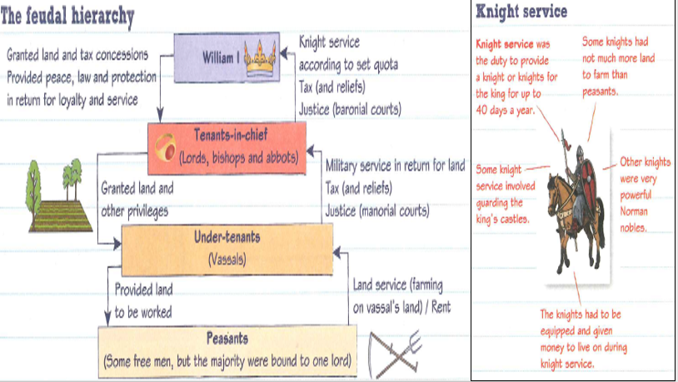
Topic 3 Norman England 1066-88
The Feudal System
William needed soldiers to control England and defend Normandy – and they needed to be paid.
He made himself owner of all the land
He rewarded his key allies – tenants in chief with grants of land
Each group in the system answered to the person above them but ultimately all owed loyalty to the king first

Slide 20
The Nature of feudalism:
Landholding: Norman landownership was simple -the king owned all the land.
In Anglo-Saxon England, many people had owned their land and could pass it to their heirs.
But in Norman England the heir had to prove their loyalty to the king before they could reclaim the land as well as to pay the king for the right to use it. This payment was called a relief.
When the heir took over the tenure of the new land- they paid relief and performed a ceremony of homage.
Any landholders could be punished with high reliefs = impossible for their sons to take over the land when they died.
Homage: When William granted land to a tenant-in-chief, an important ceremony of homage took place.
Labour service - peasants: Labour service was about working the lord’s lands e.g. plough, sow crops, and harvest in return for the use of the land. The peasants would farm this land on top of their land service, for their own benefit. They may also have had to provide a certain amount of produce each year e.g. planks, poles for fencing, honey or eels. People in towns had to do labour service for any land that they worked outside the town.
Forfeiture: In the event that a land-user did not provide the service required of them, whether military or land service, they could forfeit their land (or have to pay a fine).

Slide 21
Importance of the Church Helped control the country – praise the king and teach people their roles Church was a major land owner Church leaders = involved in shire courts and other legal processes Taught reading and writing. Bishops and abbots were well educated. Archbishops sometimes represented the king or acted as advisors. They kept collections of laws.
Stigand | Lanfranc – reforms of the Church
Who was he? Last Anglo-Saxon Archbishop of Canterbury (appointed by Godwins) What criticisms did he face? Pluralism – had post and income as Bishop of Winchester after he was made Archbishop of Canterbury (2 bishoprics) = made him very wealthy Supporting a rival Pope and acting as Archbishop when not appointed by the Pope Simony - accused of taking money in exchange for granting Church jobs to others. =easy for William to declare the whole English Church as corrupt. | Who was he? Replaced Stigand as Archbishop of Canterbury and was put in charge of the whole Church Issues faced: Stigand had no real control of the Church – it lacked discipline. Lanfranc believed only the Church or king could appoint bishops What reforms did he make? 1075 – No priest could be married. Monasteries –He increased the number and the amount of monks in them. Monks were to be well educated and had to follow the rules of the monastery. Church courts 1076– were set up to deal with anyone who committed religious or moral crimes such as adultery or blasphemy. Priests who broke the law were also tried in Church courts instead of the king’s courts. Rebuilding the cathedrals – e.g. Canterbury Cathedral. Anglo-Saxon rural cathedrals were knocked down and rebuilt (Norman style) in strategically important market towns (e.g. Selsey to Chichester) = more control of the area. Archdeacons became more common- below the bishops but above parish priests. Their role was within the bishop’s diocese and they enforced Church discipline e.g. controlled the priests and therefore the population = Normanised the Church

Slide 22
Extent of change
Anglo-Saxon England | Norman England
Slaves made up 10% of population | Some slaves freed
Peasants(ceorls) 90% of population-some free. | Peasants bound to the lord = worked harder but no real change
Thegns – 4-6000, local land owners (more than 5 hides). Provided military service | Thegns wiped out– replaced by knights/other Norman vassals of tenants-in-chief. Norman knights had less indepence and less likely to have great halls
Earls - powerful/ wealthy – could oppose a king | Saxon earls replaced with Normans –smaller earldoms (tenants-in-chief) - dependent on the king
Church undisciplined. Followed Saxon saints | Lanfranc reformed the church = Normanised and rebuilt churches
Earls controlled each earldom, had thegns etc. | Feudalism – clear hierarchy and castles built to control the population
Geld tax set by both Viking and Saxon rulers. Traded extensively e.g. with Scandinavia | Geld tax levied more frequently – wealth used to benefit Normandy. Trade with Scandinavia cut off – more with Normandy. Harrying of North hit Danelaw areas.
Saxon government | Government –Saxons replaced– but things like writs stayed the same. Everyone of Saxon origin e.g. Bishop Wulfstan proved complete loyalty to William
Anglo-Saxon England was richer and more sophisticated than Normandy – so the Normans adopted ways of doing things
Village life, particularly for peasants was the same. Farming life went on the same as before.
Towns continued to trade as before –some towns cleared for castles/churches/cathedrals (stone). Towns like York grew rapidly
The royal household – although now Norman – still consisted of servants, bodyguards, administration staff and advisors

Slide 23
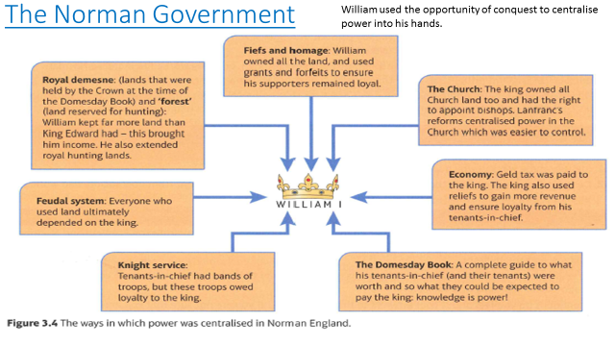
Role of the regents:
Rebellions forced William to be in England for much of 1066-72, but spent 80% on his time in Normandy.
He appointed trusted supporters as regent with the same powers that William had e.g Odo of Bayeux, and fitzOsbern (Earl of Chester), and to Lanfranc, Archbishop of Canterbury – Lanfranc was used more as the others caused problems e.g. land grabs and caused some resistance..
This system worked shows: that William chose regents wisely, and that he had built up a strong and effective system of government for them to use.
Lanfranc was regent during the Revolt of the Earls 1075 .
Role of the Earls:
William rewarded followers/ supporters at Hastings given earldom.
Reduced power and number of the earls, and they held less land (and wealth). He replaced the Anglo-Saxon earls.
Earls = important role in the military defence of strategically important borderlands.

Slide 24
Sheriff |  | Forests
Anglo-Saxon England | Norman England: | In Anglo-Saxon England the king was free to hunt anywhere in his own demesne. William had the same but wanted to expand his hunting ground – he made new areas ‘ forests’ – taking them from land holders Forest = area reserved for hunting by the king. Why hated? No hunting, foraging, collecting wood/timber Couldn’t carry weapons Seen as unfair – people suffered Made Norman land grabs seem legitimate Punishments were harsh Fines given and rights sold to other nobles
Appointed by the king – managed the kings land in an earldom (earl more important) Responsible for law and order in their shire – answered to the earl Responsible for the shires defence and gathering the fyrd | Appointed by king but more powerful – controlled their shire – answered to the king only Kept role for law and order – plus new laws to punish anti-Norman rebellion Same role in defence but custodians of castles in the shire that belonged to the king Hated for making land grabs
Domesday book |  | Norman Aristocracy
Ordered by William Christmas 1085 Gathered to pay for the Viking threat of 1085 Sorted out legal disputes over land Showed William’s power – no one could lie Details lands owned and how much they were worth. Tenants in chief had tax deals - William could reverse some. There were heavy geld taxes in 1084-1086. -the Domesday Book = ‘at a glance’ guide for working out what the financial opportunities e.g. for charging reliefs |  | Language – Norman –French. Latin – used in all official writing. English – spoken by ordinary people and peasants. Culture – spent money on rich clothing, jewellery, parties Showed off their wealth e.g. built high impact buildings Passed lands to a single heir (kept estate together) Chivalry – moral code on how knights should behave Church – very religious & should atone for sins e.g. violence Looked down on the English e.g. destroyed tombs and relics of Saxon and Celtic saints – not seen as holy

Slide 25
Q4C)
‘The main consequence of changes in government after 1066 was the king had more power than his Anglo-Saxon predecessors.’
How far do you agree? Explain your answer:
You may use the following in your answer:
Castles
the use of forfeiture
You must also use information of your own. (16)
What you need: introduction, 3 xPEEL paragraphs + a judgement.
Structure:
OPTION 1
Either x2 paragraphs agreeing and x1 disagreeing.
Or x1 paragraph agreeing and x2 disagreeing.
OPTION 2
Develop 3 paragraphs on separate factors and argue for and against within each paragraph
Advice:
Weight you answer so that your conclusion is well supported
Read the question carefully – if a specific factor is given address it
Develop 3 completely different factors/reasons
Refer the argument to the statement – are you arguing agree/disagree
Conclusions should be developed and try to analysis. Lots of marks for this question!
30 minutes

Slide 26
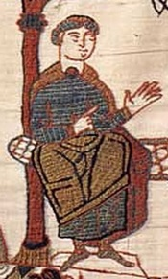
Odo
Significance of Odo:
William’s most trusted supports were his family members, they were richly rewarded.
Odo and Earl William FitzOsbern made it hard to gain Anglo-Saxon acceptance of his reign with their violent and oppressive actions.
King William allowed Odo a lot of power; he was able to act as a ‘second king’. Odo went too far in his abuse of power (in the end), but probably only because he crossed Lanfranc: it isn’t likely that many Anglo-Saxons who lost land to Odo ever got it back.
If Odo was imprisoned because of taking knights from William,that shows how seriously William took the idea that knights were loyal only to him, the king and that no one was above the law.
The pope reprimanded William for imprisoning one of his bishops, Odo.
Odo was William’s half brother – they had the same Mother, Herleva.
In 1049, William made Odo Bishop of Bayeux, even though his reputation was very poor – he was greedy and immoral (Bayeux was an important Norman town).
Odo was a major supporter of William’s invasion, contributing 100 ships to the fleet, and fought at the Battle of Hastings.
William rewarded him with the earldom of Kent and gained control of many other estates to become the second largest landholder in England, after the king.
Odo was made co-regent of England (with William FitzOsbern) when King William returned to Normandy.
1076 – a 3 day enquiry was held following complaints to Lanfranc about land seizures by Odo. Odo was forced to return the land.
1079 – William sent Odo to Northumberland, following attacks from Scotland and the murder of the Archbishop of Durham – Odo laid waste to the region.
1082 – Odo fell out of favour with William and was imprisoned. He was not released until William’s death, after Odo’s brother manages to persuade William to show mercy.
Historians don’t know why he got into trouble- probably due to his corrupt behaviour or tried to take the throne. Odo tried to take some of William’s knights out of England for a journey to Rome after he saw an opportunity to make himself Pope. This went against centralised power and knights service. No tenant-in-chief was allowed to put their own army together!
10. 1088 – Odo led the barons in revolt against William II

Slide 27
William and his sons
Robert’s revolt:
In 1077 Robert’s younger brothers played a prank on him that led to a real fight that William had to break up.
Angry that his father had not punished his brothers, Robert and his men tried to take control of Roen Castle.
William led troops against Robert and his men at Remalard. Robert fled to Flanders.
Willliam’s enemy, King Phillip of France, gave Robert a castle on the border of Normandy. Robert used it to launch attacks on Normandy.
William raised an army against Robert, in a battle in 1079 (Gerberoi), the two fought and Robert won, humiliating his father.
Matilda organised reconciliation between William and Robert at Easter, 1080.
The nobles wanted peace – their own sons were involved
William made Robert heir to Normandy again.
William’s personality:
A religious king
Tough and determined
Devoted husband
It is said he wanted to be viewed as the legitimate king of England
Was said to have repented for being brutal on his death bed
William’s relationship with his son Robert Curthose:
he was the eldest son, a good warrior but William did not think he was ready to lead the Normans against their enemies. Robert had a difficult relationship with William, but was a favourite of his mother. William wouldn’t let him have any power in Normandy.
William’s death – 1087: William had become fat and when he was leading an attack against the French castle at Mantes his horse stumbled, throwing William and causing internal injuries.

Slide 28
Who should be ruler? We can’t be certain what happened:
It is likely William did not want to leave Normandy or England to Robert – still angry at the revolt
His nobles persuaded him to stick to the promise of Robert being heir to Normandy
Giving his eldest son the land in Normandy – fitted Norman customs.
But what about England? Why split England and Normandy? He didn’t want to leave it all to Robert.
William Rufus was his favourite son and it is possible he followed FitzOsbern in splitting his lands in – Normandy to the eldest son and England to the second son.
Did William leave it up to God. It is likely he gave Rufus a helping hand by sending him to England with a letter to Lanfranc – telling him to crown Rufus King of England (William II).
The succession crisis:
The nobles had a dilemma – they had land in Normandy and England – who did the owe loyalty to?
Odo said the nobles should choose between the two brothers and help one to reunite the lands.
Odo suggested they should unite behind Robert – Robert would be easier to handle and likely to listen to Odo.
The rebellion of 1088:
Rufus must have realised there was a problem as lots of nobles did not turn up to court at Easter.
Odo led a rebellion against Rufus
The majority of the English people supported Rufus
Odo and his brother, Robert of Mortain, took refuge in Pevensey Castle
Odo then escaped to Rochester Castle, waiting for Robert to come and support him – he never arrived so Odo was forced to surrender and was exiled.
Why did Rufus win?
Robert went straight to deal with the heart of the rebellion at Rochester rather than deal with smaller rebellions
He had the support of most Norman barons, almost all of the English bishops and the English population.
Bishop Wulfstan crushed rebellions in the Marcher Earldoms
The English Fyrd helped defeat Odo and his brother in the south
William Rufus reached a peaceful settlement with the rebels and established himself as king.

