Slide 1






Christian practices
The role of the Church in the local community
Wednesday 2nd May

Slide 2
What do I need to know?
Liturgical and non-liturgical worship (How do different Christian churches worship?)
Formal and informal worship (What is the difference?)
The Bible in worship (How is the Bible used in Christian worship?)
Private worship (What are the benefits of private worship?)
Prayer, and the Lord’s Prayer (Why is the Lord’s Prayer significant? Why pray at all?)
The meaning of sacraments (What is a sacrament?)
Baptism – infant and believer’s (Why do Christians have different beliefs about when a person should be baptised?)
Eucharist in Catholicism (What is the sacrament of Holy Communion, and why is it important?)
Eucharist in the Church of England (How do C of E beliefs about the Eucharist differ from Catholic beliefs?)
Lourdes (Why is Lourdes a place of pilgrimage for Christians today?)
The role of the Church in the local community, including food banks and street pastors (Why does the Church provide these things?)
The importance of the ‘worldwide Church’ in working for reconciliation
How Christian Churches respond to persecution (How do they help?)
The work of one Christian charity (Tearfund, Christian Aid, CAFOD)

Slide 3

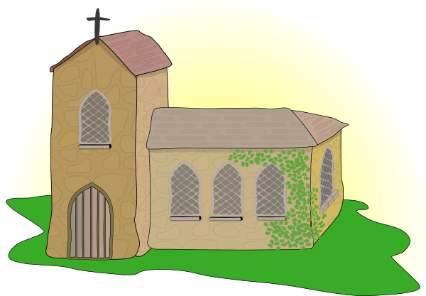
‘church’ comes from the Greek word ‘ekklesia’ which is defined as an assembly, or gathering, of Christian people
Capital C – Church of people; a community of believers
One Church, but many churches?
Little c– a church building
“And God placed all things under his (Jesus’) feet and appointed him to be head over everything for the Church, which is his body” ~ Ephesians 1:22-23

Slide 4






Throughout the history of the Church, it has been a major source of social services like schooling and medical care; it has been an inspiration for art and culture and it has campaigned for justice and championed the neglected.
In modern Britain the Church has become involved in projects that help the local community, such as food banks.

Slide 5


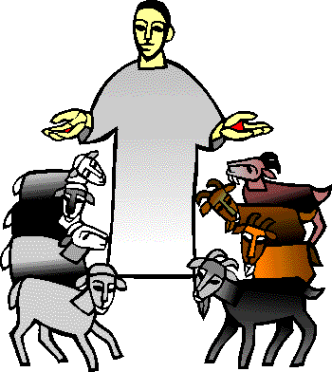
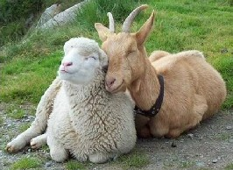
The parable of the sheep and the goats
A story told to teach a moral or a lesson
https://www.youtube.com/watch?v=iWSkdx-XwWY

Slide 6
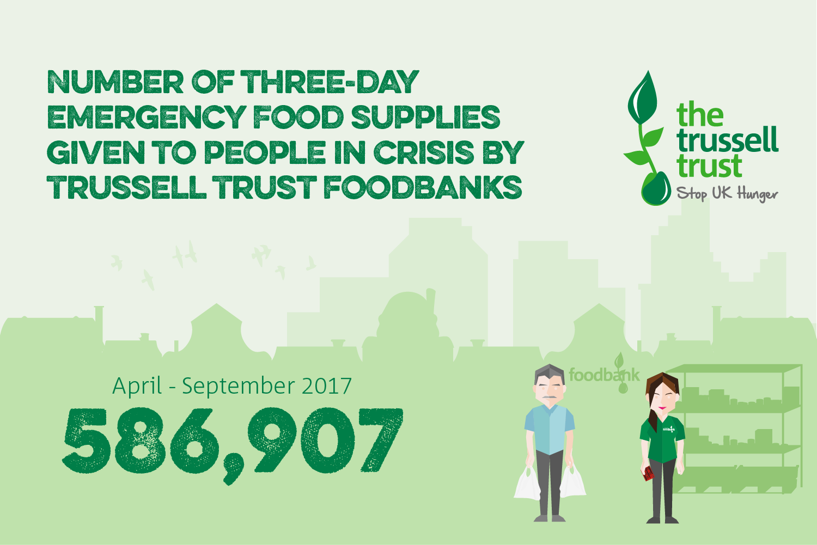

Slide 7
Case study
In 1996 Paddy and Carol Henderson met Baby Boris, a street baby living at Central Railway station with his 14-year-old mother. Paddy and Carol were working for a UN feeding programme at the time.
Whilst fundraising for Bulgaria in Salisbury in 2000, Paddy received a call from a desperate mother in Salisbury saying: “My children are going to bed hungry tonight – what are you going to do about it.”
Paddy investigated local indices of deprivation and ‘hidden hunger’ in the UK. The shocking results showed that significant numbers of local people faced short term hunger as a result of a sudden crisis.
Paddy started Salisbury Foodbank in his garden shed and garage, providing three days’ of emergency food to local people in crisis.
In 2004, the UK Foodbank Network was launched teaching churches and communities nationwide how to start their own foodbanks.

Slide 8
Case study
“The Oasis Project has been providing a warm welcome to all since 2005.
We provide practical care and training, and emotional and spiritual support in a community cafe setting.
Helping people to build a future and bring hope to lives in crisis.
We work with our associated project, Plymouth Foodbank and the church at Plymouth Central Hall
Last year 324 people attended a course or an activity at the centre. 77% said their self confidence improved, 35 gained work, 16 went on to other training.”
http://oasisproject.co.uk/

Slide 9
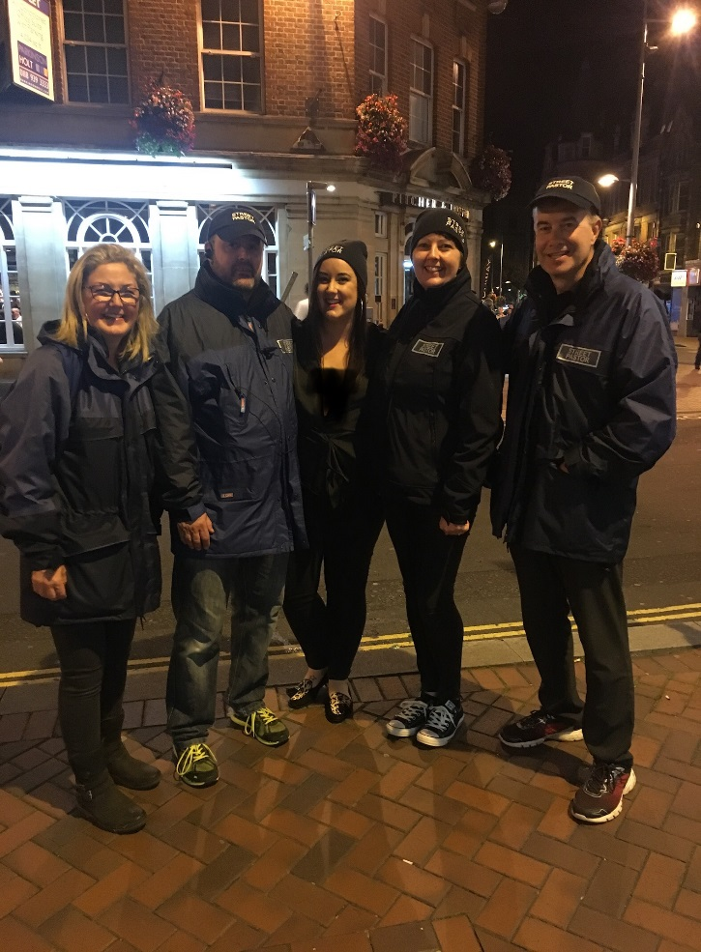
Case study
Street pastors are trained volunteers from local churches who care about their community.
They patrol in teams of men and women, usually from 10 p.m. to 4 a.m. on a Friday and Saturday night, to care for, listen to and help people who are out on the streets.
A street pastor is someone who is…
a Christian and is part of a local church;
concerned for society and their local community;
willing to engage with people, whatever their
perspective on life and wherever they hang out

Slide 10

Case study
Parish Nursing UK is a Christian charity which helps local churches appoint nurses, who in turn support people and communities towards whole person healthcare. This is care for the person’s overall well-being, incorporating body, mind and spirit.
http://parishnursing.org.uk/what-is-parish-nursing/

Slide 11
“Anyone who has two shirts should share with the one who has none, and anyone who has food should do the same”
The parable of the Good Samaritan
“When I was hungry you gave me something to eat”
“Love your enemies and pray for those who persecute you”
“Love your neighbour”
“Let each of you look not only to his own interests, but also to the interests of others.”
“Carry each other’s burdens and in this way you will fulfil the law of Christ”
“Love each other as I have loved you”

Slide 12


Agape
“Faith by itself, if not accompanied by action, is dead”
The essence of agape love is goodwill, benevolence, and willful delight in the object of love. Unlike our English word love, agape is not used in the New Testament to refer to romantic or sexual love. Nor does it refer to close friendship or brotherly love, for which the Greek word philia is used. Agape love involves faithfulness, commitment, and an act of the will.
https://www.youtube.com/watch?v=W3Yk-c9_PtQ

Slide 13
Essential information…
The Church is the holy people of God, also called the body of Christ, among whom Christ is present and active
A church is a building in which Christians worship
Individual churches and the Church as a whole help the local community in a variety of ways, including the provision of food banks. These give food for free to people who cannot afford to buy it.
Christians should help others in the local community because Jesus taught that people should show agape love
Christians believe it is important to put their faith into action.
Street pastors are people who are trained to patrol the streets in urban areas. They help vulnerable people by providing a reassuring presence on the street.

