Slide 1
Christian practices
Mission & evangelism
Reconciliation
Christian persecution
Tuesday 8th May

Slide 2
What do I need to know?
Liturgical and non-liturgical worship (How do different Christian churches worship?)
Formal and informal worship (What is the difference?)
The Bible in worship (How is the Bible used in Christian worship?)
Private worship (What are the benefits of private worship?)
Prayer, and the Lord’s Prayer (Why is the Lord’s Prayer significant? Why pray at all?)
The meaning of sacraments (What is a sacrament?)
Baptism – infant and believer’s (Why do Christians have different beliefs about when a person should be baptised?)
Eucharist in Catholicism (What is the sacrament of Holy Communion, and why is it important?)
Eucharist in the Church of England (How do C of E beliefs about the Eucharist differ from Catholic beliefs?)
Lourdes (Why is Lourdes a place of pilgrimage for Christians today?)
The role of the Church in the local community, including food banks and street pastors (Why does the Church provide these things?)
The importance of the ‘worldwide Church’ in working for reconciliation
How Christian Churches respond to persecution (How do they help?)
The work of one Christian charity (Tearfund, Christian Aid, CAFOD)

Slide 3
Mission: the vocation or calling of a religious organisation to go out into the world and spread their faith.
The Great Commission: Jesus’ instruction to his followers that they should spread his teachings to all the nations of the world.
Missionary: a person sent on a religious mission, especially to promote Christianity in a foreign country through preaching of charitable work.
Evangelism: spreading the Christian gospel by public preaching or personal witness.

Slide 4
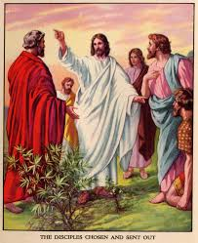
The Church not only provides a place to worship and learn about God, it also has a mission to spread the good news to non-believers that Jesus Christ is the son of God and came into the world to be its saviour.
Matthew’s gospel ends with what is known as the Great Commission:
“Therefore go and make disciples of all nations, baptise them in the name of the Father and of the Son and of the Holy Spirit, and teaching them to obey everything I have commanded you.“
Matthew 28:19-20 [NIV]

Slide 5
Pentecost
When the early disciples received the Holy Spirit at Pentecost, then days after Jesus ascended into heaven, this gave them the gifts necessary to carry out the Great Commission.
https://www.youtube.com/watch?v=Xvy-_Dayaoc

Slide 6

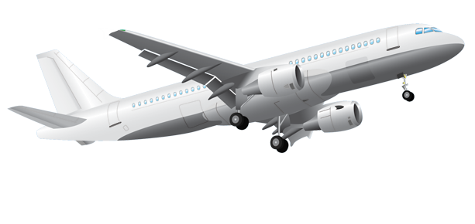
Christians have a responsibility, according to the Great Commission to tell others of their faith. This may be by spreading the word to people they meet in everyday life or, for some, through organised events or preaching.
The main aim is to persuade people to accept Jesus as their Lord and Saviour and to extend the Church to every nation of the world. The New Testament book, the Acts of Apostles explains how the early Christian Church grew in this way and includes, for example, the mission journeys of the apostle Paul.
Some people feel called to go to other countries and become missionaries, which involves evangelism and in some cases humanitarian work among the poor and disadvantaged.

Slide 7
https://www.youtube.com/watch?v=I_7tdhPHcHw

Slide 8
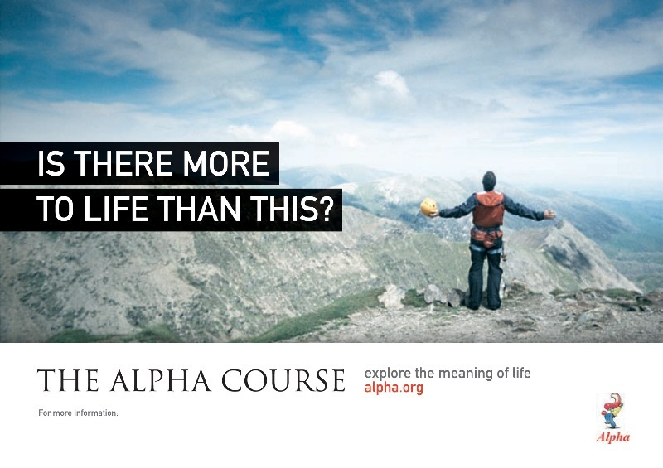
http://alpha.org/about/

Slide 9

The Alpha Course
Originally known as the Alpha Course, Alpha was started in 1977 by a Church of England curate, Reverend Charles Marnham, at Holy Trinity, Brompton, London. The aim was to help church members understand the basics of the Christian faith but soon it began to be used as an introduction for those interested in learning about Christianity. The organisers described this evangelistic course as ‘an opportunity to explore the meaning of life ’through a series of talks and discussions.
The idea caught on and many of the major Christian denominations in Britain and abroad began using it. In the 1990’s the Reverend Nicky Gumbel from Holy Trinity, Brompton was involved in revising the course and encouraging its use.
Alpha courses take place not only on church premises but also in peoples’ homes, universities, workplaces, prisons and other venues. Worldwide, millions of people have taken part in this course and other related course have been started. These include relationship and marriage courses for adults and study programmes for young people.
https://www.youtube.com/watch?v=XLQZM1QwuUs

Slide 10
Church growth
It is difficult to say how many Christians there are in the world – estimates vary from 1.5 billion to 2.5 billion.
The church has grown rapidly from the time of Christ and is still doing so in South America, Africa and Asia. This is not the case in the USA and Europe, despite Church growth programmes, or in the Middle East where Christians have suffered much persecution.

Slide 11
Begun in 1974 under the leadership of evangelist Richard Bonnke, this organisation has held evangelical missions throughout the world and in Africa in particular. Bonnke studied at the Bible College of Wales in Swansea and was a Pentecostal minster in Germany for 7 years. He believed God called him to be an evangelist in Africa when he was ten years old. He went to Lesotho and from there he has held evangelistic meetings across the continent and beyond.
https://youtu.be/SMkKUKdVN2k

Slide 12
Discipleship
The Church’s mission of sharing does not end with people deciding to become Christians. The Great Commission as described by Jesus was to make disciples, not just new believers. So the Christian mission involves not only evangelism but also the training of new converts in the way of following Jesus.
Social events
Advertising
Social media
Christian meetings
Media (radio/TV)
Fellowship meals
Prayer

Slide 13
Christian persecution
Despite the work of Christians to being reconciliation and peace, the International Society for human Rights claims that 80% of all acts of religious discrimination in the world today are directed at Christians. The Pew Research Centre reported that, in 2012, Christians were discriminated against in 139 countries – almost 75% of the world’s nations.
The persecution ranges from:
forcing Christians to pay an extra tax
Not allowing them to have good jobs
Not allowing them to build churches
Murder
It is believed that many thousands of Christians are killed each year because of their faith. In 2015 it was reported that the 10 countries where the most serious persecution was taking place are: N. Korea, Somalia, Iraq, Syria, Afghanistan, Sudan, Iran, Pakistan, Eritrea and Nigeria.
https://www.youtube.com/watch?v=8J43MoYpCdg

Slide 15
Corrymeela
https://www.youtube.com/watch?v=l7rKlzuC8OU
Christians believe that when Jesus died on the cross and rose again He saved human beings from sin, and through his grace made it possible for ‘God’s enemies’ (mankind) to be forgiven and become his friends.
So the Worldwide Church has a role to restore people’s relationship God and one another. From news bulletins it is clear that there is much disharmony and hatred in the world resulting in violence and bloodshed. Even sections within the Church have fallen out and fought with each other, for example in Northern Ireland there has been conflict between Catholics and Protestants.

Slide 16
“Blessed are those who are persecuted in the cause of righteousness, for theirs is the kingdom of heaven. Blessed are you, when people insult you, persecute you and falsely say all kinds of evil against you because of me. Rejoice, and be glad, because your reward will be great in heaven”
Sermon on the Mount - Jesus

Slide 17
Pastor Baber George
Baber George from Pakistan was imprisoned for being in a gang war and there he became a Christian.
He set up new churches and helped organised missions and conferences in city stadiums and social projects that assisted the poor and uneducated. He became a peace ambassador for the organisation Interfaith Harmony and spoke out against the persecution of Christians.
This upset some Muslims who accused him of blaspheming & his home was attacked and demolished. The police refused to assist him and a fatwa (death sentence) was issued by radical Muslims against him and his wife and 3 children in 2011. They fled for their lives to Sri Lanka, and unable to work, relied on sympathetic Christians and organisations such as the Barnabas Fund to pay their rent and provide food. They lived among other Christian refugees who had also fled from Pakistan, and after 40 months, Baber and his family were eventually granted asylum in the USA.
https://www.youtube.com/watch?v=HlLh-s4TnIc

Slide 18
“If one part suffers, every part suffers with it”

