Slide 1
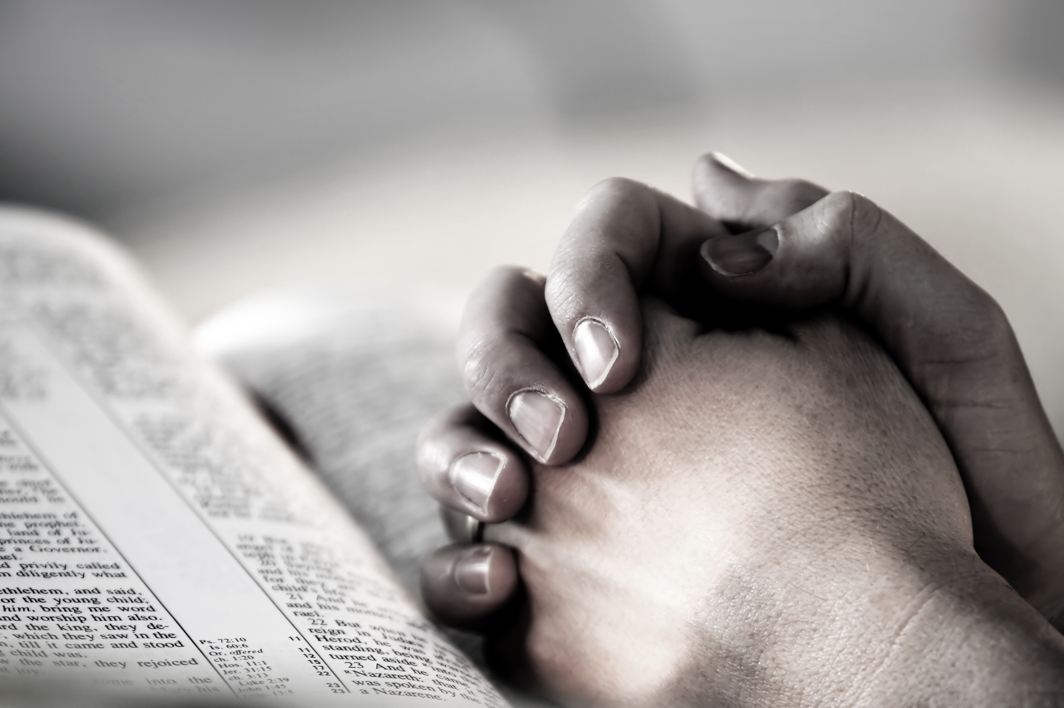
Christian practices
Worship & Prayer
Tuesday 24th April

Slide 2
What do I need to know?
Liturgical and non-liturgical worship (How do different Christian churches worship?)
Formal and informal worship (What is the difference?)
The Bible in worship (How is the Bible used in Christian worship?)
Private worship (What are the benefits of private worship?)
Prayer, and the Lord’s Prayer (Why is the Lord’s Prayer significant? Why pray at all?)
The meaning of sacraments (What is a sacrament?)
Baptism – infant and believer’s (Why do Christians have different beliefs about when a person should be baptised?)
Eucharist in Catholicism (What is the sacrament of Holy Communion, and why is it important?)
Eucharist in the Church of England (How do C of E beliefs about the Eucharist differ from Catholic beliefs?)
Lourdes (Why is Lourdes a place of pilgrimage for Christians today?)
The role of the Church in the local community, including food banks and street pastors (Why does the Church provide these things?)
The importance of the ‘worldwide Church’ in working for reconciliation
How Christian Churches respond to persecution (How do they help?)
The work of one Christian charity (Tearfund, Christian Aid, CAFOD)

Slide 3
What is worship?
worth ship = to give ‘worth’ to something
What is it? Worship is the way in which Christians show their deep love, reverence and respect for God.
Why? Worship allows Christians to praise and thank God for his blessings, to ask God for forgiveness of sin or to seek God’s help for themselves or others who may be suffering. Worship helps deepen a Christians relationship with God and gives him or her comfort and strength to live a more truly Christian life.
https://www.youtube.com/watch?v=ei6yg4TR7t0
https://www.youtube.com/watch?v=E5-aKSrLXM4

Slide 4
Different forms of worship
Liturgical | Non-liturgical | Private | Informal
Follows the same set pattern each time. Led by a priest . Hymns, set prayers and responses, sermon. E.g. RC Church, Orthodox & Anglican | Does not have to be a set pattern or ritual. Basic order can remain the same but the leader of the service can change the order, the number of hymns or types of prayers. Those planning the service may choose a theme. E.g. Methodist, Baptist & United Reform Churches | Allows individuals to spend time with God, either alone or with close family and friends. It may involves prayer, meditation, studying or meditating on a Bible passage, or using aids to worship such as an icon or a rosary. | Sometimes called ‘charismatic’ worship Often depends on people’s spontaneous prayers or sharing of thoughts. Quaker worship is mainly silent and people speak when they feel God’s spirit moving them to offer thoughts, prayers or a reading from the Bible. Pentecostal Churches often involve dancing, clapping, singing and speaking in tongues.

Slide 5
Liturgical | Non-liturgical & informal
The people receive forgiveness from God through the action of the priest. The people receive the living presence of Jesus through Holy Communion. Bible readings follow the Christian calendar & teach Christian history. There is a worldwide set order of service that is familiar to all, even visitors. The ritual has been passed down through generations, giving a sense of tradition. | The style of worship follows that of some early Christians who met to hear about Jesus in the joy of the Spirit after Pentecost. Faith is expressed in a variety of ways. Christians can share personal interpretations of the Bible. Often, readings follow the Christian calendar. People can take an active part in church by praying aloud or speaking without formal training. The service may have an emotional impact, with a feeling of personal revelation from God.

Slide 6
Prayer
What is it? Communicating with God
Why? Prayer helps Christians to:
Build up a discipline which gives them strength to copes in times of trouble.
It encourages routine that allows time for reflection in a busy day.
Through prayer and meditation Christians find peace and a sense of communion with God in their everyday lives as followers of Jesus.
Bringing together; a shared experience, usually on a spiritual level

Slide 7
Prayer
Christians believe God will answer prayer but not always in the way the person would like. Prayer can help someone accept God’s will even if it means suffering e.g. Jesus in the Garden of Gethsemane
Types of prayer:
Adoration – praising God and showing your dedication and faith
Thanksgiving – thanking God for his gifts
Supplication – asking for God’s help (either for yourself or someone else)
Confession – saying sorry and asking for forgiveness

Slide 8
The Lord’s Prayer
When Jesus was asked to teach his disciples how to pray, he
answered with the Lord’s Prayer.
The Lord’s Prayer gives Christians a pattern for how to pray as it combines giving praise to God and asking for one’s needs.
Importance of The Lord’s Prayer
It reminds Christians that God is the Father of the whole community
It reminds Christians that he or she must forgive, in order to be forgiven
It brings a sense of unity amongst the congregation when said aloud
It is a ‘set prayer’ which means it stays the same wherever you are

Slide 9
https://www.youtube.com/watch?v=vOORY6BROcI

Slide 10
You now have 60 seconds to log in to this revision Kahoot!
https://play.kahoot.it/#/?quizId=c9b91a27-4811-421c-9915-90ada0736ced

