Slide 1
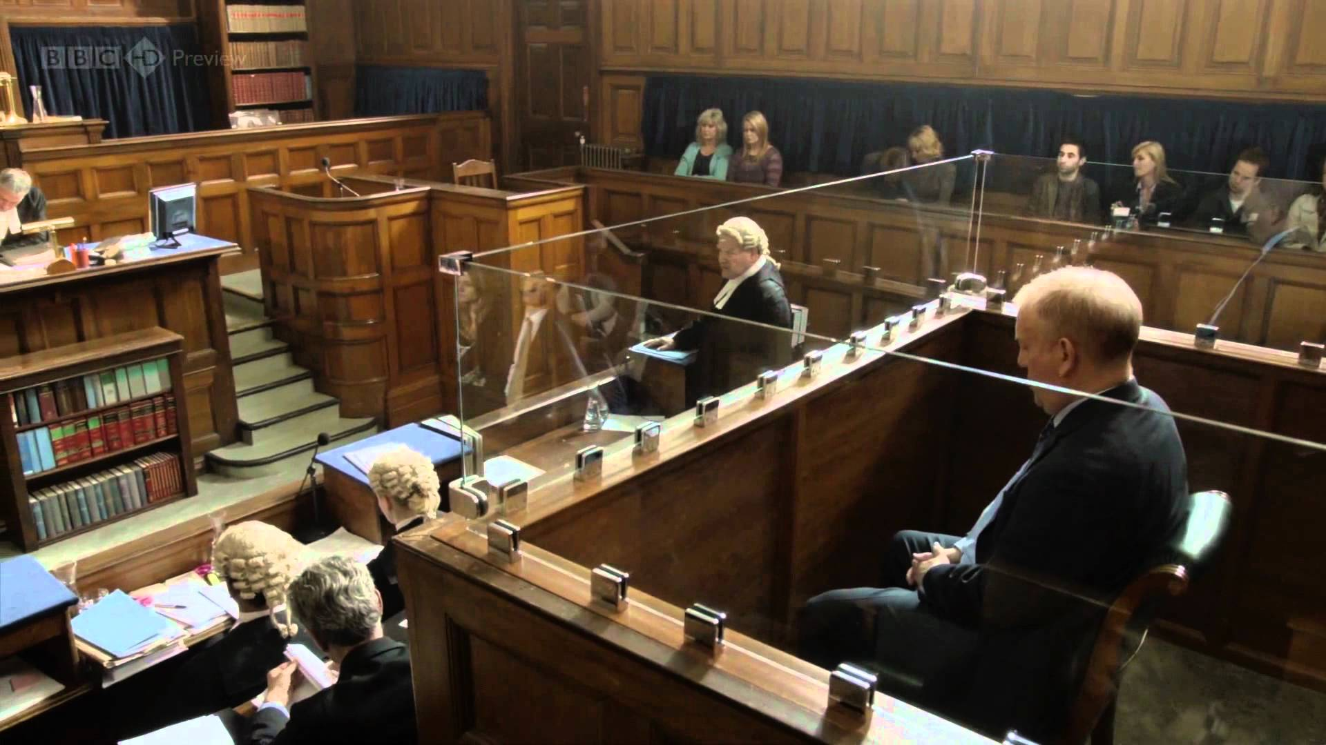
RELIGION, CRIME AND PUNISHMENT

Slide 2
Learning Objectives:
Know the definitions of crime and punishment.
Understand the legal position regarding crime and punishment.
Understand concepts of good and evil intentions and actions.
Understand Christian and Buddhists attitudes to crime, suffering and forgiveness
Understand the reasons people commit crime
Understand the three aims of punishment
Know and understand arguments for and against the death penalty

Slide 3
What are Crime and Punishment
A crime is any action against the law put in place by rulers of any state. In the UK, the government must get approval from Parliament to make new laws. The Police arrest law breakers and charge them, they are then sent to either Magistrates Court or Crown Court depending on the nature and seriousness of the crime.
Punishment can be imprisonment, or non-custodial sentences such as community service or a fine. If a Court decides the person is not guilty they are released without punishment. In the UK a Court cannot impose a sentence to cause physical harm (corporal punishment) or death (capital punishment).

Slide 4
How offenders are sentenced in England and Wales
https://www.youtube.com/watch?v=M4CIveEDtmk
5 minutes 46

Slide 5
Good and evil intentions and actions
The teachings in the Bible warn against having any evil or wrong thoughts and intentions:
  “You have heard it was said to the people long ago, ‘You shall not murder’, and anyone who murders will be subject to judgement.”
  Matthew 5:21
Evil actions are those which cause suffering, injury or possibly death. These include murder, causing a terrorist explosion and child abuse which are all illegal. Some actions may be considered evil even though they are not against the law.
In religion, evil can be linked with the devil who is the source of all that is considered evil. However, when Christians speak about evil criminal actions, they usually mean the offence is immoral and wicked rather than directly linked to the devil. Christianity generally considers crimes involving violence against people as sinful and against God.
Question: Can you think of any actions that are evil but not illegal? Why are they evil?

Slide 6
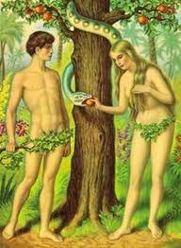
A Christian response
Many Christians would say there is no such thing as an evil person as humans are not perfect and make mistakes. They believe in original sin, the actions of Adam and Eve mean that all humans have a tendency to do evil things. If God created people to be good, there has to be a reason why they do awful things, e.g. psychological illness. In this case they should be treated for their illness while being punished for their actions.

Slide 7
Buddhist views
Buddhists tend not to speak in terms of good and evil, but in terms of skilful (generosity, kindness and understanding) and unskilful (selfishness, hatred and ignorance) actions.
The principle of Karma teaches that what is most important for Buddhists is the intention that drives an action. The five moral precepts can help Buddhists to know whether their actions are skilful or not. It is unskilful to tell a lie, but lies are not considered crimes. Yet a lie could cause more suffering than a crime, such as trespassing.
It’s all about the harm and suffering!
Generally they believe it is correct to follow the law, however, there may be some circumstances where they feel a law is unjust. It would be a matter of principle to resist a law that restricted spiritual development. If a law were made that made it illegal to meditate, Buddhists would feel justified in disobeying that law.

Slide 8
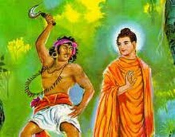
Buddhist views on punishment
The idea of punishment goes against Buddhist ethics because it causes suffering. There are consequences for a person who acts in an unskilful way, their actions will lead to suffering both in the present and in their future lives. Buddhists believe everyone can change, no-one should every be beyond hope or redemption. Buddhists try to feel compassion, avoid feeling hatred for criminals, try to understand the crime and develop a constructive response to criminals. Confession and recognition of wrong doing is important to Buddhists.
The story of ‘Finger Garland’ tells of a man who killed many people and took a finger from each victim making it into a garland to hang around his neck. When he met the Buddha, the Buddha encouraged him to live a better life, and he renounced his violence and became a follower of the Buddha.

Slide 9
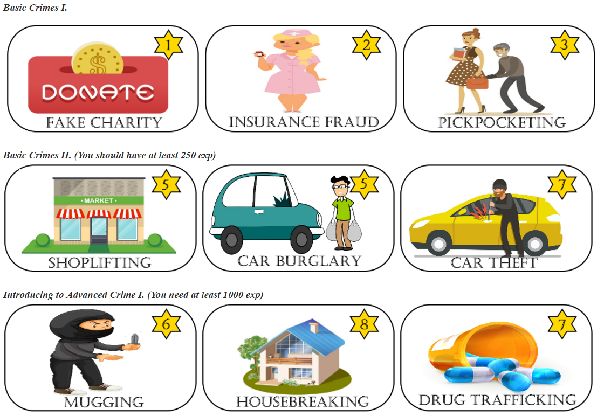
Reasons for Crime
While most people believe that all crime is wrong, sometimes it depends on why it was committed.
Can you think of at least 5 reasons why some people commit crime?

Slide 10
Reasons for Crime:
Poverty
Upbringing
Opposition to an unjust law
Hate
Greed
Addiction
Mental illness
TASK : copy these into your books and put them in order of which you think is the main cause of crime.

Slide 11
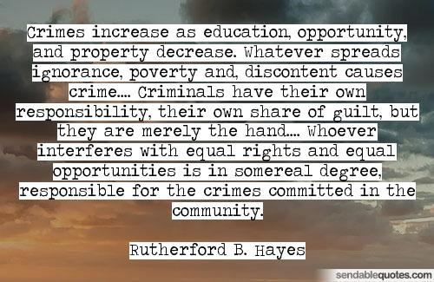

Slide 12
Poverty
There are many people living in poverty around the world and this can be a reason for crime and although this is a good reason, in the UK and other countries it is against the law to steal and people will be arrested and punished. Buddhist scriptures make it clear that poverty is an underlying driver of crime. The second moral precept says to abstain from taking what is not freely given, and the Bible says ‘thou shalt not steal’.
  “Focusing on poverty and sacrificing for the poor
  are the heart of the Gospel. If Christians don’t dig
  deep and generously open up their wallets,
  they do not have genuine faith.” Pope Francis
“…from goods not being bestowed on the destitute poverty grew rife; from poverty growing rife stealing increased, from the spread of stealing violence grew apace, from the growth of violence the destruction of life became common, from the frequency of murder both the span of life in those beings and their comeliness also wasted away…” The Buddha in the Digha Nikaya

Slide 13
Upbringing
Growing up in a household where crime is a way of life may encourage a young person to do the same. A young person’s upbringing may be troubled due to violence, addiction or neglect within the family. This could also effect them in a negative way and cause them to turn to crime.
Mental Illness
Anxiety and depression do not often lead to crime, however, some medical conditions like Kleptomania can make people steal. Serious mental health problems can cause people to become violent, and anger management problems may lead to assault or murder. Offenders can be detained in secure units where they can receive treatment and therapy.
According to Buddhism, everyone sees reality in a distorted way which leads to people inflicting suffering on themselves and others.
Addiction
Addicts may resort to stealing in order to get the money for their next fix. The drug that causes more crime than any other is alcohol. Under the influence of alcohol people can lose control of their thoughts and actions, become violent and abusive, and risk the life of others while driving over the limit.
Christians do not forbid the use of alcohol, for Catholics drunkenness is a sin, and no denomination encourages excessive drinking. In Buddhism, the fifth moral precept teaches Buddhists to abstain from intoxicants like drugs and alcohol.

Slide 14
Greed
In the UK personal possessions and wealth are seen as a sign of status. Greed can lead to crime, especially theft or fraud.
Buddhism teaches that acting out of greed is unskilful and leads to suffering. Christians follow the Ten Commandments: ‘thou shalt not covet thy neighbours house, nor his wife, nor his manservant nor his maidservant, nor his ox…”, “though shalt not steal”. Envy is considered one of the 7 deadly sins.
Hate
Hatred is a negative feeling or reaction that can lead to prejudice and violence against whoever or whatever the person hates. Hatred in Buddhism is one of the three poisons and a main cause of suffering. Buddhists believe it is important not to feel hatred even when provoked, and Christians are taught by God ‘to turn the other cheek’.
Opposition to an unjust law
Any breach of the law in a civil society is wrong. However, throughout history people have broken laws that they believe to be unjust. Buddhist might want to disobey a law that expresses prejudice and hatred. Breaking the law can lead to a change in the law, for example, the Civil Rights Movement defied laws based on segregation of blacks and whites in America.

Slide 15
Youtube clip:
Karyn McKlusky talks about poverty and reasons for violence in Scotland
2 mins 37
https://www.youtube.com/watch?v=JjvqUWl4lkA

Slide 16
Different types of crime and attitudes to lawbreakers
The law in the UK is there to protect the rights and security of all citizens. In general, Christians believe laws should be respected even though they may consider some laws to be morally wrong. Buddhists evaluate crime through the degree of harm it causes and the intention behind the act.
In UK law, all offenders are considered innocent until proven guilty. There are many different Christian attitudes towards lawbreakers; some believe the punishment should fit the crime, whereas others believe offenders should be helped not to re-offend. They may hate the crime but not the person who committed it. Most Christians believe offenders should be helped to change their ways. In the parable of the Sheep and the Goats, Jesus gave various actions that are pleasing to God, and these include treating prisoners well:
“…I was in prison and you came to visit me.”

Slide 17
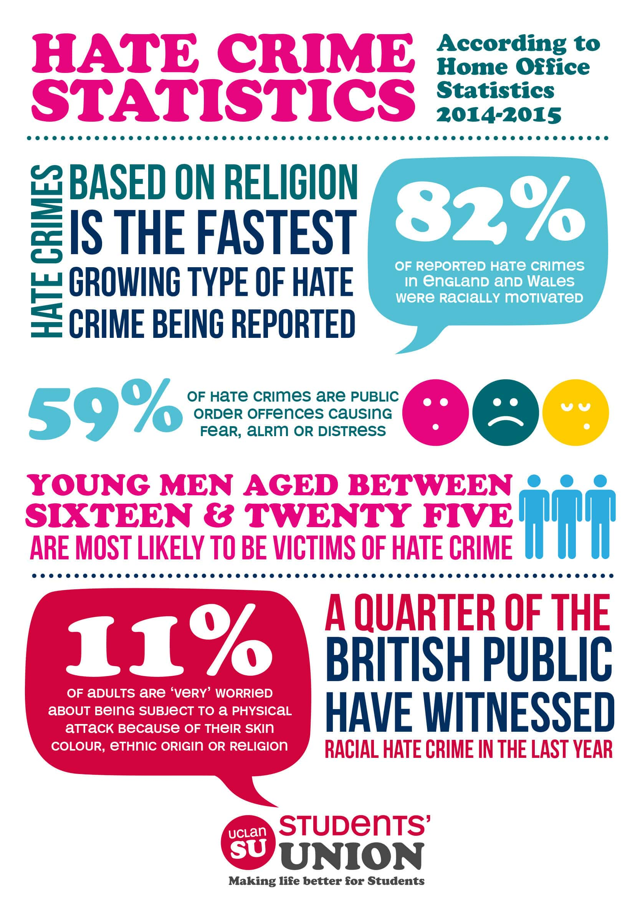

Hate Crime, Theft and
Murder

Slide 18
Hate Crimes: violent actions against someone because of their race, religion, sexuality, disability or gender.
In Buddhism, hatred is one of the three poisons so there is no justification for acting on the basis of hatred or intolerance. Hate crimes are often rooted in fear, insecurity and even envy. A person acting from hatred causes suffering to themselves and others, so nobody wins. The Buddha encouraged his followers to avoid falling into conflict with others based on differences of religious belief, because he recognised that his led to unskilful speech and even violent behaviour.
Christians condemn hate crime because they believe God created all humans with equal value, and Jesus taught that people should ‘love thy neighbour as thyself’. ‘Neighbour’ meaning everybody regardless of race, gender etc..
  “There is neither Jew nor Gentile, slave nor free, male nor female, for you are all one in Jesus Christ.” Galatians

Slide 19
Murder: the unlawful and deliberate killing of another person
Most people would agree that murder is the most serious crime. It clearly contradicts the first moral precept in Buddhism and goes against the fifth commandment, ‘thou shalt not kill’. While it might seem obvious that murder is wrong, some people argue that killing an evil person can be justified. In Buddhist scriptures there is a story that tells of a previous life of the Buddha when he was Captain of a ship carrying 500 merchants. One of the passengers planned to kill other passengers and the Buddha concluded that the most skilful thing to do in this circumstance was to kill the bandit to prevent all of the other people from being harmed.
Murder not only inflicts harm on the victim, but also on their family and friends. The spouse and children may depend on the victim and the consequences of murder can impact on a whole community.

Slide 20
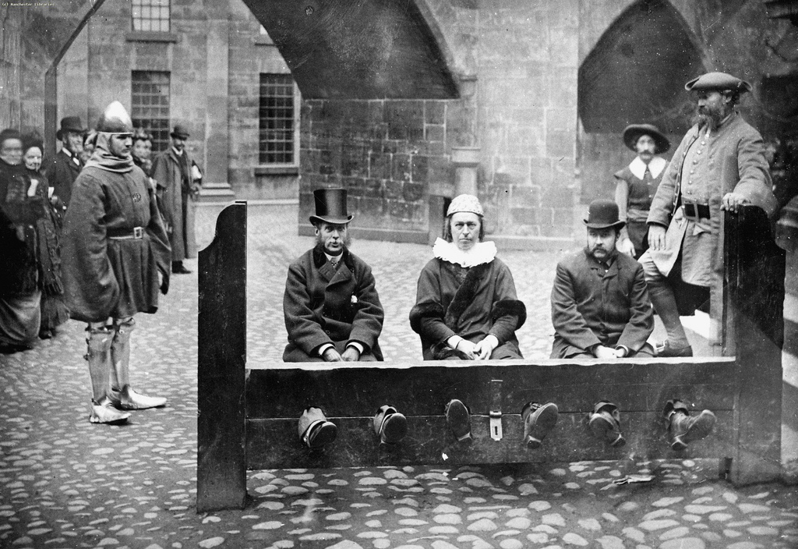
Three aims of punishment
Whenever a punishment is imposed by a Court, the Judge has to consider what purpose the punishment will serve. There are three main aims of punishment: retribution, deterrence, and reformation.

Slide 21
First Aim of Punishment - Retribution
This is one of the least positive of the three. In simple terms it means wanting to make a criminal pay for what they have done wrong. In earlier times, criminals would receive the same injuries that they caused their victims, and in the case of murder, this meant the murderer was executed to match the fate of the victim. In the Bible it says:
  “If there is serious injury, you are to take life for life, eye for eye, tooth for tooth, hand for hand, foot for foot, burn for burn, wound for wound, bruise for bruise.” Exodus 21:23
  Christians do not take this literally but interpret it to mean that an offender should receive a punishment severe enough to match the seriousness of the crime.
According to Buddhism, retribution is a form of violence that contradicts basic ethics, and does not wipe away the suffering caused by a crime, or does it encourage a criminal to accept responsibility for their actions. It usually creates bitterness and leads to further violence.

Slide 22

Question:
If there were no lawful retribution, would it lead to more vigilantes? Would people want to take the law into their own hands? Can public opinion sway a Court’s decision if the sentence of an offender is seen to be too lenient?

Slide 23
Second Aim of Punishment - Deterrence
Many people believe the threat of punishment puts people off of committing crimes. For example, the threat of a ban from driving may deter people from drinking and driving.
However the reasons why people commit crimes are more complex than a simple fear of being punished.
In Buddhism, the belief that a person might be reborn into the realm of suffering if they act badly in this life has functioned as a deterrent. But if criminals are in the grip of greed, hatred and delusion, they can lose sight of what may happen afterwards. Buddhists train their minds to imagine the consequences of their actions, and criminals often seem unable to do this.
Whilst Buddhists might agree it is important to protect society from certain criminals and support the use of prisons, the motive would not be to punish but to protect the welfare of society.

Slide 24
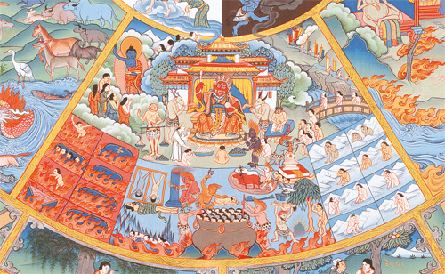

Buddhist Realm of Suffering

Slide 25
The third aim of punishment - Reformation
Reformation is the aim of punishment that most Christians and Buddhists prefer because it seeks to help offenders by working with them to help them understand the harm they cause society. This may involve group therapy, individual counselling, meeting their victims or working in the community. In the Bible it says:
  “Do not take revenge, my dear friends, but leave room for God’s wrath, for it is written: ‘It is mine to avenge; I will repay’, says the Lord. On the contrary: “If your enemy is hungry, feed him; if he is thirsty, give him something to drink(…) Do not be overcome by evil, but overcome evil with good.” Romans 12:19
  Buddhist viewpoint:
  “We should not seek revenge on those who have committed crimes against us, (…) We should reflect that by the law of Karma, they are in danger of lowly and miserable lives to come, and our duty to them it to help them rise towards Nirvana…” Dalai Lama

Slide 26
The Treatment of Criminals: prison – corporal punishment – community service
The main punishment of imprisonment is loss of liberty. Christians agree that prison should be used as a punishment for serious crimes, but strongly support rehabilitation through education and training opportunities. For Buddhists the primary purpose of prison is to protect society from serious offenders and to give them time and space to reflect on their actions.
Corporal Punishment involves physical pain, and in some parts of the world, whipping and caning is used as punishment. Corporal punishment was banned in state schools in 1987 and by 1999 in all other schools. Corporal punishment is a breach of human rights and Buddhists believe it does not solve the motives for crime.
Christians do not disagree with discipline, although they may question the method used since Jesus taught love and caring for people. Jesus always treated people with respect and Christians believe they should follow his example.

Slide 27
Community Service involves doing between 40 hours and 300 hours unpaid work in the community. Offenders have to wear orange vests with ‘Community Payback’ on them so everyone knows they have been convicted of an offence. Christians generally agree this is a suitable punishment for minor offences. The aims of community service are positive and offer the offender the chance to reform, so Buddhists also see this as a good form of punishment.
Other forms of community service can involve treatment programmes for alcohol or drug addiction, counselling and basic education services. Some offenders may be asked to meet their victims to hear their side of the story, and to apologise either directly or in writing. If offenders don’t complete their service they will be returned to Court.
ACTIVITIES:
Do you agree that prisoners should be treated with dignity while in prison?
Explain why Christians agree with the use of community service.
Explain in your own words the three forms of punishment.

Slide 28
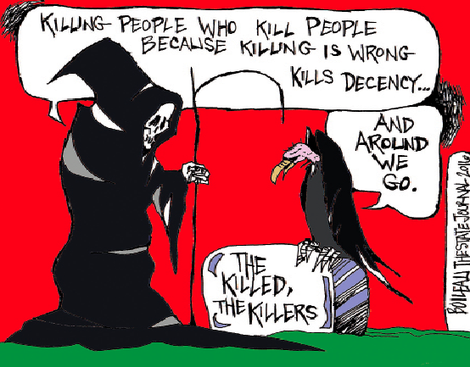
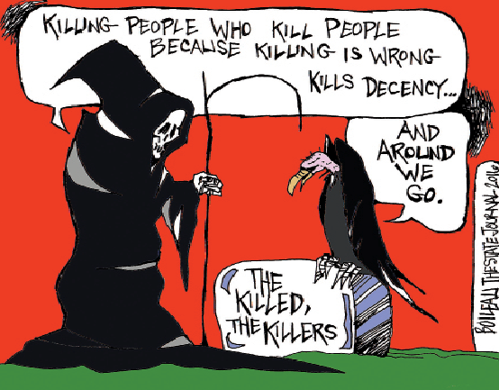
The Death Penalty

Slide 29

The death penalty was abolished in the UK in 1965. The European Community has since made it illegal in all member countries. Since its abolition, three people executed in the early 1950s have been pardoned due to new evidence proving them innocent. The chance of killing an innocent person is one of the arguments put forward by those who oppose bringing back the death penalty in the UK.
For or Against?
“The death penalty is justifiable retribution for serious criminal acts, such as murder.”
Jot down three reasons ‘for’ and three reasons ‘against’.

Slide 30
For
The death penalty deters people from committing murder
If you take a life, you deserve the death penalty
The death penalty protects society
Against
Innocent people might be wrongly convicted
There is little evidence to support the death penalty as a deterrent – in the USA there a still lots of murders
Imprisonment gives murderers the chance to repent

Slide 31
Principle of utility: philosophical idea that an action is right if it promotes maximum happiness for the maximum number of people affected by it.
The principle of utility would appear to support the death penalty, however, it does not support the death penalty on the grounds of retribution. It only allows it if the protection of the wider society can be proven.
Sanctity of life: all life is holy as it is created and loved by God; Christians believe human life should not be misused or abused.
Many Christians believe God gave life and only he has the right to take it away, therefore, the death penalty denies God’s right to take the offender’s life. However, some argue that in the case of murderers they are being punished in a way God approves of.

Slide 32
Buddhism Most Buddhists are against the death penalty because it breaks the first moral precept and does not allow the possibility of rehabilitation. It also makes revenge part of the system which is unskilful. It should also be remembered that people are sometimes wrongly convicted. Buddhism teaches that it is not possible to create happiness by making other people suffer. This encourages vengeance and cruelty which express hatred (one of the three poisons). Thailand, which is a Buddhist country, legally have capital punishment for more than 30 crimes, including drug trafficking. This shows that Buddhist ethics don’t necessarily impact on government policy. | Christianity Some Christians have different beliefs about the death penalty. Those who support it use teachings from the Old Testament, their main justification is taken from Genesis: “Whoever sheds human blood, by humans shall their blood be shed.” They often support this by making reference to Exodus: “Life for life, eye for eye, tooth for tooth.” Christians who oppose the death penalty do so as they believe in the commandment, ‘thou shalt not kill’. Only God has the right to take a life.

Slide 33

Forgiveness
https://www.youtube.com/watch?v=d-K5btaxEFY
3 minute video

Slide 34
Buddhism and Forgiveness
Buddhism teaches that it is important for someone to show forgiveness when they are holding on to a sense of being wronged, which leads to feelings of anger or resentment. Forgiving involves letting go of these feelings and letting go of the desire to see the other person being punished or suffering for what they have done. Forgiveness does not imply that a person’s actions are acceptable, instead, it shows a willingness to move on, and recognises that the other person can change.
Buddhism teaches that if people do not forgive, they will suffer. In the Dhammapada Buddha says:
“’He abused me, he struck me, he overcame me, he robbed me.’
Of those who wrap themselves up in it hatred is not quenched.”

Slide 35

It is easier to forgive if the other person confesses their wrongdoing and apologises. If they are not sorry for what they have done, it is much harder to forgive them. Sometimes offenders may find it hard to forgive themselves and this results in guilt and suffering.
Apology and forgiveness can bring reconciliation which helps the offender and victim learn to trust one another. The Buddha taught that anyone should be forgiven if they are genuinely sorry for what they have done.
Some crimes are so bad it might be impossible to forgive them. How can we forgive mass murder?
There is a Tibetan Buddhist story about two monks who were imprisoned and tortured by their captors. They met each other years later and the first monk asked the second monk, “Have you forgiven them?” He replied, “I will never forgive them!” The first monk then said, “Well, I guess they still have you in prison, don’t they?”
Question: What do you think the first monk meant?

Slide 36

Anh-Huong Nguyen on forgiveness
Anh-Huong Nguyen is a Zen Buddhist from Vietnam. In 1979, there was a brief war with China and she escaped with her family in a small boat taking refuge in a refugee camp in Malaysia. While she was there she met many young women and girls who had been raped by pirates who had boarded their boats while they were in the waters near Malaysia. To begin with she was very angry, but through meditation she came to understand that the pirates were themselves victims of their upbringing and local environments. She realised that if she had been born as a male into a family where piracy was accepted and expected, she might well have become a pirate herself. Anh-Huong recognises that suffering can sometimes make it very hard to forgive someone. But she thinks that understanding and compassion can help lead to forgiveness. She believes that a helpful question to ask is, ‘How can I better understand myself and the other person?’
By trying to understand the pirates, Ann-Huong
learnt to forgive them.

Slide 37
Christian attitudes to forgiveness
Forgiveness is a core belief in Christianity and one that Jesus emphasised in his teachings. Individual Christians are expected to forgive others, regardless of what they have done, and Christians believe that in turn, God will forgive them. In the Lord’s prayer it says:
  “Forgive us our sins, as we forgive those who trespass against us.”
During his ministry, Jesus was asked by Peter, one of his disciples:
  “Lord, how many times shall I forgive my brother when he sins against me? Up to seven times?” Jesus answered, “I tell you, not seven times, but seventy-seven times.”
  Matthew 18:21
The church interprets 77 times as an unlimited amount, therefore there is no maximum number of times a person should be forgiven. Christians believe that God’s love for them is without limit, so they should act the same towards others.
Even as he was being crucified, Jesus said:
  “Father forgive them, for they know not what they do.” Luke 23:24

Slide 38

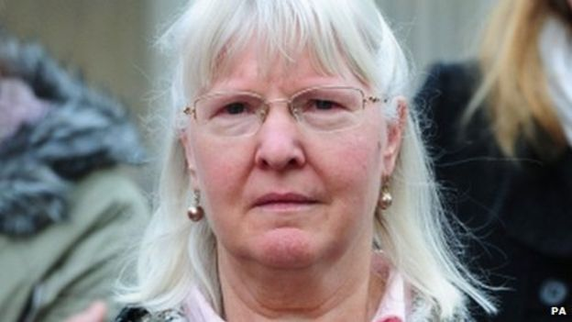
How easy is it to forgive people who have wronged you?
Could you forgive someone if they murdered someone you loved?
On Christmas Eve 2012, 68 year old retired social worker Alan Greaves was on his way to
St Saviour’s Church in Sheffield to play the organ at Midnight Mass. Tragically, he was attacked by two local men and died three days later in hospital from his head injuries.
His wife Maureen talked about forgiveness saying she didn’t want to carry the anger in her life and that her husband was a much more forgiving man and would have forgiven his attackers. She explained that it wasn’t that she didn’t want justice for Alan, but she had to carry herself in a way that would help her children. “Forgiveness means you are not seeking retribution or vengeance, it’s recognising that we are all in the same boat, we’re all the same, not perfect.” At a memorial service she asked people to pray for Alan but also for his killers.

Slide 39
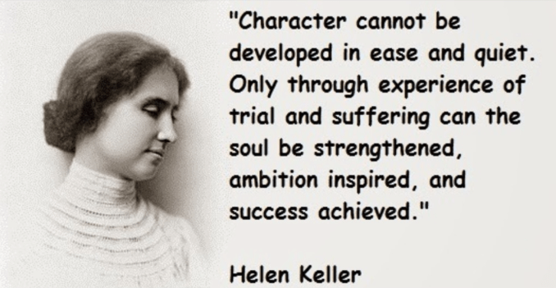
Christian attitudes to suffering and causing suffering to others
For many people suffering is an unfortunate part of living. It may be caused by something natural such as an illness, or it may be due to how people have behaved or how somebody else has behaved. Whatever the cause, Christians believe they should try to help others who are suffering. The Bible even talks about how good can come out of suffering:
  “We also glory in our sufferings, because we know that suffering produces perseverance; perseverance, character; and character, hope.”
  Romans 5:3
Christians feel that they should follow
the example of Jesus, who helped
many whom he saw suffering, and
who taught that those who believe in
God should help those who suffer.
Helen Keller, a Christian writer and
activist who became deaf and blind
as a young child said:
“We are never really happy until we
try to brighten the lives of others.”

Slide 40

So, why does a loving God, who cares about his people, allow them to suffer?
Charleston Church Shooting
In June 2015, at the Emanuel African Methodist Church in South Carolina USA, a gunman killed nine people, including a senior pastor of the church while they attended Bible study. Dylann Roof, a 21 year old white man, was captured by police and confessed that he was hoping to start a race war.
The murders caused suffering to friends and family as well as the people from the local community. When relatives faced Dylann in court, they told him they forgave him. A mother of one of the victims said, ‘You hurt me, you hurt a lot of people, but God forgives you, and I forgive you.’
Christians believe God gave humanity free will, and to stay close to God they must make good choices which do not harm others. The teachings of Jesus give guidance to help Christians to use their fee will responsibly. They believe in legal punishments imposed by Courts when people choose to behave in a way that harms others and is not pleasing to God.

Slide 41

Causing suffering to others
Christians are generally opposed to causing suffering to others. Jesus taught that humans should love one another and care for those in trouble. He even spoke out against using violence in self-defence because of the further suffering that retaliation may cause.

Slide 42
No human is perfect, it is inevitable that Christians may be the cause of suffering, often by accident or because their minds are troubled for some reason. Having caused suffering, it is important that Christians are honest with themselves, to other people and to God, and work at repairing the damage they may have caused. This way, relationships can be restored.
“One of the disciples struck the servant of the High Priest, cutting off his right ear. But Jesus answered, ‘No more of this!” And he touched the man’s ear and healed him.”
Luke 22:50
While people can’t perform miracles of healing in the way that Luke described, Christians learn from this example that if possible they should heal the wrong that has been done and the suffering that has been caused in whatever way they can.

Slide 43
I know and understand some reasons why people commit crimes
I understand Christian attitudes to some of these
I can explain Buddhist attitudes to good and evil intentions as skilful and unskilful
I can describe different types of crime – hate, theft, murder
I know and understand the three aims of punishment; retribution, deterrence and reformation
I understand Christian attitudes to suffering
I can name three forms of punishment and understand Christian attitudes
I can describe a Case Study about forgiveness and understand Christian attitudes
I know arguments for and against the Death Penalty
Haven’t got a clue
I think I get it
Ureka! I know this

Slide 44
Matthew 18:21-35 New International Version (NIV) The Parable of the Unmerciful Servant
²¹ Then Peter came to Jesus and asked, “Lord, how many times shall I forgive my brother or sister who sins against me? Up to seven times?”
²² Jesus answered, “I tell you, not seven times, but seventy-seven times.^{[a]}
²³ “Therefore, the kingdom of heaven is like a king who wanted to settle accounts with his servants. ²⁴ As he began the settlement, a man who owed him ten thousand bags of gold^{[b]} was brought to him. ²⁵ Since he was not able to pay, the master ordered that he and his wife and his children and all that he had be sold to repay the debt.
²⁶ “At this the servant fell on his knees before him. ‘Be patient with me,’ he begged, ‘and I will pay back everything.’ ²⁷ The servant’s master took pity on him, canceled the debt and let him go.
²⁸ “But when that servant went out, he found one of his fellow servants who owed him a hundred silver coins.^{[c]} He grabbed him and began to choke him. ‘Pay back what you owe me!’ he demanded.
²⁹ “His fellow servant fell to his knees and begged him, ‘Be patient with me, and I will pay it back.’
³⁰ “But he refused. Instead, he went off and had the man thrown into prison until he could pay the debt. ³¹ When the other servants saw what had happened, they were outraged and went and told their master everything that had happened.
³² “Then the master called the servant in. ‘You wicked servant,’ he said, ‘I canceled all that debt of yours because you begged me to. ³³ Shouldn’t you have had mercy on your fellow servant just as I had on you?’ ³⁴ In anger his master handed him over to the jailers to be tortured, until he should pay back all he owed.
³⁵ “This is how my heavenly Father will treat each of you unless you forgive your brother or sister from your heart.”

Slide 45
Practice questions
Which one of the following is an aim of punishment?
a) prison b) deterrence c)forgiveness d)murder
2. Give two different causes of crime.
Explain two contrasting beliefs in contemporary British society about whether the death
penalty should exist in the UK. In your answer you should refer to the main religious
tradition of Great Britain and one or more other religious traditions.
Explain two religious beliefs about reformation as an aim of punishment.
Refer to scripture or sacred writings in your answer.
‘It is right to forgive all offenders whoever they are and whatever they have done.’
Evaluate this statement. In your answer you should:
give reasoned arguments in support of this statement
give reasoned arguments to support a different point of view
refer to religious arguments
refer to non-religious arguments
reach a justified conclusion.

Slide 46
Key Terms:
Crime – an offence which is punishable by law
Punishment – something legally done to somebody as a result of being found guilty of breaking the law
Evil – the opposite of good; a force or the personification of a negative power that is seen in many traditions as destructive and against God
Poverty – being without food or other basic needs of life
Mental illness – medical condition effecting person’s feelings, emotions or moods
Addiction – physical or mental dependency on a substance or activity
Greed – wanting to possess wealth, goods or items of value which are not needed
Retribution – an aim of punishment /to get your own back; ‘an eye for an eye’
Deterrence – an aim of punishment/to put people off committing crimes
Reformation – an aim of punishment/to change someone’s behaviour for the better
Corporal punishment – (illegal in the UK) punishment of an offender by physical harm
Sanctity of life – all life is holy as it is created and loved by God; Christians believe human life should not be misused or abused
Principle of utility - philosophical idea that an action is right if it promotes maximum happiness for the maximum number of people affected by it.

Slide 47
“This conviction (that human life and dignity should be protected) has led me, from the beginning of my ministry, to advocate at different levels for the global abolition of the death penalty. I am convinced that this way is best, since every life is sacred, every human person is endowed with an inalienable dignity, and society can only benefit from the rehabilitation of those convicted of crimes.” Pope Francis
“Whoever sheds human blood,
by humans shall their blood be shed.”
Genesis 9:6
“Life for life, eye for eye,
tooth for tooth.”
Exodus 21:23
“I take no pleasure in the death of the wicked, but rather that they turn away from their ways and live.” Ezekiel 33:11
“Do not take revenge, leave room for God’s wrath, for it is written: ‘It is mine to avenge; I will repay,’ says the Lord. On the contrary: “If your enemy is hungry, feed him,(…) If he is in prison, visit him. Do not be overcome by evil, but overcome evil with good.” Romans 12:19

