Slide 1
Biology Paper 1
Cell Biology

Slide 2
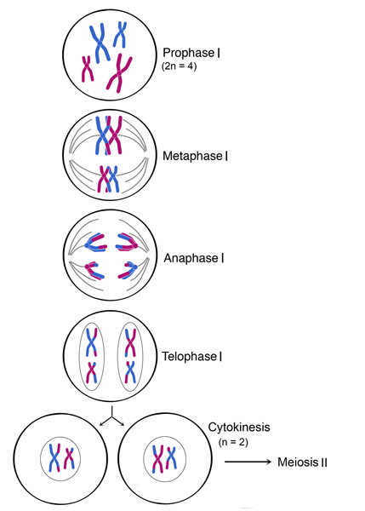
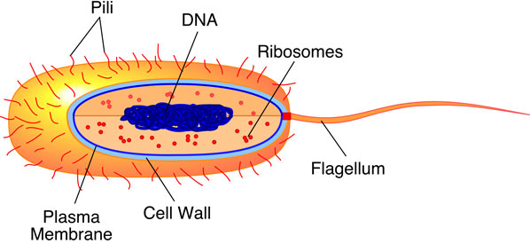
Topic 1 – Cell biology
Microscopy
Convert numbers
Standard form
Cell Specialisation
There are 5 specialisations:
Sperm cells – Reproduction
Nerve Cells – Rapid signalling
Muscle Cells – Contraction
Root Hair Cells – Water and mineral absorption
Phloem and Xylem Cells – Transporting substances
Image
size
Magnification
Real Size
Subcellular Structure | Function
Nucleus | Contains DNA and controls cell
Cytoplasm | Most chemical reactions happen
Cell Membrane | Holds cell together controls what goes in and out
Mitochondria | Produce energy from respiration
Ribosomes | Where proteins are synthesised
Cell Wall | Supports and strengthens cell
Vacuole | Storage of sugars and supports cell
Chloroplasts | Where photosynthesis happens
Mitosis
The growing and division of cells to repair and maintain existing cells. This process has two parts:
Growth and DNA Replication
Cell develops more subcellular structures and duplicates DNA into X shaped chromosomes. Each arm of the chromosome is a direct replicate of the other.
Mitosis
Chromosomes line up at the centre and cell fibres pull them apart. The two arms go to opposite ends of the cell.
Membranes form around each set of chromosomes, these form into each cell’s nucleus
The cytoplasm and cell membrane divide. The cell has now become two exactly identical daughter cells.
Stem Cells
Unspecialised cells that can become another type of cell to be used for a number of medical advances and can cure many diseases.
People are against Stem Cells due to the fact that the most useful ones are from Human Embryos, adults do produce Stem Cells, however these can only turn into certain cells.
Diffusion – Particles moving from an area of High concentration to low concentration
Osmosis – Diffusion of water molecules
Active Transport – Particles moving from an are of low concentration to high concentration – requires energy
Diffusion
Osmosis
Active Transport
Bacteria cells are different, they have strings of DNA and loops called plasmids

Slide 3
Biology Paper 1
Organisation

Slide 4
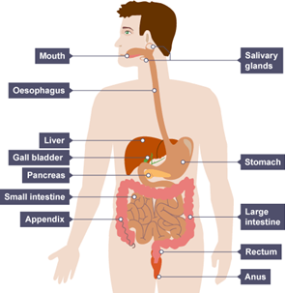
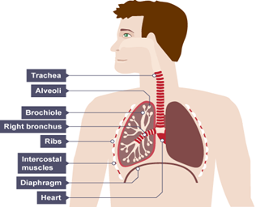
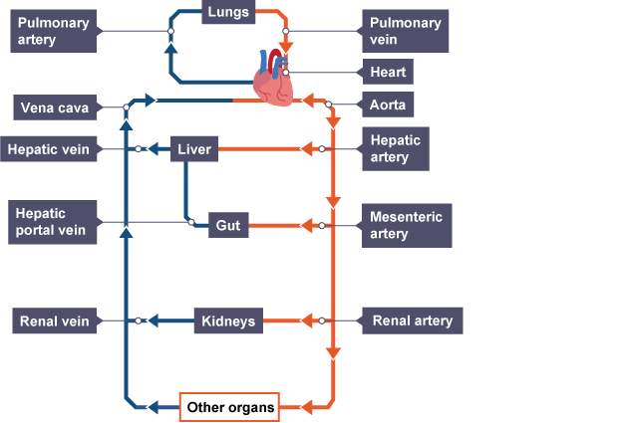
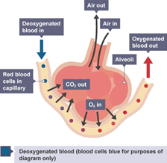
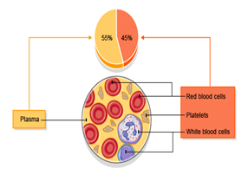
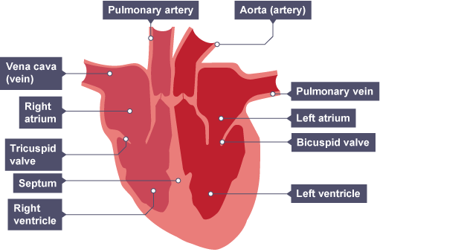
Topic 2 - Organisation
Enzyme | Location | Function
Amylase | Salivary glands, Pancreas, Small intestine | Breaks starch into sugars
Protease | Stomach, Pancreas, Small intestine | Breaks proteins into amino acids
Lipase | Pancreas, Small intestine | Breaks lipids into fatty acids
Cell Organisation
Organ – a set of specialised cells organised into tissues.
Organ system - a series of organs designed for one specific job. EG. Digestion
Bile is produced in liver, stored in gall bladder and it neutralises the HCl acid found within the stomach to let the enzymes in the small intestine function properly.
Vessel | Where | Lumen | How
Artery | Away from heart | Thick wall, Small lumen | High pressure to continue blood flow
Vein | To the heart | Thin wall, Large lumen | Low pressure, valves to keep direction correct
Capillary | Exchanges of materials at tissues | One cell thick wall, Very small lumen | Permeable walls increasing the rate of diffusion
Breaths
Breaths Per
Minute
Minutes
The Lungs
Contain alveoli, where gaseous exchange occurs between O₂ and CO₂
Blood Cells
Red – Carry O₂, Disk shape for function, Haemoglobin binds with O₂ to become Oxyhaemoglobin (to carry the O₂). No nucleus
White – Produce antibodies which defend against infection, they have a nucleus
Platelets – Help blood clot to stop bleeding out, no nucleus
Plasma – A liquid that carries blood cells, nutrients, CO₂, Urea (waste), Hormones, Proteins, Antibodies / Antitoxins
Transpiration and Translocation
Phloem Tubes – Transport food, transport can go in both directions – Translocation
Xylem Tubes – Take water up from roots to stem and leaves – Transpiration Stream
Transpiration – loss of water from the plant, side effect of Photosynthesis.
Cancer
Uncontrolled cell growth and division.
Benign – Grows until no more room in one place. Does not invade other tissues. Not dangerous (Normally)
Malignant – Grows wherever, cells can break off and grow somewhere else. Can be fatal
Cardiovascular Disease
Build of LDL cholesterol in the arteries, which makes it harder for blood to pass through. There are 2 ways of treating this, Stents and Statins. Stents are a mesh that is inserted into the artery then blown up to squeeze the LDL to the edge. Statins are a regular drug that can be taken, it contains HDL (good) cholesterol which can remove the LDL, however it isn’t an instant effect.

Slide 5
Biology Paper 1
Infection & response

Slide 6
Topic 3 – Infection & Response
Phagocytosis – the process of white blood cells engulfing and digesting pathogens
Vaccination
Small amounts of a dead pathogen, to allow the whit blood cells to create a “template” of antibodies. Protects against epidemics.
3 Stages of Drug Testing
Preclinical trails – human cells and tissues, however doesn’t apply for drugs for whole organ systems
Animal trials – drug tested on 2 animals, to find efficacy, toxicity and correct dosage
Clinical trials – blind trials, with placebos often offered. Can be double-blind, so the doctor doesn’t know either
The Ways White Blood Cells Protect
Engulfing pathogens
Antibodies to attack cell
Antitoxins to neutralise toxins released
Plant Diseases
Common signs of diseases: stunted growth, spots on leaves, patches of decay, abnormal growths, malformed stems or leaves, discolouration.
Disease | Symptoms | Spread by
Salmonella | Fever, stomach cramps, vomiting, diarrhoea | Eating contaminated food | B
Gonorrhoea | Pain when urinating, yellow / green discharge from penis / vagina | STD – sexual contact | B
Measles | Red rash, fever, can lead to pneumonia or encephalitis (brain infection) | Droplets from an infected sneeze or cough | V
HIV | Flu-like, attacks immune cells | Sexual contact, or sharing bodily fluids | V
Tobacco Mosaic Virus (TMV) | A mosaic pattern on leaves and discolouration – leads to less photosynthesis | Plant contact, | V
Rose black spot | Black or purple spots meaning photosynthesis can’t be carried out | Water or by wind | F
Malaria | Repeating episodes or fever. Can be fatal | Vectors – mosquitos | P
Monoclonal Antibodies
Monoclonal antibodies are identical antibodies, produced from a single white blood cell, meaning that all antibodies are identical and will only target one specific protein allergen. They can bind anything, and will only bind to that thing which means it can easily target a specific cell
Communicable Diseases
Bacteria are small living cells, they produce toxins which causes you to feel ill, by damaging body cells and tissues
Viruses are not a cell. They replicate within cells, to the point where they burst and cause cell damage. Cell damage is what causes you to feel ill.
Protists are single-celled Eukaryotes most being parasites. Parasites can cause damage inside or on other organisms. It is transferred by a vector.
Fungi have a body made up of hyphae (thread-like structures). These hyphae can grow and penetrate human skin causing diseases. They can produce spores which can be spread to other plants or animals

Slide 7
Biology Paper 1
Bioenergetics

Slide 8
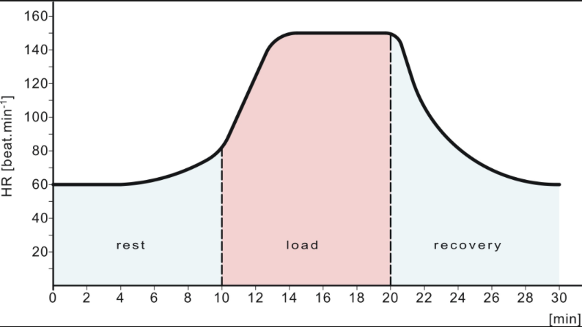
Topic 4 – Bioenergetics
Carbon Dioxide | + | water | → | Glucose | + | Oxygen
6CO₂ | + | 6H₂O | → | C₆H₁₂O₆ | + | 6O₂
Light
Photosynthesis
Photosynthesis produces glucose by using light, takes place within a plants chloroplasts, which contains chlorophyll that absorbs light. Photosynthesis is an ENdothermic reaction, meaning that heat is transferred from the environment during the process.
Factors that Effect the Rate of Photosynthesis
Light – Not enough
Carbon Dioxide – Too little
Temperature – Too high or low
Rate of Photosynthesis
Inverse square law:
Light Intensity = 1 ÷ Distance
Respiration & Metabolism
Respiration is the process of transferring energy from glucose, which occurs in every cell. Respiration is EXothermic, heat is transferred to the environment.
Aerobic Respiration
Respiration using oxygen, happens all the time on plants and animals. Most aerobic respiration happens in the cells Mitochondria
Glucose | + | Oxygen | → | Carbon Dioxide | + | Water
C₆H₁₂O₆ | + | 6O₂ | → | 6CO₂ | + | 6H₂O
Animal | Glucose | → | Lactic Acid
Plant | Glucose | → | Ethanol | Carbon Dioxide
Anaerobic Respiration
Anaerobic respiration happens when not enough oxygen is available, therefore 2 different equations are used – one for animals and one for plants
Response to exercise
Anaerobic Respiration in Humans
Anaerobic respiration leads to an oxygen debt, which is a build up of Lactic Acid, which is converted from glucose, within the muscles during exercise. This Lactic Acid has to be removed after exercise as it causes harm to the muscles. It is flushed out using oxygen, to “repay” the debt. The Lactic Acid can also enter the blood stream and get sent to the liver where it is converted back to glucose.
Better more efficient use of lungs
Positive psychological response to exercise
Better more efficient heart
Lower resting HR
Quicker recovery response to exercise
Higher metabolism
Larger lean muscle mass - higher need for energy to feed the muscle
Increased amount of mitochondria
Leaner body composition

