Slide 1
Health & Social Care
Revision Guidance
Component 3: Health & Wellbeing Topic A
Health & Wellbeing

Slide 13
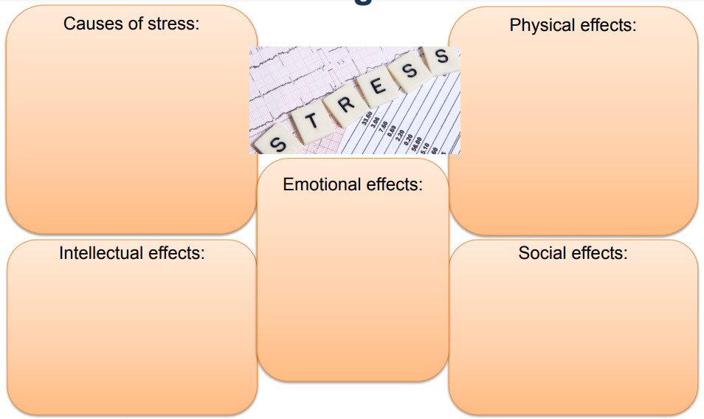

Slide 17
