Slide 1
Health & Social Care
Revision Guidance
Component 3: Health & Wellbeing (Topic B)
Health Indicators

Slide 2
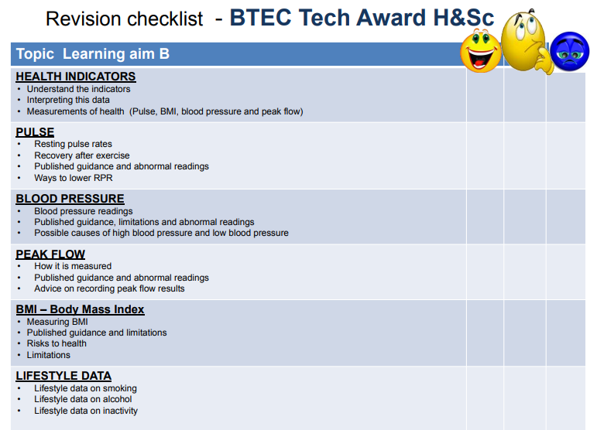

Slide 3
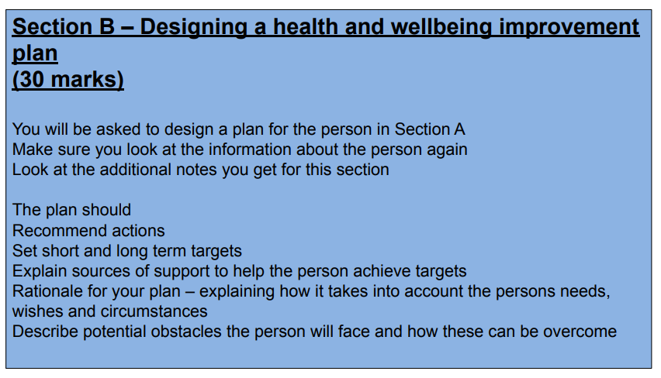

Slide 4
BTEC Tech Award H&Sc
Learning aim B
Health indicators
Physiological indicators
What is a physiological indicator?

Slide 5
BTEC Tech Award H&Sc
Learning aim B
Health indicators
What is a lifestyle indicator?
Lifestyle indicators
Why are health indicators important?

Slide 6

BTEC Tech Award H&Sc
Learning aim B
What is the NHS guidance for RPR?
Babies -
Children -
Adults -
What does the pulse measure?
Pulse
What two places can you feel the pulse?
Factors that affect RPR:
1.
2.
3.
How is a resting pulse rate measured (RPR)?

Slide 7
BTEC Tech Award H&Sc
Learning aim B
Pulse rate during exercise:
Maximum number of heart beats per minute is 220 minus the persons age
Healthy pulse rate during or after exercise is between 60 – 80% of maximum
Pulse – abnormal readings
Abnormal readings
Ways to lower RPR

Slide 8
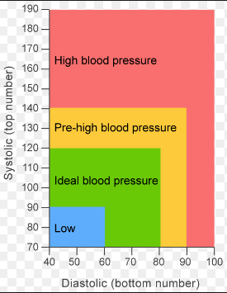
BTEC Tech Award H&Sc
Learning aim B
Causes of high blood pressure:
1.
2.
3.
4.
5.
6.
Blood pressure
Readings for blood pressure:
Low blood pressure is…
High blood pressure is…
Abnormal readings:
The risks are:

Slide 9
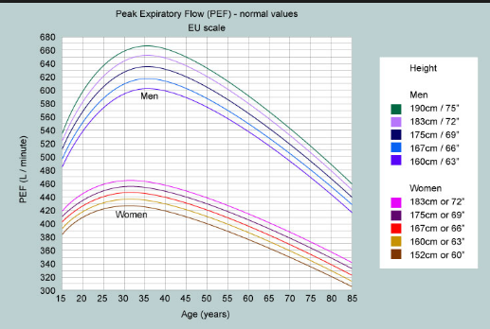
BTEC Tech Award H&Sc
Learning aim B
What is peak flow?
How is Peak flow measured?
Peak flow (PEF)
What do abnormal readings show?
Reason 1 for keeping a diary
Reason 2 for keeping a diary
Reason 3 for keeping a diary

Slide 10
BTEC Tech Award H&Sc
Learning aim B
Limitations of BMI:
Body Mass Index (BMI)
What is BMI?
BMI calculations:
Risks to health
BMI readings:
BMI | Meaning
<18.5
18.5 – 24.9
25-29.9
30 – 34.9
35 – 39.9
40 +
Underweight | Overweight

Slide 11
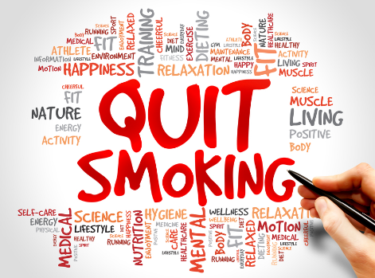
BTEC Tech Award H&Sc
Learning aim B
-
Give three ways the role of a health care organisation can help
1.
2.
3.
-
Give three barriers to quitting smoking:
1.
2.
3.
Lifestyle data - Smoking
-
Give three ways a person can be supported in quitting smoking:
1.
2.
3.
-
Give three positive effects of quitting
1.
2.
3.

Slide 12
BTEC Tech Award H&Sc
Learning aim B
-
Give three ways the role of a health care organisation can help:
1.
2.
3.
-
Give three risks to physical health
1.
2.
3.
Lifestyle data – Alcohol
-
Give three positive effects of reducing drinking
1.
2.
3.

Slide 13
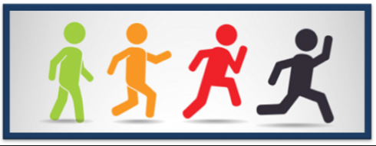
BTEC Tech Award H&Sc
Learning aim B
Lifestyle data – Inactive lifestyle
-
Why is being active important?
Effects of being inactive | Effects of being active and following recommended level of activity

