Slide 1
GCSE OPTIONS
Drama
Notes:
Insert Video

Slide 2
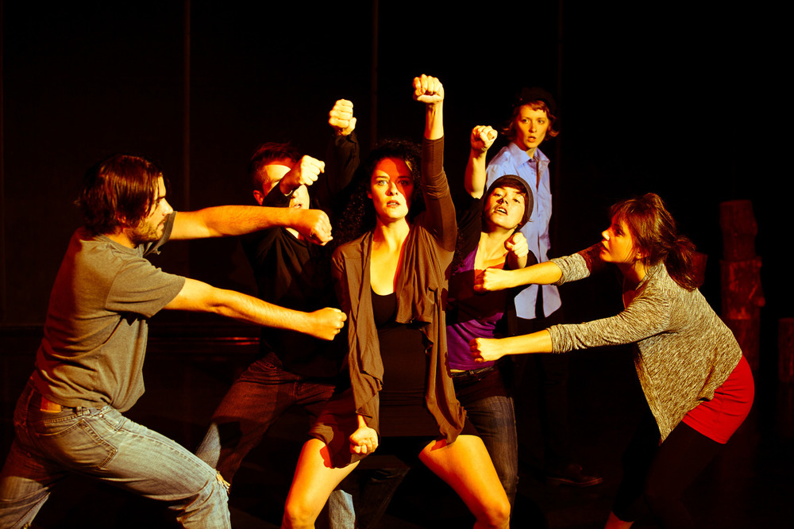
What is GCSE Drama?
GCSE Drama engages and encourages students to become confident performers and designers with the skills they need for a bright and successful future.
This qualification will teach you…
How to collaborate with others to create performance
How to think analytically and evaluate effectively
How to approach texts and performance from the perspective of either a performer or a designer
Notes:
Insert Video

Slide 3
How will I be assessed?
60% Practical- You will be required to perform
Devising (creating your own work in groups) 20 marks
Performing a script (either solo or in groups) 40 marks
40% Written
Written Exam 1 hour 45 mins 80 marks
Section A: 4 mark Drama Theory
Section B: 44 mark Study of a Set Text
Section C: 32 mark Live Theatre Review
3 pieces of coursework (1000 words for each piece) /60
Notes:
Insert Video

Slide 4
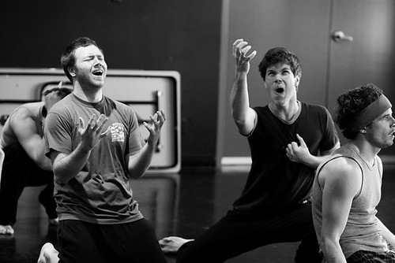
Why should I pick Drama?
Practitioner Workshops (naturalistic, epic, physical, theatre of cruelty, political)
Actor Training (vocal and physical skills)
Use technical equipment (lighting, set, sound and costume)
Study Live Theatre
Study a range of plays and texts
Notes:
Insert Video

Slide 5
Where could Drama lead me?
Whatever the future holds, students of GCSE Drama emerge with a toolkit of transferable skills, applicable both in further studies and in the workplace.
Natural progress would be to study A Level Drama and Theatre Studies or any other Drama and Performance based course.
Below is a list of careers that Drama could lead to you
Careers in the arts: Radio Presenter, Stunt Artist, TV Presenter, Stage designer, Actor/Actress, Costume Designer, Stage Manager, Makeup Artist, Director, Writer, Theatre Critic.
Other careers: Teacher, Law, Social Work, Marketing, Events Management, Journalism.
Notes:
Insert Video

Slide 6
Further information
“I love how the lessons are structured. The practical lessons are engaging and allow us to experiment more freely. I really appreciate the theory element too as these lessons prepare us for the written exam.”
“Drama is not an easy subject- it’s hard work with lots of commitment. I am grateful for the course as my confidence has grown and I feel like I have an edge over others when moving onto my next step because of the skills I have gained from studying Drama.”
“Staff are supportive and guide us to achieve the best level possible.”
If you have any further questions about the GCSE Drama Course feel free to drop me an email
Miss Morgan: Catherine.morgan@oldburywell.com
Notes:
Insert Video

