Slide 1
GCSE OPTIONS
Health and Social Care

Slide 2
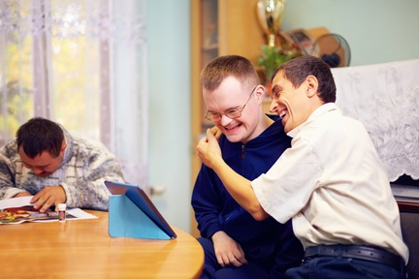
Welcome to Health and Social Care
If you are considering a career in the country’s largest employer – the health and social care sector, then this course is right for you!
Health and Social Care is an exciting and challenging vocational subject for all students passionate about making a difference.
As a Health and Social Care professional you may need to provide physical, emotional and social support.

Slide 3
Course & Course Content
You will study the Pearson BTEC Level 1/2 Tech Award in Health and Social Care course.
External assessment – set and graded by Pearson in Y11 Feb 2022
Explore
Component 1: Human Lifespan Development (30%)
Develop
Component 2: Health & Social Care Services and Values (30%)
Apply
Component 3: Health and Wellbeing (40%)
Internal assessments – issued and graded by your teacher at OWS

Slide 4
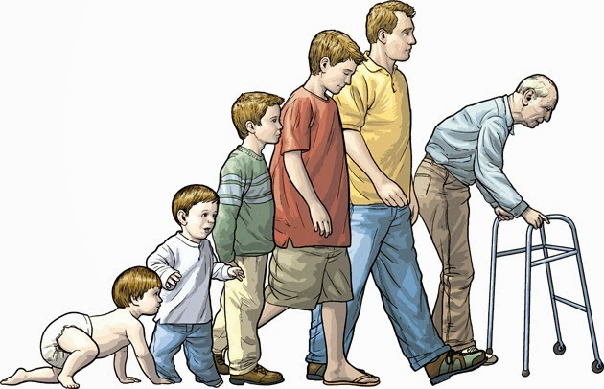
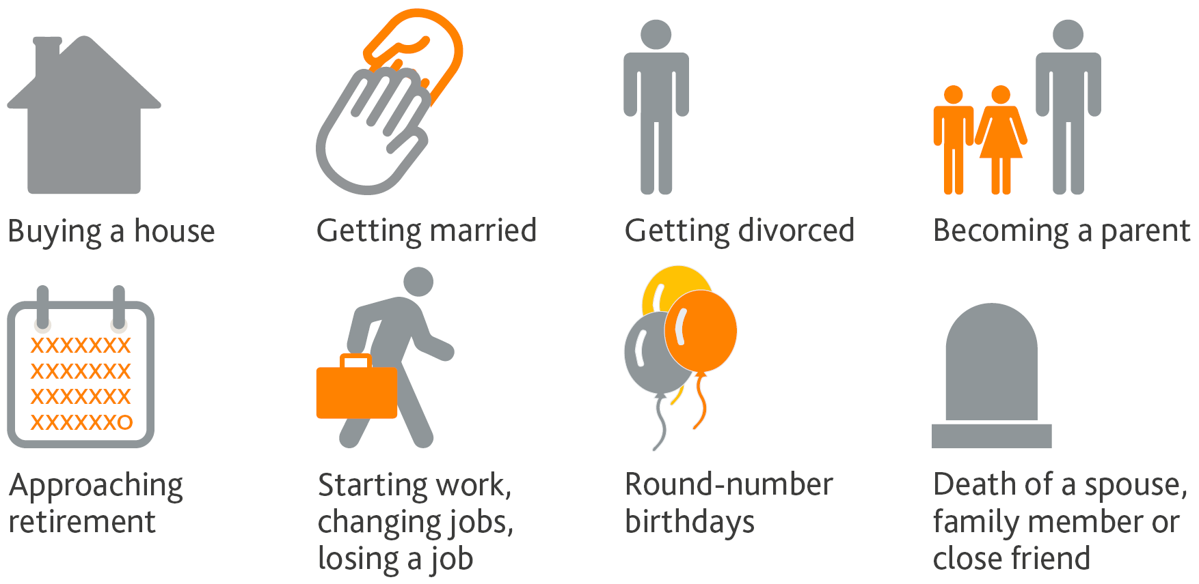
Component 1: Human Lifespan Development
LAA How we grow and develop through the life stages
LAB Life events
You will explore different aspects of growth and development across the life stages looking at the physical, intellectual, emotional and social changes and investigate factors that can affect individuals.
Life events are expected or unexpected events that occur in an individual’s life. You will explore the different events that can impact on people’s physical, intellectual, emotional and social development.

Slide 5
Component 2: Health and Social Care Services and Values
LAA Health and Social Care Services and Barriers
LAB Health and Social Care Values
You will explore the health and social care services that are available and why individuals may need to use them. You will explore the barriers that can make it difficult to use these services and how these barriers can be overcome.
You will develop skills in applying care values that are used across the health and social care sector.

Slide 6
Component 3: Health and Wellbeing
Factors affecting health and wellbeing
Interpret indicators that can be used to measure physiological health, interpreting data using published guidance
Interpret lifestyle data in relation to risks posed to physical health
Explore features of health and wellbeing improvement plans
Explore obstacles to implementing plans

Slide 7
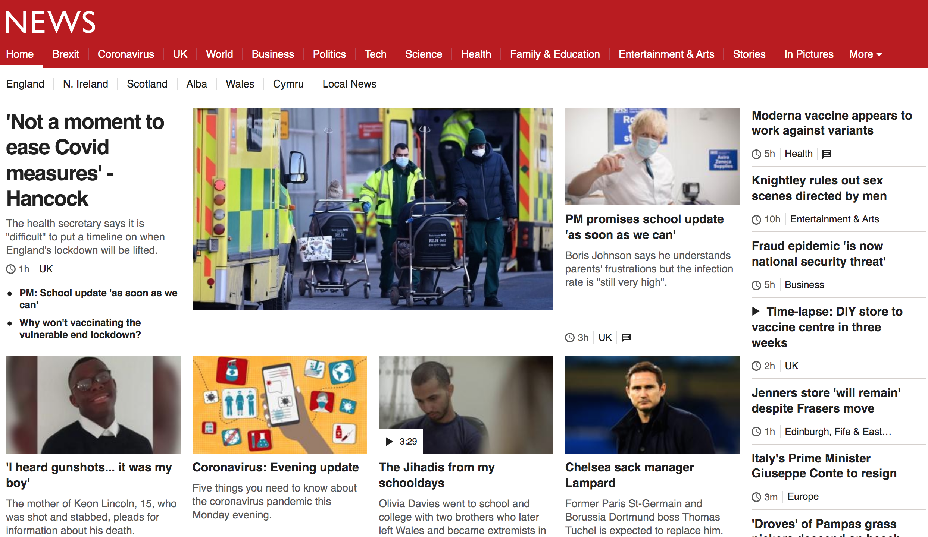
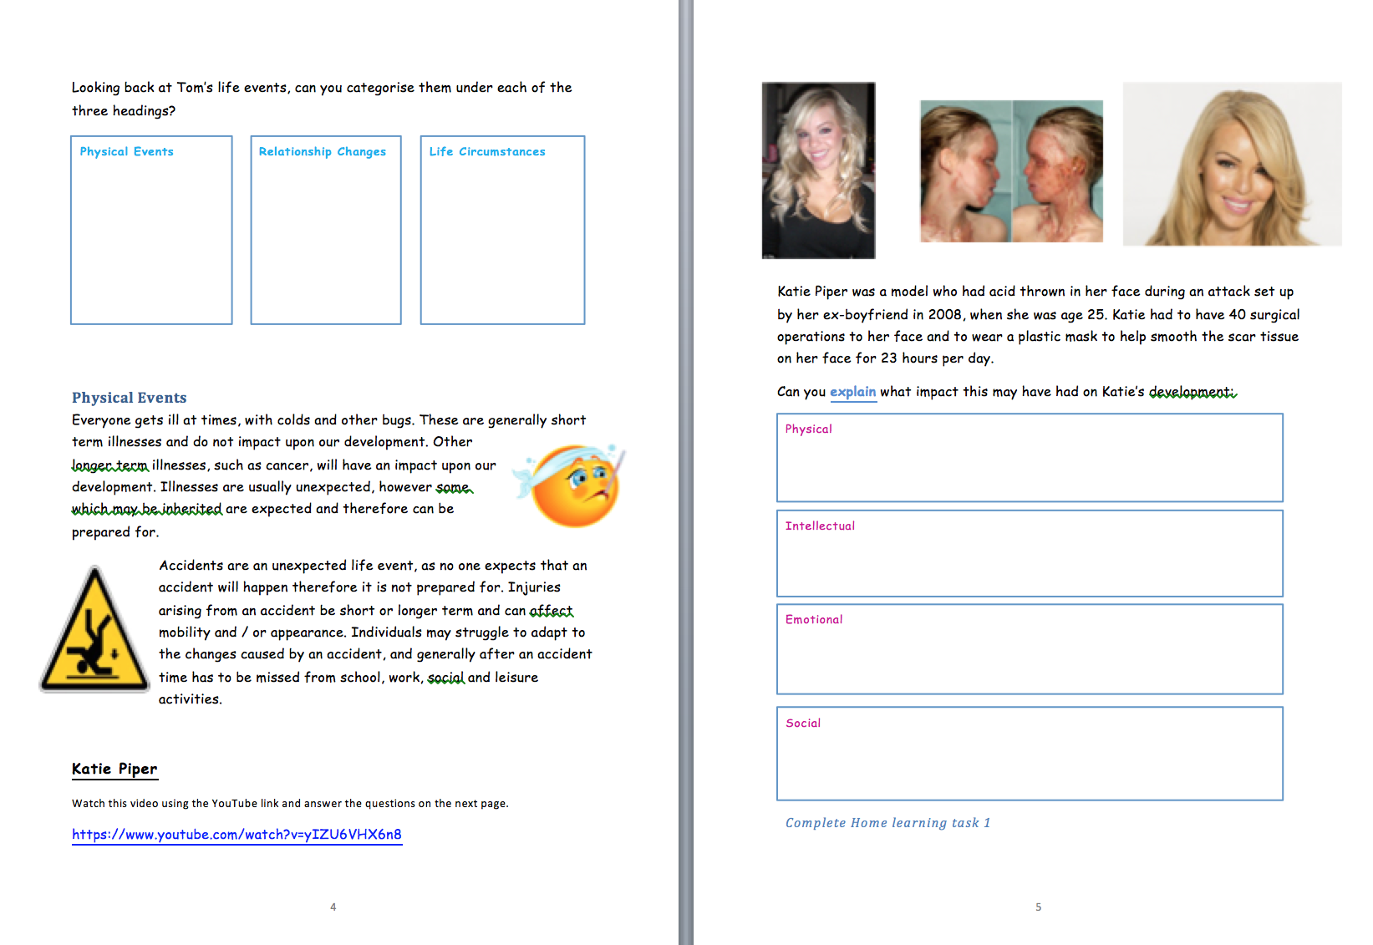
How will I be assessed?
In order for you to excel in your learning and confidence, the Health and Social Care curriculum includes the following;
Meaningful feedback of coursework
Study of the NHS
Discussion of documentaries and news
Analysis of news articles
Practical lessons
Health checks

Slide 8
Steps to Success in Health and Social Care
Understand the specification
Revision and independent study
Understand the BTEC grading system

Slide 9
Student Testimonials
Y9s
“I chose health and social care because it can be really helpful and can lead towards lots of successful careers… It helps you learn about the health and lifestyle of others in the community and is very interesting”.
“I chose health and social care because I am thinking of being a physiotherapist”.
“The things I enjoy about learning about what celebrities went through when they were younger and how that affected the way that they grew up”.
“The subject can help me in the future because you are knowledgeable on what will happen in your later life and you will be prepared for it”.
“I enjoy learning about development and the effects of development when you age”.
“I enjoy learning about the life stages”.
“I enjoy learning about how peoples lifestyle choices and decisions can impact a person’s life because it helps me to think about what are the right decisions to make in life”.

Slide 10
Student Testimonials
Y10s
“Health and social care helps me to understand people’s thoughts and feelings”.
“I chose health and social care because the aspect of it preparing you for real life and life skills in the sector interested me”.
“It teaches you about the life stages and how to live a healthy life”.
“I chose health and social care because it can help me to gain a career in the NHS”.
“If you don’t get a job in the health and social care, the knowledge will still be useful”.

Slide 11
Student Testimonials
Y11s
“I chose health and social care to explore the human lifespan. The subject helps you to understand the social and physical side of life. If you are thinking about taking the subject I recommend it and it is very enjoyable and gives you a chance to explore and study many things, the teachers are very supportive and it will bring you very far, good luck”.
“I took health and social care because I thought it was a bit different and it would give me a wider understanding of many different things. There is also practical work not just theory, and the content is interesting”.
“I chose to study the subject because it linked with PE. I enjoy learning about how people can make a difference to someone’s life”.
“I enjoy the freedom in completing independent studies such as the coursework because it allows you to fulfil your full potential by showing your knowledge and skills in the subject. You study a wide range of topics”.
“I chose to take health and social care because it was a new subject and it would give me a good opportunity to try something new and find out if I would like a job in the future that is health and social based. I enjoy working on case studies, especially the one on celebrities. I chose Katie Piper”.
Notes:
Finally the Y11s said they chose the subject to explore human span, they find the subject enjoyable and the content interesting, they chose the subject because it was something different and a new subject, chose the subject because it links to PE, enjoy the freedom in completing independent studies such as in the coursework to show your full potential.

Slide 12
What can Health and Social Care lead to in the future?
Students who achieve this qualification progress onto Level 3 Health and Social Care (A-level equivalent) and pursue careers in the Health and Social Care sector, examples include;
The National Health Service (Nurses, Midwifery)
Social work
Social services
Community care
Allied health (Physiotherapists, Occupational therapists)
Management
Education
Health psychologist
And lots more!

Slide 13
Why should I pick Health and Social Care?
You are passionate about making a difference
You can work independently
You enjoy discussing current issues
Health and Social Care is a good choice for you…if
Securing 60% of your final grade before sitting the exam gives you a sense of relief
You would like to progress onto Level 3 Health and Social Care at Bridgnorth Sixth Form

Slide 14
Where can I find any further information?
Feel free to email me any questions – Danielle.Siviter@oldburywells.com
Look at the specification online - https://qualifications.pearson.com/content/dam/pdf/btec-tec-awards/health-and-social-care/2017/specification-and-sample-assessments/tech-award-HSC-spec.pdf

